Slide 1


Joint proposal for UN-R 10, 07 series of amendments supplement 2:
Vehicle radiated immunity test:
Update of ALSE method
Revision 1
March 2025

Slide 2
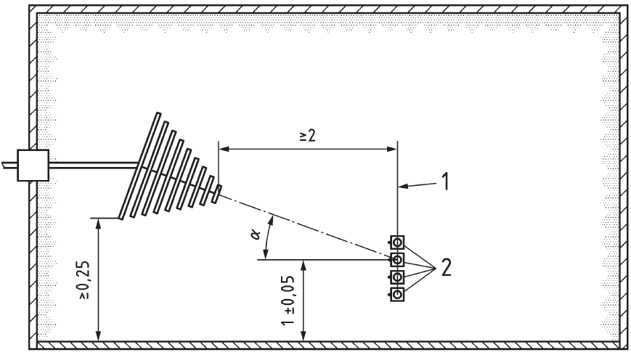
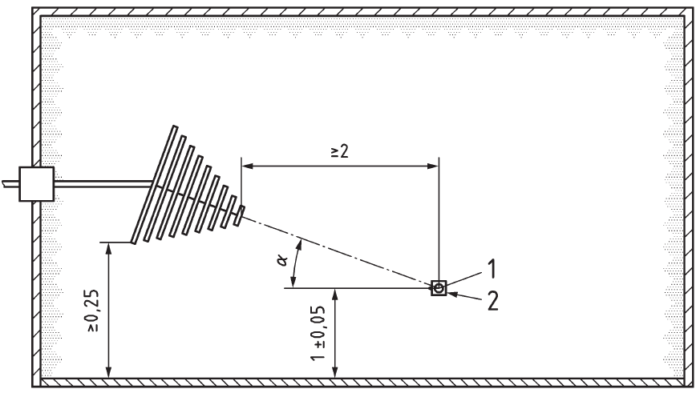
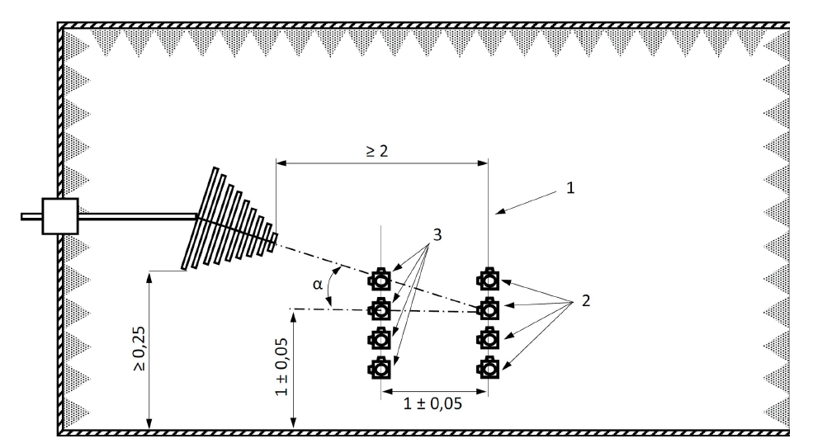
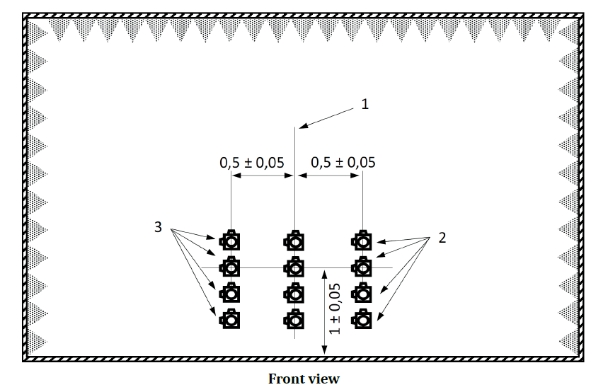
Evolution of ALSE test method (vehicle)
International standard
ISO 11451-2 published edition:
Fourth edition, 2015 (referenced by R10.07)
Revision of ISO 11451-2 under development. Expected publication in 2025.
Calibration/verification: only one field probe for frequency range > 2 GHz
New requirements:
Frontal and lateral field uniformity
Field calibration/verification: 4 probe method up to 6 GHz
Frequency | ISO 11451-2 Ed 4th (2015) | ISO 11451-2 Ed 5th (expected publication in 2025)
0.1 MHz – 20/30 MHz | Single field probe | Four field probe
20/30 MHz to 2 GHz | Four field probe
2 to 6 GHz | Single field probe
20 MHz to 2 GHz
Side view
2 to 6 GHz
Side view
Verification: frontal field uniformity
Side view
Verification: lateral field uniformity
Side view

Slide 3
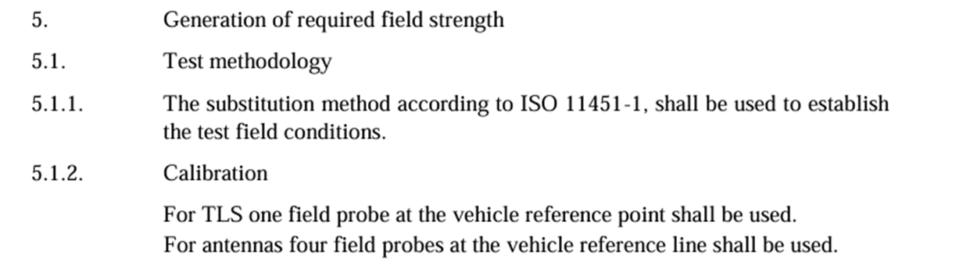
Proposal: field calibration
The number of field probes for vehicle immunity calibration is specified as follows in UN-R 10:
(No changes from UN-R10.06 to R10.07)
Source: UN Regulation No. 10 - Rev.6
Annex 6
Method of testing for immunity of vehicles to electromagnetic radiation
The reference standard ISO 11451-2 specifies the required number of field probes based on frequency bands.
→ R10.06 requires to use the four field probe method up to 2 GHz.
→ ISO 11451-2:2015 requires only a single field probe above 2 GHz.
→ In the upcoming edition of ISO 11451-2, four field probes will be required up to 6 GHz.
As R10.07 introduces a new frequency range of 2 to 6 GHz, the number of field probes should be adjusted in accordance with the reference standard.
Proposal: Update ISO 11451-2 (reference standard) for ALSE method to upcoming edition 2025 in Supplement 2.

Slide 4
Proposal (Appendix 1)
Appendix 1, amend to read:
6. ISO 11451 "Road vehicles – Vehicle test methods for electrical disturbances from narrowband radiated electromagnetic energy":
Part 1: General principles and terminology (ISO 11451-1, Fourth edition 2015);
Part 2: Off-vehicle radiation sources (ISO 11451-2, FourthFifth edition 2015 2025);
Part 4: Harness excitation methods (ISO 11451-4, Fourth edition 2022);
To be updated after publication
(expected: April/May 2025)

Slide 5
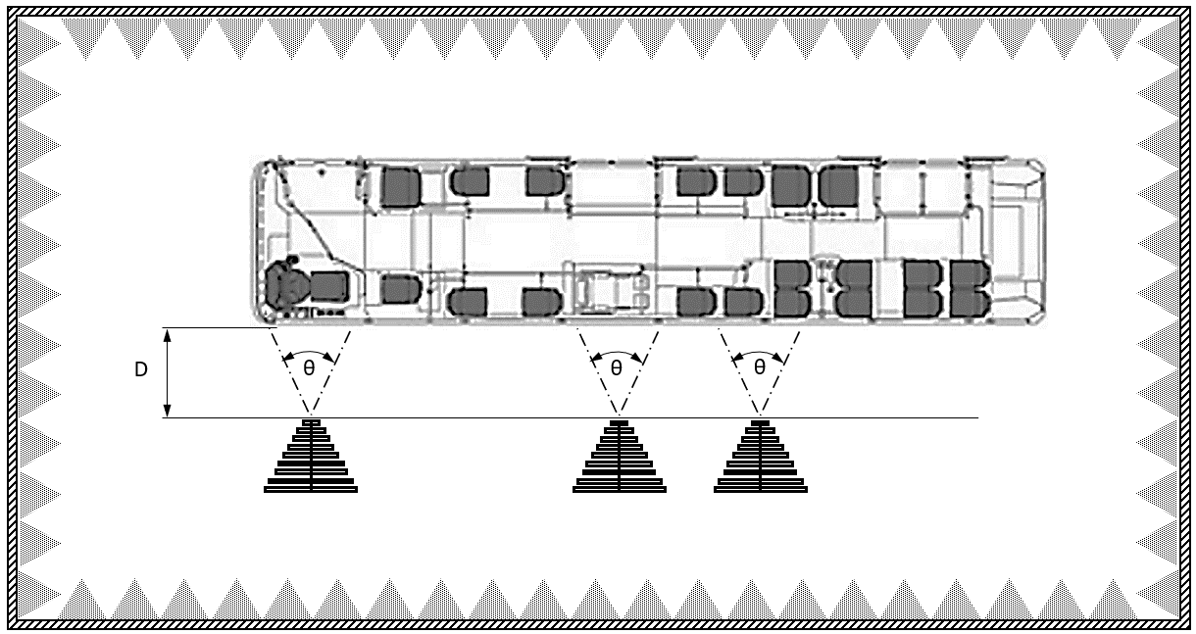
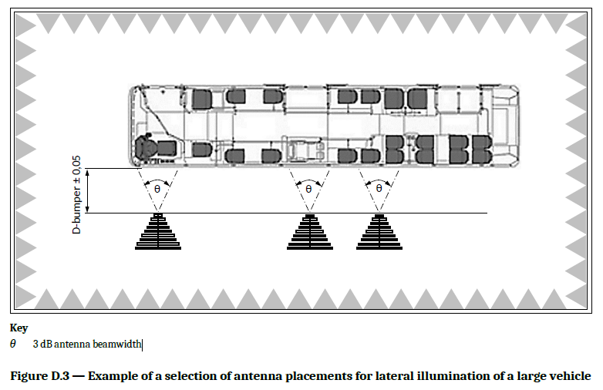
Proposal (Annex 6, figure 4)
In R10.07, an additional antenna position has been introduced for large vehicles, with the antenna distance defined as ‘D’. Currently, the tolerance for ‘D’ is not specified, so it needs to be added.
Source: ECE/TRANS/WP.29/2024/90
Source: ISO/FDIS 11451-2 fifth edition 2025
Dimensions in metres
D
D-bumper±0.05
Key
θ: 3 dB antenna beamwidth
D: the distance between the tip or phase centre of the antenna and the nearest part of the vehicle body without considering small extruding elements (such as side mirrors or fenders)
Proposal: Specify the length unit and tolerance for ‘D’.

