Slide 1



Informal document GRVA-23-34
23rd GRVA, 22-25 Sept. 2025, item 3
WMG Safe Autonomy Research Group
Guidance proposal for AI Dataset Assessment for Automated Driving Systems
Prof Siddartha Khastgir CEng MIMechE
(WP.29/GRVA) Working Party on Automated/Autonomous and Connected Vehicles (23rd session)
22 September 2025
1
© WMG 2024

Slide 2
Disclaimer:
Presentation at the views of WMG, University of Warwick, UK.
It doesn’t reflect the views of any of the contracting parties or the funder.
2
© WMG 2024

Slide 3

Background
Artificial Intelligence (AI) forms a key building block of current and future Automated Driving Systems (ADS)
UN Regulation (UNR) and Global Technical Regulation (GTR) on Automated Driving System progressing to meet their mid-2026 timelines
Both UNR and GTR have limited focus on requirements for AI development and assurance
New Informal Working Group (IWG) on AI (AI-IWG) initiated: 1st meeting in August 2025
  Scope for the AI-IWG is broader than automated driving and covers wider AI applications in automotive
GRVA-23-34
© WMG 2024
3
© WMG 2024

Slide 4
The Challenge
These activities fall short in providing engineering level guidance or measurable principles for authorities to assess the appropriateness of the AI used in the ADS’ performance
Any guidelines for AI development and assurance need to be technology agnostic
Every AI-based system will have the following development phases:
  Model creation
  Model training
  Model testing
Model training and model testing will require the use of “training” data and “testing” data,
Focus: Is the training and testing data / scenarios of the AI system sufficient?
© WMG 2024
4
© WMG 2024

Slide 5



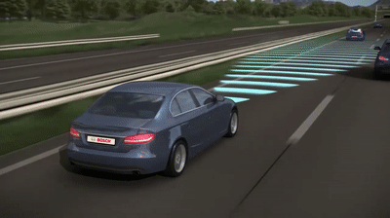

Introducing OASISS
OASISS
ODD-based AI Safety In autonomouS Systems
A methodology to quantitatively assess the adequacy of the training and testing datasets used on an AI model to ensure its safe deployment into its intended operating environment.
5
© WMG 2025

Slide 6
OASISS in AI Safety Assurance
Representativeness
Training Dataset
Is the dataset representative of the TOD?
System ODD Specification
Completeness
(Operational Design Domain)
OASISS
TOD Specification
(Target Operational Domain)
Testing Dataset
Is the dataset complete with respect to the TOD?
Acceptability Argument
Is the training and testing sufficient?
Are the deficiencies within the dataset acceptable for the considered TOD?
6
6
6
© WMG 2025

Slide 7
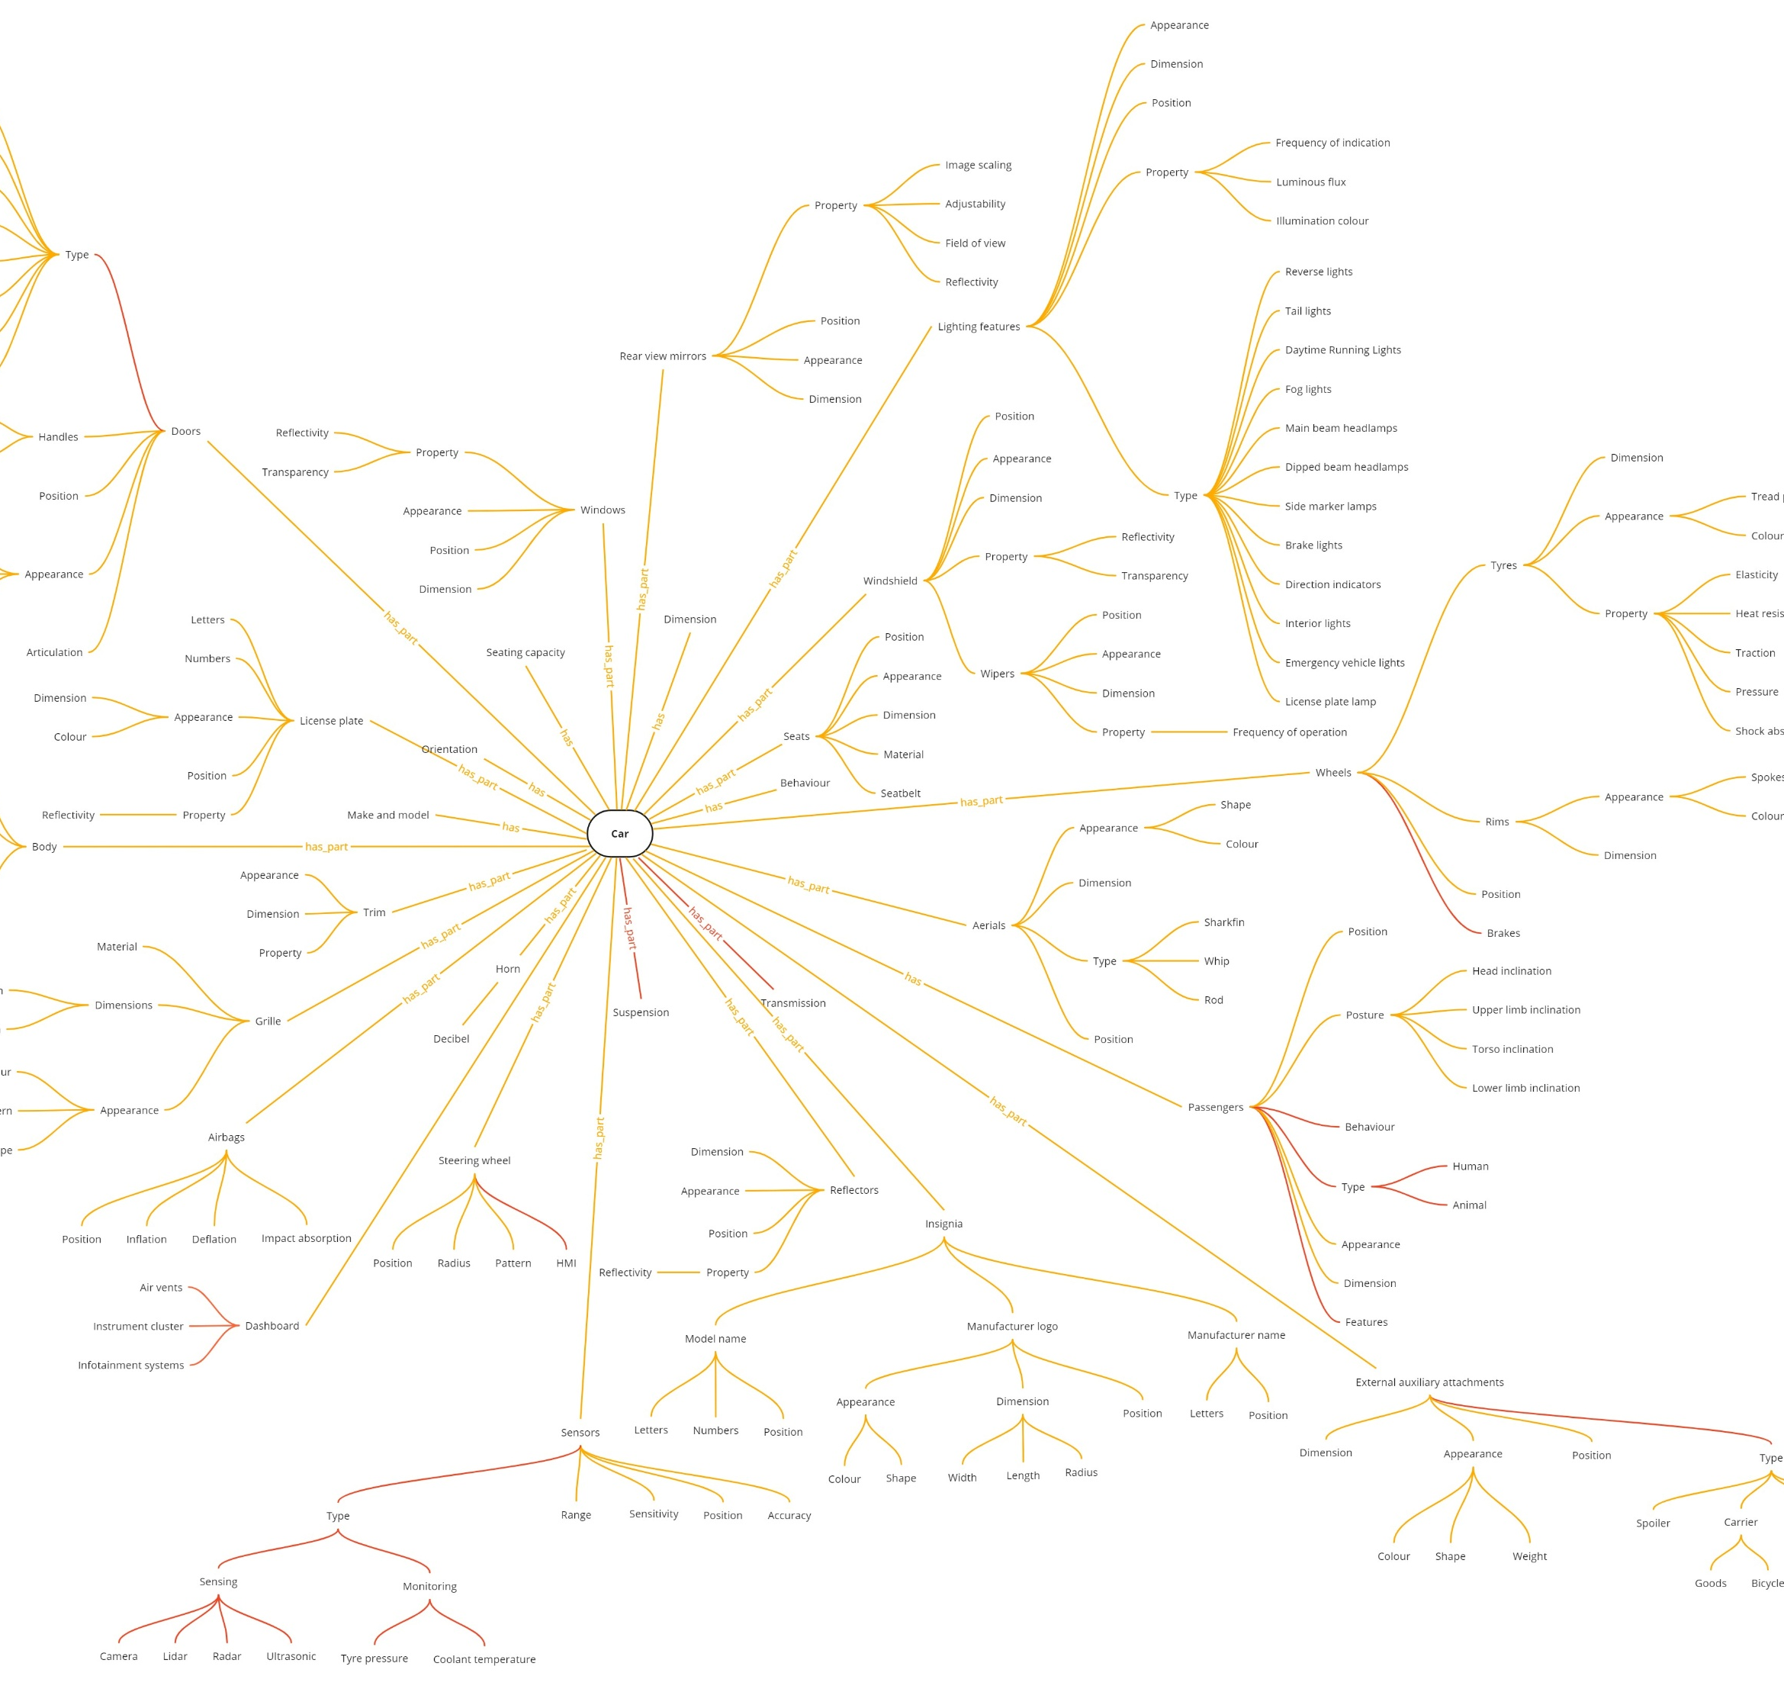
Extended Ontology
Representativeness
OASISS
Completeness
Acceptability Argument
Guidance to the expected level of granularity
7
© WMG 2025

Slide 8
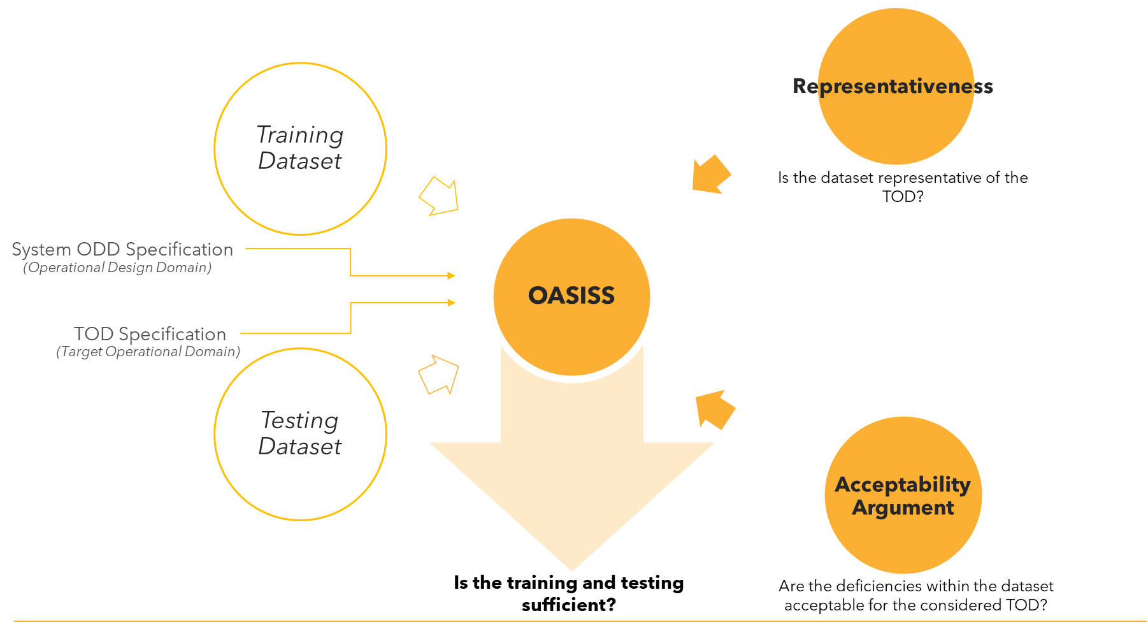
OASISS in AI Safety Assurance
Completeness
Is the dataset complete with respect to the TOD?
8
8
8
© WMG 2025

Slide 9
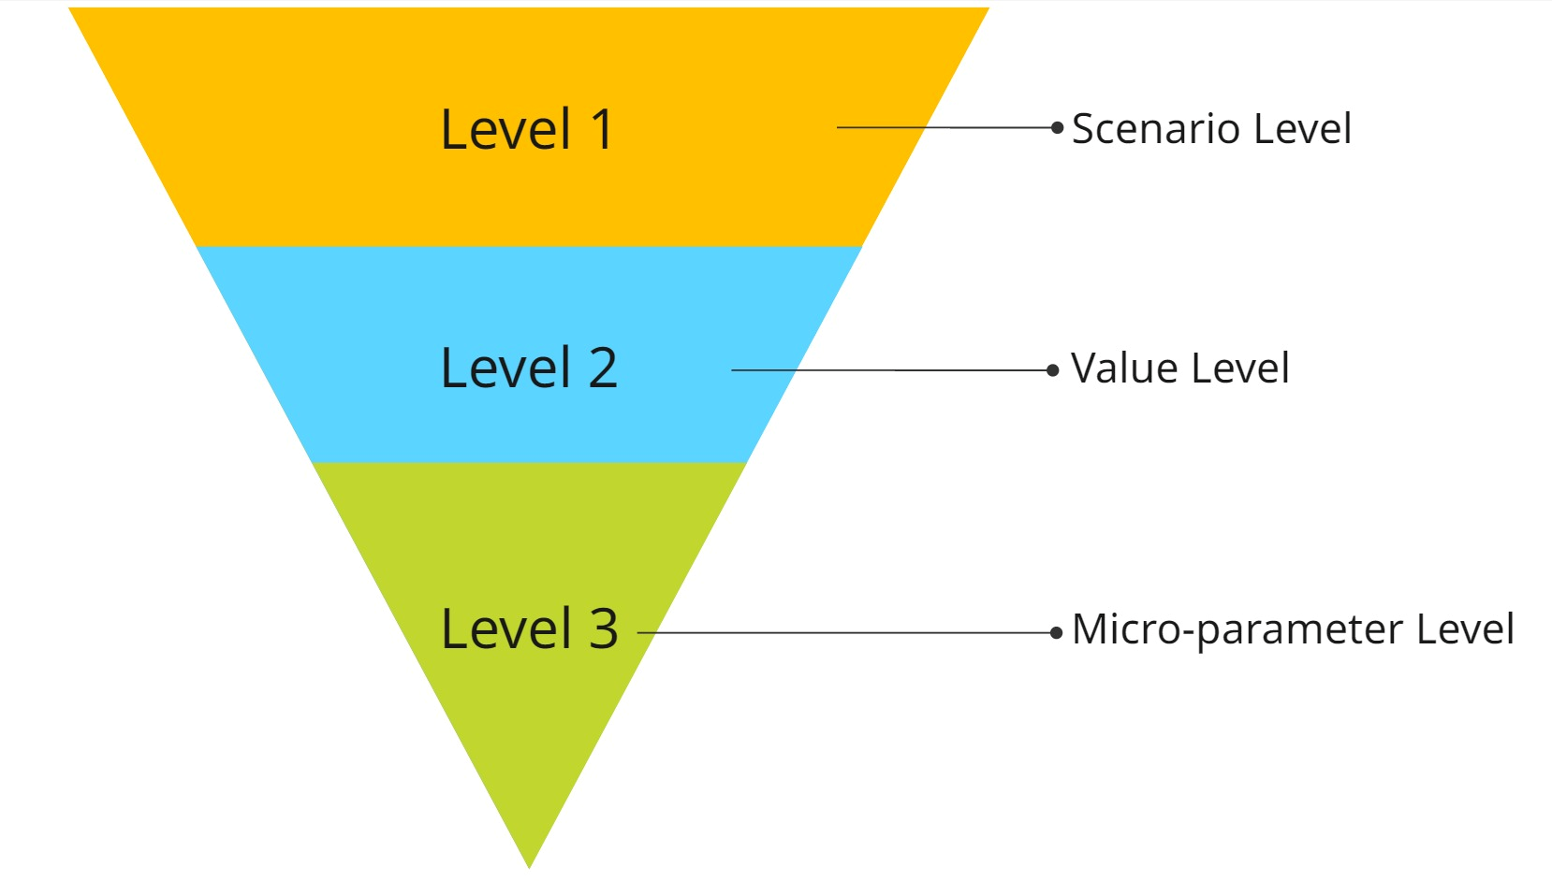
Completeness
“A scenario suite is complete with respect to the system’s area of deployment if it includes all operating conditions as they would occur within that area as well as those conditions that extend beyond the operational capacity of the system.”
9
© WMG 2025

Slide 10
Completeness
How would the system perform within its TOD?
How would the system perform outside its ODD?
ODD
TOD
Condition | TOD | ODD
1 | In | In
2 | In | Out
3 | Out | In
4 | Out | Out
TOD
ODD
Conditions which are met by ODD
Conditions in which vehicle will need to execute MRM
Conditions of interest for Completeness evaluation
10
© WMG 2025

Slide 11
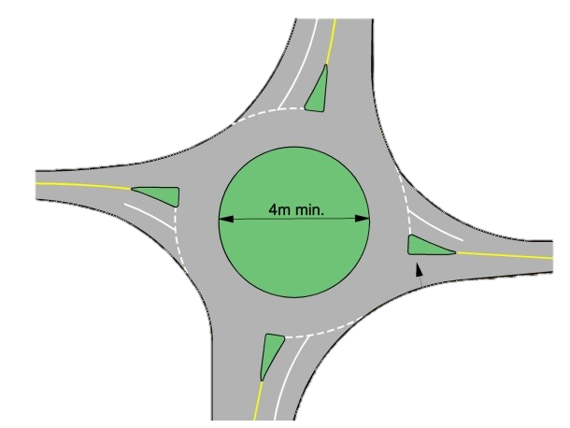

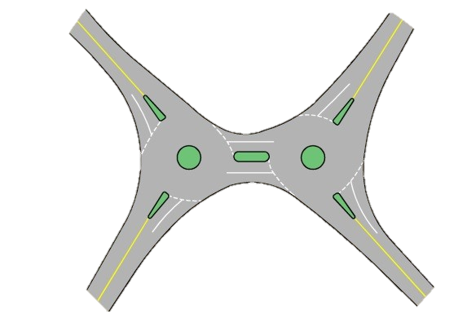


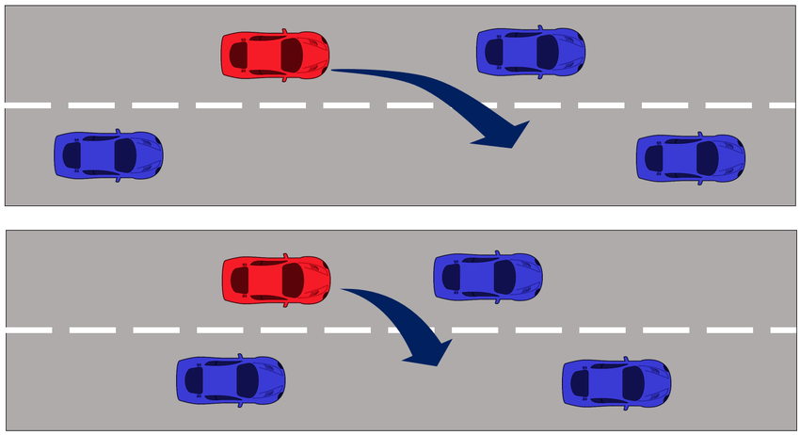
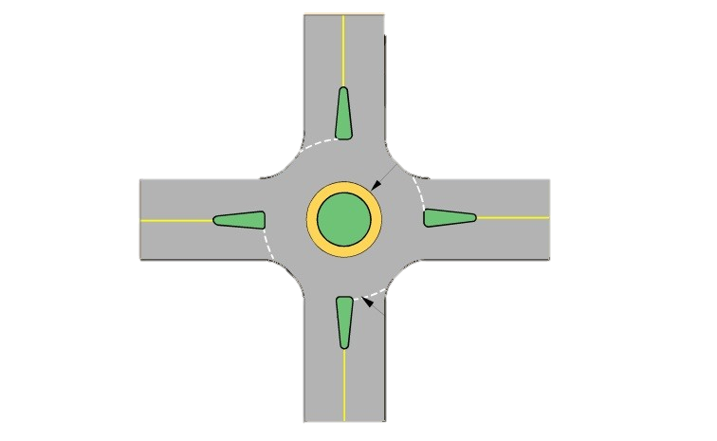
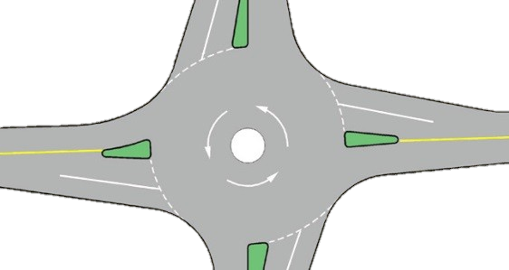




Scenario Level
Within each criteria, assigns a score of 1 if included and 0 if excluded
Element Inclusion:
All parent attributes within TOD
Behaviour Inclusion:
All behaviours
Time Transition Inclusion:
All potential time transitions
Normal
Compact
Mini
Double
Walk
Run
Lane Change
U-Turn
Roundabout
11
© WMG 2025

Slide 12










Value Level
Assigns 1 if both within TOD and outside ODD conditions are met
Categorical
Numerical
Normal
Compact
Mini
Double
Car
Bus
Truck
Van
<2.5 mm/h
2.5 – 7.6 mm/h
7.6 – 50 mm/h
50 – 100 mm/h
>100 mm/h
Roundabout
Motor Vehicle
Rainfall
Amends the score of “Element Inclusion” – an indication that an element cannot be considered complete if its values are not specified
12
© WMG 2025

Slide 13
Value Level
Assigns 1 if both within TOD and outside ODD conditions are met
Scenario Suite vs TOD
Scenario Suite vs ODD
TOD Requirement | ODD Specification | Candidate Scenario Suite Data | Completeness
 |  |  | In TOD | Out-of-ODD | In TOD ^ Out-of-ODD
Environmental Conditions
Wind [ 0 to 17.1 ] | Wind [ 0 to 20.7 ] | Wind [ 0 to 24.4 ] | 1 | 1 | 1
Scenery Elements
Drivable Area Type [ Motorway ] | Drivable Area Type [ Motorway ] | Drivable Area Type [ Motorway ] | 1 | 0 | 0
Special structure [ Bridge, Rail crossing, Tunnel ] | Special structure [ Bridge, Rail crossing ] | Special structure [ Bridge, Tunnel ] | 0 | 1 | 0
Dynamic Elements
VRU [ Cyclist, Motorcyclist ] | VRU [ Motorcyclist, Pedestrian ] | VRU [ Motorcyclist, Pedestrian ] | 0 | 0 | 0
13
© WMG 2025

Slide 14


Micro-parameter Level
Within each element, assigns a score of 1 if associated micro-parameters are included
Influential attributes
Physical attributes
Clothing
Central island features
Number of exits
Objects
Mobility assist
Traffic control
Splitter islands
Roundabout
Vulnerable Road User
Amends the score of “Element Inclusion” after Value Level evaluation – an indication that an element cannot be considered complete if it its micro-parameters have not been considered
14
© WMG 2025

Slide 15

Completeness
Features | Completeness
In-TOD conditions | ✓
Out-of-ODD conditions (in & out-of-TOD) | ✓
Occurrence distribution comparison | ✗
Micro-parameters | ✓
15
© WMG 2025

Slide 16
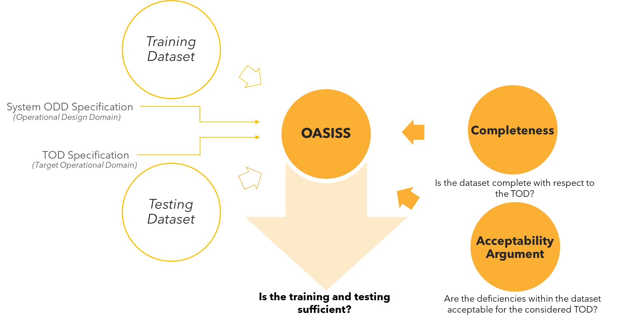
OASISS in AI Safety Assurance
Representativeness
Is the dataset representative of the TOD?
16
16
16
© WMG 2025

Slide 17
Representativeness
“A scenario suite is representative of the system’s area of deployment if the suite exhibits a distribution that is same or similar to that of real-world recorded data from that area at both individual element and joint element levels.”
Level 1
Single distribution
Level 2
Joint distribution
17
© WMG 2025

Slide 18
Representativeness
How well would the system perform within its TOD?
ODD
TOD
Condition | TOD | ODD
1 | In | In
2 | In | Out
3 | Out | In
4 | Out | Out
TOD
ODD
Area of interest for representativeness evaluation
Conditions of interest for Representativeness evaluation
18
© WMG 2025

Slide 19
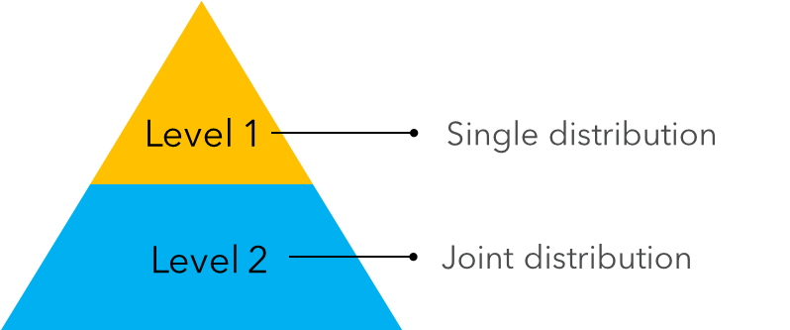
Representativeness: Single distribution
Frequency of occurrence of individual elements
Weather data
HD maps
TOD data
Driving studies
…
19
© WMG 2025

Slide 20
Representativeness: Joint distribution
Frequency of occurrence of elements with respect to other elements
Insurance claims
Accident database
TOD data
Driving studies
…
20
© WMG 2025

Slide 21
Representativeness
Features | Representativeness
In-TOD conditions | ✓
Out-of-ODD conditions (in & out-of-TOD) | ✗
Occurrence distribution comparison | ✓
Micro-parameters | ✓
Level 1
Single distribution
Level 2
Joint distribution
21
© WMG 2025

Slide 22
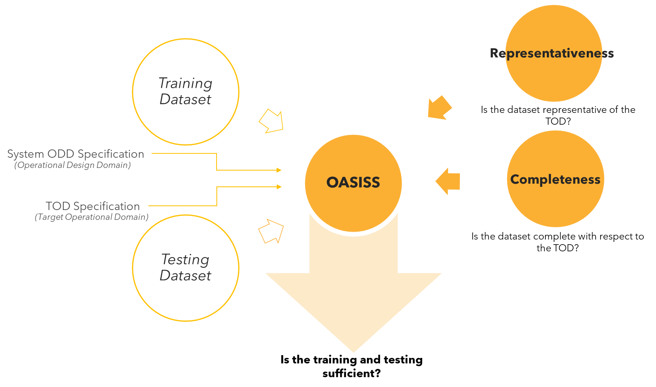
OASISS in AI Safety Assurance
Acceptability Argument
Are the deficiencies within the dataset acceptable for the considered TOD?
22
22
22
© WMG 2025
Notes:
Required to mention training or testing

Slide 23


Acceptability Argument
The evaluation of the acceptability argument is subjective
As a model-agnostic framework, allows justification of any deficiencies that the Completeness and Representativeness evaluations detect, as what the framework considers as a “gap”, may be non-influential to that specific AI model’s performance - depending on its learning capacity.
Training scenarios are expected to be more tailored to the AI model’s requirements, which may result in deviations from real-world frequency occurrence distributions. This would automatically result in a lower representativeness score.
23
© WMG 2025

Slide 24






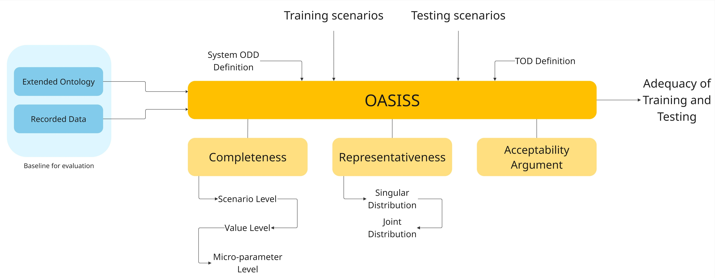



Summary of the Concepts
Vehicle
Non-Motor Vehicle
Wind
0 to 24.4 m/s
e.g. ODD
Roundabout
Mini
VRU
Pedestrian, Motorcyclist
e.g. London
Rainfall
0.01 to 100 mm/h
Wind
0 to 23 m/s
21 mm/h
15 m/s
Vehicle
Motor Vehicle
VRU
Pedestrian, Cyclist
Roundabout
Mini, Compact
Features | Completeness | Representativeness
In-TOD conditions | ✓ | ✓
Out-of-ODD conditions (in & out-of-TOD) | ✓ | ✗
Occurrence distribution comparison | ✗ | ✓
Micro-parameters | ✓ | ✓
24
© WMG 2025

Slide 25
OASISS Compliance with ISO PAS 8800
OASISS framework aligns with ISO PAS 8800 by covering the following properties to address data insufficiencies:
ISO PAS 8800
OASISS
Input dataset-related properties | Scenario suite-related properties
Accuracy | ✓
Completeness | ✓
Correctness | ✓
Independence of datasets | -
Integrity | -
Representativeness | ✓
Temporality | ✓
Traceability | ✓
Verifiability | ✓
25
© WMG 2025

Slide 26
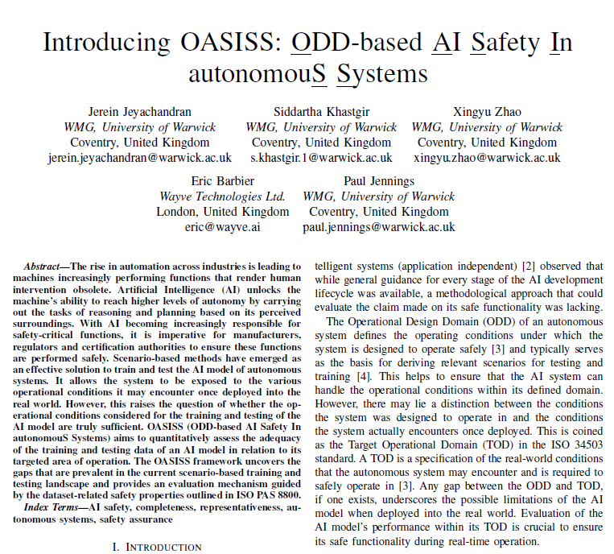
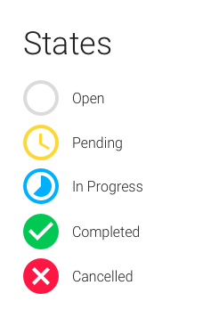
Current status
Paper on OASISS accepted at IEEE ITSC 2025
A paper detailing the proposed framework has been peer-reviewed and accepted for publication
Tool in Development:
Actively developing a software tool to implement the framework in a usable and scalable form
Real-World Application:
The tool will be used on a real-world system to demonstrate its working
Citation: Jeyachandran et. al. (2025) Introducing OASISS : ODD-based AI Safety In autonomouS Systems. In: The IEEE International Conference on Intelligent Transportation Systems (ITSC), Gold Coast, Australia, 18-21 Nov 2025 (In Press)
Paper Open Access: https://wrap.warwick.ac.uk/id/eprint/192034/
26
© WMG 2025

Slide 27
Next steps…
For AI model evaluation and assurance, it is key to undertake a dataset assessment for the training and testing data used as part of AI model development
Two key properties for assessment: Completeness and Representativeness of the dataset (with respect to TOD and ODD of the system)
UNR and GTR on Automated Driving System don’t cover such requirements at an engineering implementation level or measuring guidance for authorities
Need to consider the concepts of: Completeness; Representativeness and Acceptability Argument, as additional guidance for AI dataset assessment
OASISS provides a framework for engineering level guidance for developers and authorities providing quantified insights into the system’s trustworthiness for operation within that area
27
© WMG 2025

Slide 28
Declaration:
The author and the speaker of this presentation (and companion document GRVA-23-25) confirm that they have authorization to use all content including photos and visual elements.
The material is either copyright-free or the author/speaker hold the necessary copyright or permission.
The UNECE will remove any material from its events and supporting websites if there is unlawful use of copyrighted material.
The author/speaker takes responsibility for any infringement on copyright and holds the UNECE harmless to this effect.
28
© WMG 2024

Slide 29





Thank you.
WMG
University of Warwick
Coventry
CV4 7AL
United Kingdom
warwick.ac.uk/wmg
@siddkhastgir
S.Khastgir.1@warwick.ac.uk
Siddartha Khastgir
29
© WMG 2025

