Slide 1
GRE IWG - EMC - 49th session
28-29 October 2025
JRC Ispra
VIA ENRICO FERMI 2749 - 21027 Ispra (VA)
Notes:
Cover slide option 1. Check layout for option 2 without the banner and footer

Slide 2
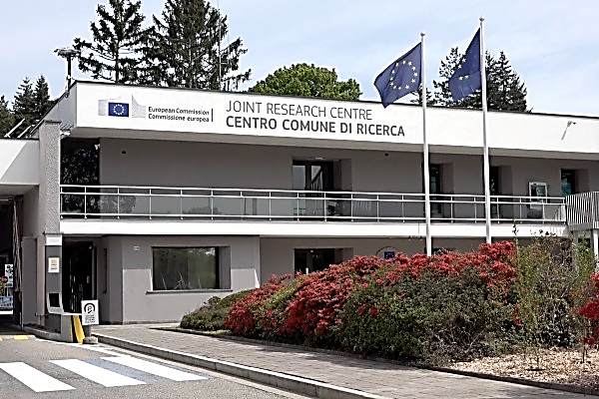
How to reach JRC in ISPRA
Milano Malpensa Airport (MXP), 25 km from JRC
Milano Linate Airport (LIN), 85 km from JRC
Bergamo-Orio al Serio Airport (BGY), 105 km from JRC

Slide 3
Access to the JRC Ispra site – meeting participation
Confirmation on attendance to F2F meeting should sent to marco.zanni@ec.europa.eu ideally by end of August/beginning of September 2025
JRC will circulating a link for the registration. The participants must fill all the fields related to hotels selected and flights (Beginning/middle of September)
Access to JRC is granted after request of entry permit. For participants coming from outside EU (TNC) the request must be submitted at least 30 day before the day of the event. Additional information will follow

Slide 4
Possible Accommodations – other info
Hotel dei Tigli – Angera - https://www.hoteldeitigli.com/eng
Hotel Villa Borghi – Varano Borghi - https://www.guestreservations.com/hotel-villa-borghi/booking?msclkid=3731d9596b54104d8157be8a902ff12e
Discount is normally offered in both the hotels for JRC guests. The amount depends from the hotel policy. Please provide the info that you are JRC guests at the time of reservation.
A joint dinner could be organized on the evening of the first meeting day (time and place to follow)
JRC will offer the transport service*:
- from the airport to the hotel at the arrival
- from the JRC to the airport at the departure
- from the hotel to the JRC and the return during the days of the meeting
*This service can be granted only for Malpensa and Linate airports

Slide 5

Thank you
This presentation has been prepared for internal purposes. The information and views expressed in it do not necessarily reflect an official position
of the European Commission or of the European Union.
Except otherwise noted, © European Union, 2025. All Rights Reserved

