Slide 1
OICA Supporting Document to GRE/2025/20 and GRE/2025/18 on Illuminated Logos
GRE-93-22
17th October 2025

Slide 2
OICA Proposal on Illuminated Logos
Documents affected: GRE/2025/20 and GRE/2025/18
Paragraph: 5.5.5.
OICA proposes to amend the existing text which use the term ‘fitted on’ and replace it with ‘switched ON’ as given below:
Paragraph 5.5.5., amend to read:
"5.5.5. In case of lampsroad illumination devices (UN Regulation No. 149) and light-signalling devices (UN Regulation No. 148) incorporating a manufacturer logo, only two lateral logos (one on each side) or one central logo can be fitted onswitched ON at the rear of the vehicle and only two lateral logos (one on each side) or one central logo can be fitted onswitched ON at the front of the vehicle. All logos that are not vehicle manufacturer or body manufacturer logos are prohibited."

Slide 3
OICA Proposal on Illuminated Logos
Justification for the change:
A logo that is not ‘switched ON’ cannot be a distraction to other road users.
"The term ‘fitted on’ used in paragraph 5.5.5. is not performance-oriented and introduces an unnecessary design constraint by limiting the total number of lamps that may be present on a vehicle, regardless of whether they are illuminated simultaneously.
OICA therefore proposes replacing ‘fitted on’ with ‘switched ON’ to better reflect functional intent and avoid restricting non-active lamp configurations.“

Slide 4
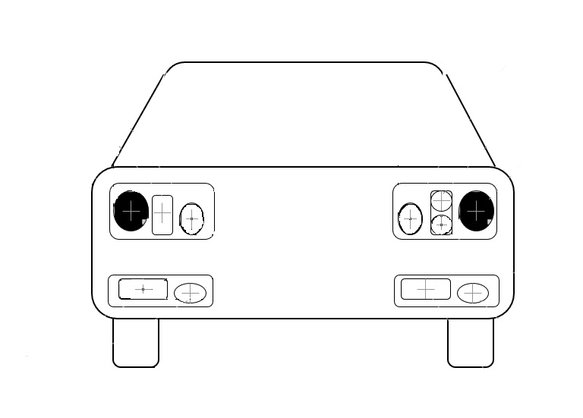
OICA Proposal on Illuminated Logos
Justification for the change:
For functions that do not operate in combination, a manufacturer should be allowed to activate either the center logo, or the two outside logos, but not a combination of three.
The total number of active illuminated logos (which is the performance for observers) does not change when compared to the “fitted” text.
Example:
Daytime: The Logo in daytime running lamps must be two outside logos because a minimum center distance applies.
Nighttime: The Logo in the position lamp preferably is the center logo because the outside logo position is compromised by a close distance to the high intensity headlamps.
Logo
Logo
Logo
Logo
Logo
Logo

Slide 5
OICA Proposal on Illuminated Logos
Document affected: GRE/2025/20
OICA proposes to add requirements for the implementation of a manufacturer logo in UN Regulation No.48 on Installation and No.149 for Road Illumination Devices.
Logos should be assessed based on performance criteria, rather than the administrative origin.
The visual impact of a manufacturer logo remains the same whether it is projected by a light-signalling device or a road illumination device. Therefore, prohibiting logos under UN Regulation No.149 is not performance-oriented and imposes unnecessary design constraints.
Example:
The position lamp light source is switched off when the headlamp is switched ON.
Headlamp light source
Logo
Logo
Position lamp light source

Slide 6
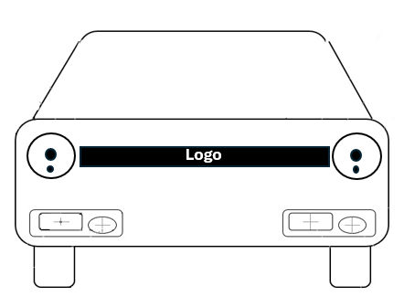
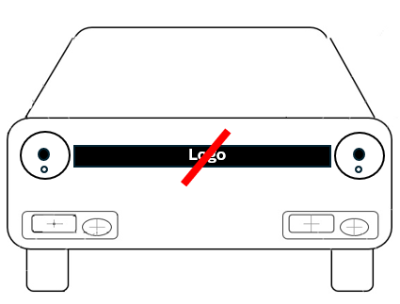
OICA Proposal on Illuminated Logos
Document affected: GRE/2025/20
OICA proposes that logos be permitted in UN R148 and R149 devices, provided they meet the same requirements, ensuring consistency without imposing non-functional design constraints.
The current prohibition on logos in road illumination devices will drive manufacturers to activate the position lamp light source within the headlamp solely to illuminate a centrally located logo.
This prohibition does not contribute to improved visibility or performance for observers and results in unnecessary energy consumption and a reduced lifetime of the light source.
Example:
1. Headlamp and position lamp switched ON maintaining an illuminated central logo.
2. The use of the Logo would not be allowed if the position lamp light source in the headlamp is switched OFF.

Slide 7
"The author and the speaker of this document/presentation confirm that they have authorization to use all content including photos and visual elements.
The material is either copyright-free or the author/speaker hold the necessary copyright or permission.
The UNECE will remove any material from its events and supporting websites if there is unlawful use of copyrighted material.
The author/speaker takes responsibility for any infringement on copyright and holds the UNECE harmless to this effect."

