Slide 1
Proposal for acceleration calculation based on GNSS data to amend document GRBP/2025/27
Document TA-42-2
TFTA 42nd session. 26 January 2026

Slide 2



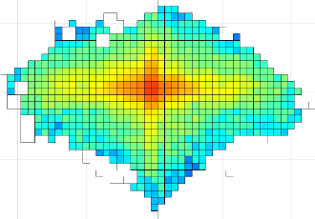

Reason for alternative calculation method
The chosen acceleration limits for test vehicles in the R117 regulation are based on real driving data from two test service providers commissioned by ETRTO.
The acceleration data, which was used for setting the limits, was recorded with a position measurement system which is commonly used by service providers.
The used formulas and filter functions are property of the measurement system provider and are not public available.
→ Issue: A regulation cannot refer explicitly to a type or a manufacturer of a measuring box.
Process of acceleration parameter determination using common GNSS-Boxes
Common GNSS box
Evaluation with AET
GNSS-Signal
Setting the Acc- limits according to driven parameters
Limits
R117
Calculation within the box
(Algorithm unknown)
Cars on test track
Acceleration Ax + Ay

Slide 3
Overview of alternative calculation method
For using the acceleration limits specified in R117, a calculation method was defined to calculate results with data from GNSS-logger boxes. The results are comparable with results from initially used position measurement system.
Calculation of Acc-Parameter using Raw-GNSS-Signal
Calculation afterwards
(Algorithm defined
and validated)
Acceleration limits from R117 can be used
GNSS-Signal
Acceleration Ax + Ay
Cars on test track
GNSS BOX
Calculation

Slide 4
Sequence of acceleration calculation
The sequence for calculating the distance‑based acceleration data used for the determination of the standard deviations of the lateral and longitudinal accelerations shall be as follows:
The longitudinal and lateral accelerations shall be calculated at each sampling step.
The calculated values shall be pre-filtered to exclude data points with excessive acceleration, excessive vehicle speed, or an insufficient number of satellites.
A low‑pass filter shall be applied to the acceleration data and the velocity.
The remaining values shall be smoothed using a moving‑average filter.
Acceleration data points measured at vehicle speeds below the specified minimum speed shall be excluded.
The standard deviations of longitudinal and lateral accelerations are calculated from remaining sampling steps.
GNSS Data
Velocity
Heading
Number of satellites
Sample rate
Compute accelerations
longitudinal
lateral
Prefilter unrealistic values
Accelerations <= 10ms²
Velocity <= 250 km/h
Number of satellites >= 5
Low pass filter
Butterworth filter with cutoff frequence 1 Hz
Smoothing
Moving average for
longitudinal Acc (1s)
Lateral Acc and velocity (2s)
Filter values
Velocity > 7km/h
Computation
Standard deviations
Longitudinal acceleration
Lateral acceleration
Input
Step 1
Step 2
Step 3
Step 4
Step 5
Step 6

Slide 5
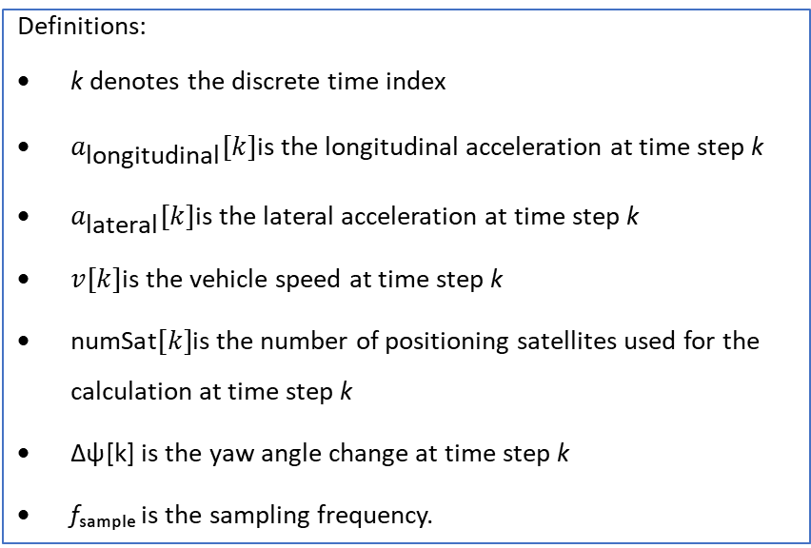
Step 1: Calculation of accelerations
Formulas:
The longitudinal component is calculated from the discrete velocity increment multiplied by the sampling frequency.
a_{longitudinal} [k]=Δv[k] ⋅ f_{sample}
with
Δv[k]=v[k]−v[k−1] for k > 1 and Δv[k=1] = 0
The lateral component is derived from the vehicle velocity and yaw angle change, considering the trigonometric contribution of the heading variation over the sampling interval.
a_{lateral} [k]= - v[k] ⋅ sin (Δψ[k]) ⋅ f_{sample}
with
Δψ[k]=ψ[k]−ψ[k−1] for k > 1 and ψ[k=1] = 0
Definitions:
k denotes the discrete time index
$a_{\text{longitudinal}}[k]$is the longitudinal acceleration at time step k
$a_{\text{lateral}}[k]$is the lateral acceleration at time step k
$v[k]$is the vehicle speed at time step k
$\text{numSat}[k]$is the number of positioning satellites used for the calculation at time step k
Δψ[k] is the yaw angle change at time step k
fₛₐₘₚₗₑ is the sampling frequency.

Slide 6
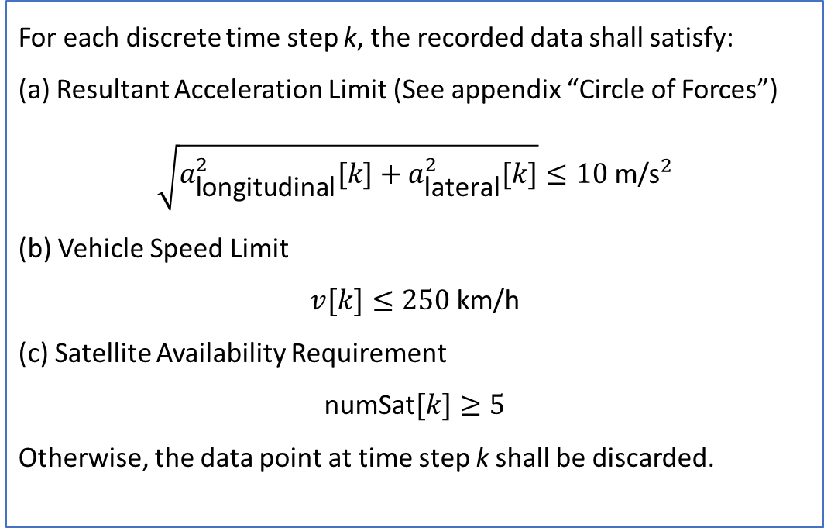
Step 2: Prefiltering
For each discrete time step k, the recorded data shall satisfy:
(a) Resultant Acceleration Limit (See appendix “Circle of Forces”)
$$\sqrt{a_{\text{longitudinal}}^{2}[k]+a_{\text{lateral}}^{2}[k]}≤10 {\text{m}\text{/}\text{s}}^{2}$$
(b) Vehicle Speed Limit
$$v[k]≤250 \text{km}\text{/}\text{h}$$
(c) Satellite Availability Requirement
$$\text{numSat}[k]≥5$$
Otherwise, the data point at time step k shall be discarded.

Slide 7
Step 3 / 4 / 5: Filter & Smoothing
Butterworth Filter:
For filtering the measurement, a Butterworth filter second order with a cut-off frequency of 1 Hz shall be used.
Smoothing (Moving Average):
A moving‑average filter shall be applied to the acceleration and velocity signals.
For the longitudinal acceleration, a moving‑average window of 1 second shall be used.
For the lateral acceleration and the vehicle speed, a moving‑average window of 2 seconds shall be applied.
Filter:
  All accelerations measured for the (smoothed) velocity less than 7 km/h are excluded.

Slide 8
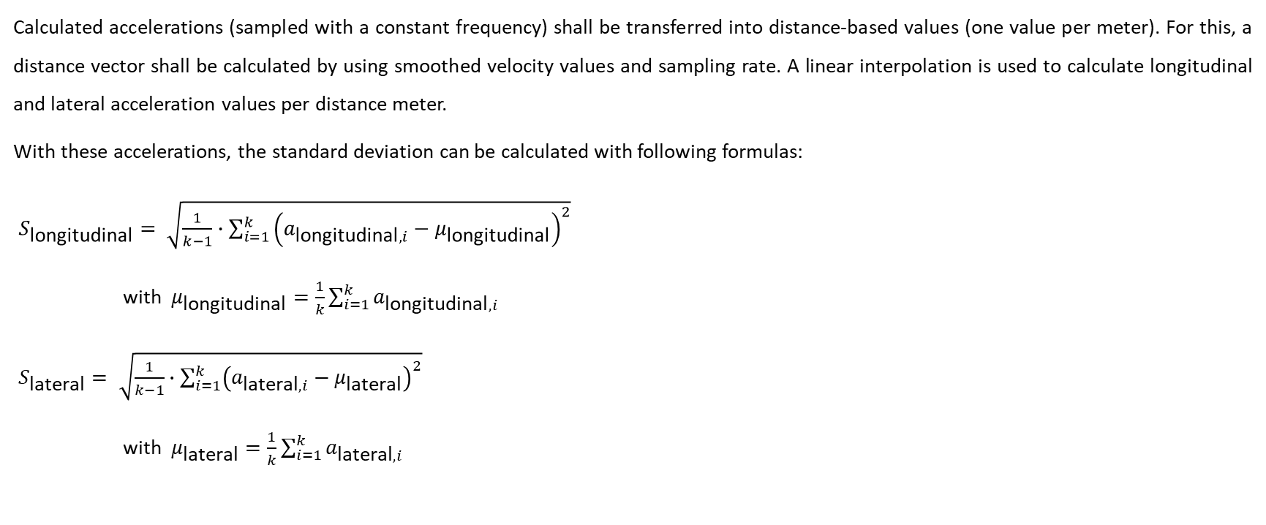
Step 6: Distance-based Standard Deviation
Calculated accelerations (sampled with a constant frequency) shall be transferred into distance-based values (one value per meter). For this, a distance vector shall be calculated by using smoothed velocity values and sampling rate. A linear interpolation is used to calculate longitudinal and lateral acceleration values per distance meter.
With these accelerations, the standard deviation can be calculated with following formulas:
$S_{\text{longitudinal}}= \sqrt{\frac{1}{k−1}∙\sum_{i=1}^{k}{{\left(a_{\text{longitudinal},i}−μ_{\text{longitudinal}}\right)}^{2}}}$
with $μ_{\text{longitudinal}}=\frac{1}{k}\sum_{i=1}^{k}{a_{\text{longitudinal},i}}$
$S_{\text{lateral}}= \sqrt{\frac{1}{k−1}∙\sum_{i=1}^{k}{{\left(a_{\text{lateral},i}−μ_{\text{lateral}}\right)}^{2}}}$
with $μ_{\text{lateral}}=\frac{1}{k}\sum_{i=1}^{k}{a_{\text{lateral},i}}$

Slide 9
Calculation of distribution of driving styles
Proposal for new text
Current Text in R117
Calculation of distribution of driving styles
The following steps shall be followed for the calculation of the distribution of driving styles:
(a) Cumulate the total test distance (8000 ± 300 km) of acceleration data on a vehicle at the circuit.
(b) Compute the standard deviations of longitudinal and lateral acceleration (S_{longitudinal} and S_{lateral}) for each complete 20 km segment, starting with the segment from 0 to 20 km and progressing in 1 km increments, over the nominal test distance (8,000 ± 300 km), using the method specified in paragraph 1 of this appendix.
Calculation of distribution of driving styles
The following steps shall be followed for the calculation of the distribution of driving styles:
(a) Cumulate 8 000 km of acceleration data on a vehicle at the circuit. The accelerations data obtained while qualifying the circuit for abrasiveness may be used. The provisions defined for vehicle speed in paragraph 1.6.13.2. (d) of this Annex shall be respected in every single convoy test;
(b) Split the data in segments of 20 km;
(c) Compute the longitudinal and lateral acceleration standard deviations (S_{longitudinal} ; S_{lateral}) for each segment, following the method described in paragraph 1. of this appendix;
Slightly wrong wording but big impact!
For setting the limits of driving styles 20km segments were used,
but with increments of 1 km (0-20 km, 1-21 km, 2-22 km, …. )

Slide 10
Thank you!

Slide 11
Appendix

Slide 12
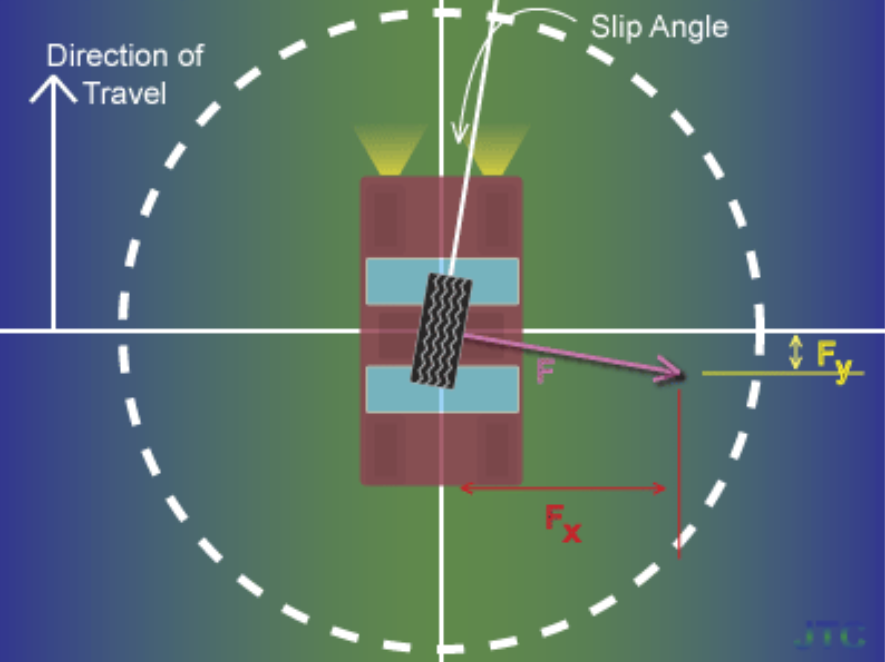


Circle of forces
The circle of forces is a useful way to explain the dynamic interaction between a vehicle’s tire and the road surface. The diagram to the right shows the tire from above, so that the road surface lies in the xy-plane. The vehicle to which the tire is attached is moving in the positive y direction.
A tire can generate horizontal force where it meets the road surface by the mechanism of slip. That force is represented in the diagram by the vector F.
The magnitude of F is limited by the dashed circle, but it can be any combination of the components F_{x} and F_{y} that does not extend beyond the dashed circle.
$$F=\sqrt{Fx2+Fy2}$$
$$AccMax=\sqrt{AccLong2+AccLat2}$$
Source: Circle of forces - Wikipedia

Slide 13
Comparison between the calculation methods
Two types of GNSS-Boxes were tested against each other (on the same vehicle):
Box A is a position measurement system commonly used by vehicle testing providers (accelerations calculated internally)
Box B is a GNSS logger box from another provider (subsequent acceleration calculation from logged GNSS-data according to proposed calculation method)
 |  | StdDev|Acc long |  | StdDev|Acc Lat |  | Max Acc Long |  | Max Acc Lat |  | Urban-like|Acc |  | Highway-like|Acc |  | Max Speed |  | <60 km/h |  | 60-90 km/h |  | >90 km/h
 | Limit | 0.45 m/s² |  | 0.93 m/s² |  | 5 m/s² |  | 5 m/s² |  | ≥ 25% |  | ≥ 35% |  | 140 km/h |  | ≥ 10% |  | ≥ 25% |  | ≥ 35%
 | Tolerance | ±10% |  | ±10% |  | < 0.02% distance |  | < 0.1% distance |  |  |  |  |  | < 0.5% distance
Filename |  | BOX A | Box B | BOX A | Box B | BOX A | Box B | BOX A | Box B | BOX A | Box B | BOX A | Box B | BOX A | Box B | BOX A | Box B | BOX A | Box B | BOX A | Box B
20250212_0448 |  | 0.469 | 0.468 | 0.931 | 0.930 | 4.40 | 4.38 | 5.31 | 7.14 | 41.1 | 40.7 | 34.4 | 35.3 | 131 | 132 | 13 | 13 | 50 | 50 | 37 | 37
20250213_0444 |  | 0.426 | 0.424 | 0.927 | 0.926 | 5.66 | 5.66 | 5.65 | 5.66 | 35.9 | 34.2 | 40.7 | 41.9 | 133 | 133 | 14 | 14 | 47 | 47 | 40 | 40
20250214_0442 |  | 0.420 | 0.415 | 0.929 | 0.929 | 6.87 | 5.43 | 6.70 | 6.69 | 30.3 | 27.2 | 42.7 | 45.2 | 134 | 134 | 15 | 15 | 47 | 47 | 38 | 38
20250217_0450 |  | 0.448 | 0.444 | 0.970 | 0.971 | 5.69 | 4.86 | 5.30 | 5.29 | 37.8 | 35.1 | 35.3 | 37.8 | 132 | 132 | 12 | 12 | 49 | 49 | 39 | 39
20250218_0448 |  | 0.421 | 0.419 | 0.895 | 0.895 | 4.09 | 4.07 | 5.40 | 5.43 | 34.0 | 33.2 | 39.2 | 39.8 | 134 | 134 | 14 | 14 | 48 | 48 | 38 | 38
20250219_0458 |  | 0.405 | 0.401 | 0.882 | 0.880 | 4.44 | 4.42 | 5.46 | 5.45 | 20.7 | 19.5 | 54.4 | 55.4 | 134 | 134 | 16 | 16 | 46 | 46 | 38 | 38
20250219_1302 |  | 0.433 | 0.432 | 0.945 | 0.944 | 5.97 | 6.86 | 5.91 | 5.82 | 37.7 | 36.4 | 39.1 | 40.7 | 132 | 131 | 13 | 13 | 47 | 47 | 40 | 40
20250220_0455 |  | 0.421 | 0.420 | 0.889 | 0.889 | 5.07 | 5.04 | 4.85 | 4.85 | 28.6 | 26.8 | 48.3 | 49.8 | 135 | 135 | 16 | 16 | 45 | 45 | 39 | 39
20250221_0438 |  | 0.417 | 0.412 | 0.901 | 0.900 | 6.77 | 4.78 | 4.54 | 4.60 | 24.9 | 24.1 | 49.4 | 49.8 | 132 | 132 | 15 | 15 | 45 | 45 | 40 | 40
20250224_0512 |  | 0.466 | 0.464 | 0.963 | 0.962 | 5.22 | 5.21 | 5.63 | 5.66 | 41.7 | 41.5 | 27.2 | 25.7 | 132 | 132 | 13 | 13 | 48 | 48 | 40 | 40
20250225_0508 |  | 0.465 | 0.462 | 0.929 | 0.929 | 4.73 | 4.74 | 5.51 | 5.67 | 38.4 | 37.6 | 32.8 | 33.6 | 132 | 132 | 14 | 14 | 49 | 49 | 37 | 37
20250225_1247 |  | 0.480 | 0.479 | 0.963 | 0.963 | 4.84 | 7.06 | 5.41 | 5.42 | 47.0 | 46.0 | 28.6 | 29.4 | 135 | 132 | 12 | 12 | 50 | 50 | 38 | 38
20250226_0506 |  | 0.456 | 0.453 | 0.934 | 0.934 | 5.94 | 4.62 | 5.26 | 5.11 | 38.6 | 37.1 | 36.3 | 38.0 | 133 | 132 | 14 | 14 | 47 | 47 | 39 | 39
Mean |  | 0.441 | 0.438 | 0.928 | 0.927 | 5.36 | 5.16 | 5.46 | 5.60 | 35.13 | 33.80 | 39.11 | 40.18 | 133.00 | 132.69 | 13.92 | 13.92 | 47.54 | 47.54 | 38.69 | 38.69
Conclusion: The tested GNSS Logger box in combination with the newly proposed acceleration calculation method produces results, that are very close to the obtained acceleration data from measurement system commonly used by vehicle testing providers.
→ The proposed calculation method can be used!

Slide 14
Verify proposed calculation method
To verify the proposed calculation method, ETRTO provides 13 example files and the results to be calculated.
 | StdDev Acc long |  | StdDev Acc Lat |  | Max Acc Long |  | Max Acc Lat |  | Urban-like|Acc | Highway-like|Acc | Max Speed |  | <60 km/h | 60-90 km/h | >90 km/h
 | Limit | Tolerance | Limit | Tolerance | Limit | Tolerance | Limit | Tolerance | Limit | Limit | Limit | Tolerance | Limit | Limit | Limit
Filename | 0.45 m/s² | ±10% | 0.93 m/s² | ±10% | 5 m/s² | < 0.02% distance | 5 m/s² | < 0.1% distance | ≥ 25% | ≥ 35% | 140 km/h | < 0.5% distance | ≥ 10% | ≥ 25% | ≥ 35%
20250212_0448 | 0.468 | 4 | 0.93 | 0 | 4.38 | 0 | 7.14 | 0.007 | 40.7 | 35.3 | 132 | 0 | 13 | 50 | 37
20250213_0444 | 0.424 | -5.8 | 0.926 | -0.4 | 5.66 | 0.003 | 5.66 | 0.005 | 34.2 | 41.9 | 133 | 0 | 14 | 47 | 40
20250214_0442 | 0.415 | -7.8 | 0.929 | -0.1 | 5.43 | 0.001 | 6.69 | 0.022 | 27.2 | 45.2 | 134 | 0 | 15 | 47 | 38
20250217_0450 | 0.444 | -1.3 | 0.971 | 4.4 | 4.86 | 0 | 5.29 | 0.01 | 35.1 | 37.8 | 132 | 0 | 12 | 49 | 39
20250218_0448 | 0.419 | -6.9 | 0.895 | -3.8 | 4.07 | 0 | 5.43 | 0.006 | 33.2 | 39.8 | 134 | 0 | 14 | 48 | 38
20250219_0458 | 0.401 | -10.9 | 0.88 | -5.4 | 4.42 | 0 | 5.45 | 0.009 | 19.5 | 55.4 | 134 | 0 | 16 | 46 | 38
20250219_1302 | 0.432 | -4 | 0.944 | 1.5 | 6.86 | 0.002 | 5.82 | 0.008 | 36.4 | 40.7 | 131 | 0 | 13 | 47 | 40
20250220_0455 | 0.42 | -6.7 | 0.889 | -4.4 | 5.04 | 0 | 4.85 | 0 | 26.8 | 49.8 | 135 | 0 | 16 | 45 | 39
20250221_0438 | 0.412 | -8.4 | 0.9 | -3.2 | 4.78 | 0 | 4.6 | 0 | 24.1 | 49.8 | 132 | 0 | 15 | 45 | 40
20250224_0512 | 0.464 | 3.1 | 0.962 | 3.4 | 5.21 | 0.003 | 5.66 | 0.012 | 41.5 | 25.7 | 132 | 0 | 13 | 48 | 40
20250225_0508 | 0.462 | 2.7 | 0.929 | -0.1 | 4.74 | 0 | 5.67 | 0.006 | 37.6 | 33.6 | 132 | 0 | 14 | 49 | 37
20250225_1247 | 0.479 | 6.4 | 0.963 | 3.5 | 7.06 | 0.003 | 5.42 | 0.004 | 46 | 29.4 | 132 | 0 | 12 | 50 | 38
20250226_0506 | 0.453 | 0.7 | 0.934 | 0.4 | 4.62 | 0 | 5.11 | 0.006 | 37.1 | 38 | 132 | 0 | 14 | 47 | 39

