Slide 1
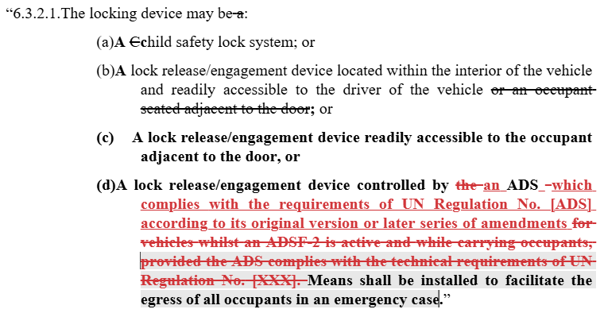

Slide 2
No ADSF-2* fitted | Category X* (i.e. only ADSF-2*) | With ADSF-2*, other than Cat X (‘dual mode’)
 |  | Whilst ADSF-2* active | Manual driving / ADSF-1
A  B C D  | A B C D | A B C D | A B C D
Acceptable fitment: A / B / C | Acceptable fitment: A / C / D | Acceptable fitment: A / C / B+D If B+D option used, then B or D depends on current feature status
Child lock
Lock release accessible to driver
Lock release accessible to adjacent occupant
ADS-controlled locking
* Which can operate with occupants

