Slide 1
Review / Answer to comments on “Production” part(SG3)
Leading team:
Hwansoo Chong (NIER)
Tina Dettmer (OICA)
George Benedian(OICA)
Ansgar Christ (CLEPA)
Tongzhu Zhang (CATARC)

Slide 2
3.2.9 Representative vehicle (pp39)
1
“title and content are completely mis-match and seems to be inconsistent methodology proposed by SG3
Do we need to define the "representative vehicle" originally desired by IWG ?
(pp37, commented by JPN)
A: What was originally desired by IWG?
Our understanding was the following task:
to develop a method for selecting a representative vehicle, so we don’t have to calculate the carbon footprint (CF) for every single vehicle produced by an OEM.
Additionally, this method should allow us to estimate the CF of other vehicles within the same group, using specific parameters that define their similarities.
Clear ?

Slide 3
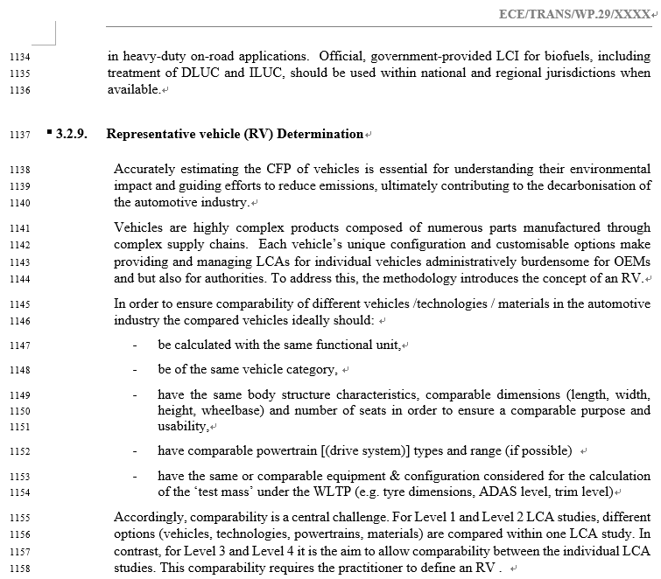
Newly commented by BC(pp39):
Potentially confusing as powertrain and drivetrain are different concepts
US to check

Slide 4

2
2
“Any reference to OEM-to-OEM comparisons should be avoided in the drafting for the following reasons:
(1) The objective of the A-LCA activity is to enable CFP evaluations within each OEM and support the automotive industry’s path toward carbon neutrality. It should not include elements directly linked to competitive business comparisons.
(2) Given that Product Category Rules (PCRs) for the parts comprising a vehicle have not yet been established—and are not expected to be in the near future—accurate and fair comparisons between OEMs are fundamentally infeasible at this stage.”
(pp39, commented by JPN)
Newly commented by BC (pp41): Japan to check

Slide 5
3
Clear
3
Traction battery definition is required in the section „definition“
(pp39, commented by George @ OICA)
A: this is just a notification for SG7 to check for a definition for the traction battery in the section 3.1.3.

Slide 6
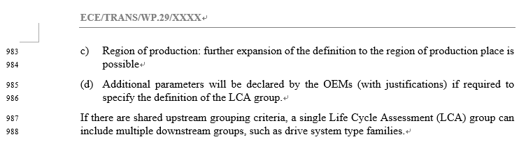
4
4
"according to the intention of "(c) region of production" , it should be (c) energy mix at production location “
(pp40, commented by JPN)
A: No we don’t agree this is not ok for OICA
Newly commented by BC (pp42):
This is not correct to change it into the energy mix.
This consideration should be reflected in chapert 4, where the SGs outline the methodology, particularly regarding the use of data for energy or the data for the supply chain or logistics.
We included the parameter (c) to make sure that the size of the LCA group is limited

Slide 7
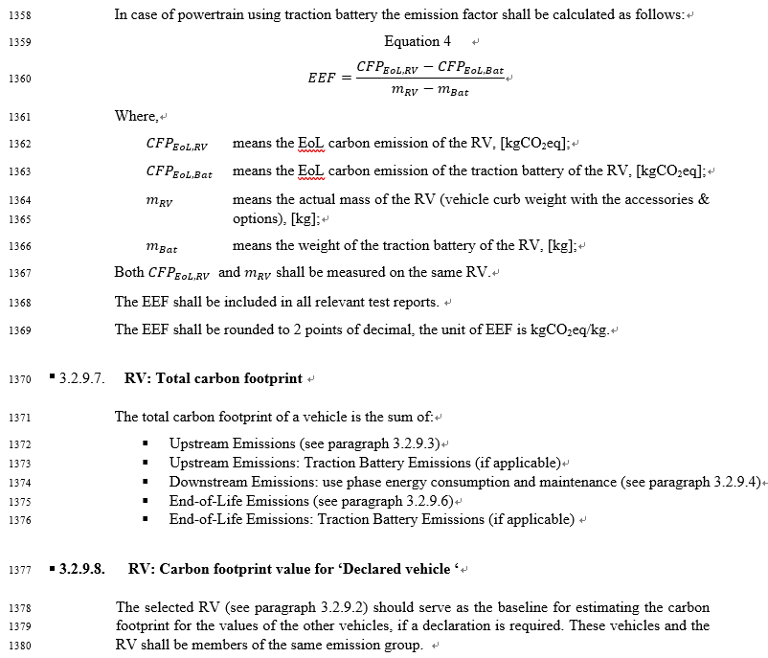
Newly commented by BC (pp45) :
Do we need a definition of curb weight. This does not exist in the EU and RoM would be potentaially different.

Slide 8
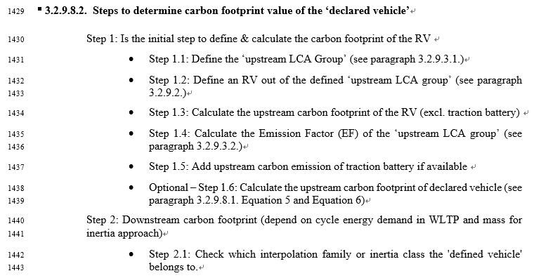
Commented by George (pp47, 20th May): To be checked by SG7, if here is the correct place for this part
Commented by Caroline: George, I suggest to let here this paragraph, it really helps the reading.

Slide 9

5
This not related to the representative vehicle section. Mistake with numbering -> SG7 has to adjust it
Fixed
3.2.8.8.3 → 3.2.10

Slide 10

6
6
[SG7 leader comment] : I merged here the proposal of SG1 and SG3 - they are aligned. (pp46, MIR Caroline)
A: Title is misleading as the section refers to additional separate reporting of specific CFP contributions.
This not related to the rep. vehicle section. Mistake with numbering -> SG7 has to adjust it.
Fixed
3.2.8.8.4 → 3.2.11

Slide 11

7
Updated (pp49)
7
“define "primary data" correctly (there is a bunch of inconsistent and/or odd description), then motivate the practitioners to increase the usage of "primary data", or clearly require which data need to be "primary“”
(pp46, commented by JPN)
A: A: Contributions from various sources were included and led to inconsistencies (see e.g. ).
Revised text is proposed for the revised draft that ensures consistency and the OICA comment!
8

Slide 12
8
Deleted (pp49)
9
8
“This contradicts the definition of primary data in the sentences above and needs to be removed. ” (Commented by OICA)
“Emission factors are typically secondary data (currently, certified values are based on secondary emission factors). This provision would significantly hinder the acquisition of primary data, resulting in no availability of primary data during primary data share definition. Suggested to re-evaluate this sentence.” (Commented by OICA)
A: Revised text is proposed for the revised draft that ensures consistency and the OICA comment!
9

Slide 13
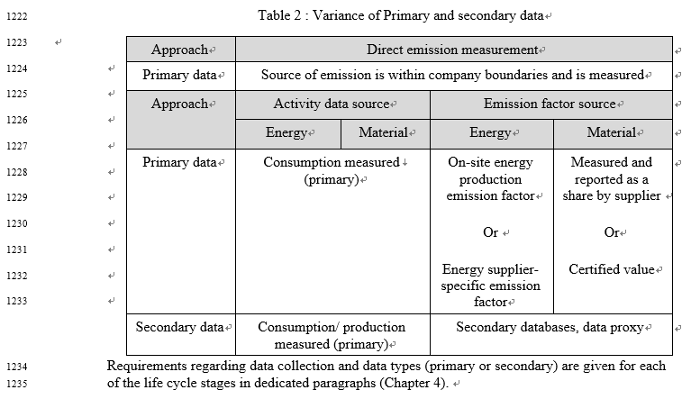
10
Updated (pp49)
11
12
10
“Can you please clarify this point? I do not understand what this means. ”
(pp47, commented by OICA_13)
A : Corrected: Quantified and shared by supplier
“This seems not to be in line with the section on electricity modelling. ”
(commented by OICA_12)
A : In line with market based modelling!
Consistency with SG3 section. Certified values are ocnsidered as primary information as long as they are compliant with A-LCA guideline’s most important principles (Allocation hierarchy, Electricity modelling, End-Of-Life allocation (RCM value))
(commented by OICA)
A : Rejected: The quality “primary” is a question of the source of information not of verification/certification
11
12

Slide 14
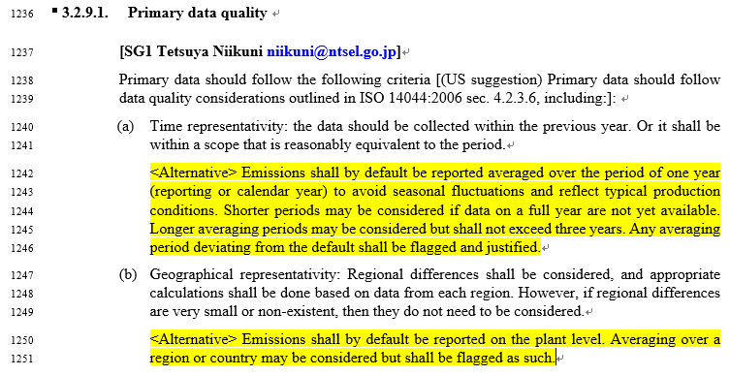
13
14
Updated (pp50)
→ 3.2.12.1 Data quality
(newly added)
13
“define "primary data quality" correctly so that the reader understand what kind of guidelines are considered (there is a bunch of inconsistent and/or odd description)” (pp47, commented by JPN_30)
“If suppliers deep(er) in the supply chain provide primary information the time scope is probably much longer (assuming the data is handed forward tier by tier)”(Commented by OICA_12)
A : Contributions from various sources were included and led to inconsistencies.
Revised text is proposed for the revised draft
14

Slide 15
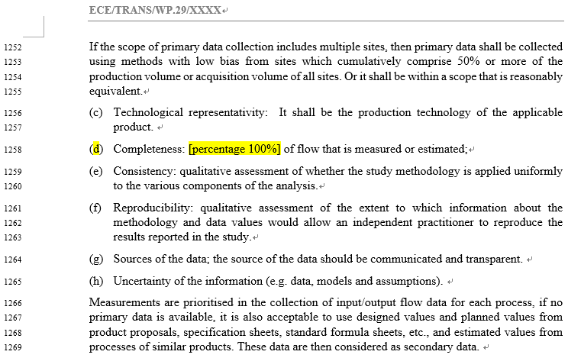
15
16
17~18
Updated (pp50)
15
“Should the remaining production volume be estimated? What should be done if the country of production is different? "97% or more" seems more appropriate than "50% or more". This is also consistent with the 3% cut-off standard described below.” (pp48, commented by JPN_31)
“List should be aligned with revised Catena-X rulebook (3.1)”(Commented by OICA_16)
“Can you please explain what is meant by that? ”(Commented by OICA_17)
Replacing percentage with 100% does not seem to make sense(Commented by BC)
A : Contributions from various sources were included and led to inconsistencies. Revised text is proposed for the revised draft
16
17~18

Slide 16
Updated (pp50)
19
20
21
19
shift to 3.2.10.3(Secondary data quality) (Commented by CLEPA_15)
“Requirements refer to all type of data not only primary data!”(Commented by CLEPA_a4)
What is the criterion?(Commented by CLEPA_16)
A : Contributions from various sources were included and led to inconsistencies.
Revised text is proposed for the revised draft.
20
21

Slide 17
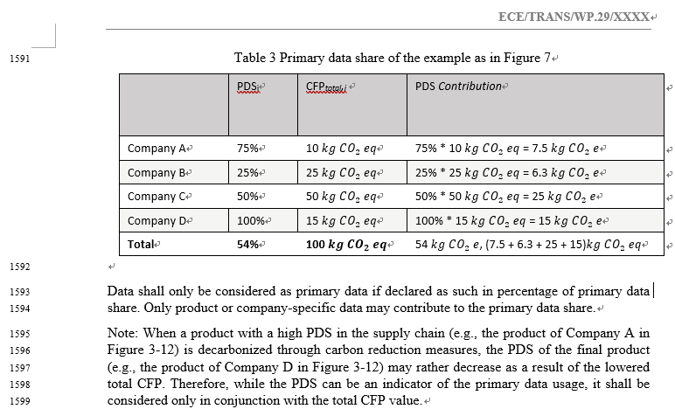
Newly commented by BC (pp53):
Incomplete sentence

Slide 18

23
24
23
“When applying the cut-off on different levels (as suggested in the paragraph) it must be ensured that the overall cut-off of 3% on the product level is not surpassed- ” (pp51, Commented by OICA_20)
Assumption: Tier level is meant. This is ensured if 3% on each level is the threshold!
“Even of there are some simplified rules it should be assured that there is consistency to the cut-off specified above. ” (Commented by OICA_21)
Adapted: … simplified rules for the proof to be applied.
Clear ?
24
Commented by BC (pp53) : SG3 to respond

Slide 19
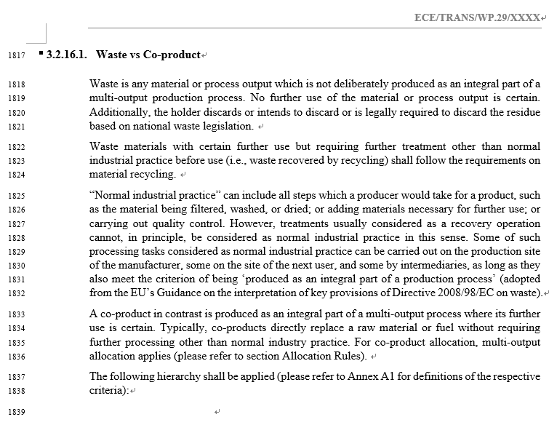
Newly commented by BC(pp59):
Annex A1 of what?

Slide 20
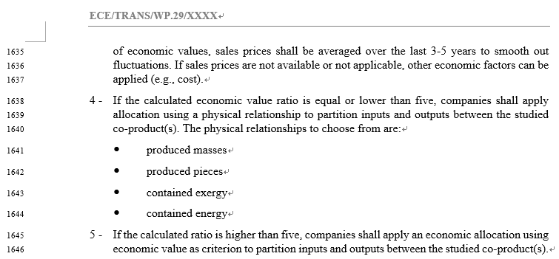
25
Clear (pp64) ?
26
25
“The appropriateness of the economic value ratio "5" should be demonstrated. ISO 14049:2012 recommends allocation based on physical quantities when changes in the share of physical quantities of outputs are proportional to changes in total GHG emissions. In other cases, allocation based on economic value is recommended. For example, in petroleum refining, allocation between light oils (such as gasoline) and heavy oils is recommended to be based on economic value. Therefore, the phrase "economic value ratio of 5 or less" should be deleted and the statement "If physical relationships are not used, the validity of the allocation method used in the study should be demonstrated" should be added.»
(pp59, commented by JPN_32)
Rejected: Physical relationship can always be used but be sometimes misleading: E.g. mining of PGM materials usually has other less valuable metals as co-products. It is however not appropriate to split the CO2 emission burden by mass of the metals, since the whole mining is only done because of PGM!
is this a known term? should we have a definition? (Commented by BC)
A : Exergy is well defined in thermodynamics
26

Slide 21
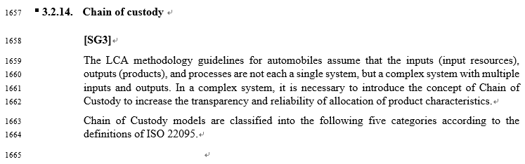
27
27
“There is no need to describe the general explanation of CoC here in Chapter 3. An example where mass balance is expected to be used in automobiles is green steel (recycled steel). Therefore, if CoC is to be mentioned in the guideline, a brief explanation and a reference to ISO 22095 in Section SG2 of Chapter 4 would be sufficient.”
(PP60, Commented by JPN_33)
Rejected: CoC is not an issue for SG2 only. Explanation could be shortened -> make specific proposal
Clear

Slide 22
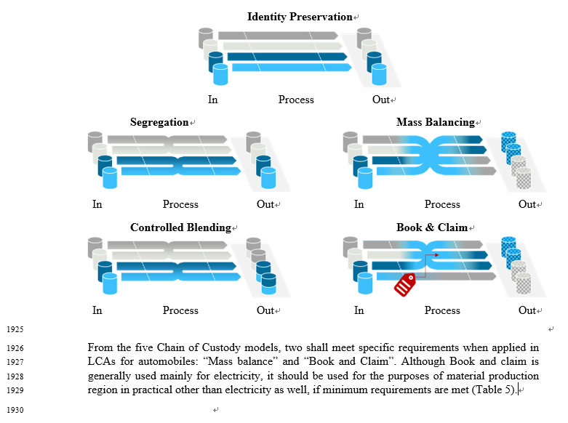
Commented by BC (pp65) :
This test is unclear

Slide 23
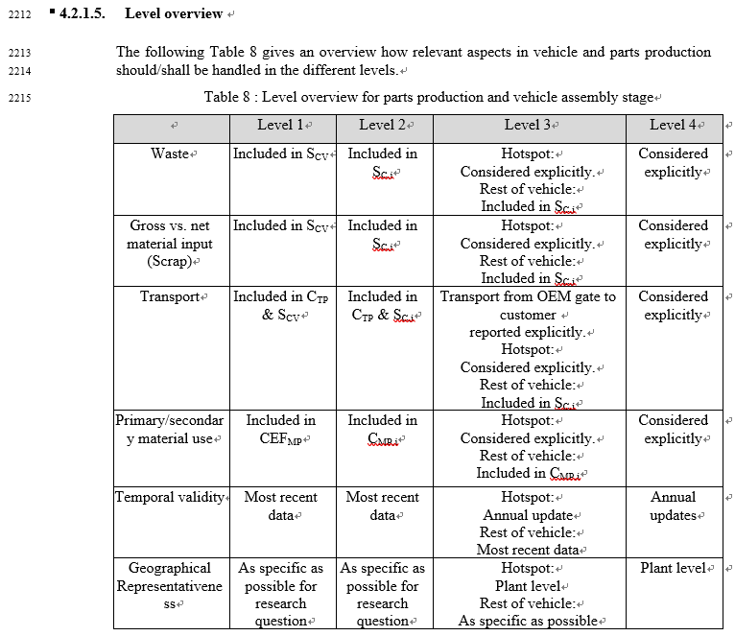
31
31
I suggest to remove the last two line of the table, and put a dedicated table in the section data type - data requirement.
(pp80, MIR Caroline)
Rejected: Joined Table with SG2 would make sense but chapter 3 section on data quality is to general
Clear ??

Slide 24
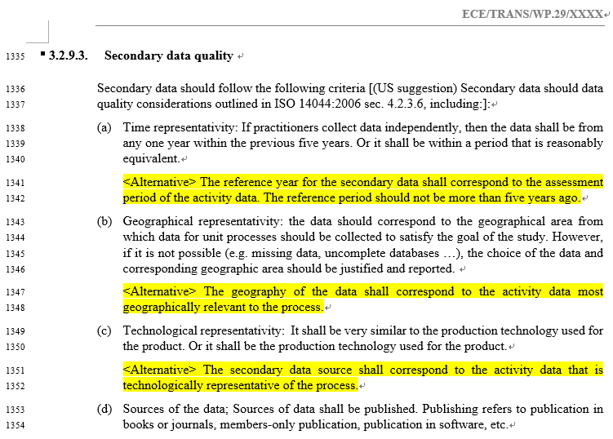
Deleted & clear ??
22
22
What do you mean by very similar ?(commented by MIR Caroline)
A : see comments No. 19~21, and the revised text will be proposed as below;
Technological representativeness: The data shall be collected/selected for processes that technologically correspond or are most representatitive to the processes of the activity.

