Slide 1
Crashworthiness of buses:
Analysis of European data and suggestions for improvements
GRSP-77-17, submitted by Norway
77th GRSP, 5-9 May 2025, agenda item 24 (d)
PhD. Tor-Olav Nævestad, head of research group Safety and resilience, Institute of Transport Economics

Slide 2
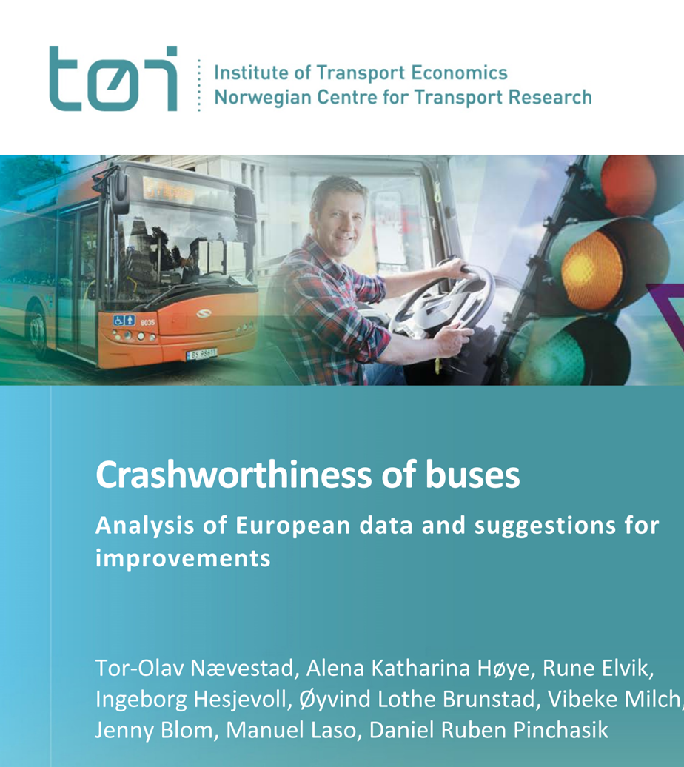
Short introduction:
The Norwegian Public Road Administration commissioned study
Focus: bus driver collision protection.
Five reports produced; the main report will be presented now.
Norway introduced a new requirement 23.10.2023
Study: What is needed to protect bus drivers? With CBA.
Notes:
Bus drivers are more vulnerable in collisions than car and truck drivers, because of: lacking crumple zones in bus fronts, lack of mandatory EU crashworthiness standards focusing on bus drivers, and a low driver seating position in many buses (e.g. city buses).
The vulnerable situation of bus drivers in collisions with frontal impacts has been indicated in bus accidents in Norway in the last ten years. In some of these crashes, bus drivers have been killed or seriously injured despite relatively low speeds of impact.

Slide 3
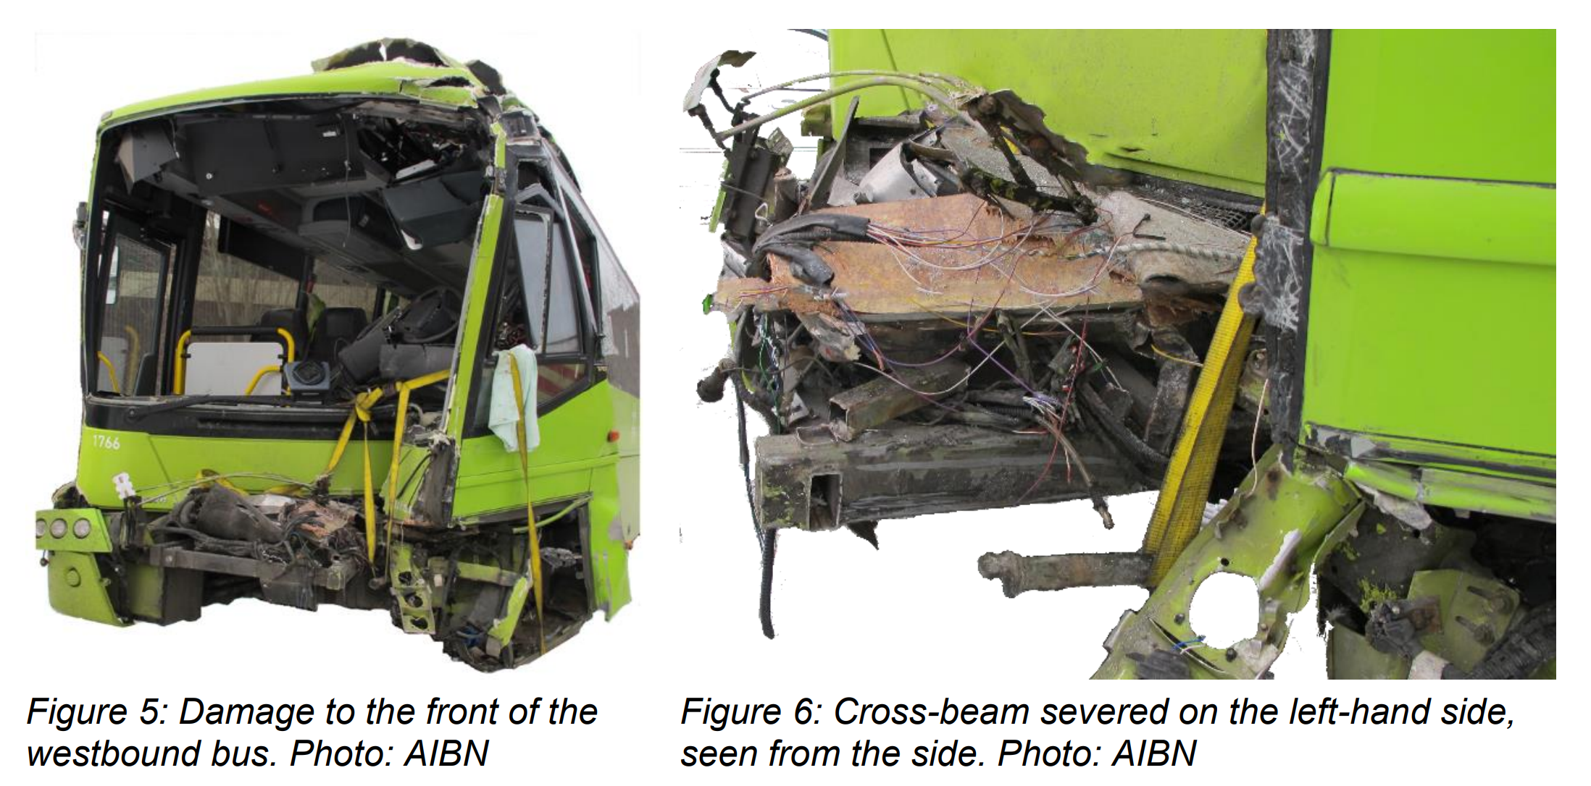
Background: Nafstad 2017: Fatal head on accident with two buses colliding at 34 km/h

Slide 4
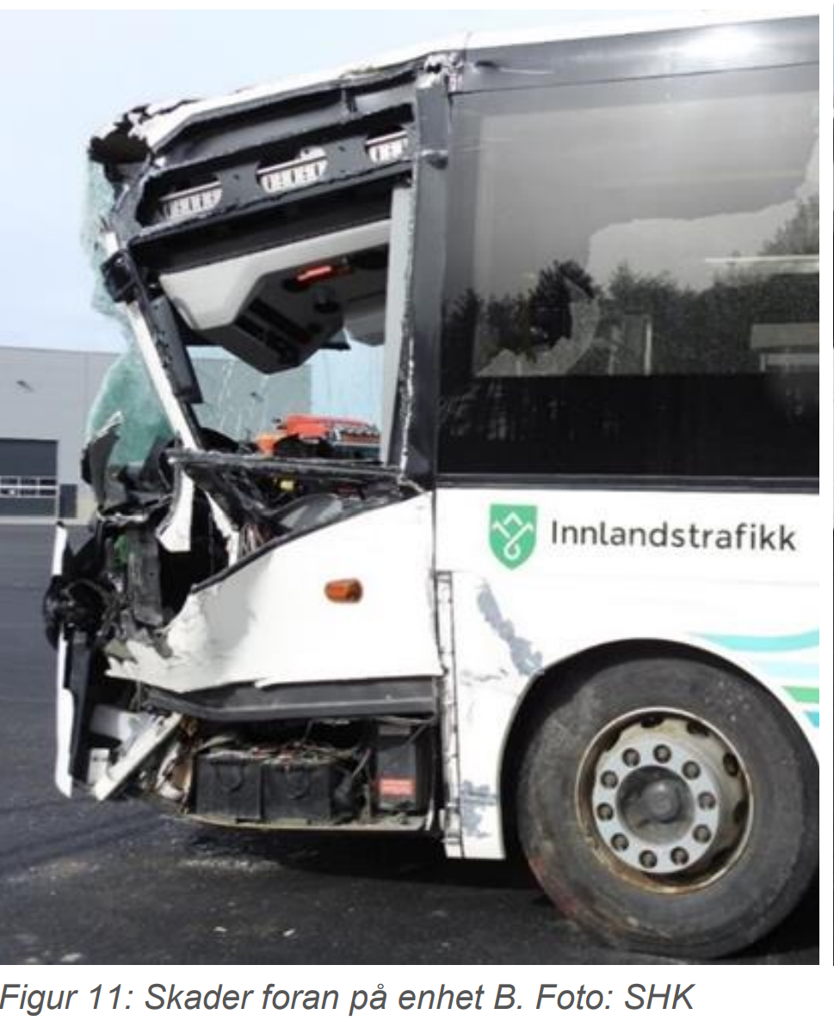
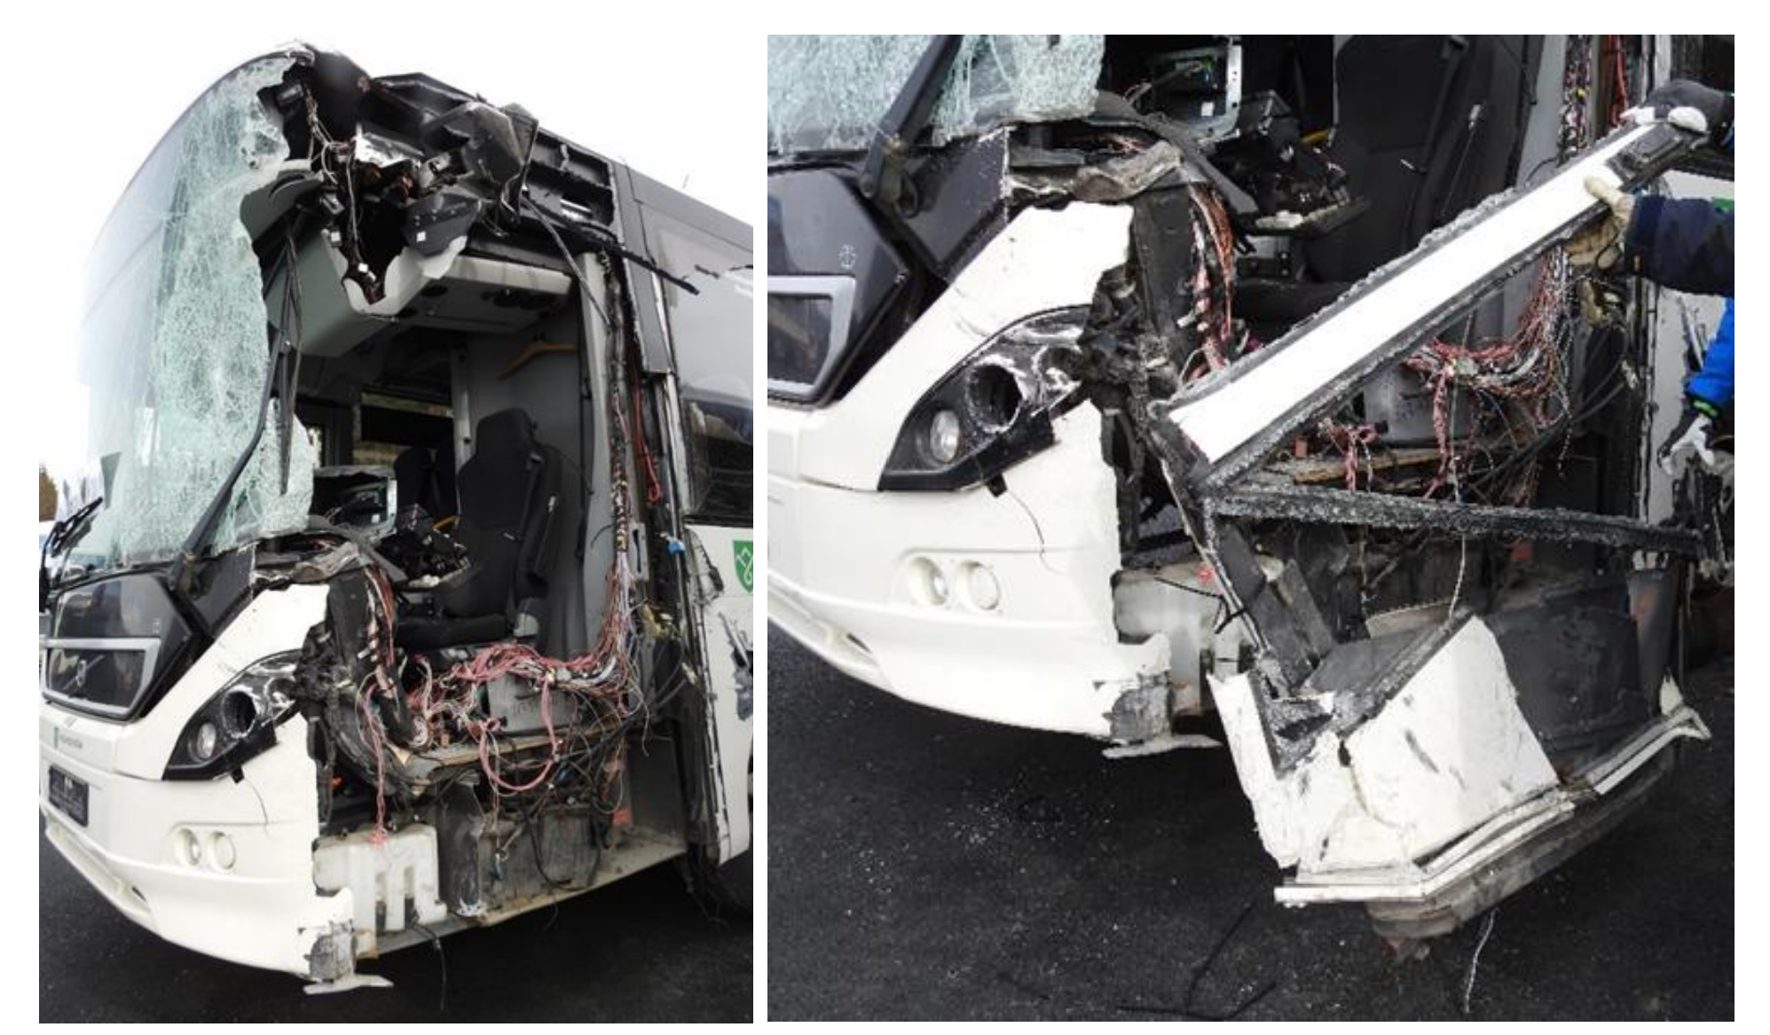
Tangen 2021: Fatal head on accident with two buses, around 35- 50 km/h

Slide 5
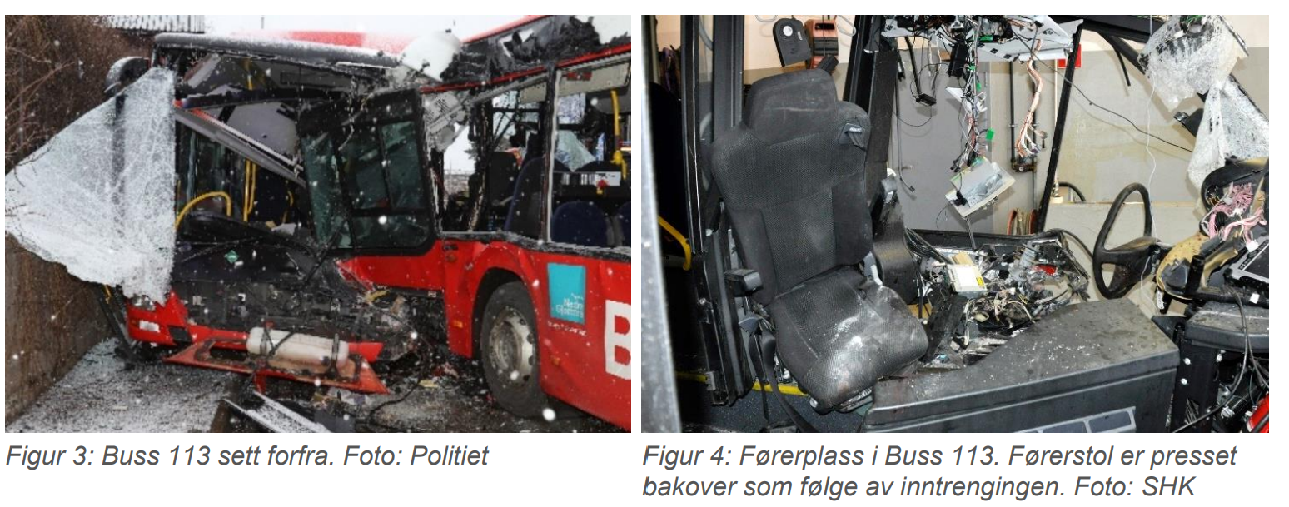
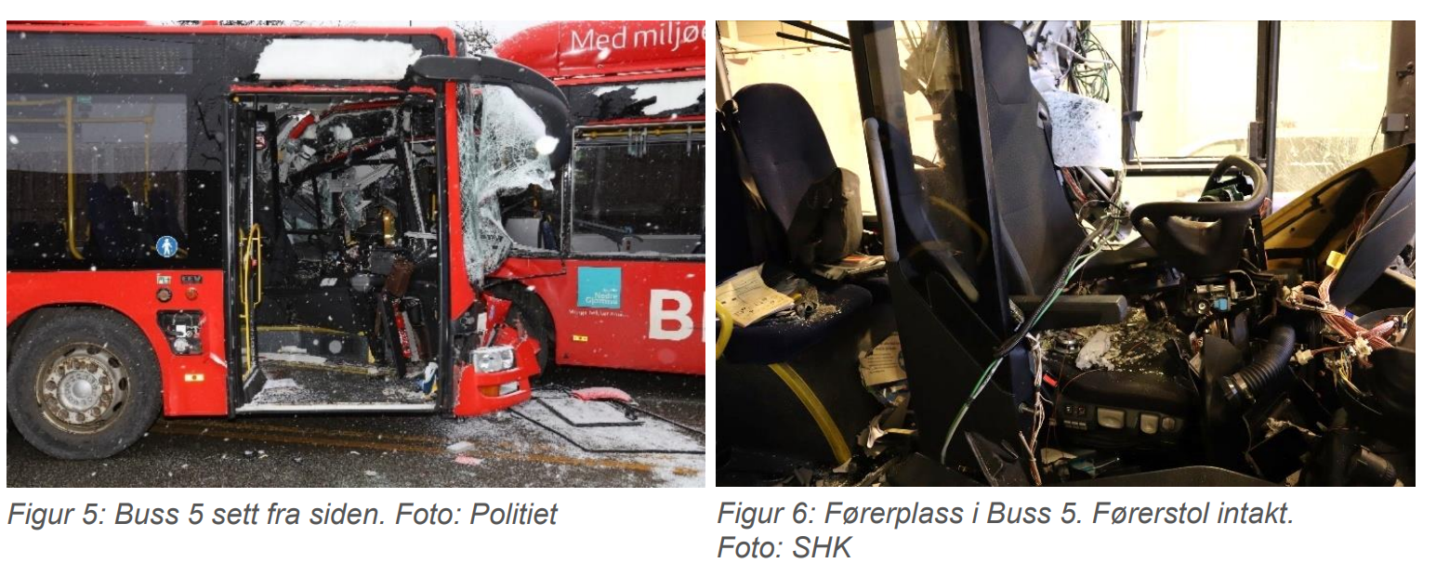
Fredrikstad 2023, fatal head-on accident with two buses, speed 35 km/h

Slide 6
Summing up the background:
Bus drivers have been killed in low-speed accidents.
If two passenger cars had crashed at similar speeds, it is unlikely that the outcome would have been fatal.
The automotive industry has made progress with respect to vehicle safety, due to stricter regulations.
The safety of HV, especially buses, has not kept pace.
Thus, bus occupants face a higher injury risk in collisions.
Norway adopted UN R.29.03 for buses on 01.10.2023
This standard applies, however, originally to trucks.
Notes:
If two passenger cars with state-of-the-art crashworthiness had crashed head-on at a similar speed, it is unlikely that the crash would have been fatal. If all protective systems (crumple zone, collapsible steering wheel column, seat belts, air bags) had worked properly, it might very well have resulted in property damage only.
In recent decades, the automotive industry has made significant strides in vehicle safety due to stricter regulations. However, despite these advancements, the progress in the safety of heavy vehicles, especially buses, has not kept pace. The regulations governing safety in this sector have remained relatively unchanged, resulting in a lack of advanced safety equipment in many buses currently on the road. Consequently, passengers and drivers of these vehicles may face a higher risk of injuries in the event of a collision.
Truck cabs are subject to crashworthiness standards under UN Regulation 29.03, which mandates tests for structural integrity and occupant safety in head-on and rollover crashes. Passenger cars must meet crash-test standards that ensure survival space for drivers and passengers during collisions. There are, however, no mandatory EU crashworthiness standards targeting the situation of bus drivers. As an exception to this situation, Norway adopted UN R.29.03 for buses on 01.10.2023. This standard, however, originally applies to trucks, and it may not fully address the unique design and operational characteristics of buses compared to trucks. Thus, there is a need to study the crash protection of bus drivers, and to develop targeted solutions which can provide bus drivers with sufficient protection in case of accidents with frontal impacts.

Slide 7
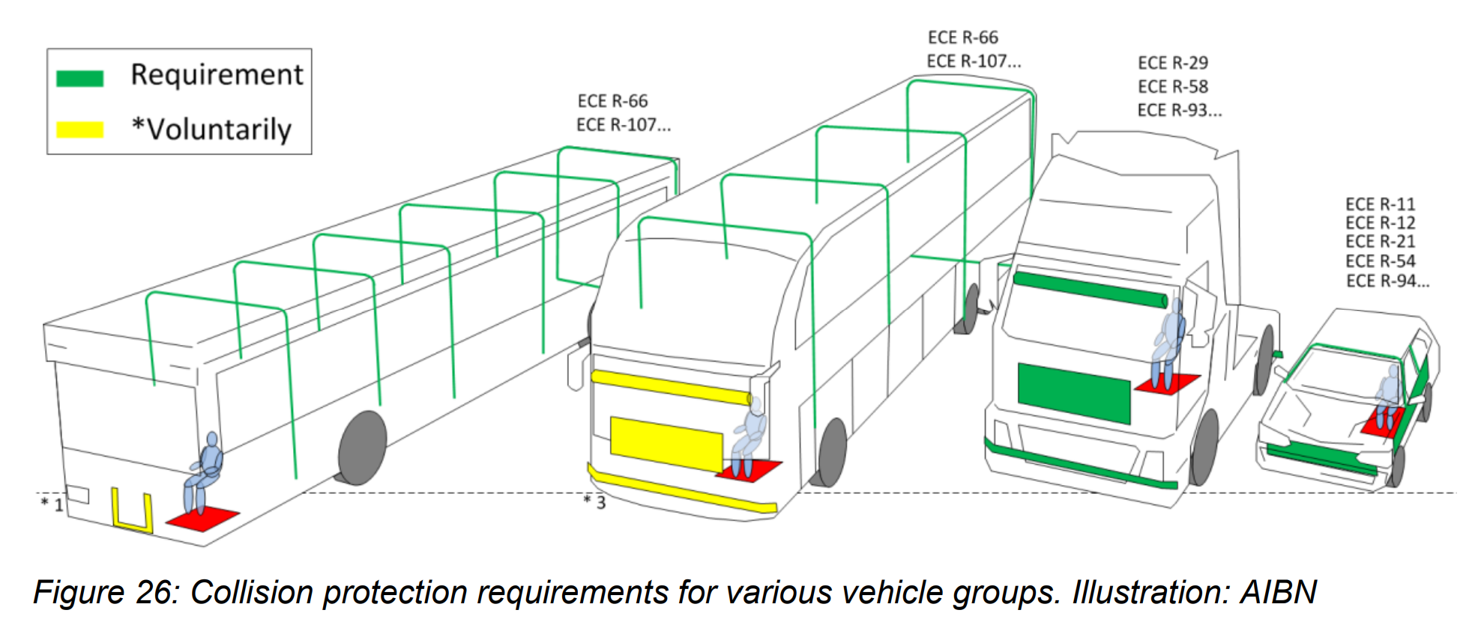
Main objectives:
To conduct an analysis of collision safety in buses, particularly focusing on how well the driver (and other road users) are protected, in case of collision, and to assess possible solutions.

Slide 8
Structure of our main report:
Part A: Description of the scope of the problem of bus accidents in Europe, including deficiencies in current bus front designs’ protection of the bus driver in collisions.
  Analysis and comparison of bus accidents and factors influencing the severity of bus accidents across countries.
  Descriptions of deficiencies in current bus front designs.
Part B: Description of possible solutions to reduce bus accidents, including a new model for bus front design, aiming to increase the collision protection of bus drivers.
  Presentation of measures to improve collision safety in buses.
  Assessment of the benefits and costs of the suggested measures for improving collision safety in buses and the expected developments over time.

Slide 9
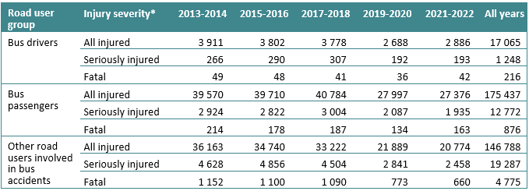
Overview of bus accidents in Europe, based on the CARE-database 2013-22:
Buses/coaches in crashes account for 2% of all road fatalities in the EU.
Notes:
Buses/coaches in crashes account for 2% of all road fatalities in the EU. For the full period of 2013-2022, the CARE database contains information on 216 bus driver fatalities and 1 243 serious injuries among bus drivers.
In addition, 876 bus passengers and 4 775 other road users were killed in these crashes.
The numbers of seriously injured is underestimated because some countries do not report injury severity, but there were at least 33 307 in the study period.

Slide 10
How many bus driver KSIs could hypotethically have been avoided, or reduced with improved collision protection?
Our analyses of accidents are based on CARE, but also several national databases with more detailed data, e.g. about impact points in the collisions.
Based on six countries for which the impact point is known: 2/3 of KSI bus drivers were in bus accidents with frontal impact.
In these accident, which account for 963 KSI bus drivers (if the numbers are extrapolated to all countries), severity might have been reduced by better collision protection.

Slide 11
Deficiencies in current bus front designs:
AIBN reports from three Norwegian accidents raise concerns about a potential pattern in these accidents.
The scenarios for which buses are designed do not align with the realities of the incidents they face.
Particularly the front corners and A-pillars, are not designed to face frontal collisions with low overlap.
Despite the introduction of new regulations in Norway requiring frontal impact tests (i.e. R29.03), these do not address the structural weaknesses observed in the aforementioned accidents.

Slide 12
The Impact energy of each of these three accidents was estimated based on the information given by the reports of the accidentology.
The level of energy produced in these three accident scenarios is about 10 times higher (approx. 550 kJ) than the energy values prescribed in Regulation UN R29.03 (55 kJ).
Estimations of collisions with passenger cars (1333 kg) indicate that the energy levels absorbed by the bus range from 1124 kj (54 km/h), to 686 (30 km/h) to 148 (20 km/h).

Slide 13
Measures to improve collision safety in buses:
Based on estimations of ideal energy absorption capabilities for buses in collision scenarios and analyses of accidents.
We propose five main changes to bus structures.

Slide 14
The “bus front improvement model”
1) Improvement of crash compatibility.
Enhanced Structural Integrity: Developing more robust connections between the transverse profile and the side panels of buses is crucial.
Energy Absorption Zones: in the front structure of buses.
Small Overlap Impact Testing: similar to tests now common for passenger cars
Advanced Materials: Exploring the use of advanced, energy-absorbing materials
Compatibility Design Standards: between buses and smaller vehicles
Mandatory Implementation of UN R93.00: front underrun protection device for trucks. To distribute impact forces more evenly and prevent smaller vehicles from under-riding the bus in a collision.
Integration with Towing Hook regulation: Combining the R93.00 requirements with existing towing hook regulation, EU R1005/2010 could ensure that the frontal structure of buses is strengthened without compromising their serviceability.
Goal: to create bus structures that not only protect their occupants but also minimize damage and injury risk to occupants of other vehicles involved in collisions.

Slide 15
The “bus front improvement model”
The position of the driver. In the case of urban buses, it would be possible to raise the position of the driver slightly.
Reinforcements in the structure. Structural reinforcements focused on the driver side. Use a “semi-cage” open structure, protecting the lower area but also providing a better connection with the vehicle’s roof. The definition of a specific test or tests to evaluate bus safety in more realistic conditions would be necessary.
Reinforcement of front grill and floor. One critical area of concern is the behaviour of the frontal structure during collision events. Cur­rent designs often result in the front of the bus transforming into a hazardous "lance" or "battering ram" upon impact. This transformation has lethal consequences, particularly for the drivers involved in such collisions. The towing hook mount point could serve as the starting point to extend the frontal structure reinforcement and the front underrun protection.
Reinforcement of the roof. The AIBN reports show that in all of them, the upper roof connection was detached from the lateral structure.

Slide 16
Assessment of benefits and costs
Assumptions: the model reduces fatal injury by 30%, serious injury by 20% and slight injury by 10% in crashes with impact points between 10 and 12 o’clock.
Under these conditions, the present value of the benefits will be EUR 377per bus, whilst system costs may be assumed to lie between EUR 8 500-12 000 per bus.
Costs therefore seem to outweigh benefits.
Notes:
The cost benefit analyses consist of seven steps.
The first step is to estimate injury risk to bus drivers. To obtain estimates of injury risk that can be regarded as representative for Europe, statis­tics on the number of killed or injured bus drivers reported in CARE have been combined with estim­ates of million kilometres driven by buses. For most countries included, the data refer to 2013-2022. The countries included are Belgium, Bulgaria, Croatia, Estonia (fatality risk only), France (fatality risk only), Germany, Italy (fatality risk only), Netherlands, Norway, Poland, Portugal, Sweden, and Switzerland. For the period covered by the data, there were 128 bus driver fatalities, 830 seriously injured bus drivers, and 6 746 slightly injured bus drivers in these countries.
The second step is to estimate monetary valuation of injuries. The Handbook on the external costs of Transport (van Essen et al. 2019) is used to assign monetary values to the injuries. To update these estimates to 2023-values, the index for real incomes (i.e. incomes in fixed prices) reported by Eurostat has been applied. The updated estimates are: 1 fatal injury: 3,921,557 €1 serious injury (very serious and serious combined): 597,223 €1 slight injury: 46,133 €
The third step is to estimate expected costs of injuries per bus. Applying the monetary valuations above and the mean estimates of risk, the total annual societal cost of injuries to bus drivers per bus kilometre can be calculated.
The fourth step is to include the costs of measures improving crashworthiness.
The fifth step is to include effects of measures improving crashworthiness. An important problem in performing a cost-benefit analysis of improved crashworthiness for buses, is that the effects of the measures intended to improve crashworthiness are unknown, as none of the measures have been (widely) implemented. Only their potential effects are known to some extent, for example as results of crash tests.
The sixth step is to assess the impact points influenced by the suggested measures to improve crashworthiness. Based on that, the share of injuries to bus drivers that these impact points account for, can be assessed.
The final step is to compare benefits and costs of safety systems based on the information from the preceding steps.

Slide 17
Vision Zero and Safe System
From a Safe System perspective and a work environment perspective, it can be argued that bus drivers should have the same protection as car and truck drivers in collisions.
Safe System approach: the traffic system must be designed so external forces in accidents do not exceed the human bodies’ tolerance for biomechanical impacts.
For bus drivers, there is still a considerable potential when it comes to Safe System implementation.
Our study indicates that the frontal structure of the bus also might endanger other vehicles in crashes.
This is another example of how bus frontal design might conflict with Safe System principles.
Our suggested model also seeks to mitigate this, and might thus also reduce the injury risk of counterparties in bus accidents.
Light vehicle occupants comprise 22% of the killed and severely injured in bus accidents.

Slide 18
The reports in the project:
Crashworthiness of buses: Analysis of European data and suggestions for improvements: https://www.toi.no/getfile.php?mmfileid=79142
Nævestad, T.-O., A. K. Høye, R. Elvik, I. Hesjevoll, Ø. L. Brunstad, V. Milch, J. Blom (2025) Literature review of active and passive measures to improve bus safety, TØI report. Institute of Transport Economics
Høye, A.K., I. Hesjevoll, T.-O. Nævestad, R. Elvik, Ø. L. Brunstad, V. Milch, J. Blom (2025) Analysis of bus accidents in Europe, TØI report. Institute of Transport Economics.
Elvik R. (2025) Expected developments in bus accidents, TØI Working document. Institute of Transport Economics.
Laso, M., T.-O. Nævestad (2025) Technical Study of collision protection for bus drivers: Development of a new model for collision protection, TØI report. Institute of Transport Economics.

