Slide 1
Additional TPRDs supply lines

Slide 2
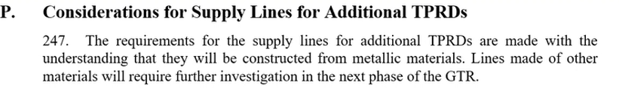
Background
Supply lines for remote TPRDs are at the same level of pressure as the Hydrogen Container
Current GTR-13 requirements do not include requirements for supply lines for remote TPRD
  It is part of the focus topics for GTR-13 Phase 3:
    (i) Improvements of the test procedures (Station risk assessment issues, remote TPRD, etc.).
UN-R 134 introduced them: Proposal for the 03 series of amendments to UN Regulation No. 134 (Hydrogen and fuel cell vehicles)
ISO 19887-1 was brought as an alternative to evaluate the performance of the supply lines for additional TPRDs. Refer to Proposal for Terms of Reference and Rules of Procedure of the GRSP task force on UN regulations for hydrogen vehicles (TFH2). III.7.

Slide 3
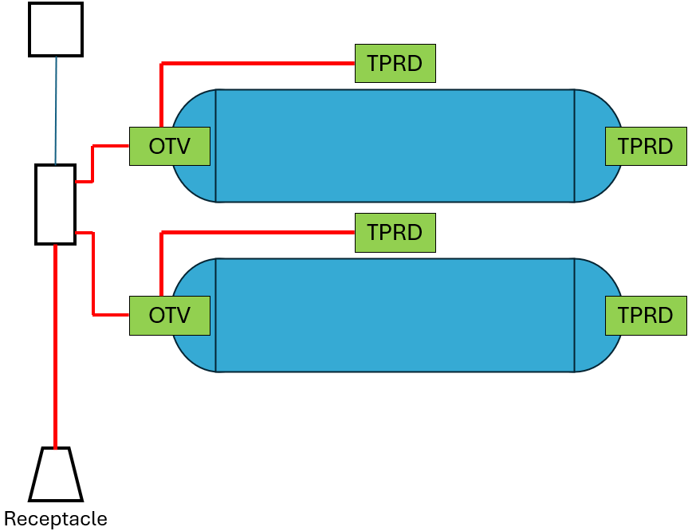
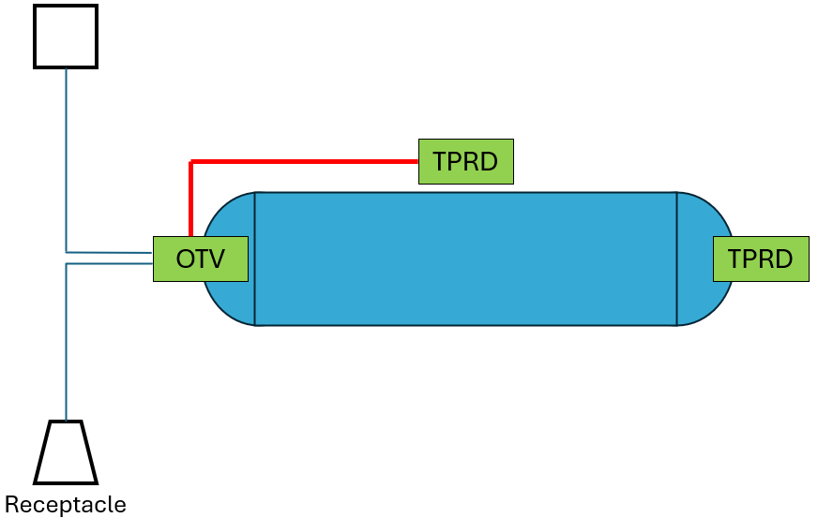
Background
focus
focus
no
no
no

Slide 4
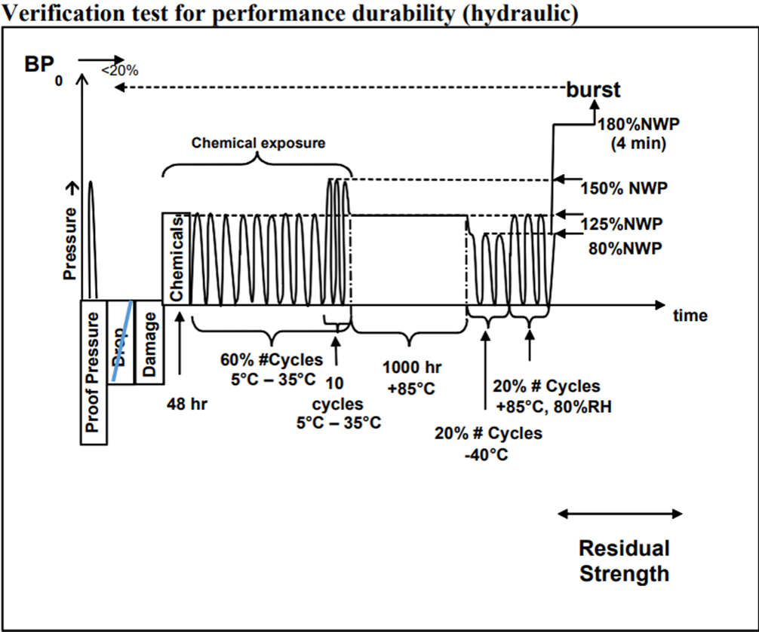
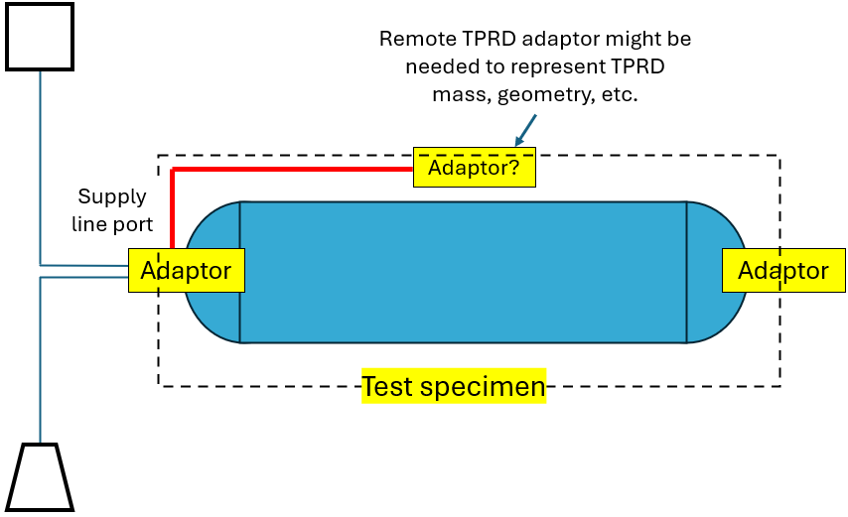
UN-R 134_03: Hydraulic Series alternative (except drop – using OTV/End plug adaptors, mock-up/dummies)
UN Regulation No. 134_03 series of amendments:
2.1. “Appropriate adaptor” means a test component that substitutes for the container valve or end plug and includes an outlet with the proper fitting size and geometry to connect the supply line to the additional TPRD.

Slide 5
UN-R 134_03: Hydraulic Series alternative (except drop – using OTV/End plug adaptors, mock-up/dummies)
UN Regulation No. 134_03 series of amendments:
2.1. “Appropriate adaptor” means a test component that substitutes for the container valve or end plug and includes an outlet with the proper fitting size and geometry to connect the supply line to the additional TPRD.

Slide 6
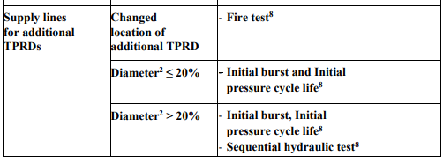
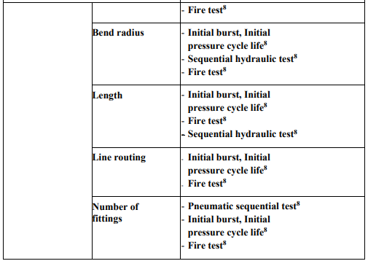
UN-R 134_03: Hydraulic Series alternative (Change of Design table)

Slide 7
UN-R 134 Hydraulic Series alternative (except drop – using OTV/End plug mock-up/dummies)
Discussion:
Industry experts, unaware of any Remote TPRD incidents reported in the last 25 years.
Appropriate adaptor is a seal intended component that shall perform as the component that it is representing but not the intended component for operation.
This new requirement is more representative of a System test and hydraulic series is intended as a container test.
System mounting, supply lines for remote TPRD, will have to reflect real life scenario, which is something that is typically evaluated at the vehicle level.
Remote TPRD implicit in pneumatic test and fire test
Proof/Burst chamber size, supply lines length might exceed current chamber size.
Proof at Manufacturer, chamber size, supply lines length might exceed current chamber size.
Creates additional burden for the testing laboratories this burden is passed on as a cost to the OEMs, discouraging innovation and implementation of hydrogen systems.

Slide 8
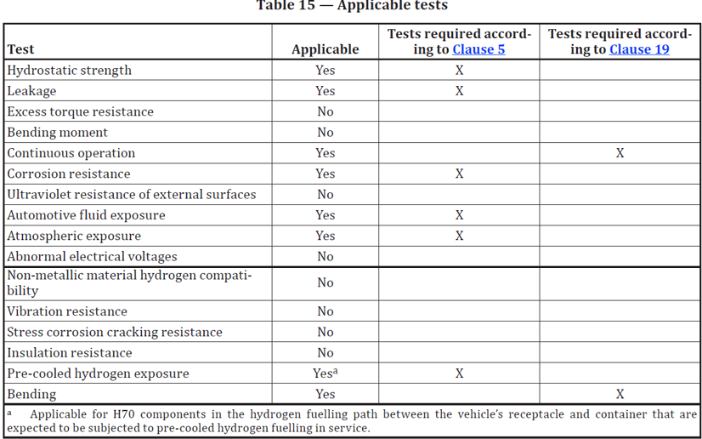
ISO 19887-1 (clause 19: rigid lines) alternative

Slide 9
ISO 19887-1 (clause 19: rigid lines) alternative
Discussion:
Mechanical test ➔ crash test is performed at vehicle’s fuel system level.
Final configuration of fuel system is sometimes unknown during CHSS homologation.
Vibration test + extensive testing is performed at vehicle’s fuel system level.

