Slide 1
Review / Answer to comments on “Production” part(SG3)
Leading team:
Hwansoo Chong (NIER)
Tina Dettmer (OICA)
George Benedian(OICA)
Ansgar Christ (CLEPA)
Tongzhu Zhang (CATARC)

Slide 2
3.2.8 Representative vehicle
1
“title and content are completely mis-match and seems to be inconsistent methodology proposed by SG3
Do we need to define the "representative vehicle" originally desired by IWG ?
(pp37, commented by JPN)
A: What was originally desired by IWG?
Our understanding was the following task:
to develop a method for selecting a representative vehicle, so we don’t have to calculate the carbon footprint (CF) for every single vehicle produced by an OEM.
Additionally, this method should allow us to estimate the CF of other vehicles within the same group, using specific parameters that define their similarities.

Slide 3

2
2
“Any reference to OEM-to-OEM comparisons should be avoided in the drafting for the following reasons:
(1) The objective of the A-LCA activity is to enable CFP evaluations within each OEM and support the automotive industry’s path toward carbon neutrality. It should not include elements directly linked to competitive business comparisons.
(2) Given that Product Category Rules (PCRs) for the parts comprising a vehicle have not yet been established—and are not expected to be in the near future—accurate and fair comparisons between OEMs are fundamentally infeasible at this stage.”
(pp39, commented by JPN)
A: I‘m ok to delete this sentence

Slide 4
3
3
Traction battery definition is required in the section „definition“
(pp39, commented by George @ OICA)
A: this is just a notification for SG7 to check for a definition for the traction battery in the section 3.1.3.

Slide 5

4
4
"according to the intention of "(c) region of production" , it should be (c) energy mix at production location “
(pp40, commented by JPN)
A: No we don’t agree this is not ok for OICA

Slide 6

5
This not related to the representative vehicle section. Mistake with numbering -> SG7 has to adjust it

Slide 7

6
6
[SG7 leader comment] : I merged here the proposal of SG1 and SG3 - they are aligned. (pp46, MIR Caroline)
A: Title is misleading as the section refers to additional separate reporting of specific CFP contributions.
This not related to the rep. vehicle section. Mistake with numbering -> SG7 has to adjust it.

Slide 8

7
7
“define "primary data" correctly (there is a bunch of inconsistent and/or odd description), then motivate the practitioners to increase the usage of "primary data", or clearly require which data need to be "primary“”
(pp46, commented by JPN)
A: A: Contributions from various sources were included and led to inconsistencies (see e.g. ).
Revised text is proposed for the revised draft that ensures consistency and the OICA comment!
8

Slide 9
8
9
8
“This contradicts the definition of primary data in the sentences above and needs to be removed. ” (Commented by OICA)
“Emission factors are typically secondary data (currently, certified values are based on secondary emission factors). This provision would significantly hinder the acquisition of primary data, resulting in no availability of primary data during primary data share definition. Suggested to re-evaluate this sentence.” (Commented by OICA)
A: Revised text is proposed for the revised draft that ensures consistency and the OICA comment!
9

Slide 10

10
11
12
10
“Can you please clarify this point? I do not understand what this means. ”
(pp47, commented by OICA_13)
A : Corrected: Quantified and shared by supplier
“This seems not to be in line with the section on electricity modelling. ”
(commented by OICA_12)
A : In line with market based modelling!
Consistency with SG3 section. Certified values are ocnsidered as primary information as long as they are compliant with A-LCA guideline’s most important principles (Allocation hierarchy, Electricity modelling, End-Of-Life allocation (RCM value))
(commented by OICA)
A : Rejected: The quality “primary” is a question of the source of information not of verification/certification
11
12

Slide 11
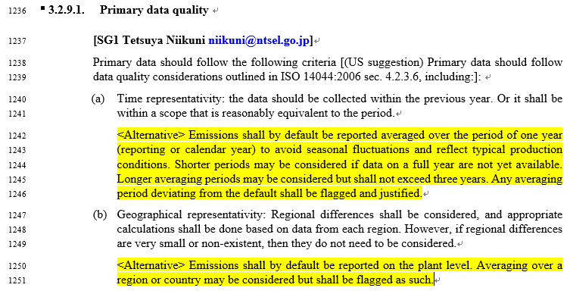
13
14
13
“define "primary data quality" correctly so that the reader understand what kind of guidelines are considered (there is a bunch of inconsistent and/or odd description)” (pp47, commented by JPN_30)
“If suppliers deep(er) in the supply chain provide primary information the time scope is probably much longer (assuming the data is handed forward tier by tier)”(Commented by OICA_12)
A : Contributions from various sources were included and led to inconsistencies! Revised text is proposed for the revised draft
14

Slide 12

15
16
17~18
15
“Should the remaining production volume be estimated? What should be done if the country of production is different? "97% or more" seems more appropriate than "50% or more". This is also consistent with the 3% cut-off standard described below.” (pp48, commented by JPN_31)
“List should be aligned with revised Catena-X rulebook (3.1)”(Commented by OICA_16)
“Can you please explain what is meant by that? ”(Commented by OICA_17)
Replacing percentage with 100% does not seem to make sense(Commented by BC)
A : Contributions from various sources were included and led to inconsistencies! Revised text is proposed for the revised draft
16
17~18

Slide 13
19
20
21
19
shift to 3.2.10.3(Secondary data quality) (Commented by CLEPA_15)
“Requirements refer to all type of data not only primary data!”(Commented by CLEPA_a4)
What is the criterion?(Commented by CLEPA_16)
A : Contributions from various sources were included and led to inconsistencies! Revised text is proposed for the revised draft
20
21

Slide 14

22
22
What do you mean by very similar ?(commented by MIR Caroline)
A :

Slide 15

23
24
23
“When applying the cut-off on different levels (as suggested in the paragraph) it must be ensured that the overall cut-off of 3% on the product level is not surpassed- ” (pp51, Commented by OICA_20)
Assumption: Tier level is meant. This is ensured if 3% on each level is the threshold!
“Even of there are some simplified rules it should be assured that there is consistency to the cut-off specified above. ” (Commented by OICA_21)
Adapted: … simplified rules for the proof to be applied.
24

Slide 16

25
26
25
“The appropriateness of the economic value ratio "5" should be demonstrated. ISO 14049:2012 recommends allocation based on physical quantities when changes in the share of physical quantities of outputs are proportional to changes in total GHG emissions. In other cases, allocation based on economic value is recommended. For example, in petroleum refining, allocation between light oils (such as gasoline) and heavy oils is recommended to be based on economic value. Therefore, the phrase "economic value ratio of 5 or less" should be deleted and the statement "If physical relationships are not used, the validity of the allocation method used in the study should be demonstrated" should be added.»
(pp59, commented by JPN_32)
Rejected: Physical relationship can always be used but be sometimes misleading: E.g. mining of PGM materials usually has other less valuable metals as co-products. It is however not appropriate to split the CO2 emission burden by mass of the metals, since the whole mining is only done because of PGM!
is this a known term? should we have a definition? (Commented by BC)
A : Exergy is well defined in thermodynamics
26

Slide 17

27
27
“There is no need to describe the general explanation of CoC here in Chapter 3. An example where mass balance is expected to be used in automobiles is green steel (recycled steel). Therefore, if CoC is to be mentioned in the guideline, a brief explanation and a reference to ISO 22095 in Section SG2 of Chapter 4 would be sufficient.”
(PP60, Commented by JPN_33)
Rejected: CoC is not an issue for SG2 only. Explanation could be shortened -> make specific proposal

Slide 18

28
28
[SG7 leader comment] : this section should be aligned with the section related to cut off and system boundaries and infrastructure (pp 67, MIR Caroline)
A : To be aligned once system boundaries are fixed!

Slide 19

29
30
29
(SG7 leader comment] : 2 questions :
- what type of data do you recommend for logistic ? 1/ Primary or secondary data ; 2/ for activity data and EF and 3: for which level ?
When secondary data is allowed : you recommend here to model the logistic based on the methodology of the GLEC 3.1, except for infrastructure. So EF from GLEC are not recommended but only the method to calculate them ? (pp 68, MIR Caroline)
A : To be aligned once system boundaries are fixed
Where should the quotation marks open?
A :
30

Slide 20
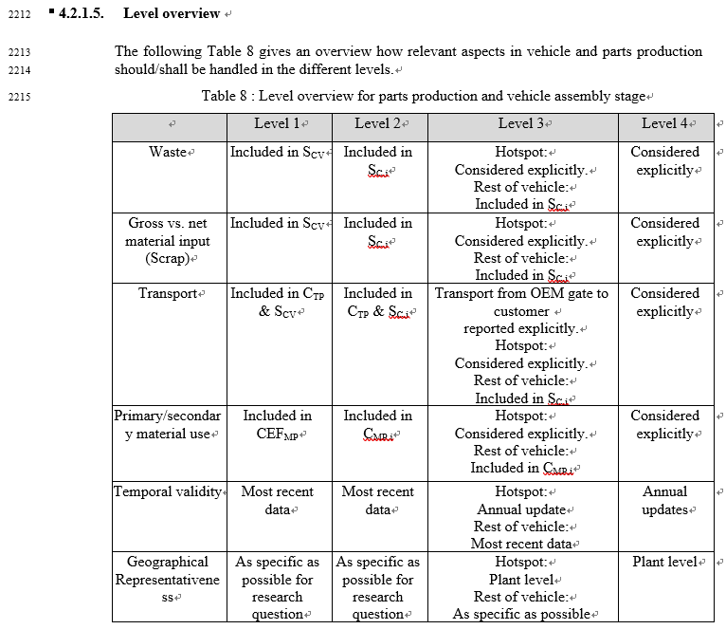
31
31
I suggest to remove the last two line of the table, and put a dedicated table in the section data type - data requirement.
(pp80, MIR Caroline)
Rejected: Joined Table with SG2 would make sense but chapter 3 section on data quality is to general

Slide 21

32
33
32
I suggest to add this table to specify for each level what type of data (primary or secondary data) should be used. Time representativeness and geographical representativeness can also be mentioned here (pp82, MIR Caroline)
Q : What is the added value beyond Table8!
Is this to ensure the data is real (actuality) or up to date (currency)? (commented by Euro7)
Adapted: currentness of data
33

