Slide 1
Indoor Drum Method
- parameters enhancement -
Document TA-29-5
Agenda item 4
TFTA 29th session 29 January 2025

Slide 2
Introduction
Both DRUM Method and VEHICLE Method are now under assessment in 2024 GRBP TFTA Correlation/Validation Plan and in 2024 GRBP TFTA Market Assessment Plan with targets:
  Internal consistency of each method (eg: Open road vehicle method multi circuit assessment 2025)
  Correlation between methods
The correlation between the two methods is a key characteristic to guarantee a robust & reliable process for tyre compliance verification all over the world.
Based on 2023 data some actions and ideas have been implemented:
  on VEHICLE side, several amendments have been introduced after 2023 Correlation/Validation Plan, such as narrower tolerances on vehicle set-up. These amendments are under assessment in the 2024 plans.
  on DRUM side, ETRTO technical assessment is that there is space for enhancements on the 2023 JASIC method proposal with the aim to:
    Improve the repeatability on the same drum and between drums,
    Improve the correlation with vehicle method.

Slide 3
ETRTO proposal for drum method parameters further assessment
ETRTO believe that a simple adaptation of the JASIC DRUM method can better emulate the real driving parameters. Keys parameters draft modifications proposal:
  For better reproducibility:
  For better correlation:
To demonstrate the above assumptions, ETRTO is proposing some enhancements to the drum method, aiming above targets and following a plan to be performed in first semester 2025 (in parallel with the TAPP Analysis of 2024 test results) with deadline before September 2025 GRBP.
    Single specified surface
    New procedure to level out Sand Paper P120 wear
    Only one specified third body nature and effective flow rate range.
    Replicating the tyre solicitations (lateral, longitudinal and vertical forces) of the current VEHICLE test method on the drum (drive axle tyres)
    Inflation pressure according to VEHICLE test method
    Dynamic camber settings around the static tuning of the VEHICLE test method.

Slide 4
ETRTO drum test parameters draft proposal (1)

Slide 5
ETRTO drum test parameters draft proposal (2)
*
* To be further evaluated

Slide 6
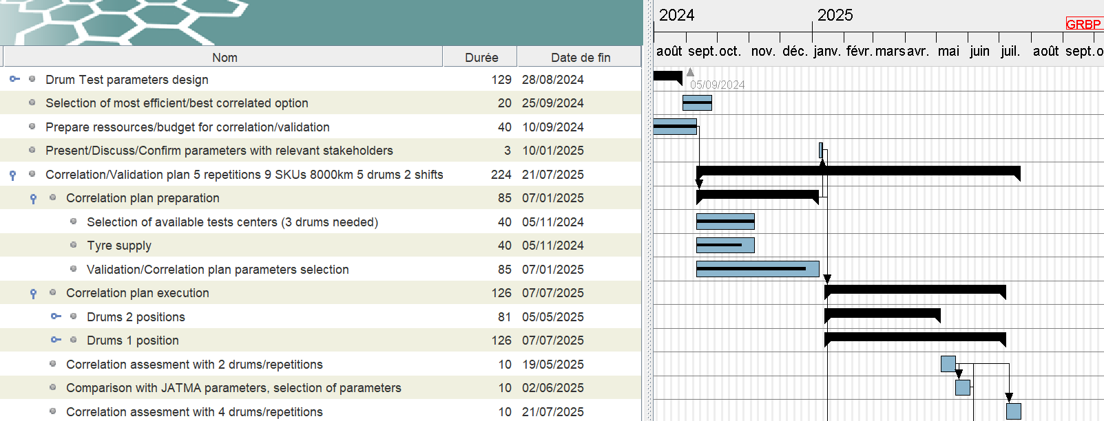
GANTT

Slide 7
Correlation/Validation plan for ETRTO parameters proposal for enhancing DRUM method
Encouraging preliminary results. Further preliminary concept tests running, results of which are not yet available.
Following possible schedule done with following assumptions:
  4 repetitions on 4 different drums running in // and for 9 SKU
  6000 km, 75 kph average ➔ ~80 hours of test (6000 km to confirm)
  Test duration to be indicated by each participant companies.
Run the test with at least 4 different drums:
  4 ETRTO members have already offered their availability for verifying the method enhancement.
  Additional drums would be welcome.
Objective is to capture data until August at the latest to be ready for GRBP in September 2025.

Slide 8
Possible Scenario in case of positive results
Purpose of the experimental plan is to verify whether some proposals which ETRTO members have done in ISO & UN Meetings are confirmed or not by experimental Data
In case of positive verification, the Data from the Market Assessment will continue to have their validity, provided that we take into account the desired increased dynamics
The Graphs below explain a possible scenario. Let’s suppose we will be able to pass from the left situation to the right situation, characterized by a lower error and a slope nearer to 1.
The Error Reduction won’t cause any problem; furthermore, it will decrease the inversion risk
The slope nearer to 1 will simply be able to get thresholds from drum more similar to thresholds from Vehicle

Slide 9
Thanks for you attention

Slide 10
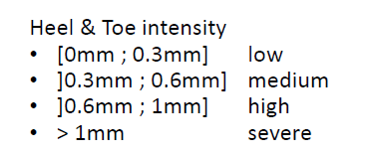
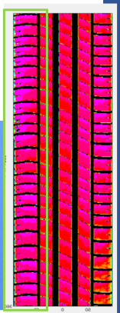
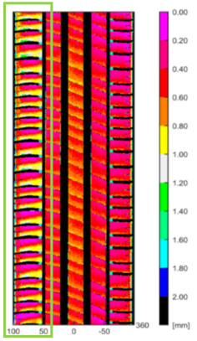
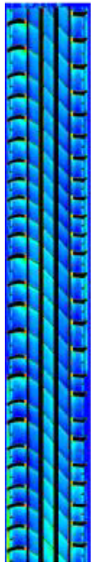

ETRTO position about ISO 18511-2 drum method irregular wear
Id | Comment | Proposal
1 | Irregular wear too important | Adopt vehicle wheel alignment
Especially summer tires show shoulder Heel & Toe wear which is in that intensity not observable in on-road tests
Observed on JASIC and ETRTO drums
Conclusions:
  Not representative usage conditions
  Possible impact on Abrasion Rate Index
Tire/ Test | Heel&Toe [mm] | Intensity H&T finding
Summer SRTT/ Vehicle on-road | 0.2 | low
Summer SRTT/ Drum 1 JASIC | 0.6 | medium
Summer SRTT/ Drum 2 JASIC | 0.57 | medium
Summer SRTT/ Drum 3 JASIC | yes | ?
Summer SRTT/ Drum 5 ETRTO | 1.0 | high
Summer SRTT/ Drum 6 ETRTO | 0.7 | high
Summer SRTT/ Drum 7 ETRTO | 0.6 | medium
Summer SRTT/ Drum 7 ETRTO | 1.0 | severe
Summer SRTT/ Drum 7 ETRTO | 0.85 | high
Summer SRTT/ Drum 7 ETRTO | 0.82 | high
Examples: Summer SRTT 17’’
Vehicle
Drum 5
Drum 1

Slide 11
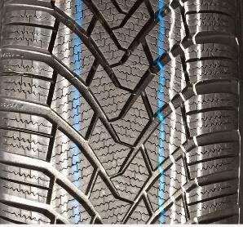
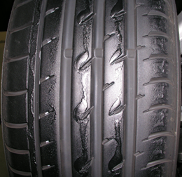
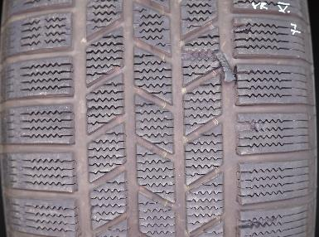
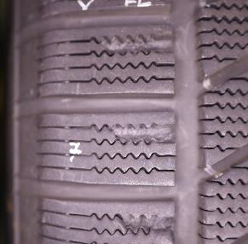
ETRTO position about ISO 18511-2 drum method test temperature
Id | Comment | Proposal
2 | Temperature too high for Snow tyres | Decrease temperature range to [15;20] for Snow tyres
Temperatures above 15°C not the normal use case for snow tyres,
might impact result rating or even ranking
On multiple position machines one can observe material transfer via
drum surface from tyre A to tyre B if tread temperature increases
High ambient temperatures (>20°C) lead to non-valid results
due to torn-off blocks on winter pattern
transfered marking
original marking
Collected rubber from drum surface

Slide 12
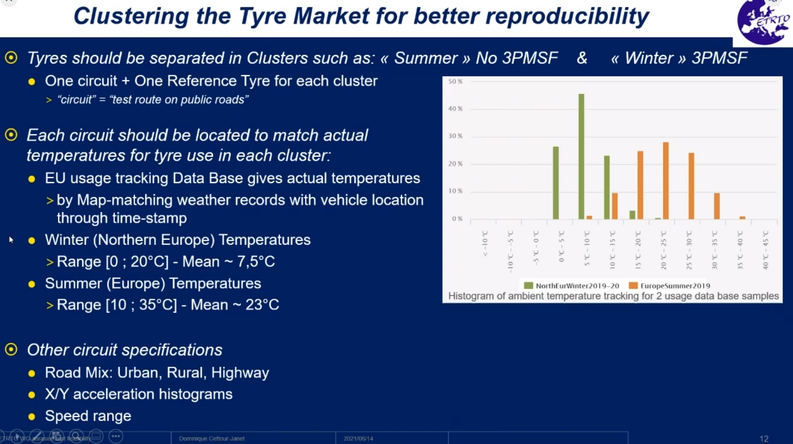
ETRTO position about ISO 18511-2 drum method test temperature
Id | Comment | Proposal
2 | Temperature too high for Snow tyres | Decrease temperature range to [15;20] for Snow tyres

Slide 13
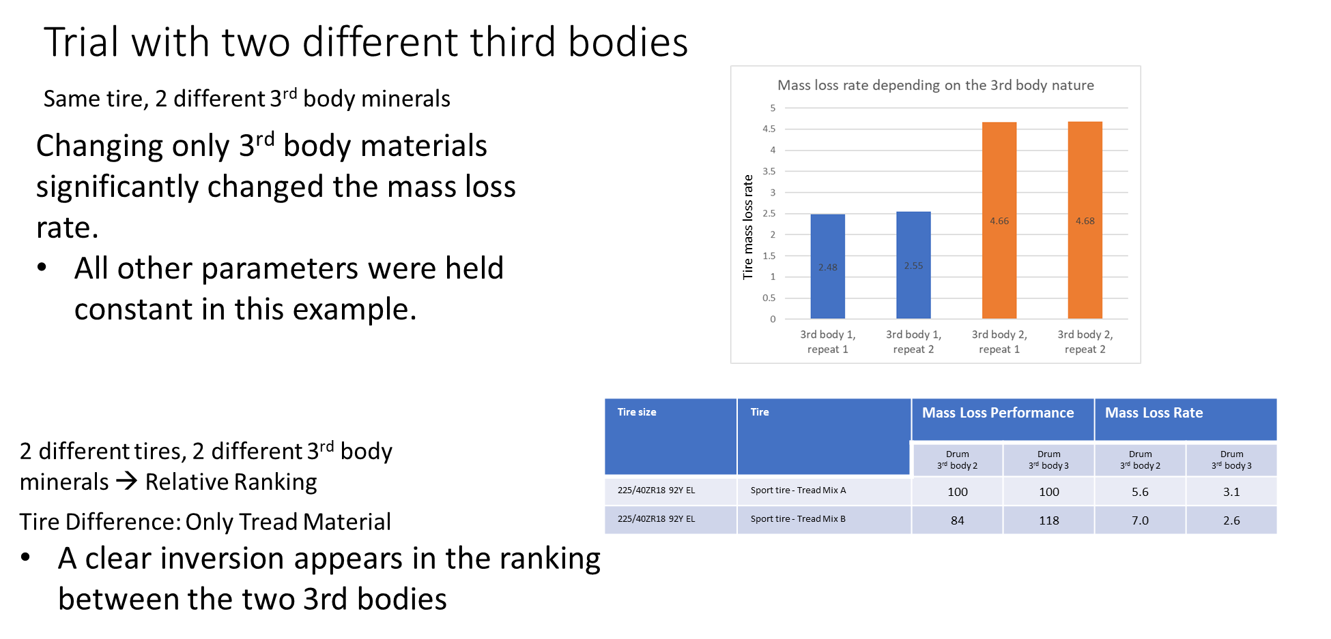
ETRTO position about ISO 18511-2 drum method 3rd body nature
#3

Slide 14
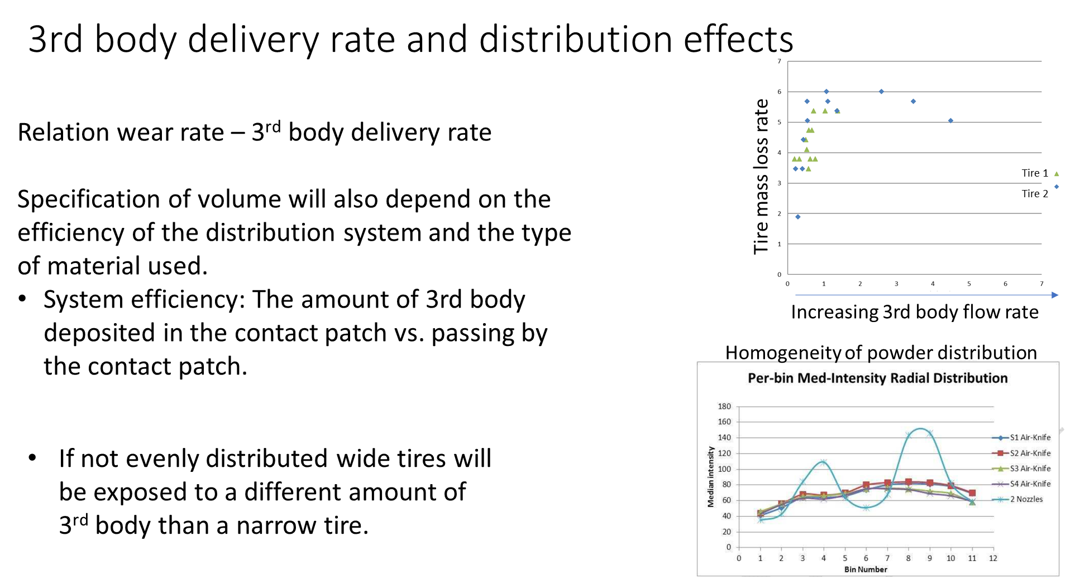
ETRTO position about ISO 18511-2 drum method 3rd body distribution
#3

Slide 15
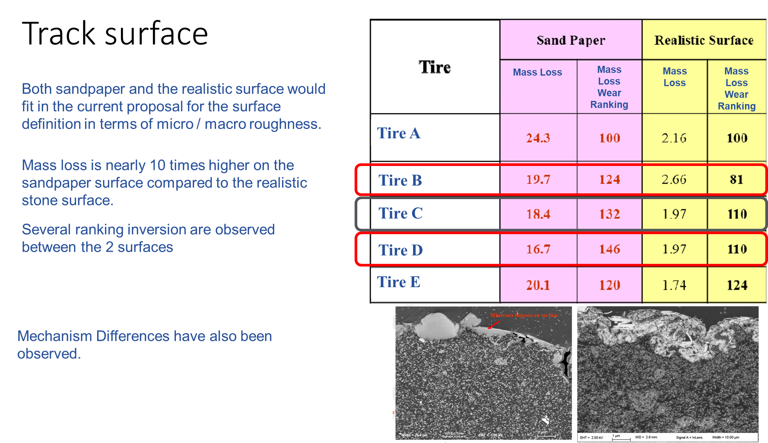
ETRTO position about ISO 18511-2 drum method track surface
#4

Slide 16
ETRTO position about ISO 18511-2 drum method pressure & load
ISO Drum Cycle (Fz, P) Value
In the ISO Cycle:
- Fz value is 80% of LI instead of 67% of the vehicle method
- P Value is the reduced value instead of the nominal value (2.1b vs 2.5b for SL, 2.5 vs 2.9 for XL)
Discussion
  The difference has been previously criticised.
  Actually, examining experimental measurements of the footprint length on drum, it appears that the increase of Fz is necessary to have on DRUM the same footprint length that we have on flat
  Less reasonable appears to be the difference in pressure, since it can change the shape of the footprint itself
  In our opinion it would be reasonable to maintain the higher value of Fz equal to 80% of LI, but converting the pressure to vehicle prescribed pressure

Slide 17
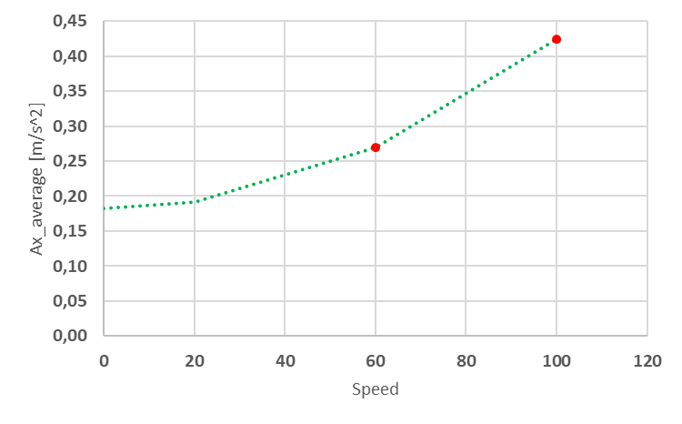
ETRTO position about ISO 18511-2 drum method Y acceleration (1/2)
ISO DRUM -Cycle Analysis: Fx & Fy
ISO Ax_average = 0.34 m/s^2 → It is a sensible value, it correctly considers the force need to overcome the aerodynamics and rolling resistance
The Ax Average is also consistent at different speeds
 | Total Per Cycle |  |  | Cycles Needed
 | Time [s] | Space [Km] |  | Space [Km] | Ncycles | Time [h]
Total | 12490 | 252 |  | 5000 | 20 | 69
100 Phase | 3965 | 110
60 Phase | 8525 | 142
 | AVERAGE
 | Ax [m/s2] | Ay [m/s2] |  | Ax_GPS | Ay_GPS
Total | 0,34 | 0,07 |  | 0,00 | 0,00
100 Phase | 0,42 | 0,07 |  | 0,01 | 0,00
60 Phase | 0,27 | 0,07 |  | 0,00 | 0,00
 | RMS
 | Ax [m/s2] | Ay [m/s2] |  | Ax_GPS | Ay_GPS
Total | 0,65 | 1,06 |  | 0,54 | 1,06
100 Phase | 0,76 | 0,51 |  | 0,62 | 0,50
60 Phase | 0,55 | 1,34 |  | 0,48 | 1,34
ISO Ay_average = 0.07 m/s^2 → The value is too low, it does not take into account the vehicle alignment effect

Slide 18
ETRTO position about ISO 18511-2 drum method Y acceleration (2/2)
2) Conclusions & Proposal
Longitudinal direction Ax
  No issues. It takes into account the necessity of the tractive tyre to win the resistance against the motion (aerodynamics, rolling resistance etc.).
  It is correctly positive and increases quadratically with speed and it has a sensible value.
  Example: ISO DRUM Cycle: LI 94 5256 N -> Fx_average = Fz * 0.034382 g = 181 N
Lateral direction Ay
  The value is very low (about 40 N for LI 94)
  Example: ISO DRUM Cycle: LI 94 Fz=5256 N-> Fy_average = Fz * 0.00756 g = 40 N
Vehicle Reality: Ky = 0.5 * Fz = 2628 N/deg - Toe_ave = 0.05 deg – Fy = Ky * Toe_ave = 131 N
In our opinion, in the ISO DRUM Cycle it is neglected the continuous lateral force applied to single tyres due to vehicle alignment.
A possible solutions could be
  considering an average normalized cornering stiffness ky=0.4 1/deg
  considering an average cornering stiffness increasing with LI, and equal to Ky = 0.4*Fz [N/deg]
  cosidenring an average toe_angle equal to 0.1 deg
  Then add to the ISO DRUM Cycle a constant lateral force opposite to PS and equal to Fy_add= Ky * Toe_ave [N]
  Example, a LI 94 could have an additional lateral force of Fy = 0.4 * 5256 * 0.1 = 210 N, opposite to PS
  Higher LI will have proportionally higher added lateral force
  Alternatively, Ky and PS could be measured with a narrow range short cycle before the test

Slide 19
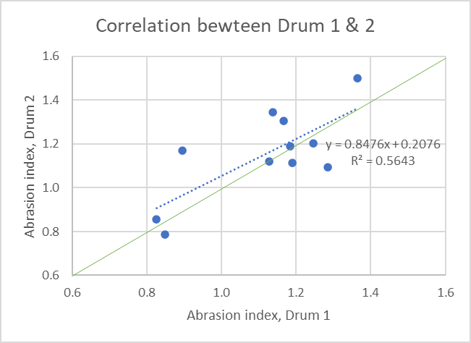
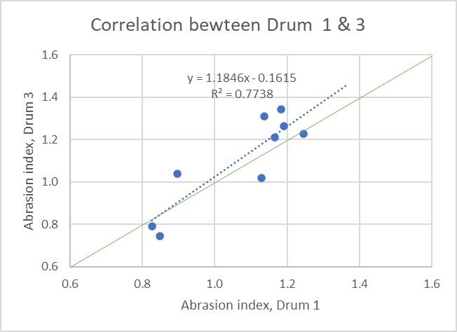
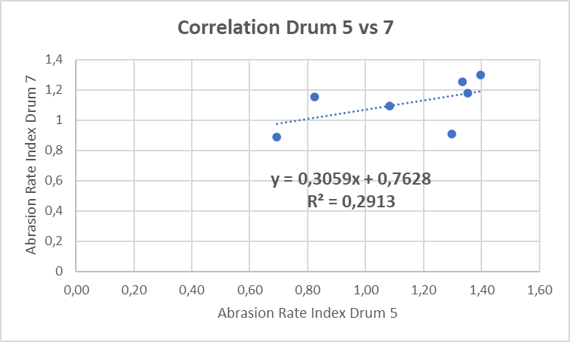
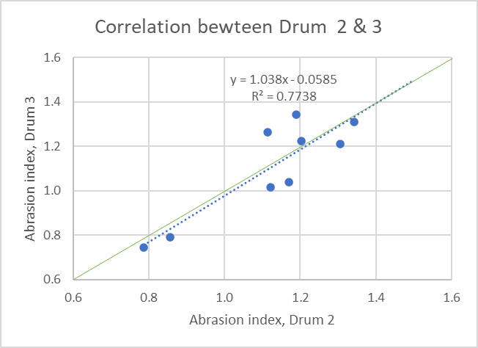
ETRTO position about ISO 18511-2 drum method drums correlation
Correlation between drums varies depending on the case
Drum 1 to 4 : JASIC
Drum 5 to 7 : ETRTO
R²
 | Drum 2 | Drum 3 | Drum 5
Drum 1 | 0.564 | 0.774
Drum 2 |  | 0.774
Drum 7 |  |  | 0.291
          NOTE: data are too limited (only 1 repeat on each Drum → no indication on the reproducibility on a single drum) to assess the correlation among drums.
          This does not prevent to use these data for technical discussions, but possible findings have to be confirmed

Slide 20
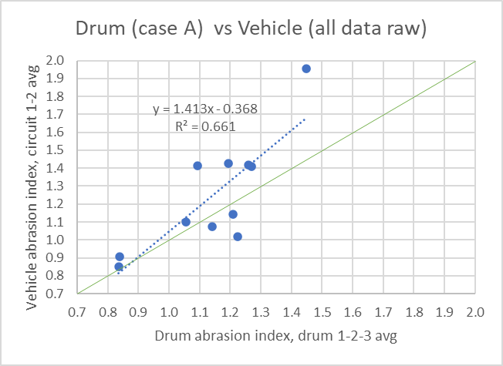
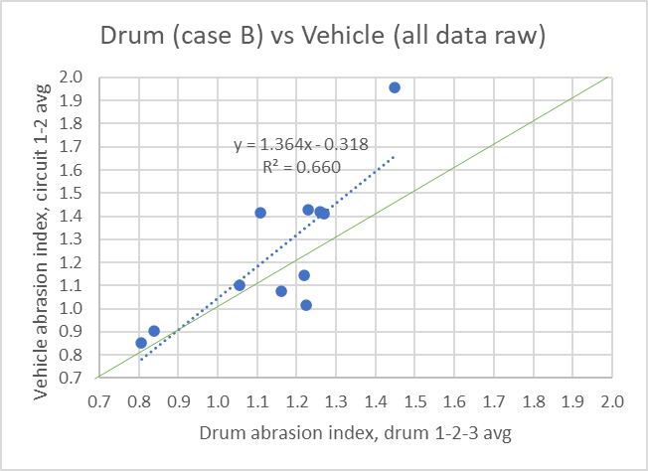
ETRTO position about ISO 18511-2 method drum/vehicle correlation
Correlation between vehicle method and drum method
Test Temp: all
Drum Surface: all
Test Temp: Std ∼25 °C
Drum Surface: Sand Paper 80
Case A – 39 data
Case B – 32 data
R² is at 0.66
Note: Correlation improved when reducing the variability of vehicle method (Removing P308 and Fiat 500 vehicle data)

