Slide 1
Informal document No. GRPE-93-31r2e
93rd GRPE, 15 –17 October 2025
Agenda item 3(a)
Summary
of UNR154 (WLTP)
GRPE/2025/15
GRPE-93-29e & 30e
prepared by
the European Commission, United Kingdom, Japan and
the International Organization of Motor Vehicle Manufacturer

Slide 2
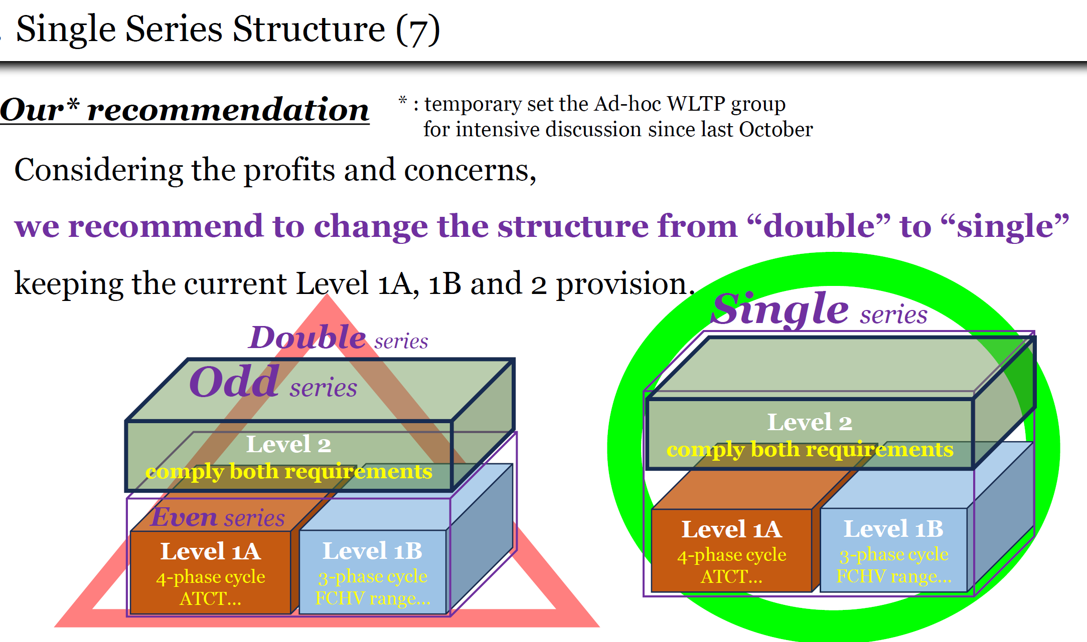
1. Progress after 92nd GRPE
GRPE-92-06e
During 92nd GREP session,
GRPE has accepted the single series structure (covers all Levels) and
expects to receive the Working Document for new series of amendment to align with the regional requirement.
Since then, all ad-hoc WLTP member have been working on finalising the document to submit it by due date.
Then it was close to the END….
HOWEVER…

Slide 3



2. Remarkable Change after 92nd GRPE
During the intensive discussion on GTR#22 (Battery Deterioration Requirement) transposition into UNR within EC, UK, JPN and OICA, it has made a decision
to split GTR#22 element into
UNR154 (homologation) and UNR83 (in-service conformity)
GTR#22
Homologation & COP
In-service conformity
UNR83
Annex 5
UNR154
mainly Annex C1
This decision creates a massive chaos on drafting work,
but we were able to submit the Working Document
with huge effort by drafting coordinator and OICA

Slide 4
3. Working Documents (GRPE/2025/15) for 04 series of amendment
Due to last minutes decision to include GTR#22 elements,
the Working Document (GRPE/2025/15) has a variety of square brackets.
Then, the Informal Documents* which remove all square brackets from WD
were developed and
Request GRPE
to review and approve the GRPE-93-29e & 30e
* GRPE-93-29e : excluding the Small Volume Manufacture provision
GRPE-93-30e : including the Small Volume Manufacture provision

Slide 5
4. Informal Documents (GRPE-93-29e/30e) _1
The main topics outlined in the list GRPE-92-08 and 09 are as follows:
All of these proposals are agreed upon by the Ad-hoc WLTP group.
・New PN10 provision and New SHED Limit are updated to Level 1A to reflect Euro7.
Level 1B remains unchanged, Durability provisions as well.
・PEV range test at low temperature introducing a new annex to Annex B10,
Level 1A aligns with Euro 7 and Level 1B is a new proposal to align from a harmonization perspective.
The test method is based on GTR 15 amendment 6 and represents an improved proposal.
・For OBFCM, Level 1A aligns with Euro 7, while Level 1B aligns with Japanese provisions.
Regulatory developments have led to the requirement to enlarge the scope of OBFCM
to cover majorities of powertrain.
・Individual proposals from Korea, Sweden, Japan and OICA listed in GRPE-92-09 are also
incorporated and items that had been deferred from being submitted to WP29 are as well.

Slide 6
4. Informal Documents (GRPE-93-29e/30e) _2
Additionally,
・ the Declaration at the time of certification under the specific requirement:
For Level 1A, alignment with Euro7.
For Level 1B and Level 2, the situation remains essentially unchanged.
・As part of incorporating GTR22 requirements,
UNR154 contains Homologation & COP requirements,
while UNR83-09 contains ISC requirements including alignment with UNR-OBM requirements.
・Considering the Small Volume Manufacture provision,
EU and UK prefers to align the SVM provisions with Euro 7 in the relevant UNRs
According to Japan this provision should not be handled as a part of just single UNR/GR## issue,
then it is expected to escalate to GRPE/WP.29 level for further discussion.
As related reference items,
・On-Board Monitoring / Environmental Vehicle Passport -> New UNR-OBM
・Manipulation devices/strategy and Anti-tampering/CS -> UNR83-09

Slide 7
5. Next Actions
04 Series of Amendment
Based on the WP.29 decision in November session for small volume manufacture provision, select one of the Informal Documents (either 29e or 30e) and submit to March 2026 WP.29 session for their approval
(2) New supplement
In parallel, develop the Working Document for new supplement considering the
defeat device requirement in Level 2 (conflict to manipulation device)
transitional provision in Level 1B (OBFCM smooth implementation)
editorial correction, if any

