Slide 1
IWG-EMC-50-02
Proposal by CLEPA:
Clarification of ESA charging conditions
(IWG-EMC-46-11/12 and IWG-EMC-49-07 Flowchart proposal Follow-up)

Slide 2
Background & Rationale
IWG-EMC-50-02
A flowchart was added in R10.07 to clarify the charging mode configuration for vehicles.
However, such clarification is still not yet available for ESAs.
Test Description | Vehicle |  | ESA
Broadband radiated emission | Annex 4 | Defined in a clear flowchart | Annex 7 | Not clearly defined
Radiated immunity | Annex 6 | Defined in a clear flowchart | Annex 9 | Not clearly defined
Emission of harmonics generated on AC power lines | Annex 11 | Defined in a clear flowchart | Annex 17 | Not clearly defined
Emission of voltage changes, fluctuations and flicker on AC power lines | Annex 12 | Defined in a clear flowchart | Annex 18 | Not clearly defined
Emission of radiofrequency conducted disturbances on AC or DC power lines | Annex 13 | Defined in a clear flowchart | Annex 19 | Not clearly defined
Immunity of Electrical Fast Transient/Burst disturbances conducted along AC and DC power lines | Annex 15 | Defined in a clear flowchart | Annex 21 | Not clearly defined
Immunity of surges conducted along AC and DC power lines | Annex 16 | Defined in a clear flowchart | Annex 22 | Not clearly defined
NOTE: The scope of this table is limited to test conditions relevant to REESS charging mode only.
A proposal was submitted to introduce an ESA flowchart in UN R10.08. (IWG-EMC-46-11/12 and IWG-EMC-49-07)
The initial draft was a simplified AC/DC-based structure.
Based on feedback received, the approach was reviewed and updated to a MODE-based structure to align with the vehicle flowchart.
This ensures a clearer one-to-one alignment with the vehicle flowchart logic and avoids deviation caused by an AC/DC-only structure.

Slide 3
ESA Flowchart Comparison
IWG-EMC-50-02
AC/DC-based (Initial Draft)
MODE-based (Proposed Revision)
Annex 7: test modes to be selected for REESS coupled to the power grid.
Annex 7: test mode to be selected for REESS coupled to the power grid.
AC charging mode available?
AC charging from standard socket-outlet?
Test at one reference charge current; it’s the supply path’s maximum rated input current.
Mode 1 available?
Mode 2
or 3 available?
Y
Y
Y
N
Test Mode1
N
Y
N
N
Mode 2 available?
Test at one configuration (single or 3-phase) to be selected based on the maximum total nominal charge current
Y
Test Mode2
AC charging from dedicated EVSE?
Y
N
Mode 3 available?
Test Mode3 in one configuration (single or 3-phase) to be selected based on the maximum total nominal charge current
N
Y
N
DC charging mode available?
Y
Test the ESA in DC charging mode
Mode 4 available?
Y
Test Mode4
N
N
End of test REESS coupled to the power grid.
End of test REESS coupled to the power grid.

Slide 4
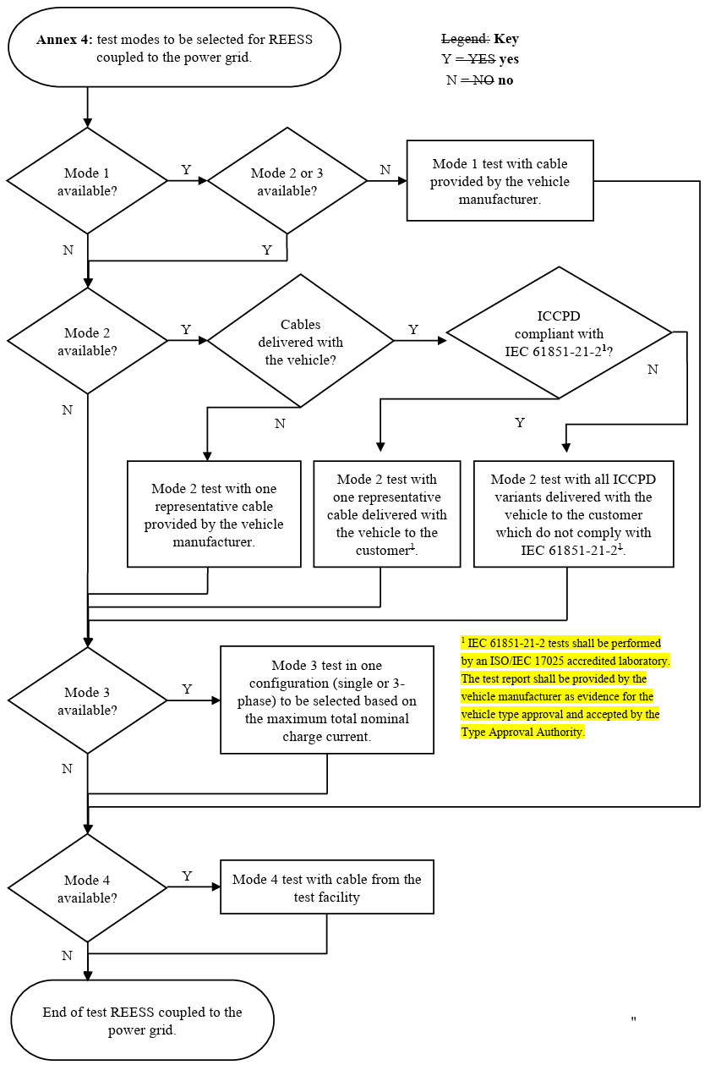
Proposal: Annex 7 Radiated Emission
IWG-EMC-50-02
Original flowchart (Vehicle)
Proposed flowchart (ESA)
Annex 7: test mode to be selected for REESS coupled to the power grid.
Mode 1 available?
Mode 2
or 3 available?
Y
N
Test Mode1
N
Y
Mode 2 available?
Y
Test Mode2
Mode 3 test in one configuration (single or 3-phase) to be selected based on the maximum total nominal charge current
N
Mode 3 available?
Test Mode3 in one configuration (single or 3-phase) to be selected based on the maximum total nominal charge current
Y
N
Mode 4 test with cable from the test facility
Mode 4 available?
Y
Test Mode4
N
Source : ECE/TRANS/WP.29/2025/110 - (GRE) - Proposal for Supplement 1 to the 07 series of amendments to UN Regulation No. 10 (Electromagnetic Compatibility)
End of test REESS coupled to the power grid.

Slide 5
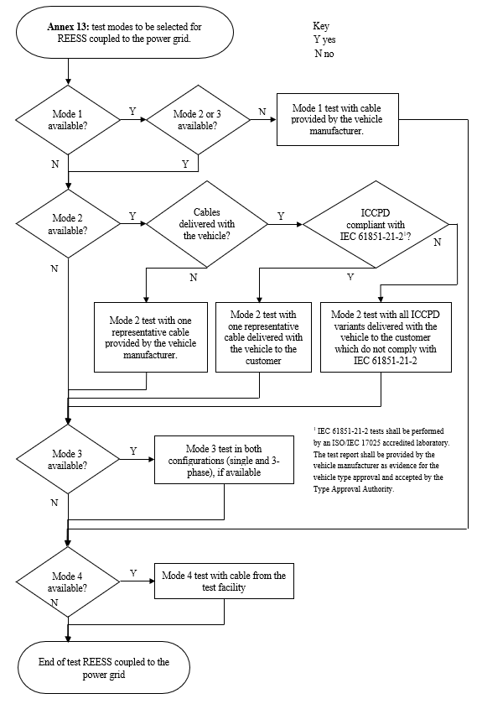
Proposal: Annex 19 Conducted Emission
IWG-EMC-50-02
Original flowchart (Vehicle)
Proposed flowchart (ESA)
Annex 19: test mode to be selected for REESS coupled to the power grid.
Mode 1 available?
Mode 2
or 3 available?
Y
N
Test Mode1
N
Y
Mode 2 available?
Y
Test Mode2
Mode 3 test in both configurations (single and 3-phase), if available
N
Mode 3 available?
Y
Test Mode3 in both configuration (single and 3-phase)
Mode 4 test with cable from the test facility
N
Mode 4 available?
Y
Test Mode4
N
Source : ECE/TRANS/WP.29/2025/110 - (GRE) - Proposal for Supplement 1 to the 07 series of amendments to UN Regulation No. 10 (Electromagnetic Compatibility)
End of test REESS coupled to the power grid.

Slide 6
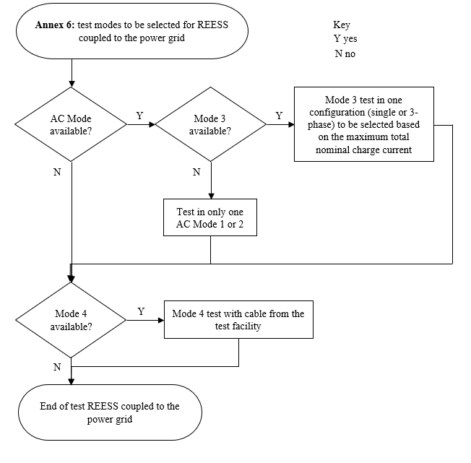
Proposal: Annex 9 Radiated Immunity
IWG-EMC-50-02
Original flowchart (Vehicle)
Proposed flowchart (ESA)
Annex 9: test mode to be selected for REESS coupled to the power grid.
AC Mode available?
Mode 3 available?
Test Mode3 in one configuration (single or 3-phase) to be selected based on the maximum total nominal charge current
Y
Y
Mode 3 test in one configuration (single or 3-phase) to be selected based on maximum total nominal charge current
N
N
Test in only one AC Mode 1 or 2
Mode 4 test with cable from the test facility
Mode 4 available?
Y
Test Mode4
N
End of test REESS coupled to the power grid.
Source : ECE/TRANS/WP.29/2025/110 - (GRE) - Proposal for Supplement 1 to the 07 series of amendments to UN Regulation No. 10 (Electromagnetic Compatibility)

Slide 7
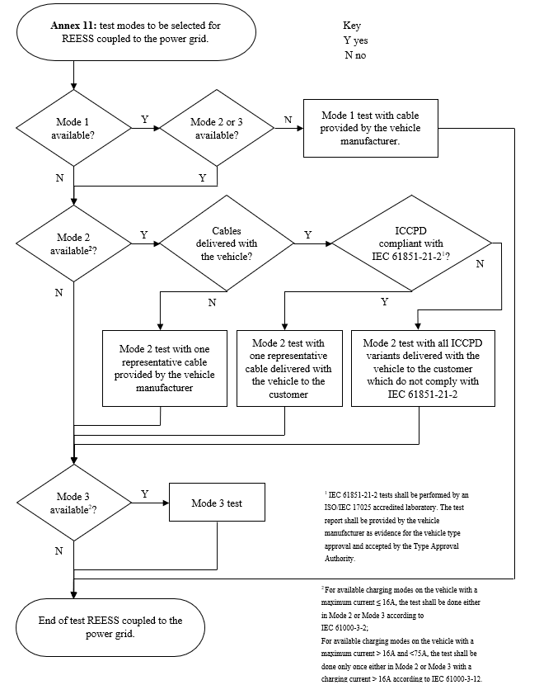
Proposal: Annex 17 Harmonics
IWG-EMC-50-02
Original flowchart (Vehicle)
Proposed flowchart (ESA)
Annex 17: test mode to be selected for REESS coupled to the power grid.
Mode 1 available?
Mode 2
or 3 available?
Y
N
Test Mode1
N
Y
² For available charging modes on the vehicle with a maximum current ≤ 16A, the test shall be done either in Mode 2 or Mode 3 according to IEC 61000-3-2;
For available charging modes on the vehicle with a maximum current > 16A and <75A, the test shall be done only once either in Mode 2 or Mode 3 with a charging current > 16A according to IEC 61000-3-12.
Mode 2 available¹
¹ For available charging modes on ESAs with a maximum current ≤ 16A, the test shall be done either in Mode 2 or Mode 3 according to IEC 61000-3-2;
For available charging modes on ESAs with a maximum current > 16A and <75A, the test shall be done only once either in Mode 2 or Mode 3 with a charging current > 16A according to IEC 61000-3-12.
Y
Test Mode2
N
Mode 3 available¹
Y
Test Mode3
N
End of test REESS coupled to the power grid.
Source : ECE/TRANS/WP.29/2025/110 - (GRE) - Proposal for Supplement 1 to the 07 series of amendments to UN Regulation No. 10 (Electromagnetic Compatibility)

Slide 8
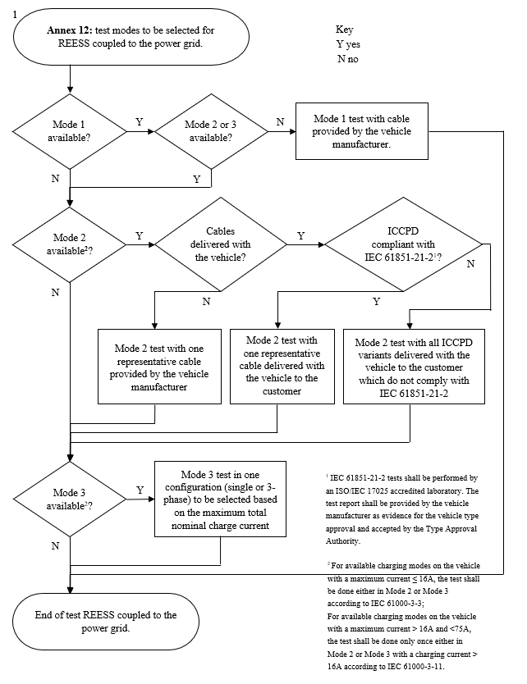
Proposal: Annex 18 Flicker
IWG-EMC-50-02
Original flowchart (Vehicle)
Proposed flowchart (ESA)
Mode 3 test in one configuration (single or 3-phase) to be selected based on maximum total nominal charge current
Annex 18: test mode to be selected for REESS coupled to the power grid.
Mode 1 available?
Mode 2
or 3 available?
Y
N
Test Mode1
N
Y
² For available charging modes on the vehicle with a maximum current ≤ 16A, the test shall be done either in Mode 2 or Mode 3 according to IEC 61000-3-3;
For available charging modes on the vehicle with a maximum current > 16A and <75A, the test shall be done only once either in Mode 2 or Mode 3 with a charging current > 16A according to IEC 61000-3-11.
Mode 2 available¹
¹ For available charging modes on ESAs with a maximum current ≤ 16A, the test shall be done either in Mode 2 or Mode 3 according to IEC 61000-3-3;
For available charging modes on ESAs with a maximum current > 16A and <75A, the test shall be done only once either in Mode 2 or Mode 3 with a charging current > 16A according to IEC 61000-3-11.
Y
Test Mode2
N
Mode 3 available¹
Test Mode3 in one configuration (single or 3-phase) to be selected based on the maximum total nominal charge current
Y
N
End of test REESS coupled to the power grid.
Source : ECE/TRANS/WP.29/2025/110 - (GRE) - Proposal for Supplement 1 to the 07 series of amendments to UN Regulation No. 10 (Electromagnetic Compatibility)

Slide 9
Additional explanation – Harmonics & Flicker (1/3)
IWG-EMC-50-02
Key points from the 2025 Interpretation
- Reference standards
IEC 61000-3-2:2018/AMD2:2024/ISH1:2025 (Interpretation Sheet + Amendment)
IEC 61000-3-3:2013/AMD2:2021/ISH1:2025 (Interpretation Sheet + Amendment)
Background:
Some equipment indicates several different current values (e.g. “rated current” for different operating modes), which has led to inconsistent classification and occasional misapplication of IEC 61000-3-2(or 3)
Key principle:
If the equipment’s maximum continuous input current exceeds 16A, then the equipment should be tested under IEC 61000-3-12(or 11), and IEC 61000-3-2(or 3) should NOT be applied.

Slide 10
Additional explanation – Harmonics & Flicker (2/3)
IWG-EMC-50-02
Supporting material (Vehicle footnote applied)
Annex 17: test modes to be selected for REESS coupled to the power grid.
AC charging available?
Y
Y
Single & 3-phase
AC supply
supported?
I_{max} in single- & 3-phase ≤ 16A
N
16A < I_{max} in single-phase ≤ 75A
& I_{max} in 3-phase ≤ 16A
N
16A < I_{max} in single & 3-phase ≤ 75A
Vehicle footnote 2
² For available charging modes on the vehicle with a maximum current ≤ 16A, the test shall be done either in Mode 2 or Mode 3 according to IEC 61000-3-2;
For available charging modes on the vehicle with a maximum current > 16A and <75A, the test shall be done only once either in Mode 2 or Mode 3 with a charging current > 16A according to IEC 61000-3-12.
Y
Y
Y
N
Test according to IEC 61000-3-2
in single or 3-phase at I_{max}
Test according to IEC 61000-3-12
in single-phase at I_{max}
Test according to IEC 61000-3-12 in the configuration (single or 3-phas) with the higher I_{max}
Single- phase
AC supply only
supported?
Y
16A < I_{max} in single-phase ≤ 75A
Y
Test according to IEC 61000-3-12
in single-phase at I_{max}
N
N
Test according to IEC 61000-3-2
in single at I_{max}
3- phase
AC supply only
supported?
Y
Y
Test according to IEC 61000-3-12
in 3-phase at I_{max}
16A < I_{max} in 3-phase ≤ 75A
N
N
Test according to IEC 61000-3-2
in 3-phase at I_{max}
End of test REESS coupled to the power grid.
NOTE: I_{max} = maximum rated charging/input current

Slide 11
Additional explanation – Harmonics & Flicker (3/3)
IWG-EMC-50-02
Supporting material (Remy’s comment considered)
This flowchart was drafted based on Remy’s (UTAC) comments and internal consideration; therefore, it may not fully reflect Remy’s exact intent.
However, it aims to capture the key principle raised by Remy:
one test to IEC 61000-3-2 and one test to IEC 61000-3-12 (one each)
Annex 17: test modes to be selected for Coupled to the power grid.
AC charging available?
Y
Single & 3-phase
AC supply
supported?
Y
I_{max} in single- & 3-phase ≤ 16A
N
16A < I_{max} in single-phase ≤ 75A
& I_{max} in 3-phase ≤ 16A
N
16A < I_{max} in single & 3-phase ≤ 75A
N
Y
Y
Y
Test according to IEC 61000-3-2
in single and 3-phase at I_{max}
Test according to IEC 61000-3-2 in 3-phase
and IEC 61000-3-12 in single-phase at I_{max}
Test according to IEC 61000-3-2 in 3-phase at 16A if available
and IEC 61000-3-12 in single-phase at I_{max}
Single- phase
AC supply only
supported?
Test according to IEC 61000-3-2 in single-phase
at 16A if available
and IEC 61000-3-12 in single-phase at I_{max}
Y
16A < I_{max} in single-phase ≤ 75A
Y
N
※ At 16A if available
= If the current consumption can be adjusted
N
Test according to IEC 61000-3-2
in single at I_{max}
3- phase
AC supply only
supported?
Y
Y
Test according to IEC 61000-3-2 in 3-phase
at 16A if available
and IEC 61000-3-12 in 3-phase at I_{max}
16A < I_{max} in 3-phase ≤ 75A
N
N
Test according to IEC 61000-3-2
in 3-phase at I_{max}
End of test REESS coupled to the power grid.
NOTE: I_{max} = maximum rated charging/input current

Slide 12
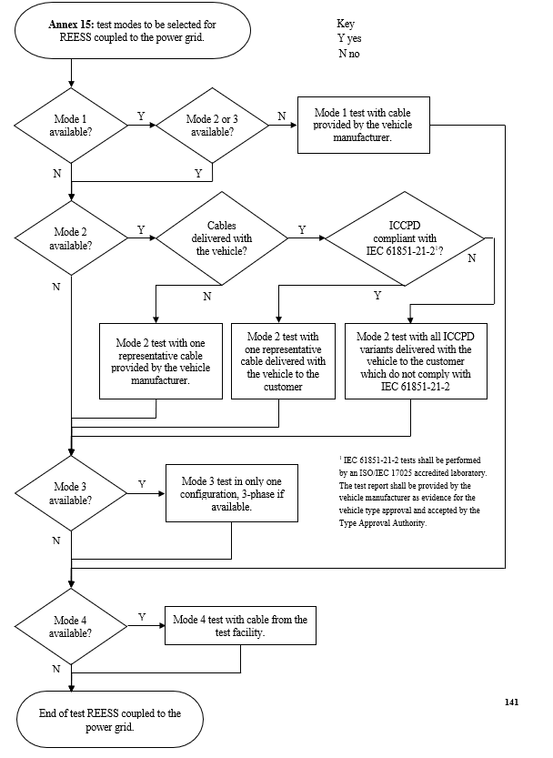
Proposal: Annex 21 Burst
IWG-EMC-50-02
Original flowchart (Vehicle)
Proposed flowchart (ESA)
Annex 21: test mode to be selected for REESS coupled to the power grid.
Mode 1 available?
Mode 2
or 3 available?
Y
N
Test Mode1
N
Y
Mode 2 available?
Y
Test Mode2
Mode 3 test in only one configuration, 3-phase if available.
N
Mode 3 available?
Test Mode3 in only one configuration, 3-phase if available.
Y
N
Mode 4 test with cable from the test facility
Mode 4 available?
Y
Test Mode4
N
Source : ECE/TRANS/WP.29/2025/110 - (GRE) - Proposal for Supplement 1 to the 07 series of amendments to UN Regulation No. 10 (Electromagnetic Compatibility)
End of test REESS coupled to the power grid.

Slide 13
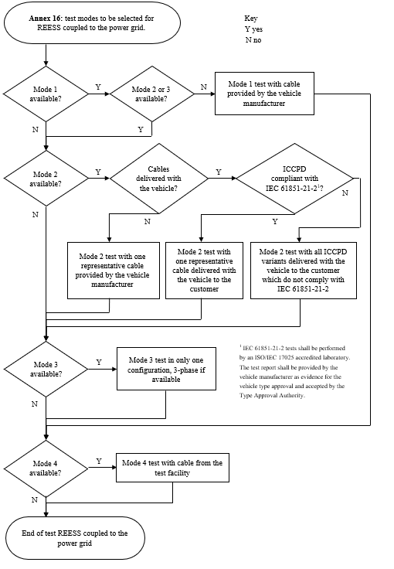
Proposal: Annex 22 Surge
IWG-EMC-50-02
Original flowchart (Vehicle)
Proposed flowchart (ESA)
Annex 22: test mode to be selected for REESS coupled to the power grid.
Mode 1 available?
Mode 2
or 3 available?
Y
N
Test Mode1
N
Y
Mode 2 available?
Y
Test Mode2
Mode 3 test in only one configuration, 3-phase if available.
N
Mode 3 available?
Test Mode3 in only one configuration, 3-phase if available.
Y
N
Mode 4 test with cable from the test facility
Mode 4 available?
Y
Test Mode4
N
Source : ECE/TRANS/WP.29/2025/110 - (GRE) - Proposal for Supplement 1 to the 07 series of amendments to UN Regulation No. 10 (Electromagnetic Compatibility)
End of test REESS coupled to the power grid.

Slide 14
Summary and Outlook
IWG-EMC-50-02
MODE-based flowcharts are proposed to ESA charging-mode configuration.
This approach is applied to mirror the vehicle flowchart framework in UN R10.07, rather than re-structuring the logic into a AC/DC split.
For all relevant test items, the ESA flowcharts mirror the vehicle flowcharts as-is, while keeping the scope strictly ESA-only.
For Harmonics and Flicker, additional reference material is provided to further explain and demonstrate that the ESA flowcharts follow the vehicle flowcharts as-is, including how the applicable standards are determined by current rating and phase configuration.
Additional test conditions — such as charging currents above 75 A or new charging technologies — will be reviewed and incorporated once the corresponding standards are established.
Overall, the proposal aims to provide a clear, consistent, and harmonized configuration for ESA charging-mode testing, fully aligned with the UN R10.07 vehicle framework.
The author and the speaker of this presentation confirm that they have authorization to use all content including photos and visual elements.
The material is either copyright-free or the author/speaker hold the necessary copyright or permission.
The UNECE will remove any material from its events and supporting websites if there is unlawful use of copyrighted material.
The author/speaker takes responsibility for any infringement on copyright and holds the UNECE harmless to this effect.

