Slide 1
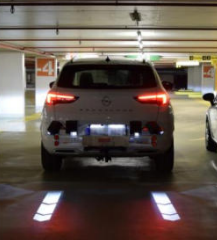
Informal document GRE-92-04
(92nd GRE, 22-25 April 2025, agenda item 7 (a))
Reversing projection
Statistical data supporting GRE/2024/20 Rev.1
92nd GRE session
22-25 April 2025

Slide 2
Statistical data supporting GRE/2024/20 Rev.1
Overview
Nr. | Region | Title | Researcher / Submitter
1 | Germany | Emergency braking systems for reversing (Notbremssystem für Rückwärtsfahrt) | ADAC (FIA)
2 | United Kingdom | Casualties in Greater London during 2023 | Transport for London
3 | France | Collisions between pedestrians and reversing vehicles in public settings in France | HAL open science
4 | United Kingdom | Analysis of police collision files for pedestrian fatalities in London, 2006-10 | Transport Research Laboratory TRL
5 | Japan | Accidents when four-wheel vehicles are reversing | Itarda
6 | South Korea | Traffic accidents statistics and traffic accidents during reversing in Korea | TMACS
7 | European Commission | Road Traffic Fatalities Europe 2022 | EC Mobility and Transport (EU Care Database)
8 | United Kingdom | Reported road casualties in Great Britain: pedestrian factsheet, 2023 | Dpt. of Transport
9 | Europe and North America | 2023 Statistics of Road Traffic Accidents | UNECE
2

Slide 3
Statistical data supporting GRE/2024/20 Rev.1
Key figures and GTB conclusion
REVERSING ACCIDENTS INVOLVING PEDESTRIANS ARE very significant WORLDWIDE
  France (p. 8): reversing accounts for 7% of pedestrian accidents in public setting and 39% of manoeuvres were made for entering or leaving a parking space Germany (p. 5): 17% of all pedestrian and vehicle collisions are taking place at the rear end
  Japan (p. 10): 77% of the fatalities / serious injuries while reversing were accounted by vulnerable road users, and pedestrians accounted for 57% of the VRU
  Korea (p. 11): even though the overall number of accidents has decreased in recent years (-15%), the number of accidents during reversing is still rising (+30%)
THE NUMBER OF VRUs HAVE INCREASED, particularly pedestrians and cyclists
  Europe (p. 14 ) in urban areas, more than 68% of all registered fatalities affected VRUs, of which 49% are pedestrians
  UK (p. 15): the pedestrian traffic (distance walked) has increased by 19% between 2004 and 2023
  Europe (p. 16): the COVID-19 pandemic may have led to an increase in the number of VRUs, particularly cyclists
DISTRACTED PEDESTRIANS
  UK (p. 9): 48% of the pedestrians were recorded as “failed to look properly” and this factor was observed for all age groups
  In Korea, Germany and Netherlands the governments have installed in-ground traffic lights for smartphone zombies (link)
more substantial reduction in fatalities among car users compared to VRUs is a general trend in Europe
  Europe (p. 16): UK -25% vs. -15%
  Spain -55% vs. -10%
  Japan (p. 10): looking at the accidents of four-wheel vehicles while reversing: the number is gradually decreasing, certainly related to the introduction of
  the back monitor BUT the composition rate considering all casualty accidents is increasing of 1%, reaching 5%
GTB conclusion: statistical data from different regions of the world clearly indicate that more efforts shall be made to reduce accidents involving VRUs, in particular pedestrians that are more and more distracted by smartphones while walking. The increasing number of electric vehicles represents an additional risk factor in the future due to the lack of engine noise in slow maneuvering such as reversing.
→ Reversing projections represent a valid solution to improve the safety of VRUs
3

Slide 4
Statistical data supporting GRE/2024/20 Rev.1
Annex
4

Slide 5
Statistical data supporting GRE/2024/20 Rev.1
Germany - Emergency braking systems for reversing
Nr. | Region | Title | Researcher / Submitter
1 | Germany | Emergency braking systems for reversing (Notbremssystem für Rückwärtsfahrt) Link: https://www.adac.de/rund-ums-fahrzeug/ausstattung-technik-zubehoer/assistenzsysteme/parkassistent-bremsfunktion/ Link: ÖAMTC: Fünf Parkassistenten mit Notbremssystem im Test | ÖAMTC Link: Fünf Parkassistenten mit Notbremssystem im Test | ÖAMTC | ADAC (FIA)
Vehicles need more safety features for reverse movement, an automatic brake assistant is the most promising feature.
17% of all pedestrian and vehicle collisions are taking place at the rear end.
This is an extra risk for elder pedestrians as secondary injuries become more relevant.
One of the major reasons is the restricted sight from inside the vehicle.
Euro NCAP included braking assistants as a safety benefit since 2020.
5

Slide 6
Statistical data supporting GRE/2024/20 Rev.1
UK - Casualties in Greater London during 2023
Nr. | Region | Title | Researcher / Submitter
2 | United Kingdom | Casualties in Greater London during 2023 Link: https://content.tfl.gov.uk/casualties-in-greater-london-2023.pdf | Transport for London
Car occupant fatalities dominate in 2023 for the rest of Great Britain (47%), whereas in London pedestrians represent the largest percentage of fatalities (52%)
Accidents During Reversing: a significant number of accidents involving casualties occur during reversing maneuvers. These accidents often involve vulnerable road users like pedestrians and cyclists who may not be easily visible to drivers.
Accidents During City Turns: Turning maneuvers in city environments are another common scenario for accidents, especially involving pedestrians and cyclists.
6

Slide 7
Casualties in London during reversing and city turns
Source : Transport of London
Total 26176
Total 27207
Pedestrians: The number of casualties remained constant at 4,555 each year (17,41%).
Cyclists: There was a decrease in casualties from 5,091 in 2022 to 4,802 in 2023 (~18,4%).
Motorcyclists: The number of casualties increased from 6,151 in 2022 to 6,406 in 2023 (~24,5%).
7

Slide 8
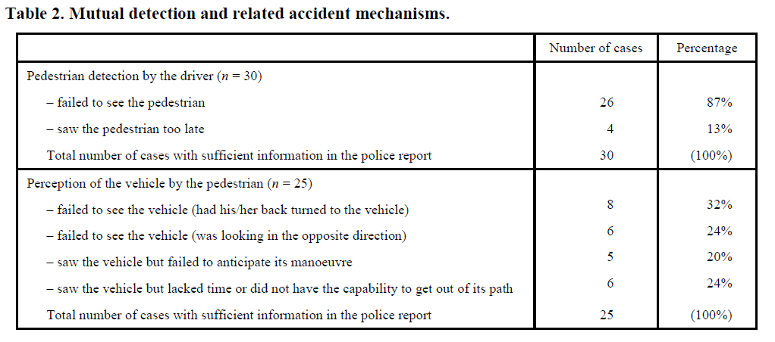
Statistical data supporting GRE/2024/20 Rev.1
France - Collisions between pedestrians and reversing vehicles in public settings
Nr. | Region | Title | Researcher / Submitter
3 | France | Collisions between pedestrians and reversing vehicles in public settings in France Link: https://hal.science/hal-01702228v1 | HAL open science
Reversing accounts for 7% of pedestrian accidents in public setting.
39% of reversing manoeuvres were made for entering or leaving a parking space.
in 20% of the cases the pedestrian failed to anticipate the vehicle’s manoeuver
in 24% of the cases the pedestrian saw the vehicle but did not have the capability to get out of its path
8

Slide 9
Statistical data supporting GRE/2024/20 Rev.1
UK - Analysis of police collision files for pedestrian fatalities in London, 2006-10
Nr. | Region | Title | Researcher / Submitter
4 | United Kingdom | Analysis of police collision files for pedestrian fatalities in London, 2006-10 Link: https://content.tfl.gov.uk/pedestrian-fatalities-in-london.pdf | Transport Research Laboratory TRL
This study analyzed 197 police fatal files where a pedestrian was killed in London in the period 2006-2010.
The sample was selected to be broadly representative in terms of pedestrian age group, the vehicles involved and geography (inner or outer London).
Summary:
64% of the collisions were within 20m of a junction; most commonly at a T, staggered junction or crossroads;
48% of the pedestrians were recorded as “failed to look properly” and this factor was observed for all age groups
9

Slide 10
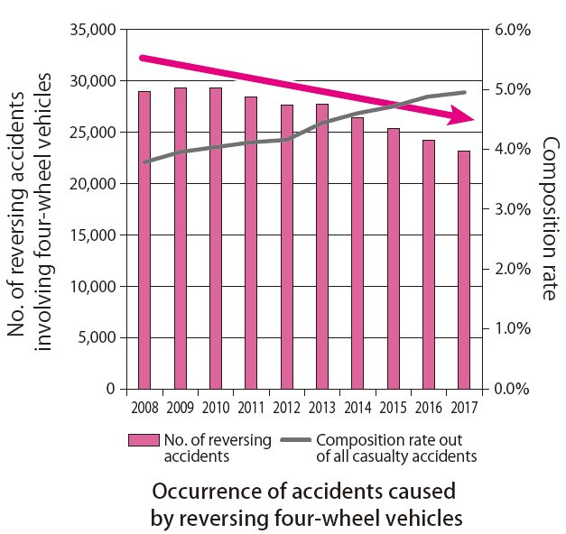
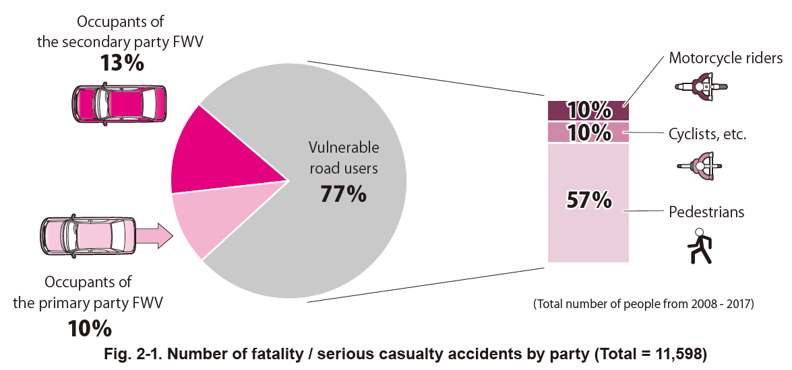
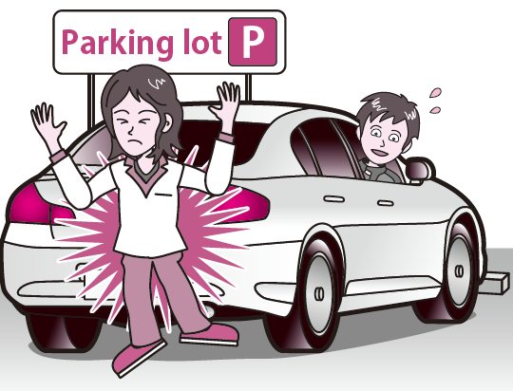
Statistical data supporting GRE/2024/20 Rev.1
Japan - Accidents when four-wheel vehicles are reversing
Nr. | Region | Title | Researcher / Submitter
5 | Japan | Accidents when four-wheel vehicles are reversing Link: https://www.itarda.or.jp/contents/95/info128_e.pdf | Itarda
> In Japan, during the period 2008-2017, looking at the accidents of four-wheel vehicles while reversing:
the number is gradually decreasing, certainly related to the introduction of the back monitor
BUT the composition rate considering all casualty accidents is increasing, reaching 5%
Accidents of four-wheel vehicles while reversing
3/4 of the fatalities / serious injuries were accounted by vulnerable road users,
and pedestrians accounted for 3/4 of the VRU
> Reversing accidents frequently occur at relatively low speeds below 10km/h.
> Pedestrians often get into such accidents while walking within parking lots or in the vicinity around their entrances.
> Bicycles and motorcycles often get into such accidents while traveling along uninterrupted road section or at intersections (including the vicinity around them).
10

Slide 11
Statistical data supporting GRE/2024/20 Rev.1
South Korea - Traffic accidents statistics and traffic accidents during reversing in Korea
Nr. | Region | Title | Researcher / Submitter
6 | South Korea | Traffic accidents statistics and traffic accidents during reversing in Korea Link: https://tmacs.kotsa.or.kr/web/TG/TG200/TG2100S/Tg2102.jsp?mid=S1202# (TMACS - Traffic Safety Information Management Complex System) | TMACS
In Korea, during the period 2019-2023, even though the number of accidents and casualties for all types of accidents have decreased over the years by roughly 15%, the number of traffic accidents during reversing and the involved casualties continuously increased:
+31% number of traffic accidents during reversing
+28% number of persons killed or injured involved in these accidents
11

Slide 12
Traffic Accidents Statistics in Korea
Source : TMACS (Traffic Safety Information Management Complex System in Korea)
Unit : Accidents
Unit : Persons
Total 195,597
Total 302,547
Total 175,581
Total 266,300
Total 169,672
Total 252,315
Total 175,581
Total 245,548
Total 169,359
Total 250,172
Unit : Accidents
Unit : Persons
Number Year | Number of Traffic Accidents with
 | Total | Fatalities | Seriously Injured | Slightly Injured | Other Injured
2023 | 169,359 | 1,889 | 39,191 | 121,677 | 6,602
2022 | 165,754 | 1,943 | 37,863 | 120,257 | 5,691
2021 | 169,672 | 2,130 | 40,679 | 122,144 | 4,719
2020 | 175,581 | 2,246 | 44,277 | 123,378 | 5,680
2019 | 195,597 | 2,516 | 53,755 | 132,430 | 6,896
Average | 175,193 | 2,145 | 43,153 | 123,977 | 5,918
Number Year | Number of Casualties
 | Total | Fatalities | Seriously Injured | Slightly Injured | Other Injured
2023 | 250,172 | 1,962 | 44,506 | 189,649 | 14,055
2022 | 245,548 | 2,011 | 42,654 | 188,457 | 12,426
2021 | 252,315 | 2,220 | 46,256 | 192,969 | 10,870
2020 | 266,300 | 2,334 | 50,650 | 200,117 | 13,199
2019 | 302,547 | 2,620 | 62,303 | 220,561 | 17,063
Average | 263,376 | 2,229 | 49,274 | 198,351 | 13,523
Source : TMACS (Traffic Safety Information Management Complex System, https://tmacs.kotsa.or.kr/web/TG/TG200/TG2100S/Tg2102.jsp?mid=S1202#)
12

Slide 13
Traffic Accidents During Reversing in Korea
Source : TMACS (Traffic Safety Information Management Complex System in Korea)
Unit : Accidents
Unit : Persons
Total 3,011
Total 4,053
Total 3,179
Total 4,365
Total 3,435
Total 4,533
Total 3,548
Total 4,818
Total 3,943
Total 5,195
Unit : Accidents
Unit : Persons
Number Year | Number of Traffic Accidents with
 | Total | Fatalities | Seriously Injured | Slightly Injured | Other Injured
2023 | 3,943 | 3 | 269 | 3,522 | 149
2022 | 3,548 | 4 | 221 | 3,205 | 118
2021 | 3,435 | 1 | 267 | 3,071 | 96
2020 | 3,179 | 3 | 264 | 2,831 | 81
2019 | 3,011 | 0 | 298 | 2,610 | 103
Average | 3,423 | 2 | 264 | 3,048 | 109
Number Year | Number of Casualties
 | Total | Fatalities | Seriously Injured | Slightly Injured | Other Injured
2023 | 5,195 | 3 | 291 | 4,657 | 244
2022 | 4,818 | 4 | 241 | 4,380 | 193
2021 | 4,533 | 1 | 291 | 4,087 | 154
2020 | 4,365 | 3 | 286 | 3,928 | 148
2019 | 4,053 | 0 | 328 | 3,548 | 177
Average | 4,593 | 2 | 287 | 4,120 | 183
Source : TMACS (Traffic Safety Information Management Complex System, https://tmacs.kotsa.or.kr/web/TG/TG200/TG2100S/Tg2102.jsp?mid=S1202#)
13

Slide 14
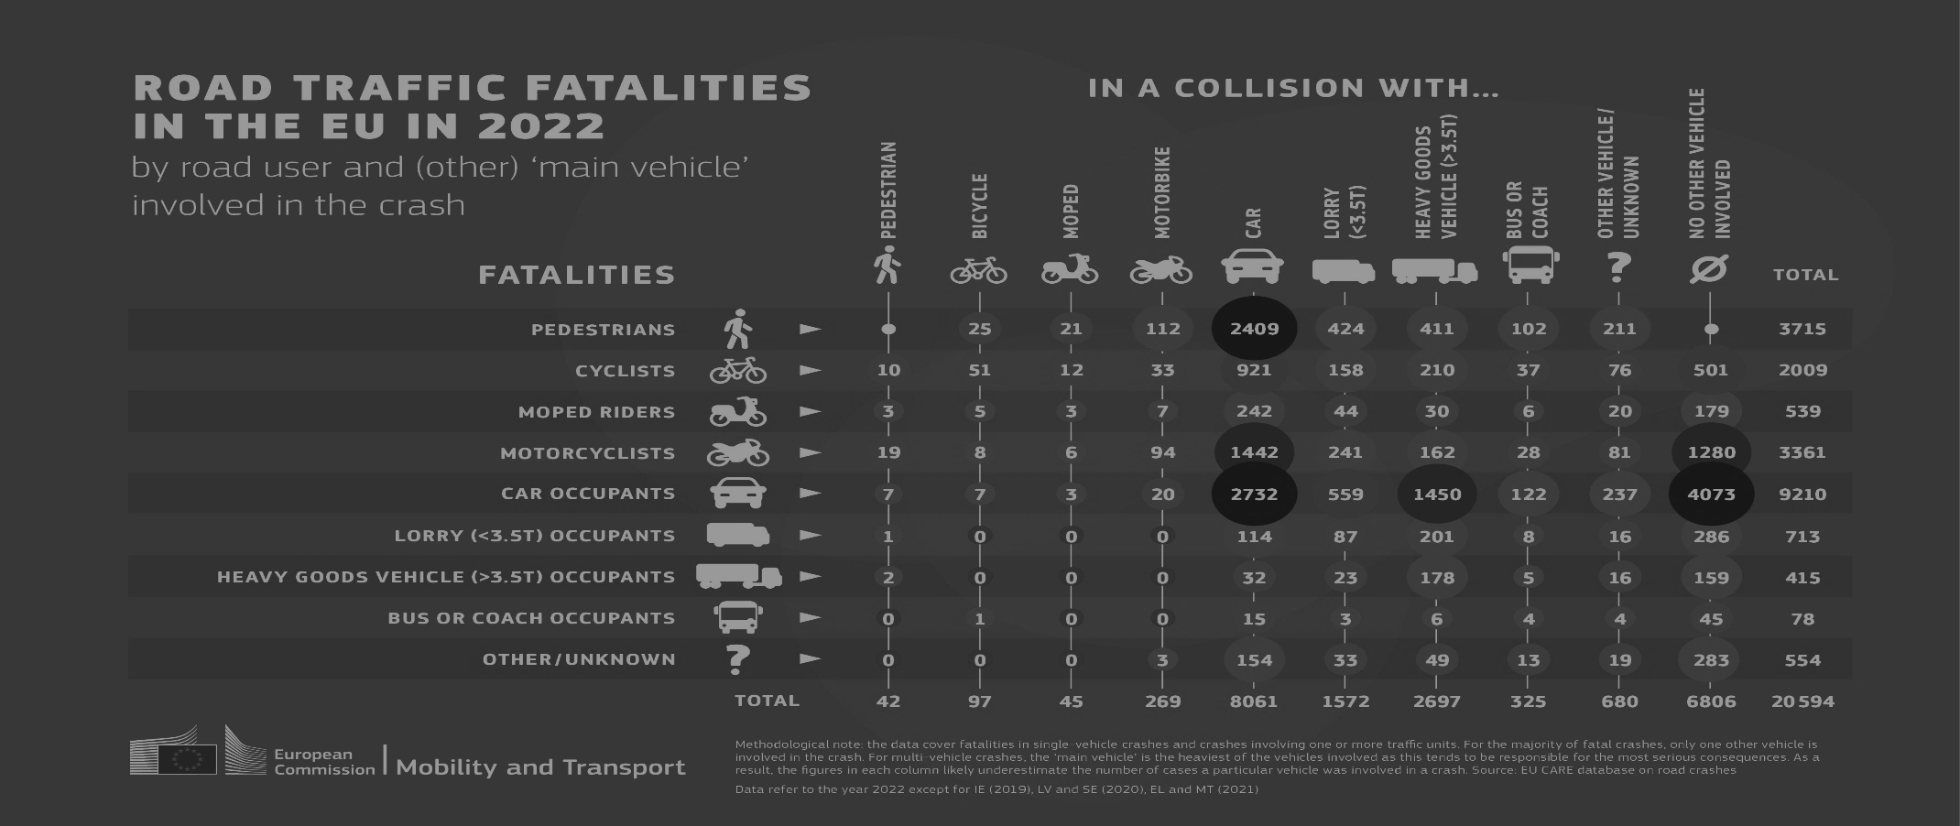
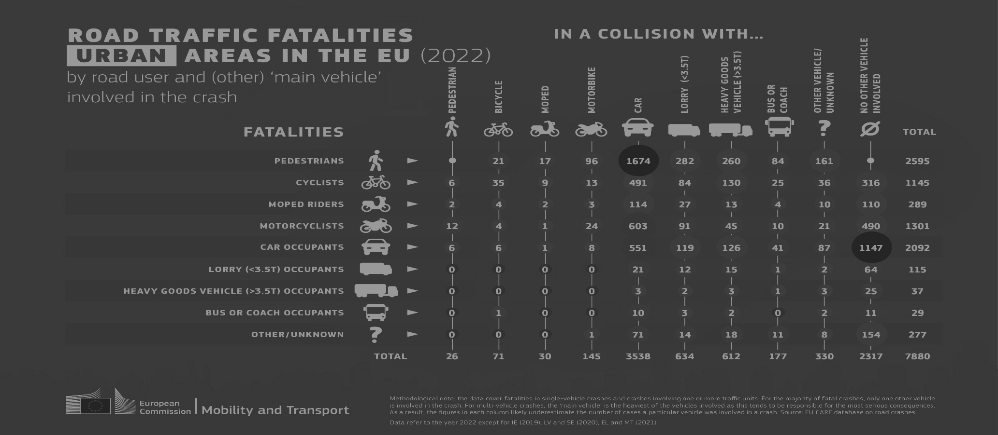
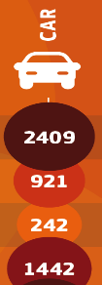
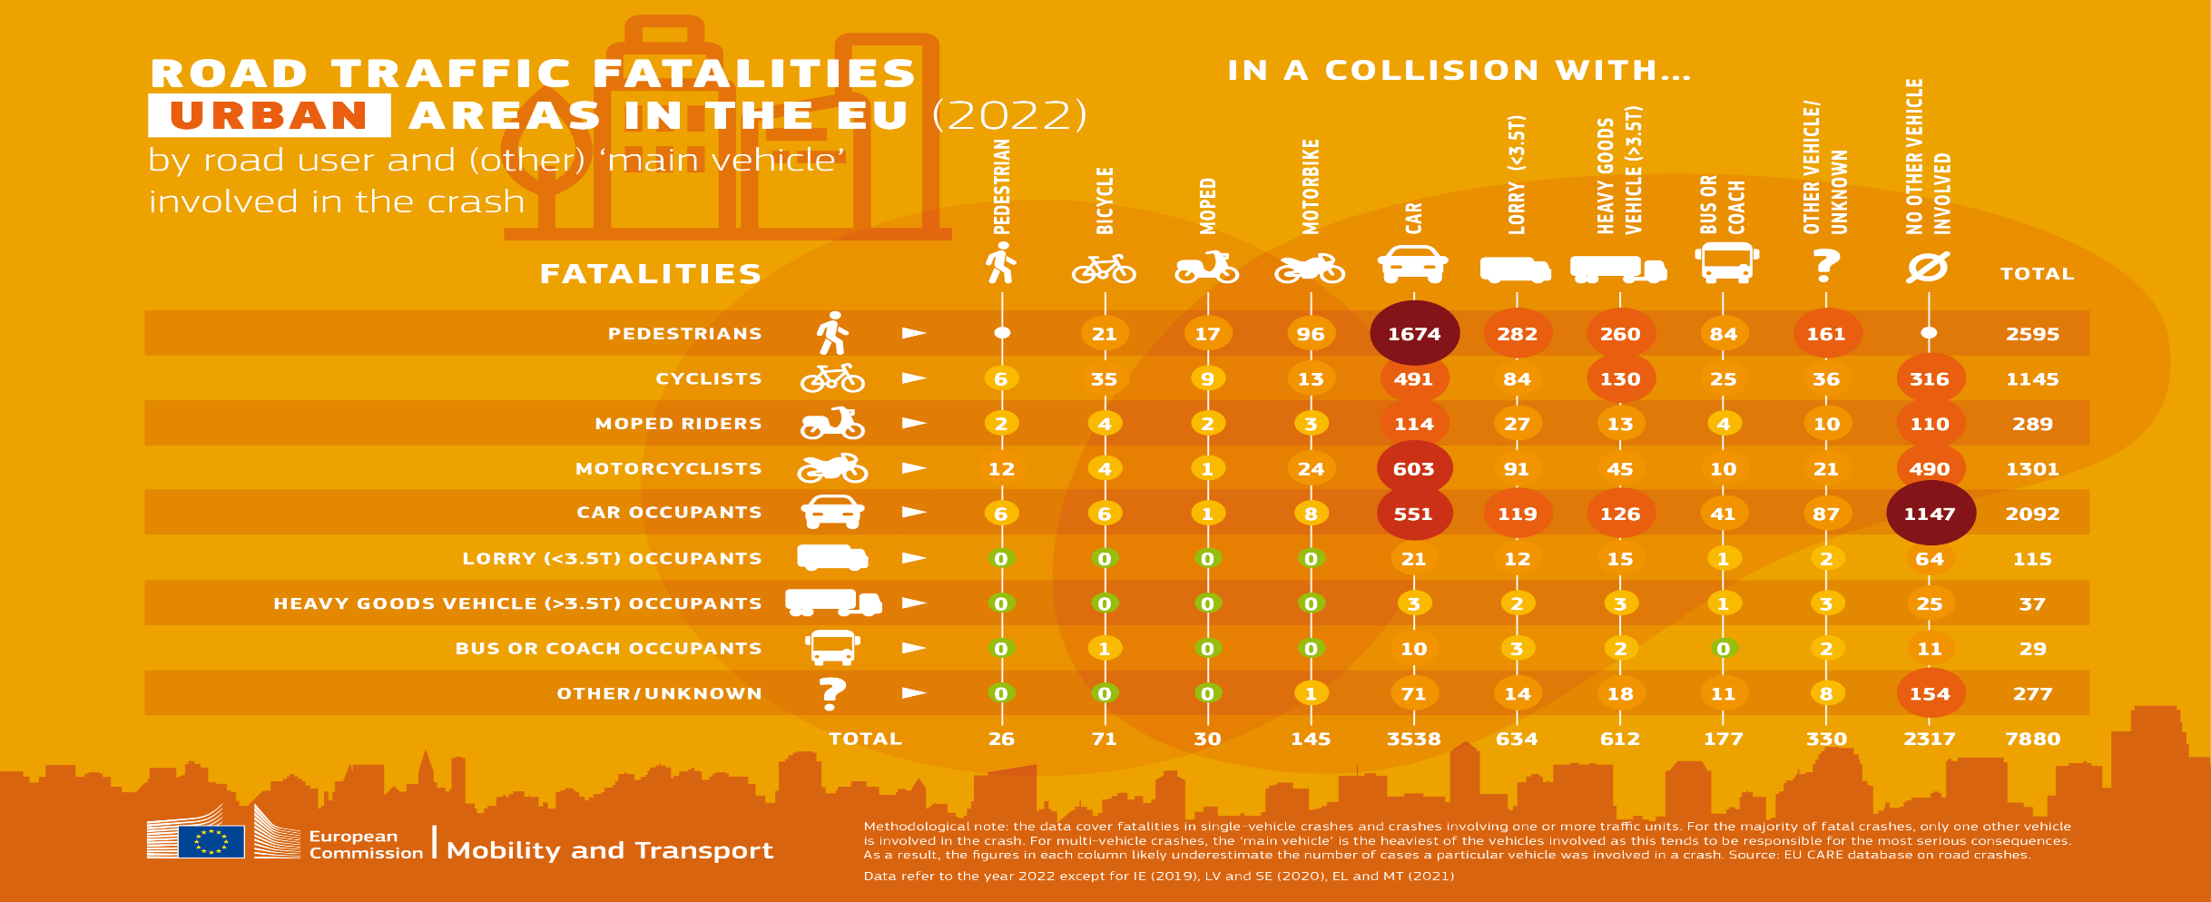
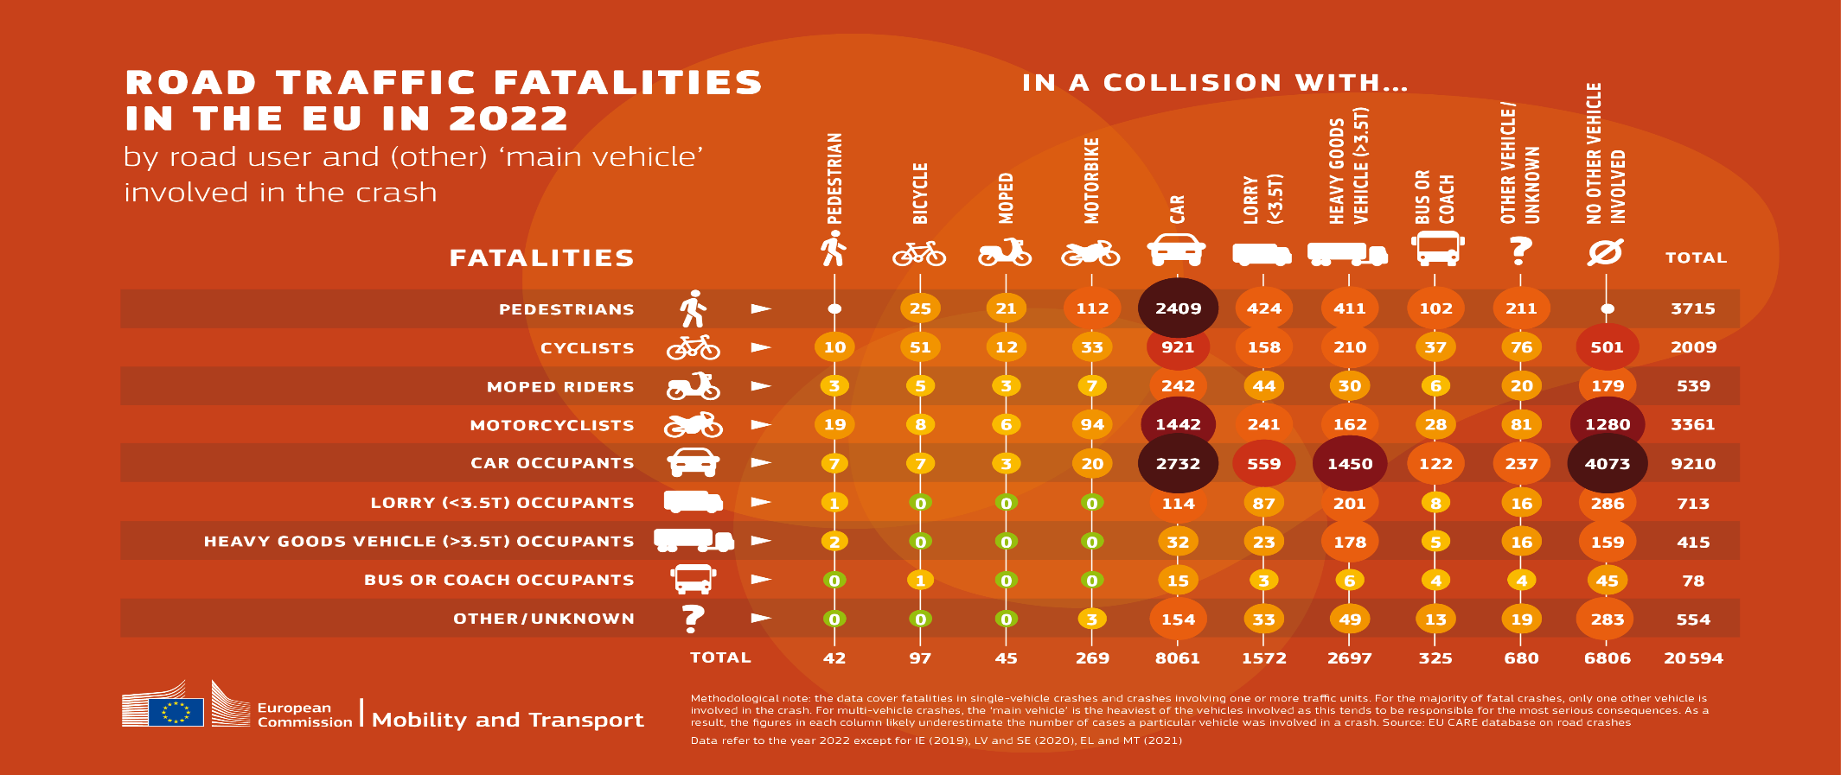
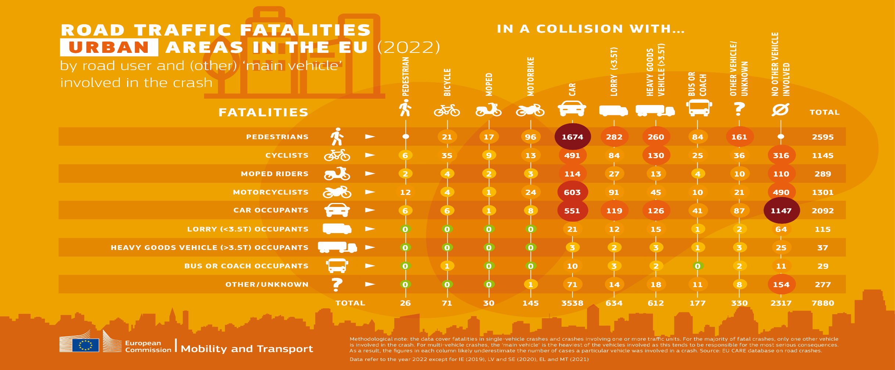
Statistical data supporting GRE/2024/20 Rev.1
EC - Road Traffic Fatalities Europe 2022
Nr. | Region | Title | Researcher / Submitter
7 | European Commission | Road Traffic Fatalities Europe 2022 Links: road traffic fatalities EUROPE 2022 road traffic fatalities in URBAN areas EUROPE 2022 | EC Mobility and Transport (EU Care Database)
In Europe:
More than 47% of all registered fatalities affected VRUs, of which 39% are pedestrians
More than 62% of fatalities originated by a car affected VRUs, of which 48% are pedestrians.
In Urban areas: more than 68% of all registered fatalities affected VRUs, of which 49% are pedestrians
14

Slide 15
Statistical data supporting GRE/2024/20 Rev.1
UK - Reported road casualties in Great Britain: pedestrian factsheet, 2023
Nr. | Region | Title | Researcher / Submitter
8 | United Kingdom | Reported road casualties in Great Britain: pedestrian factsheet, 2023 Link | Dpt. of Transport
It should be noted that it has been long known that a considerable percentage of non-fatal casualties are not reported to the police.
This should be borne in mind when analyzing and interpreting the data.
Pedestrian traffic (distance walked) has increased by 19% between 2004 and 2023
66% of pedestrian fatalities occurred on urban roads
The weekday peak time for pedestrian killed or seriously injured casualties is from 3pm to 6pm. By contrast, the peak is later in the early evening at weekends
The most common contributory factor allocated to pedestrians in fatal or serious collisions (FSC) with another vehicle was ‘Pedestrian failed to look properly’
Further contributory factors assigned to pedestrians were ‘pedestrian careless, reckless or in a hurry’ followed by ‘failure to judge vehicle’s path or speed’
15

Slide 16
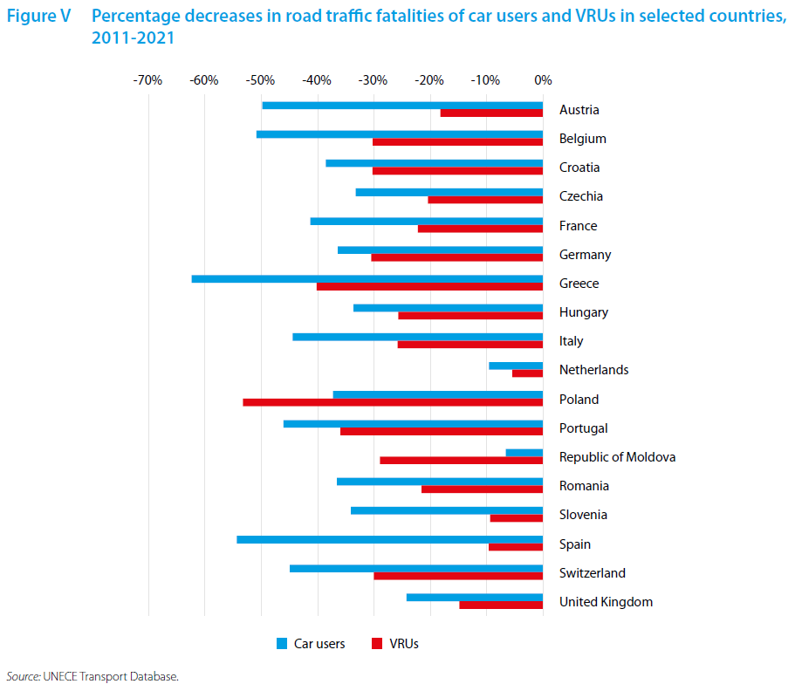
Statistical data supporting GRE/2024/20 Rev.1
UNECE - 2023 Statistics of Road Traffic Accidents
Nr. | Region | Title | Researcher / Submitter
9 | Europe and North America | 2023 Statistics of Road Traffic Accidents Link: https://w3.unece.org/roadsafety/2023/ | UNECE
Road traffic accidents involving vulnerable road users
the general trend indicates a more substantial reduction in fatalities among car users compared to VRUs
the COVID-19 pandemic may have led to an increase in the number of VRUs, particularly cyclists.
this could result in higher fatality rates within this group, especially if road infrastructure and safety measures have not adapted to accommodate the change.
16

