Slide 1
Suggestion on Swappable Battery
Informal document GRPE-93-46
93rd GRPE, 14-17 October 2025
Agenda item 17
GRPE(93th)
15th-17th October 2025
Expert from Japan
Copyright [2025/10/15-17] JASIC, all rights reserved. For reproduction permission and all other issues, please contact [jasic@jasic.org].

Slide 2
Reminder(Reference:GRPE-92-15-Rev.1)
GRPE Workshop on Sustainable Battery Regulations
(17 October 2024 : 9.30 – 12.30 @The UN, Geneva)
"sustainable" in aspect of the environment
(1) Utilization of on-board and removed battery as buffer for renewable energy would be required. e.g.RED III Art.20a in EU
"sustainable" in aspect of the customer acceptability / vehicle life.
(2) Battery cost accounts for a large proportion of the vehicle price, and it prevent the penetration of electrified vehicle. In several business models, battery is sold, leased or subscribed separately from vehicle.
(3) Vehicle has longer life span than that of battery. Service exchange of battery is therefore expected within the middle of vehicle life, especially for commercial vehicles.
(4) Battery would be swapped with next generation one, due to the rapid evolution of battery technology.
Next Steps
To discuss how we can layout "sustainable" battery under the framework of WP.29, respecting environment protection and safety.

Slide 3


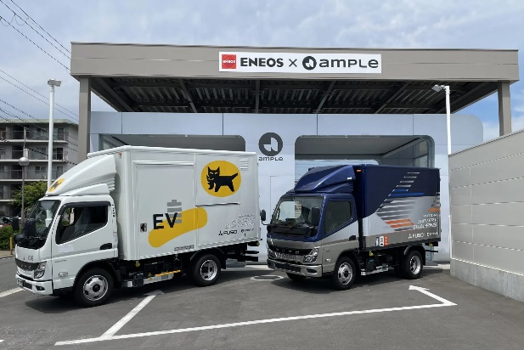
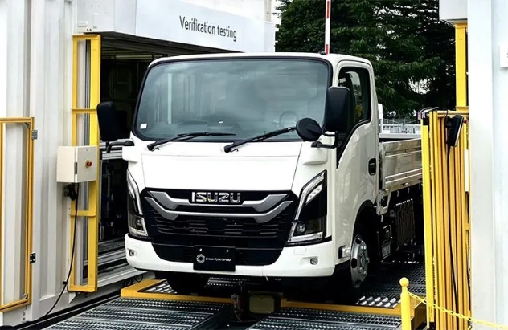
One Option: Swappable Battery
Reminder(Reference:GRPE-92-15-Rev.1)
Challenges of adopting in-vehicle battery EV
Benefits of replacing to swappable battery EV
Operating rate deteriorates because of long charging time.
In “last one-mile delivery”, carriers often leave and return all at once. Power peak and electricity cost will rise significantly due to fast charging at the same time.
High installation and construction costs
ex.) Quick charger is required for each vehicle.
It is possible to replace the full-charge battery at any time in short time.
By separating car body and battery, the delivery company can purchase only the car body.
Users can charge swappable batteries when power demand is low.
Battery station can be used as an emergency power in the event of a disaster.
High introduction costs (vehicle price) making it difficult to recover the investment.
*From interviews with delivery companies
Swappable Battery
Battery Station
Manufactures have started to demonstrate Swappable Battery EVs.
Source: JAMA

Slide 4
Reminder(Reference:GRPE-92-15-Rev.1)
(Tentative) Issues for “swappable battery” under the framework of WP.29
Possible items to be discussed as Functionality/requirements
 | Approval for vehicle installing swappable battery | Approval for vehicle and battery separately
Approval | How to approve series of vehicles installing different number of battery packs?(As one type vs as different types?) | How to approval swappable battery separately?
Safety | Needs for requirements: To deal with swapping in aspect of safety?(Measures to prevent electric shock and vehicle movement during swapping etc.) To ensure functionality of attachment (such as strength against mechanical shocks etc.) | Needs for requirements: To deal with swapping in aspect of safety?(Measures to prevent electric shock and vehicle movement during swapping etc.) To ensure functionality of attachment (such as strength against mechanical shocks etc.) Performance requirements against water and dusts
Durability of swappable battery | Durability requirements for individual batteries? How to trace the history of use of battery? | Durability requirements for individual batteries? How to trace the history of use of battery?
Cyber security |  | Protection from cyber attacks
Allert of battery failure |  | Storing and transferring information regarding battery failed
Software update of battery management system |  | How to check compatibility between battery and vehicle combinations
Lifetime of swappable battery | Needs for specified definition of lifetime, durability as vehicle including swappable battery | Needs for specified definition of lifetime, durability as vehicle including swappable battery

Slide 5
Suggested Work Plan(Updated)
Preparation (~ Dec. 2025)
GRPE summarizes the following items then asks for a guidance from WP.29.
To identify issues (continuously)
To summarize the items to be taken as “Swappable Battery” related issues based on the above identification
To assess the views of wider range of stakeholders under the WP.29 on “Swappable Battery”
=> The results were mentioned in the reported from the vice-chair.
Setting a new body under the WP.29 framework(~March 2026)
To determine the work structure
To draft ToR

Slide 6
Suggestion based on Feedback from GRSP leading team
GRPE could consider…
Establishment of a new Task Force under GRPE
This Task Force will share relevant tasks with existing other groups such as,
    EV Fast and Smart Charging Cluster(Infrastructure relevant)
    Retrofit EV(Type approval relevant)
    （EVE-IWG(Battery durability? relevant)）
To plan two step approach as
Step One: Identify work items
Step Two: Draft/Modify Tearms of Reference

Slide 7
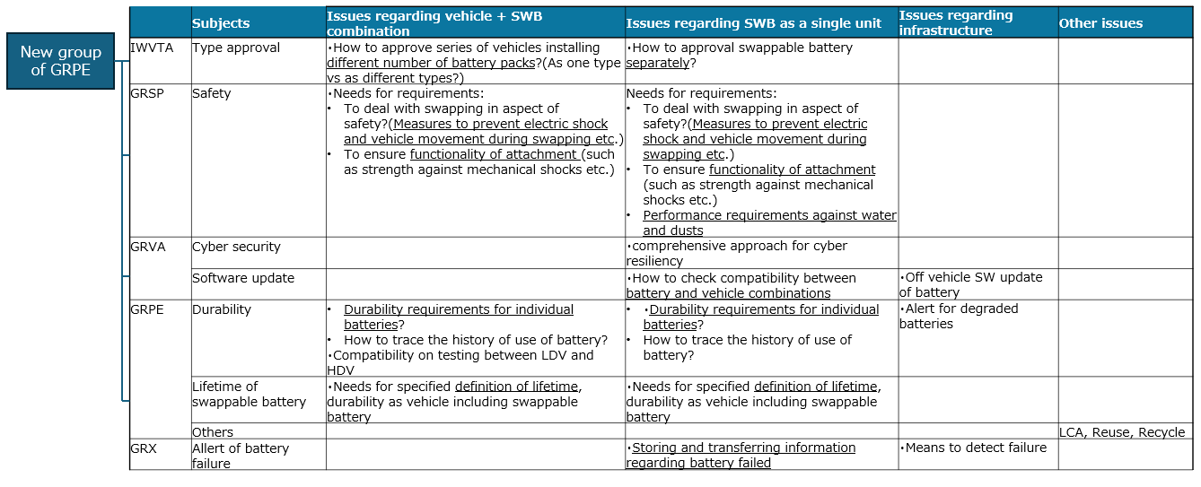
Based on Vice-chair’s report (GRPE-93-06)…
Retrofit EV relevant ？
(and replace battery’s issue?)
F&SC relevant ？
EVE-IWG relevant ？

Slide 8
Suggested Timeline(tentative)
GRPE Calendar
2025
2026
2027
 | 25 Oct | 25 Nov | 26 Mar | 26 Jun | 26 Oct | 26 Nov | 27 Mar | 27 Oct
GRPE | ★ |  | ★ |  | ★ |  | ★ | ★
WP.29 |  | ♦ | ♦ | ♦ |  | ♦
SWB Calendar
Feedback
Step One: Identify work items
Step Two: Draft/Modify Tearms of Reference
Agreement on ToR（if needed）
Proceed discussions to address identified items
In 2026 March, mainly determine the work structure and take feedback from GRPE (and WP.29)
By 2026 June(or October), draft ToR completely
(including existing other group’s ToRs)
●
★

Slide 9
Thank you!

Slide 10
Note to UNECE Secretariat
The author and the speaker of this presentation confirm that they have authorization to use all content including photos and visual elements.
The material is either copyright-free or the author/speaker hold the necessary copyright or permission.
The UNECE will remove any material from its events and supporting websites if there is unlawful use of copyrighted material.
The author/speaker takes responsibility for any infringement on copyright and holds the UNECE harmless to this effect

