Slide 1

Proposal for UN-R 10, 08 series of amendments:
Vehicle radiated immunity test:
Introduction of reverberation chamber
March 2025

Slide 2
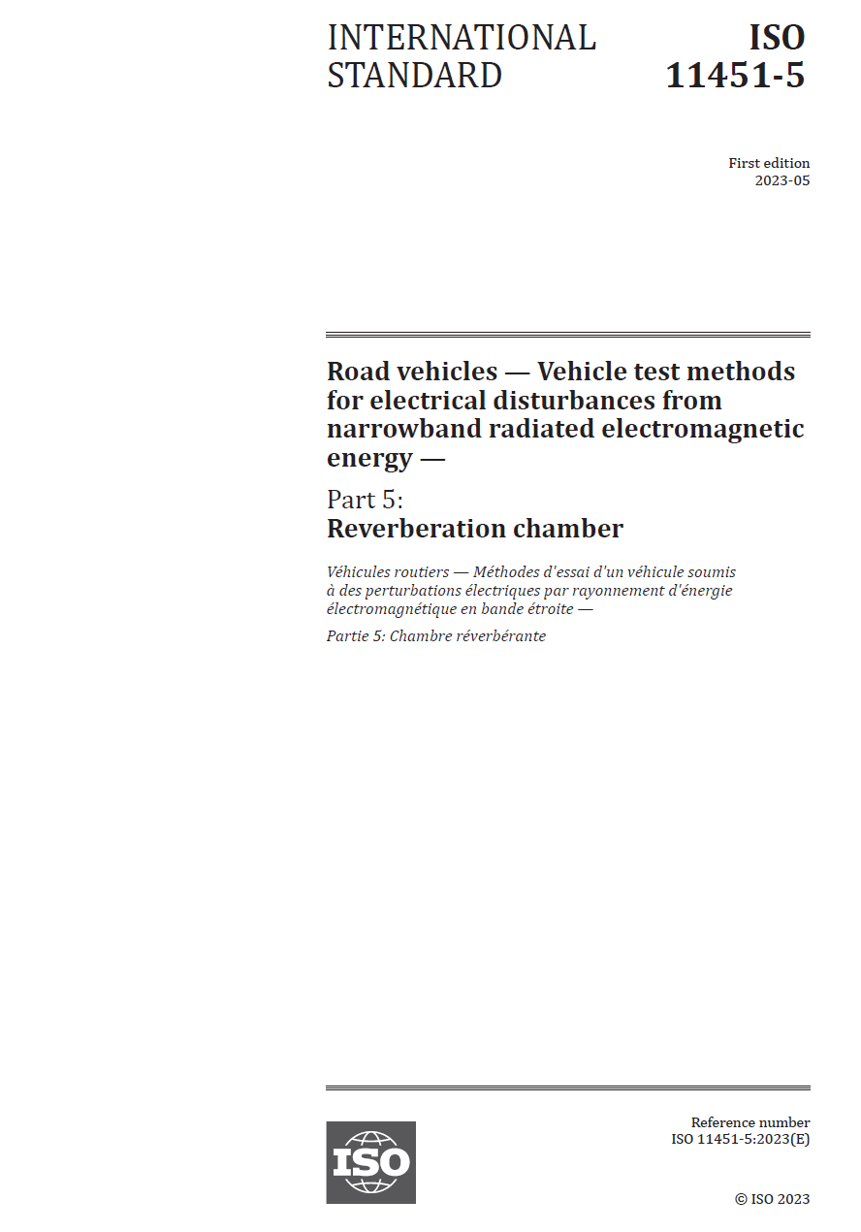
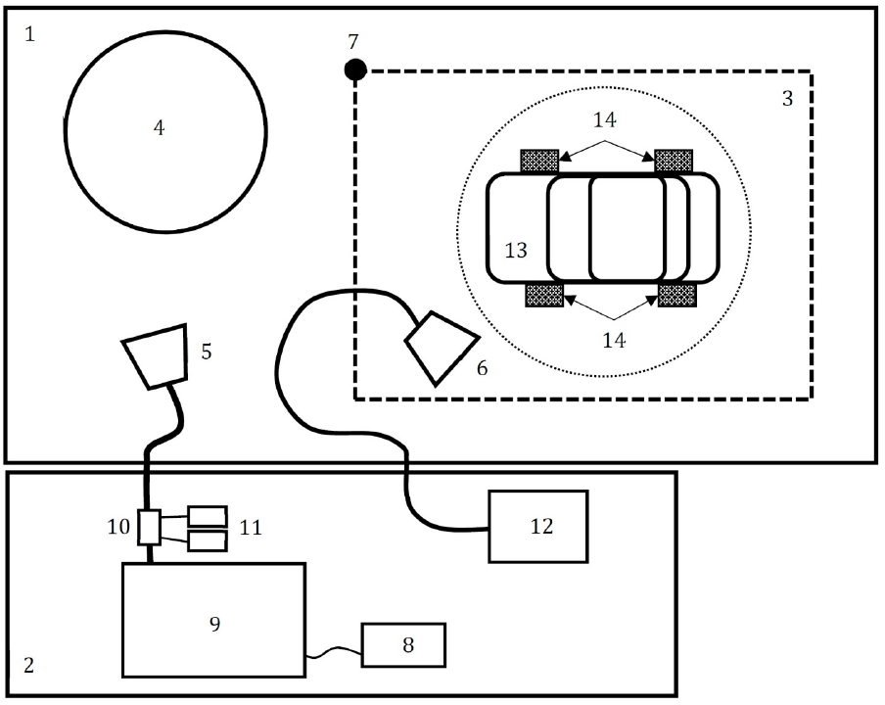
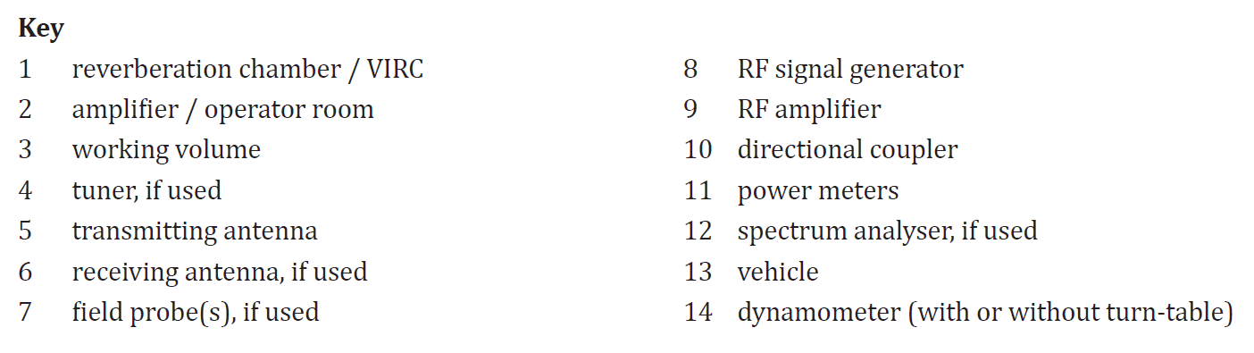
Reverberation method
Established immunity test method in use for automotive, military, aerospace and household applications.

Slide 3
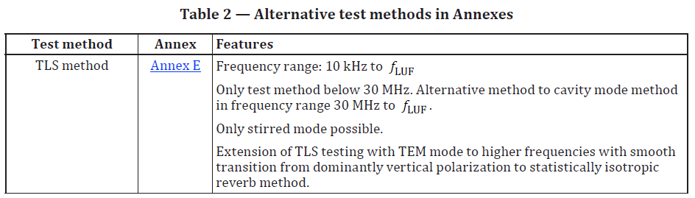
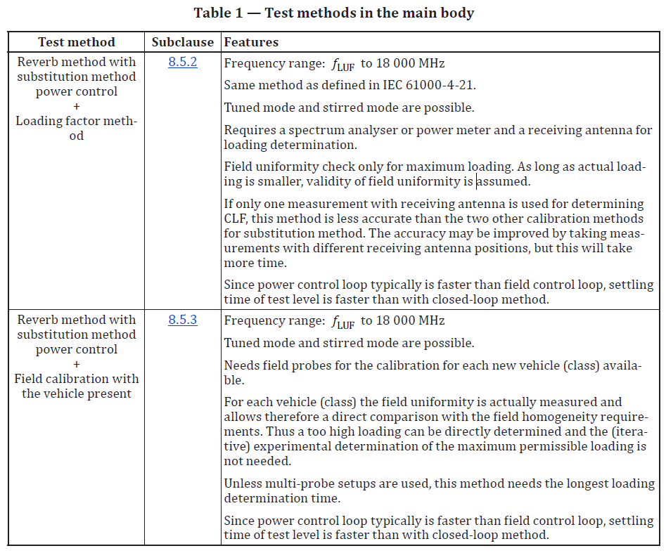
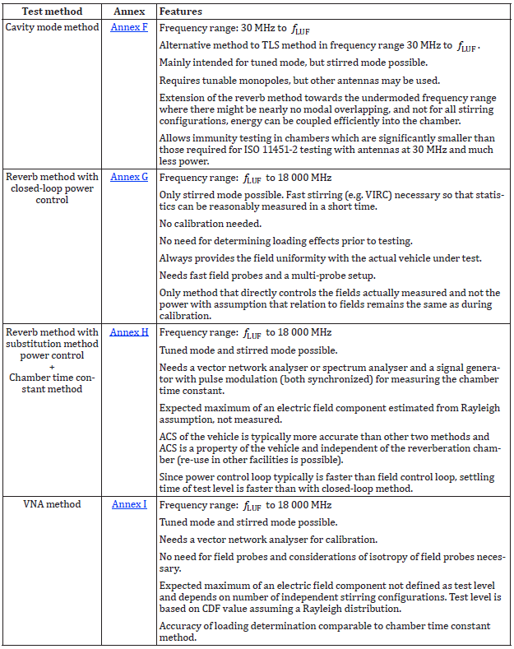
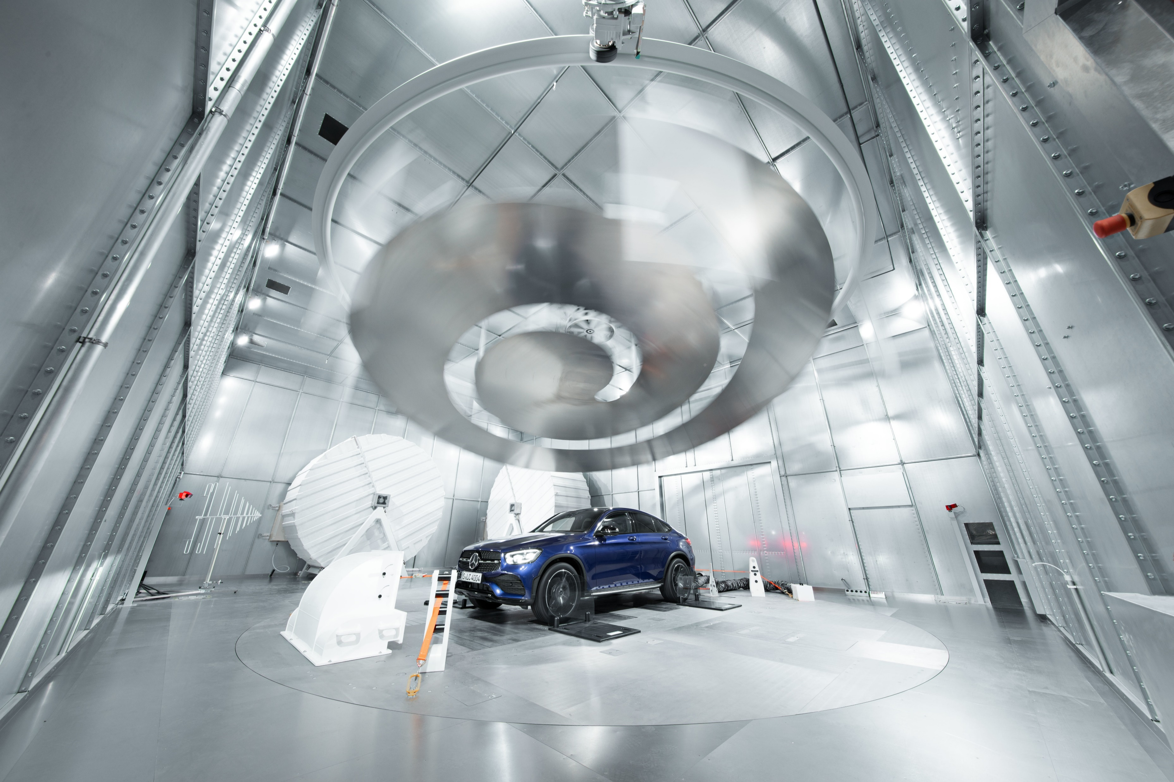
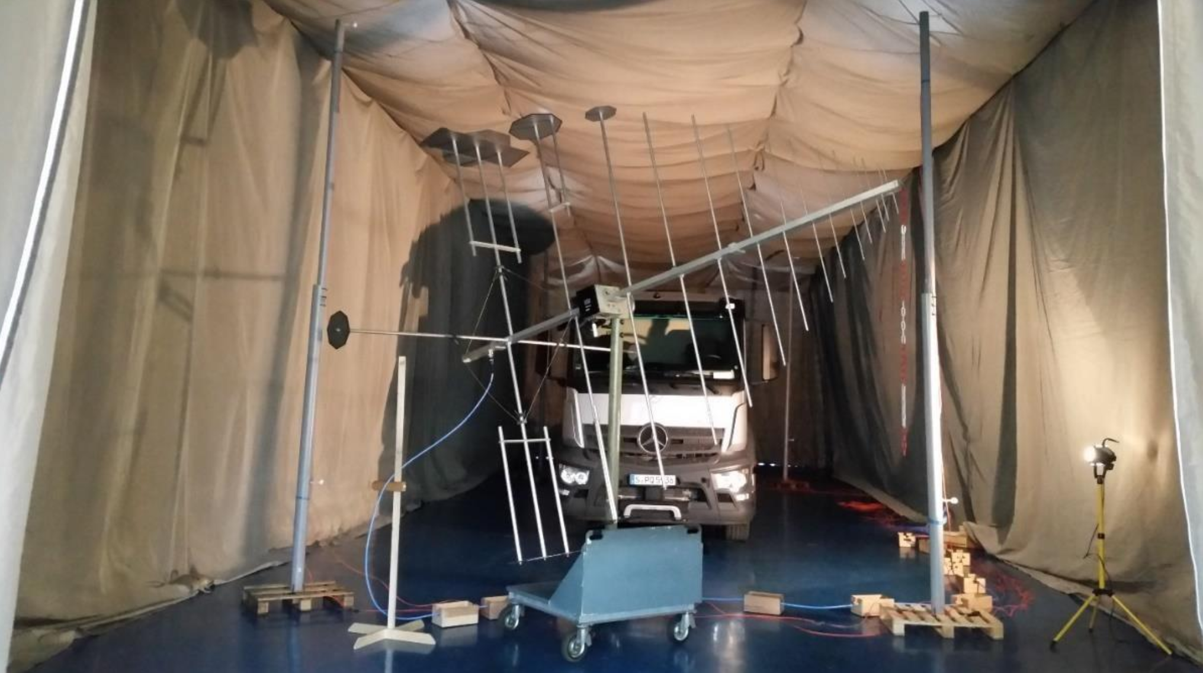
Proposal for R10.08
ISO 11451-5:2023
Tests methods in the main body to be used for vehicle type approval
Alternative methods not for type approval
Alternative test methods are not normative (informative annexes).

Slide 4
Proposal (Main body of the regulation)
Insert new paragraph 2.xx., to read:
2.xx. “Lowest Usable Frequency (LUF)” for which the field uniformity requirements are met for the reverberation method in accordance with ISO 11451-5 and ISO 11452-11.
Paragraph 6.4.2.1., amend to read:
6.4.2.1. If tests are made using the ALSE method described in Annex 6, in accordance with ISO 11451-2, the field strength shall be 30 volts/m rms (root mean squared) in over 90 per cent of the 20 to 2,000 MHz frequency band and a minimum of 25 volts/m rms over the whole 20 to 2,000 MHz frequency band. The field strength shall be 10 volts/m rms in over 90 per cent of the 2,000 to 6,000 MHz frequency band and a minimum of 8 volts/m rms over the whole 2,000 to 6,000 MHz frequency band.
If tests are made using the reverberation chamber method described in Annex 6, in accordance with ISO 11451-5, the field strength shall be 21 volts/m in over 90 per cent of the 20 to 2,000 MHz frequency band and a minimum of 18 volts/m over the whole 20 to 2,000 MHz frequency band. The field strength shall be 7 volts/m in over 90 per cent of the 2,000 to 6,000 MHz frequency band and a minimum of 6 volts/m over the whole 2,000 to 6,000 MHz frequency band. The test method may be used over the entire frequency range or in combination with the ALSE method, depending on the LUF.
If tests are made using the BCI method described in Annex 6, in accordance with ISO 11451-4 BCI the current shall be 60 mA rms in over 90 per cent of the 20 to 2,000 MHz frequency band and a minimum of 50 mA rms over the whole 20 to 2,000 MHz frequency band.“
ISO 11451-5:2023:
“The applicable frequency range for the reverb method is LUF to 18 000 MHz.”
“rms”: please refer to document
GRE-47-xx (OICA) Vehicle immunity - Editorial Update of test level requirement
The vehicle test levels shall be equal to ESA test levels (see 7.18.2.1).

Slide 5
Proposal (Main body of the regulation)
Paragraph 7.7.2.1., amend to read:
7.7.2.1. If tests are made using the ALSE method described in Annex 6, the field strength shall be 30 volts/m rms (root mean squared) in over 90 per cent of the 20 to 2,000 MHz frequency band and a minimum of 25 volts/m rms over the whole 20 to 2,000 MHz frequency band. The field strength shall be 10 volts/m rms in over 90 per cent of the 2,000 to 6,000 MHz frequency band and a minimum of 8 volts/m rms over the whole 2,000 to 6,000 MHz frequency band.
If tests are made using the reverberation chamber method described in Annex 6, in accordance with ISO 11451-5, the field strength shall be 21 volts/m in over 90 per cent of the 20 to 2,000 MHz frequency band and a minimum of 18 volts/m over the whole 20 to 2,000 MHz frequency band. The field strength shall be 7 volts/m in over 90 per cent of the 2,000 to 6,000 MHz frequency band and a minimum of 6 volts/m over the whole 2,000 to 6,000 MHz frequency band. The test method may be used over the entire frequency range or in combination with the ALSE method, depending on the LUF.
If tests are made using the BCI method described in Annex 6, with ISO 11451-4 BCI method the current shall be 60 mA rms in over 90 per cent of the 20 to 2,000 MHz frequency band and a minimum of 50 mA rms over the whole 20 to 2,000 MHz frequency band.
“rms”: please refer to document
GRE-47-xx (OICA) Vehicle immunity - Editorial Update of test level requirement
The vehicle test levels shall be equal to ESA test levels (see 7.18.2.1).

Slide 6
Proposal (Appendix 1)
Appendix 1, amend to read:
6. ISO 11451 "Road vehicles – Vehicle test methods for electrical disturbances from narrowband radiated electromagnetic energy":
Part 1: General principles and terminology (ISO 11451-1, Fourth edition 2015);
Part 2: Off-vehicle radiation sources (ISO 11451-2, Fourth edition 2015);
Part 4: Harness excitation methods (ISO 11451-4, Fourth edition 2022);
Part 5: Reverberation Chamber (ISO 11451-5, First edition 2023).

Slide 7
Proposal (Annex 6)
No change, only for information:
1.1. The test method described in this Annex shall only be applied to vehicles. This method concerns both configurations of vehicle:
(a) Other than "REESS charging mode coupled to the power grid";
(b) "REESS charging mode coupled to the power grid".
A vehicle is considered to be a “large vehicle”, if it is longer than 12 m and/or wider than 2.60 m and/or higher than 4.00 m.
Annex 6, paragraphs 1.2., amend to read:
1.2. Regular test method
This test is intended to demonstrate the immunity of the vehicle electronic systems. The vehicle shall be subject to electromagnetic fields as described in this Annex. The vehicle shall be monitored during the tests.
If not otherwise stated in this Annex the test shall be performed according to
ISO 11451-2 in an ALSE:
  with front irradiation for vehicle not considered as “large vehicles”. Rear irradiation is specified in paragraph 5.1.3.
  with front irradiation and with additional antenna positions for “large vehicles”. Additional antenna position(s) shall be chosen by the manufacturer in conjunction with the Type-Approval Authority after considering the distribution of electronic systems with immunity related functions and the layout of any wiring harness. Tests shall be performed with levels defined in paragraph 6.4.2.1. of this Regulation. For REESS charging mode, only the electronic systems and wiring harnesses required for charging mode shall be considered for antenna positions.
ISO 11451-5 in a reverberation chamber. The test method (substitution method with either loading factor method or field calibration with vehicle present) may be used over the entire frequency range or in combination with the ALSE method, depending on the LUF. The split frequency from an ALSE to a reverberation chamber shall be greater or equal to the LUF.

Slide 8
Proposal (Annex 6)
Annex 6, paragraphs 1.3., amend to read:
1.3. Alternative test methods
The test may be alternatively performed in an outdoor test site for all vehicles (including “large vehicles”). The test facility shall comply with (national) legal requirements regarding the emission of electromagnetic fields. The test shall be performed according to ISO 11451-2 in an OTS:
      with front irradiation for vehicle not considered as “large vehicles”
      with front irradiation and with additional antenna positions for “large vehicles”. Additional antenna position(s) shall be chosen by the manufacturer in conjunction with the Type Approval Authority after considering the distribution of electronic systems with immunity related functions and the layout of any wiring harness. Tests shall be performed with levels defined in paragraph 6.4.2.1. of this Regulation.
For “large vehicles”, one of the following alternative methods may be chosen by the manufacturer in conjunction with the Type Approval Authority:
      Immunity to external sources according to ISO 11451-2 in ALSE or OTS in the frequency range 20 to 6,000 MHz with front irradiation and ESA immunity to external sources according to Annex 9 in the frequency range 20 to 6,000 MHz for ESA with immunity related functions out antenna beamwidth. Concerned ESA shall be chosen by the manufacturer in conjunction with the Type-Approval Authority Vehicle test shall be performed with levels defined in paragraph 6.4.2.1. of this Regulation. ESA tests shall be performed with levels defined in paragraph 6.8.2.1. of this Regulation.
      Harness excitation methods (BCI) according to ISO 11451-4 in the frequency range 20 to 2,000 MHz and immunity to external sources according to ISO 11451-2 in ALSE or OTS in the frequency range 2,000 to 6,000 MHz with additional antenna position(s). Additional antenna positions shall be chosen by the manufacturer in conjunction with the Type Approval Authority after considering the distribution of electronic systems with immunity related functions and the layout of any wiring harness. Tests shall be performed with levels defined in paragraph 6.4.2.1. of this Regulation.
      Harness excitation methods (BCI) according to ISO 11451-4 in the frequency range 20 to 2,000 MHz and ESA immunity to external sources according to Annex 9 in the frequency range 2,000 to 6,000 MHz for all ESA involved in immunity related functions. ESA involved in immunity related functions shall be chosen by the manufacturer in conjunction with the Type Approval Authority. Vehicle test shall be performed with levels defined in paragraph 6.4.2.1. of this Regulation. ESA shall be performed with levels defined in paragraph 6.8.2.1. of this Regulation.
      Harness excitation methods (BCI) according to ISO 11451-4 in the frequency range 20 to 2,000 MHz and immunity to external sources according to ISO 11451-5 in a reverberation chamber (substitution method with either loading factor method or field calibration with vehicle present). The combination of the BCI test method with the reverberation chamber method shall cover the entire frequency range from 20 MHz to 6,000 MHz. The split frequency shall be greater or equal to the LUF. Vehicle test shall be performed with levels defined in paragraph 6.4.2.1. of this Regulation.
Alternative method using ESA immunity to external sources according to Annex 9 does not require E-marking of the concerned ESA. The test report shall be prepared or approved by a laboratory accredited to ISO 17025 and recognized by the Type Approval Authority responsible for carrying out the tests and provided along with the information document shown in Annex 2B. The same test method (vehicle type approval in combination with ESA test report for Annex9) shall be applied during Conformity of Production test or any applicable test method according to this Annex."

Slide 9
Proposal (Annex 6)
The test setup for REESS in charging mode applies to reverberation chamber as well:
Amend “ALSE” to read “ALSE or reverberation chamber”
Example:
Annex 6, paragraphs 2.3.1, amend to read:
2.3.1. Charging station / Power mains
The power mains socket can be placed anywhere in the test site with the following conditions:
- The socket(s) shall be placed on the ground plane (ALSE or reverberation chamber) or floor (OTS);
- The length of the harness between the power mains socket and the AMN(s) shall be kept as short as possible, but not necessarily aligned with the charging harness;
The harness shall be placed as close as possible to the ground plane (ALSE or reverberation chamber) or floor (OTS).
Occurances of „ALSE“ in Annex 6 (Charging setup)
2.3.1. (2 times)
2.3.2. (2 times)
2.3.3.
2.4.1. (4 times)
2.4.2. (2 times)
2.4.3.
2.4.4.

Slide 10
Proposal (Annex 6)
Annex 6, paragraph 3., amend to read:
3. Reference point
3.1. ALSE method
Renumber paragraphs 3.1 to 3.4.
3.2. Reverberation chamber
3.2.1 For the purposes of this annex, the working volume is the space at which the field strength shall be established according to ISO 11451-5.
Annex 6, paragraph 5., amend to read:
Generation of required field strength
5.1. Test methodology in an ALSE
…
5.2. Test methodology in a reverberation chamber
In a reverberation chamber substitution method with either loading factor method or field calibration with vehicle present shall be applied according to ISO 11451-5.

Slide 11
Proposal (Annex 6, Figure 1)
1.4 Applicability of test methods:
Figure 1

