Slide 1
ETRTO comments on latest outcomes on LEON-T study
TF VS, 9 July 2025

Slide 2
Agenda
1
Context & Historical Perspective
2
Zoom on the JRC presentation
3
Recommendations from ETRTO

Slide 3
1-Context & Historical Perspective
Timeline of key documents:
Date | Document | Author | Key point
Feb 2022 | TFVS-07-11 | EC (Emisia & TNO) | Proposed 2 dB noise reduction target
Sept 2022 | TFVS-11-06 | ETRTO | Demonstrated the unfeasibility of the -2 dB
2022 | ETRMA report | ETRMA | Confirmed ETRTO position
Feb 2025 | TFVS-17-05 | JRC | Confirmed initial EC conclusions with a more favourable outlook
Common conclusion from ETRTO and ETRMA in 2022:
- “-2 dB target” = not technically realistic
- Would compromise key performance factors (safety ones, rolling resistance, wear & abrasion)
Not reflected in JRC study in 2025:
- A reasonably small (2 dB) reduction of pneumatic tyre noise is feasible without compromising safety, rolling resistance and other parameters.

Slide 4
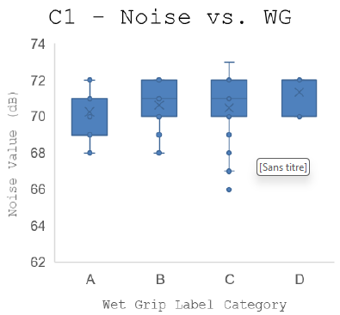
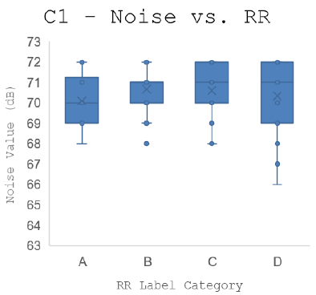
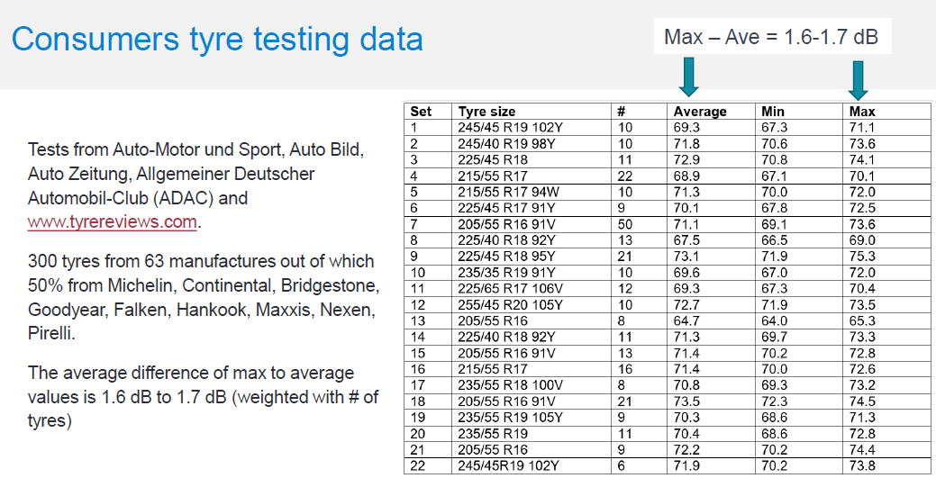
2- Zoom on the JRC presentation _ TFVS-17-05
1- Supporting data not enough robust
It is not robust / not correct to compare Noise levels with RR or WG labels :
  RR or WG labels (A, B, C, D) are discrete sets, no indications are available to know if a given tyre is low or high in the label → impossible to draw “tendencies”
  Only a multivariate regression analysis can properly reflect performance compromise
  Moreover, the study does not consider the inherent uncertainty in noise measurements
For the “Consumers testing data” using a TyreReviews study, the values are not comparable.
Indeed, in the same dimensional box, there can be several test campaigns at different locations, different atmospheric conditions etc.
Reminder: the dispersion of the test measurement is > 2dB, mainly due to track & atmospheric influent parameters.

Slide 5
2- Zoom on the JRC presentation _ TFVS-17-05
2- Technical infeasibility of – 2 dB without trade-off
Design constraints: Further reduction requires major changes that compromise safety and other performances.
All ETRTO and ACEA studies (GRBP 70-25, GRBP 75-18, …) confirmed a trade-off between noise and safety. However, the LEON-T study reports that “a reasonably small (2 dB) reduction in pneumatic tyre noise is feasible without compromising safety, rolling resistance and other parameters.
“-2 dB” is a huge reduction of noise. 90% of the SKUs on the market in C1 are graded B for noise, so between LV-2 and LV.
For recall, relevant progress has already been made over the last 15 years by the tyre industry to reduce the rolling noise by up to 5dB.
3- Measurement uncertainty not addressed
- The measurement uncertainty is > 2 dB for a proposed -2 dB target
- Risk of undetectable gains

Slide 6
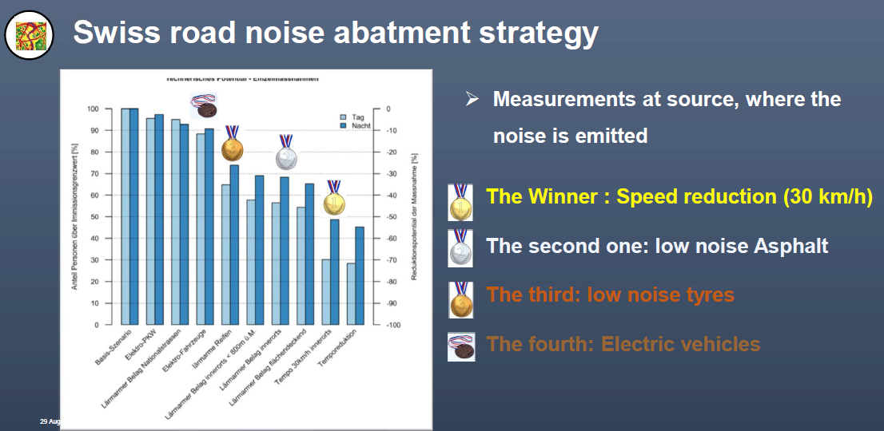
3- Recommendations from ETRTO
1- Acknowledge physical and technical limitations
- Tyre noise already highly optimized
- Further reductions would compromise safety and other performances
2- Implement a new accurate methodology
- Reduction of the uncertainty of the test method
- Creation of the GOIE
3- Adopt a systemic and balanced approach
(insights from TFVS-13-03 _ FOEN)
- Combine efforts on tyres, road surfaces, vehicles and speed
- Consider infrastructure in the noise reduction strategy
- Promote shared, locally adapted solutions
ETRTO stands ready to contribute to realistic, measurable and sustainable noise reduction policies

Slide 7
THANK YOU

