Slide 1
Proposal for R10.07 Supplement 2 by CLEPA:
Correction on Flicker Limits

Slide 2
Proposal for R10.07 Supplement 2
1. Update Parameters to incorporate reference standards updates
  In the R10.07, the reference standard IEC 61000-3-3 and IEC 61000-3-11 have been updated.
    IEC 61000-3-3 Edition 2.0 → Edition 3.2
    IEC 61000-3-11 Edition 1.0 → Edition 2.0
  With the update of the reference standards, certain parameter values have been clarified. To ensure consistency and alignment with the latest standards, these corrections should be incorporated into R10.
  This change is not a technical modification but an update to reflect the latest standards.
2. Correction of incorrect IEC reference in test conditions of Annex 18
  It has been identified that the IEC reference in the Test Conditions section of Annex 18 is incorrect, and the necessary corrections have been made.
  Current: Paragraph 4 - Assessment of voltage changes, voltage fluctuations and flicker
  Revised: Paragraph 6 - Test conditions

Slide 3
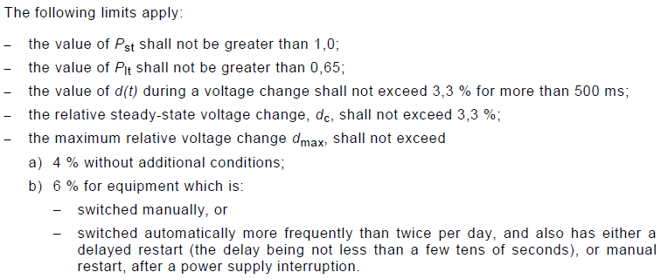
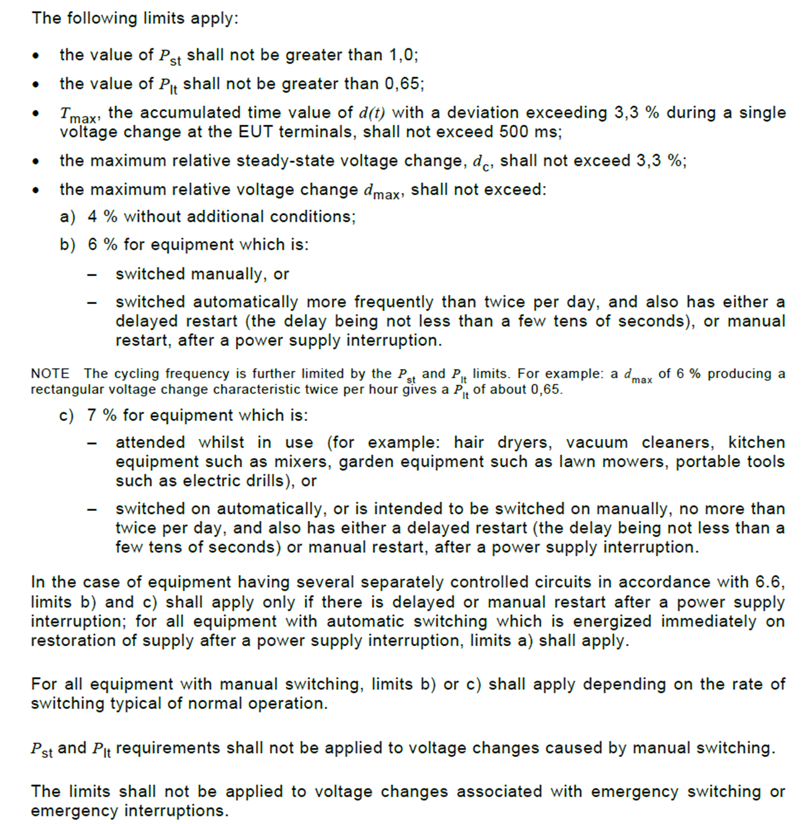
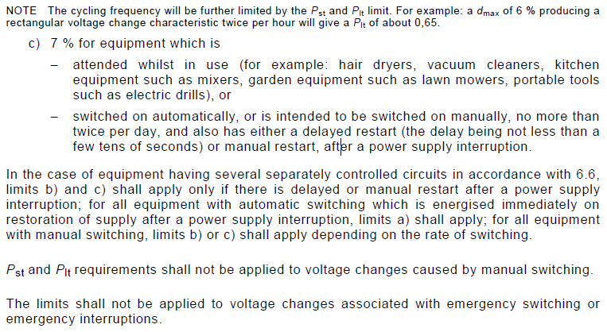
Comparison of IEC Standards
IEC 61000-3-3 Edition 2.0 |  | IEC 61000-3-3 Edition 3.2
Source: IEC 61000-3-3 Edition 2.0 - 2008 |  | Source: IEC 61000-3-3 Edition 3.2 - 2013+AMD1:2017+AMD2:2021+COR1:2022
• the value of Pst shall not be greater than 1,0;
• the value of Plt shall not be greater than 0,65;
• Tmax, the accumulated time value of d(t) with a deviation exceeding 3,3 % during a single
voltage change at the EUT terminals, shall not exceed 3,3 % for more than 500 ms;
• the maximum relative steady-state voltage change, dc, shall not exceed 3,3 %;
• the maximum relative voltage change dmax, shall not exceed:
a) 4 % without additional conditions;
b) 6 % for equipment which is:
  – switched manually, or
  – switched automatically more frequently than twice per day, and also has either a
  delayed restart (the delay being not less than a few tens of seconds), or manual
  restart, after a power supply interruption.
  ➔ This revision aims to clearly define each parameter within the limits.

Slide 4
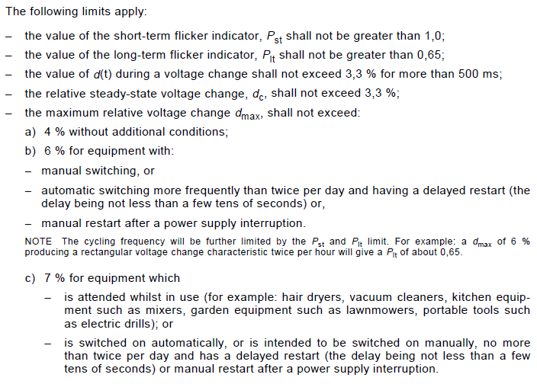
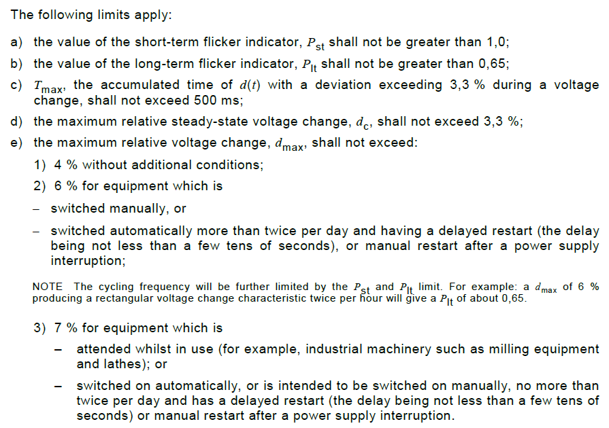
Comparison of IEC Standards (ctd.)
IEC 61000-3-11 Edition 1.0 |  | IEC 61000-3-11 Edition 2.0
Source: IEC 61000-3-11 Edition 1.0 - 2000 |  | Source: IEC 61000-3-11 Edition 2.0 - 2017
a) the value of the short-term flicker indicator, P_{st} shall not be greater than 1,0;
b) the value of the long-term flicker indicator, P_{lt} shall not be greater than 0,65;
c) T_{max}, the value accumulated time of d(t) with a deviation exceeding 3,3 % during a voltage
change, shall not exceed 3,3 % for more than 500 ms;
d) the maximum relative steady-state voltage change, d_{c}, shall not exceed 3,3 %;
e) the maximum relative voltage change, d_{max}, shall not exceed:
  1) 4 % without additional conditions;
  2) 6 % for equipment which is
  − switched manually, or
  − switched automatically more frequently than twice per day and having a delayed restart
  (the delay being not less than a few tens of seconds) or manual restart after a power
  supply interruption,
  ➔ This revision aims to clearly define each parameter within the limits.

Slide 5
Proposal for R10.07 Supplement 2 (ctd.)
1. Update Parameters to incorporate reference standards updates
7.4. Specifications concerning emission of voltage changes, voltage fluctuations and flicker on AC power lines from vehicles.
7.4.2. Vehicle type approval limit
7.4.2.1. If measurements are made using the method described in Annex 12, the limits for rated current ≤ 16 A per phase and not subjected to conditional connection are those defined in IEC 61000-3-3, paragraph 5:
  - The value of Pst_{st} shall not be greater than 1.0;
  - The value of Plt_{lt} shall not be greater than 0.65;
  - T_{max}, tThe accumulated time value of d(t) with a deviation exceeding 3.3 per cent during a single voltage change at the EUT terminals, shall not exceed 3.3 per cent for more than 500 ms;
  - The maximum relative steady-state voltage change, dc_{c}, shall not exceed 3.3 per cent;
  - The maximum relative voltage change dmax_{max}, shall not exceed 6 per cent.
7.4.2.2. If measurements are made using the method described in Annex 12, the limits for rated current > 16 A and ≤ 75 A per phase and subjected to conditional connection are those defined in IEC 61000-3-11, paragraph 5:
  - The value of Pst_{st} shall not be greater than 1.0;
  - The value of Plt_{lt} shall not be greater than 0.65;
  - T_{max}, tThe value accumulated time of d(t) with a deviation exceeding 3.3 per cent during a voltage change, shall not exceed 3.3 per cent for more than 500 ms;
  - The maximum relative steady-state voltage change, dc_{c}, shall not exceed 3.3 per cent;
  - The maximum relative voltage change dmax_{max}, shall not exceed 6 per cent.
Source: UN Regulation No. 10 - Rev.6
※ As there are no changes to the Flicker specification from R10.06 to R10.07, the draft revision was prepared based on R10.06

Slide 6
Proposal for R10.07 Supplement 2 (ctd.)
2. Correction of incorrect IEC reference in test conditions of Annex 18
Annex 18
3. Test Arrangements
3.1. The tests for ESA in configuration "REESS charging mode coupled to the power grid" with rated current ≤ 16 A per phase and not subjected to conditional connection shall be performed according to paragraph 46. of IEC 61000-3-3.
3.2. The tests for ESA in configuration "REESS charging mode coupled to the power grid" with rated current > 16 A and ≤ 75 A per phase and subjected to conditional connection shall be performed according to paragraph 6. of IEC 61000-3-11.
Source: UN Regulation No. 10 - Rev.6
※ As there are no changes to the Flicker specification from R10.06 to R10.07, the draft revision was prepared based on R10.06

