Slide 1
Proposal for R10.08 by CLEPA:
Clarification of harmonics limits
IEC 61000-3-12 : input current > 16 A and ≤ 75 A per phase

Slide 2
Background
The reference standards for harmonics are categorized based on the input current:
  IEC 61000-3-2: Input current ≤ 16 A per phase
  IEC 61000-3-12: Input current > 16 A and ≤ 75 A per phase
In R10.07, a NOTE was added below the harmonics limit table (input current ≤ 16 A per phase) to provide clarification of the requirements.
This clarification was necessary because IEC 61000-3-2 specifies two distinct conditions for determining compliance with harmonic requirements:
  Requirement 1: Directly applying the average value for individual harmonic currents to the limits specified in the table.
  Requirement 2: Applying 150% and 200% of the limit table values to the 1.5-second smoothed r.m.s. harmonic current values.
However, a similar clarification has not been provided for the harmonics limit table referenced in IEC 61000-3-12 (input current > 16 A and ≤ 75 A).
NOTE: For the application of limits given in Table 4, refer to IEC 61000-3-2, paragraph 6.3.3.4.
※ Related document: IWG-EMC-43-03e (OICA-CLEPA) Clarification on harmonics.docx

Slide 3
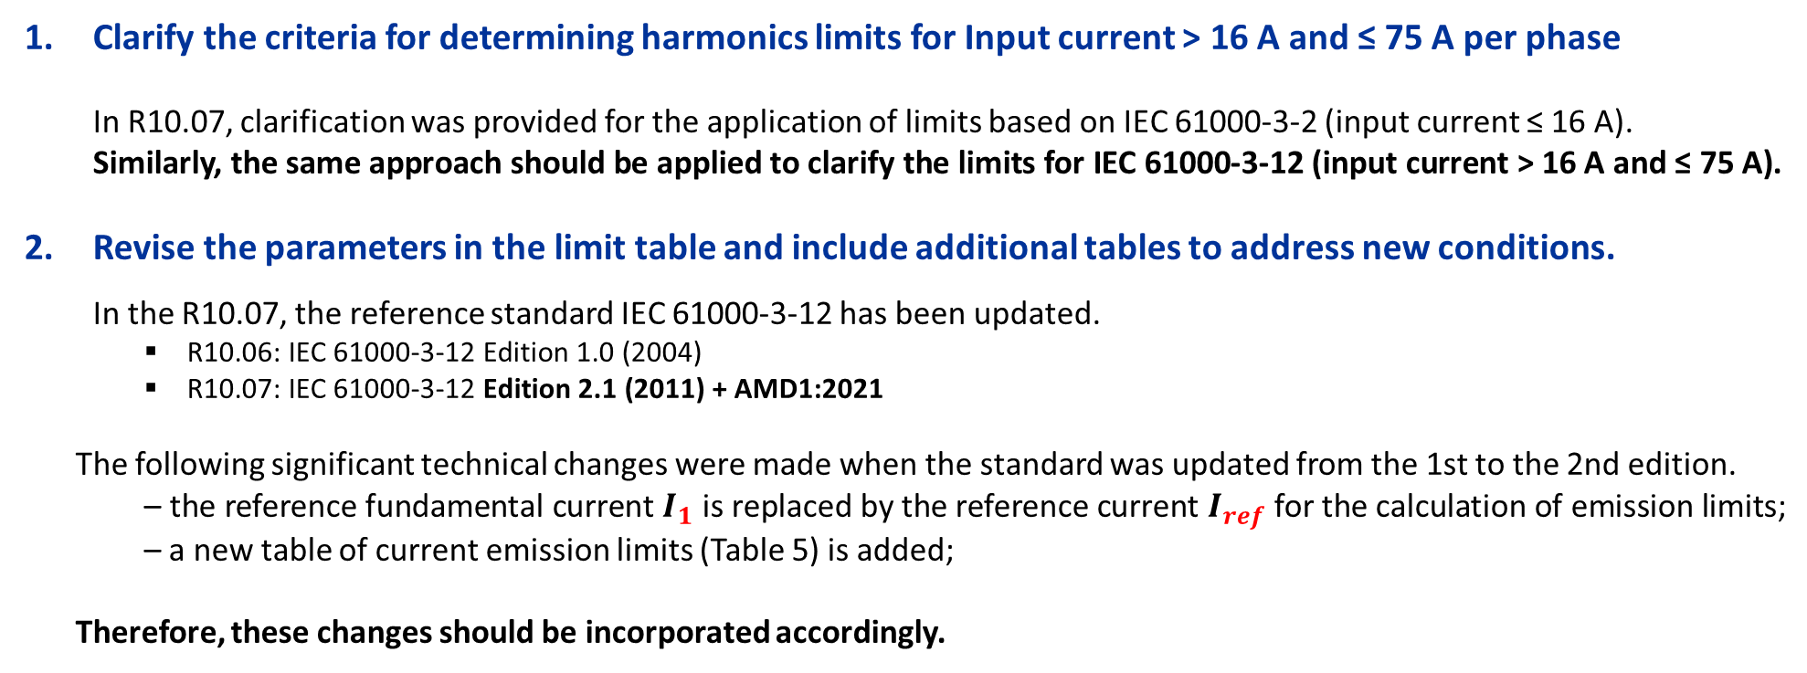
Proposals: Summary
Clarify the criteria for determining harmonics limits for Input current > 16 A and ≤ 75 A per phase and incorporate the updated reference standards.
Clarify the criteria for determining harmonics limits for Input current > 16 A and ≤ 75 A per phase
  In R10.07, clarification was provided for the application of limits based on IEC 61000-3-2 (input current ≤ 16 A).
  Similarly, the same approach should be applied to clarify the limits for IEC 61000-3-12 (input current > 16 A and ≤ 75 A).
Revise the parameters in the limit table and include additional tables to address new conditions.
  In the R10.07, the reference standard IEC 61000-3-12 has been updated.
    R10.06: IEC 61000-3-12 Edition 1.0 (2004)
    R10.07: IEC 61000-3-12 Edition 2.1 (2011) + AMD1:2021
  The following significant technical changes were made when the standard was updated from the 1st to the 2nd edition.
    – the reference fundamental current $I_{1}$ is replaced by the reference current $I_{ref}$ for the calculation of emission limits;
    – a new table of current emission limits (Table 5) is added;
  Therefore, these changes should be incorporated accordingly.

Slide 4
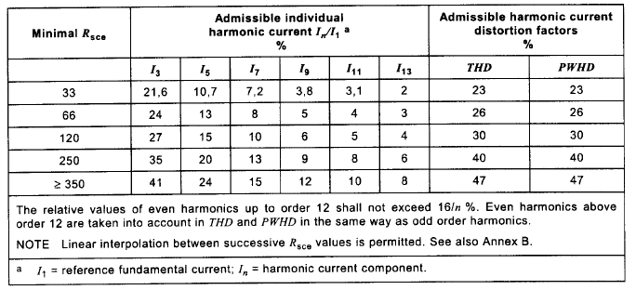
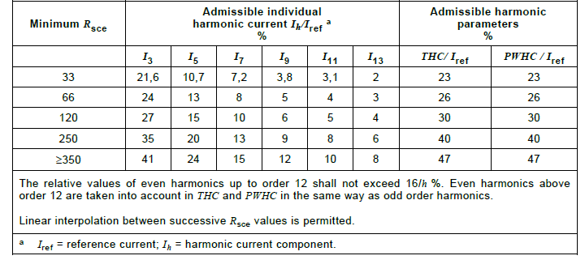

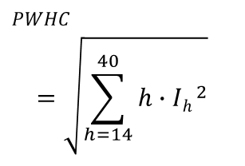

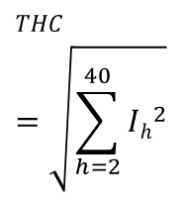


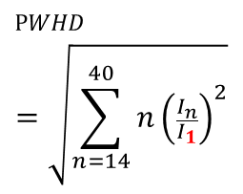


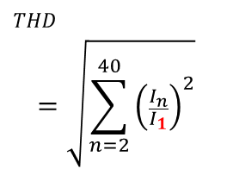
Comparison of Standards
The reference fundamental current $I_{1}$ is replaced by the reference current $I_{ref}$ for the calculation of emission limits
IEC 61000-3-12 Edition1.0 -2004
IEC 61000-3-12 Edition2.1 - 2011+AMD1:2021
Source : IEC 61000-3-12 Edition1.0 -2004
Source : IEC 61000-3-12 Edition2.1 - 2011+AMD1:2021
Admissible individual harmonic current
Admissible harmonic current distortion factors parameters
$${I_{n}}/{I_{1}}$$
$${I_{h}}/{I_{ref}}$$
$$THD$$
$${THC}/{I_{ref}}$$
$$PWHD$$
$${PWHC}/{I_{ref}}$$
$$THD$$
$$=\sqrt{\sum_{n=2}^{40}{{\left(\frac{I_{n}}{I_{1}}\right)}^{2}}}$$
$$THC$$
$$=\sqrt{\sum_{h=2}^{40}{{Ih}^{2}}}$$
$$PWHD$$
$$=\sqrt{\sum_{n=14}^{40}{{n\left(\frac{I_{n}}{I_{1}}\right)}^{2}}}$$
$$PWHC$$
$$=\sqrt{\sum_{h=14}^{40}{{h∙Ih }^{2}}}$$

Slide 5
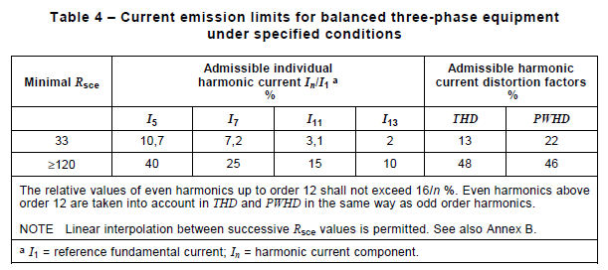
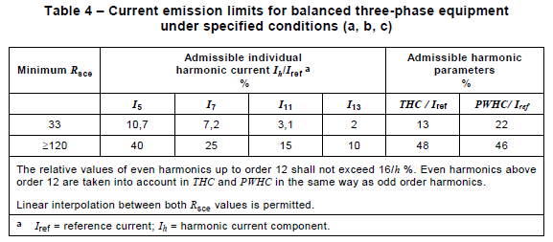
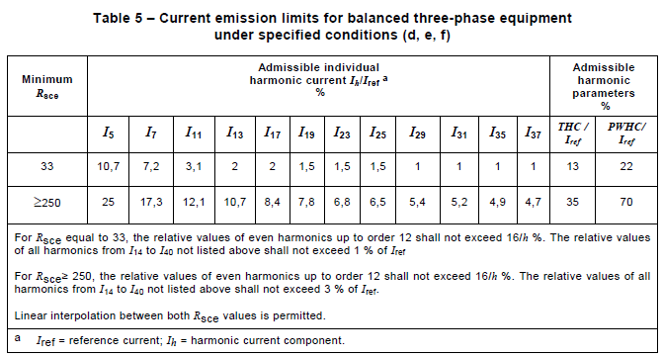
Comparison of Standards (ctd.)
A new table of current emission limits (Table 5) is added
IEC 61000-3-12 Edition1.0 -2004
IEC 61000-3-12 Edition2.1 - 2011+AMD1:2021
Source : IEC 61000-3-12 Edition1.0 -2004
New table of condition d, e, f
Source : IEC 61000-3-12 Edition2.1 - 2011+AMD1:2021

Slide 6
Proposals for R10.08
The harmonics specification for input current > 16 A and ≤ 75 A per phase remains unchanged from R10.06 to R10.07. Therefore, the following is based on R10.06 as the reference document.
Source: UN Regulation No. 10 - Rev.6
7.3. Specifications concerning emission of harmonics on AC power lines from vehicles
7.11. Specifications concerning emission of harmonics on AC power lines from ESAs
7.3.2. Vehicle type approval limit
7.11.2. ESA type approval limit
7.3.2.2. If measurements are made using the method described in Annex 11, the limits for input current > 16 A and ≤ 75 A per phase are those defined in IEC 61000-3-12, and given in given in Table 5, Table 6, and Table 7 and Table 8.
7.11.2.2. If measurements are made using the method described in Annex 17, the limits for input current > 16 A and ≤ 75 A per phase are those defined in IEC 61000-3-12 and given in Table 134, Table 145, and Table 156 and Table 17.
Table 134
Maximum allowed harmonics (input current > 16 A and ≤ 75 A per phase) for single phase or other than balanced three-phase equipment
Table 145
Maximum allowed harmonics (input current > 16 A and ≤ 75 A per phase) for balanced three-phase equipment
Table 156
Maximum allowed harmonics (input current > 16 A and ≤ 75 A per phase) for balanced three-phase equipment under specific conditions (a, b, c)
Table 17
Maximum allowed harmonics (input current > 16 A and ≤ 75 A per phase) for balanced three-phase equipment under specific conditions (d, e, f)
Table 5
Maximum allowed harmonics (input current > 16 A and ≤ 75 A per phase) for single phase or other than balanced three-phase equipment
Table 6
Maximum allowed harmonics (input current > 16 A and ≤ 75 A per phase) for balanced three-phase equipment
Table 7
Maximum allowed harmonics (input current > 16 A and ≤ 75 A per phase) for balanced three-phase equipment under specific conditions (a, b, c)
Table 8
Maximum allowed harmonics (input current > 16 A and ≤ 75 A per phase) for balanced three-phase equipment under specific conditions (d, e, f)

Slide 7
Proposals for R10.08 (ctd.)
Table 5 (and Table 134)
Maximum allowed harmonics (input current > 16 A and ≤ 75 A per phase) for single phase or other than balanced three-phase equipment
Minimum R_{sce} | Acceptable individual harmonic current I_{nh}/I_{1ref} % |  |  |  |  |  | Maximum current harmonic ratio %
 | I₃ | I₅ | I₇ | I₉ | I₁₁ | I₁₃ | THDC/ I_{ref} | PWHDC/ I_{ref}
33 | 21.6 | 10.7 | 7.2 | 3.8 | 3.1 | 2 | 23 | 23
66 | 24 | 13 | 8 | 5 | 4 | 3 | 26 | 26
120 | 27 | 15 | 10 | 6 | 5 | 4 | 30 | 30
250 | 35 | 20 | 13 | 9 | 8 | 6 | 40 | 40
≥ 350 | 41 | 24 | 15 | 12 | 10 | 8 | 47 | 47
Relative values of even harmonics lower or equal to 12 shall be lower than 16/nh %. Even harmonics greater than 12 are taken into account in the Total Harmonic DistortionCurrent (THDC) and Partial Weighted Harmonic DistortionCurrent (PWHDC) in the same way than odd harmonics. Linear interpolation between successive values of Short Circuit Ratio of an Equipment (R_{sce}) is authorized. NOTE: For the application of limits, refer to IEC 61000-3-12, Paragraph 4.2.5.
※ The harmonics specification for input current > 16 A and ≤ 75 A per phase remains unchanged from R10.06 to R10.07. Therefore, the following is based on R10.06 as the reference document. (Source: UN Regulation No. 10 - Rev.6)

Slide 8
Proposals for R10.08 (ctd.)
Table 6 (and Table 145)
Maximum allowed harmonics (input current > 16 A and ≤ 75 A per phase) for balanced three-phase equipment
Minimum R_{sce} | Acceptable individual harmonic current I_{nh}/I_{1ref} % |  |  |  | Maximum current harmonic ratio %
 | I₅ | I₇ | I₁₁ | I₁₃ | THDC/ I_{ref} | PWHDC/ I_{ref}
33 | 10.7 | 7.2 | 3.1 | 2 | 13 | 22
66 | 14 | 9 | 5 | 3 | 16 | 25
120 | 19 | 12 | 7 | 4 | 22 | 28
250 | 31 | 20 | 12 | 7 | 37 | 38
≥ 350 | 40 | 25 | 15 | 10 | 48 | 46
Relative values of even harmonics lower or equal to 12 shall be lower than 16/nh %. Even harmonics greater than 12 are taken into account in the THDC and PWHDC in the same way than odd harmonics. Linear interpolation between successive values of R_{sce} is authorized. NOTE: For the application of limits, refer to IEC 61000-3-12, Paragraph 4.2.5.
※ The harmonics specification for input current > 16 A and ≤ 75 A per phase remains unchanged from R10.06 to R10.07. Therefore, the following is based on R10.06 as the reference document. (Source: UN Regulation No. 10 - Rev.6)

Slide 9
Proposals for R10.08 (ctd.)
Table 7 (and Table 156)
Maximum allowed harmonics (input current > 16 A and ≤ 75 A per phase) for balanced three-phase equipment under specific conditions (a, b, c)
Minimum R_{sce} | Acceptable individual harmonic current I_{nh}/I_{1ref} % |  |  |  | Maximum current harmonic ratio %
 | I₅ | I₇ | I₁₁ | I₁₃ | THDC/ I_{ref} | PWHDC/ I_{ref}
33 | 10.7 | 7.2 | 3.1 | 2 | 13 | 22
≥ 120 | 40 | 25 | 15 | 10 | 48 | 46
Relative values of even harmonics lower or equal to 12 shall be lower than 16/nh %. Even harmonics greater than 12 are taken into account in the THDC and PWHDC in the same way than odd harmonics. Linear interpolation between successive values of R_{sce} is authorized. NOTE: For the application of limits, refer to IEC 61000-3-12, Paragraph 4.2.5.
※ The harmonics specification for input current > 16 A and ≤ 75 A per phase remains unchanged from R10.06 to R10.07. Therefore, the following is based on R10.06 as the reference document. (Source: UN Regulation No. 10 - Rev.6)

Slide 10
Proposals for R10.08 (ctd.)
Table 8 (and Table 17)
Maximum allowed harmonics (input current > 16 A and ≤ 75 A per phase) for balanced three-phase equipment under specific conditions (d, e, f)
Minimum R_{sce} | Acceptable individual harmonic current I_{h}/I_{ref} % |  |  |  |  |  |  |  |  |  |  |  | Maximum current harmonic ratio %
 | I₅ | I₇ | I₁₁ | I₁₃ | I₁₇ | I₁₉ | I₂₃ | I₂₅ | I₂₉ | I₃₁ | I₃₅ | I₃₇ | THC/ I_{ref} | PWHC/ I_{ref}
33 | 10.7 | 7.2 | 3.1 | 2 | 2 | 1.5 | 1.5 | 1.5 | 1 | 1 | 1 | 1 | 13 | 22
≥ 250 | 25 | 17.3 | 12.1 | 10.7 | 8.4 | 7.8 | 6.8 | 6.5 | 5.4 | 5.2 | 4.9 | 4.7 | 35 | 70
For R_{sce} equal to 33, relative values of even harmonics lower or equal to 12 shall be lower than 16/h %. Relative values of all harmonics from I₁₄ to I₄₀ not listed above shall not exceed 1% of I_{ref} For R_{sce} ≥ 250, relative values of even harmonics greater than 12 shall be lower than 16/h %. Relative values of all harmonics from I₁₄ to I₄₀ not listed above shall not exceed 3% of I_{ref} . Linear interpolation between successive values of R_{sce} is authorized. NOTE: For the application of limits, refer to IEC 61000-3-12, Paragraph 4.2.5.
※ The harmonics specification for input current > 16 A and ≤ 75 A per phase remains unchanged from R10.06 to R10.07. Therefore, the following is based on R10.06 as the reference document. (Source: UN Regulation No. 10 - Rev.6)

Slide 11
※ The harmonics specification for input current > 16 A and ≤ 75 A per phase remains unchanged from R10.06 to R10.07. Therefore, the following is based on R10.06 as the reference document. (Source: UN Regulation No. 10 - Rev.6)
Proposals for R10.08 (ctd.)
Annex 11
Method(s) of testing for emission of harmonics generated on AC power lines from vehicle
Annex 17
Method(s) of testing for emission of harmonics generated on AC power lines from an ESA
4.3. The limits for single phase or other than balanced three-phase "REESS charging mode coupled to the power grid" with input current > 16 A and ≤ 75 A per phase are given in Table 5 of paragraph 7.3.2.2. of this Regulation.
4.4. The limits for balanced three-phase "REESS charging mode coupled to the power grid" with input current > 16 A and ≤ 75 A per phase are given in Table 6 of paragraph 7.3.2.2. of this Regulation.
4.5. For three-phase "REESS charging mode coupled to the power grid" with input current > 16 A and ≤ 75 A per phase, when at least one of the three conditions a), b) or c) described in paragraph 5.2. of IEC 61000-3-12 is fulfilled, then the limits given in Table 7 of paragraph 7.3.2.2. of this Regulation can be applied.
4.6. For three-phase ESAs in configuration "REESS charging mode coupled to the power grid" with input current > 16 A and ≤ 75 A per phase, when at least one of the three conditions d), e) or f) described in paragraph 5.2. of
IEC 61000-3-12 is fulfilled, then the limits given in Table 8 of paragraph 7.3.2.2. of this Regulation can be applied.
4.3. The limits for single phase or other than balanced three-phase ESAs in configuration "REESS charging mode coupled to the power grid" with input current > 16 A and ≤ 75 A per phase are given in Table 134 of paragraph 7.11.2.2. of this Regulation.
4.4. The limits for balanced three-phase ESAs in configuration "REESS charging mode coupled to the power grid" with input current > 16 A and ≤ 75 A per phase are given in paragraph Table 145 of 7.11.2.2. of this Regulation.
4.5. For three-phase ESAs in configuration "REESS charging mode coupled to the power grid" with input current > 16 A and ≤ 75 A per phase, when at least one of the three conditions a), b) or c) described in paragraph 5.2. of IEC 61000-3-12 is fulfilled, then the limits given in Table 156 of paragraph 7.11.2.2. of this Regulation can be applied.
4.6. For three-phase ESAs in configuration "REESS charging mode coupled to the power grid" with input current > 16 A and ≤ 75 A per phase, when at least one of the three conditions d), e) or f) described in paragraph 5.2. of
IEC 61000-3-12 is fulfilled, then the limits given in Table 17 of paragraph 7.11.2.2. of this Regulation can be applied.

