Slide 1
ECE/TRANS/WP.29/GRVA/2025/7 Proposal for amendments to UN-R79 (Steer-by-wire)
Informal document GRVA-21-51
21st GRVA, 20-24 January 2025 Agenda item 6(b)
Submitted by the experts from CLEPA and OICA

Slide 2
Main progress since GRVA-20
GRVA-21 update
4 workshops with good participation of experts from UK, F, DE, JPN, SWE, FIN, KOR, CHN and industry
As per conclusion of GRVA-20
Working Document GRVA/2025/7 submitted in October 2024
Informal Document amending the working document as discussed in TechWS’s no. 4-7
All comments received during TechWS’s are considered in informal document
Alignment of EBSIG and R79 regarding
Requirements on an Energy Management System
Definition of Electrical Supply
Requirements for warnings on performance and state of electrical storage device(s)
Agreement on the safety concept in case of a failure of the energy source
Speed below or equal to 10 km/h or standstill must be reached before loss of steering
Energy availability must be demonstrated by performing 18 continuous lane changes in 90 s for M1 N1 (9 LC’s for HCVs)
Maximum deceleration demand of 2 m/s² during the automatic deceleration phase, for best controllability by the driver
Automatic deceleration shall start earliest 60 s after failure detection

Slide 3
Timeline
GRVA-21 update
Today
GRVA 18
01/2024
GRVA 19
05/2024
GRVA 20
09/2024
GRVA 21
01/2025
GRVA 22
05/2025
WP.29
06/2025
EIF
6 months
transition period
Adoption
Informal Doc.
GRVA-18-18
working doc. GRVA/2024/28
Present the progress and status
23.10.24
working doc.
Informal doc. amending
GRVA/2025/7
Technical Workshops with CPs
18.03.2024
Kick-Off
(UK, France, China)
11.04.2024
Comments from CPs
#1
#2
#3
#4
#6
#7
#5
2024
2025
The objective for today is the endorsement of the proposal, for June WP29

Slide 4
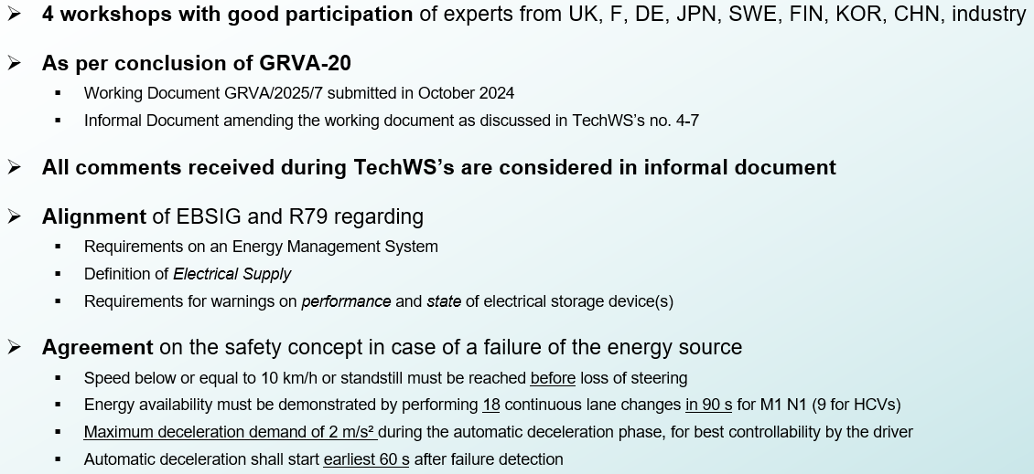
Introduction of proposal (1/3)
5.3.3.6.7. There shall be an energy management system for the electrical storage device(s).
5.3.3.6.7.1.-4. Subparagraphs 1-4
=> Carry-over from EBSIG concept
2.17. "Electrical supply" means a device (e.g. battery, REESS, generator, fuel-cell or a combination of these components) that supplies electrical power to the steering system's electrical storage device(s).
=> Carry-over from EBSIG concept
5.3.3.3. In the event of a failure of the energy source, or of the electrical supply, of the control transmission, it shall be possible to carry out at least 24 "figure of eight" manoeuvres, where each loop of the figure is 40 m diameter at 10 km/h speed and at the performance level given for an intact system in paragraph 6. The test manoeuvres shall begin at an energy storage level given in paragraph 5.3.3.5. In the case where the energy transmission, or a part of it, shares the same energy source, or same electrical supply, as the control transmission, the requirements of paragraph 5.3.3.6. may be used as an alternative to those above.
5.4.2.1.5.
5.4.2.1.5.1. -> Warning when performance of electrical storage device(s) is insufficient
5.4.2.1.5.2. -> Warning when state of electrical storage device(s) is insufficient
=> Carry-over from EBSIG concept

Slide 5
Introduction of proposal (2/3)
5.3.3.6.2. It shall be ensured that the condition as per paragraph 5.3.3.6.1. is reached at the latest before the energy level is down to an amount not allowing for a further lane change as specified in 5.3.3.6.3., unless the failure leads to loss of propulsion.
Additionally, the system shall aim at using the remaining energy in order to maximize the time before reaching the condition as per paragraph 5.3.3.6.1. The means by which this requirement is fulfilled shall be described by the manufacturer and assessed according to Annex 6.
5.3.3.6.3. After failure occurrence sufficient energy shall be available to steer the vehicle. The amount of energy is deemed sufficient if it is possible to perform 18 subsequent lane changes for vehicles of categories M1 and N1, and 9 lane changes for vehicles of categories M2, M3, N2 and N3, within a maximum time of 90s, with a vehicle speed of 20 km/h (+/- 2 km/h). The lane changes shall be alternately to the left and then to the right, while the lateral movement of the vehicle shall be at least 3 meters. In case the safety concept of the vehicle manufacturer is preventing from completing the number of lane changes as specified above at the required speed, the remaining number of lane changes shall be performed at the reduced speed according to the safety concept. This procedure shall be recorded in the test report and included in the type-approval documentation.
It shall be understood, that para. 6.1.4. applies during the procedure as described above.
5.3.3.6.4. The maximum deceleration demand to reach the condition as per paragraph 5.3.3.6.1. shall not exceed 2 m/s². However, the deceleration demand may be increased up to 4 m/s², only in the case that such higher deceleration is necessary to comply with the requirements of paragraphs 5.3.3.6.2. and 5.3.3.6.3., in specific conditions to be specified by the vehicle manufacturer and to be assessed as per Annex 6 to this regulation. It should be understood that the driver still has the possibility to stop the vehicle earlier. In case the longitudinal movement is controlled by another system (e.g. AEBS, Automatic Cruise Control) the vehicle may decelerate at a higher value, e.g. to avoid a collision.
5.3.3.6.5. Any automatic deceleration shall start earliest 60 seconds after the failure detection, unless the condition specified in 5.3.3.6.2. and/or 5.3.3.6.4. (i.e. in case the longitudinal movement is controlled by other systems like AEBS, Automatic Cruise Control) are met before. Additionally, there shall be an appropriate warning to inform the driver about the upcoming deceleration. This warning shall be distinct and of great urgency. The signal to activate the hazard warning lights shall be generated with the start of the automatic deceleration. The hazard warning light signal shall be overridden by the direction indicator, when the driver manually activates it.

Slide 6
Introduction of proposal (3/3)
5.3.3.4. In the event of a failure within the energy transmission, with the exception of those parts listed in paragraph 5.3.1.1., there shall not be any immediate changes in steering angle. As long as the vehicle is capable of being driven at a speed greater than 10 km/h the requirements of paragraph 6. for the system with a failure shall be met after the completion of at least 25 "figure of eight" manoeuvres at 10 km/h minimum speed, where each loop of the figure is 40 m diameter.
The test manoeuvres shall begin at an energy storage level given in paragraph 5.3.3.5. In case the safety concept of the vehicle manufacturer is preventing from performing the 25 "figure of eight" manoeuvres as specified above (e.g. the traction is limited to below 10km/h before the completion of the 25 manoeuvres), the procedure by which this requirement can be checked shall be agreed between the manufacturer and the Technical Service. This procedure shall be recorded in the test report and included in the type-approval documentation.
Additionally, in case the safety concept also includes automatic braking to actively reduce the vehicle speed, the deceleration demand shall not exceed 2 m/s². Any automatic deceleration demand shall start earliest 60 seconds after the failure detection. In case the longitudinal movement is controlled by another system (e.g. AEBS, Automatic Cruise Control) the vehicle may decelerate at a higher value or at an earlier point in time than specified above, e.g. to avoid a collision.
The safety concept used to fulfil the requirements above shall be described by the vehicle manufacturer and assessed according to the requirements of Annex 6.
This clarifies that the safety concept is possibly limiting speed earlier than the completion of the 25 figures of 8.
In this case the demonstration shall be done with specific test arrangements to be agreed between the vehicle manufacturer and the Technical Service and recorded in the test report.
Clarifies that automatic braking is not a must: cutting off traction may be enough, given a failure in the transmission does not generate any potential risk to be short of energy.
The deceleration demand is limited to 2 m/s², to be consistent with para. 5.3.3.6.4.
To be consistent with para. 5.3.3.6.5., any automatic deceleration demand shall start earliest 60 s
The safety concept has to be assessed according to the CEL Annex 6.

