Slide 1
Proposal for R10.08 by CLEPA:
Clarification on Flicker limits for ESA

Slide 2
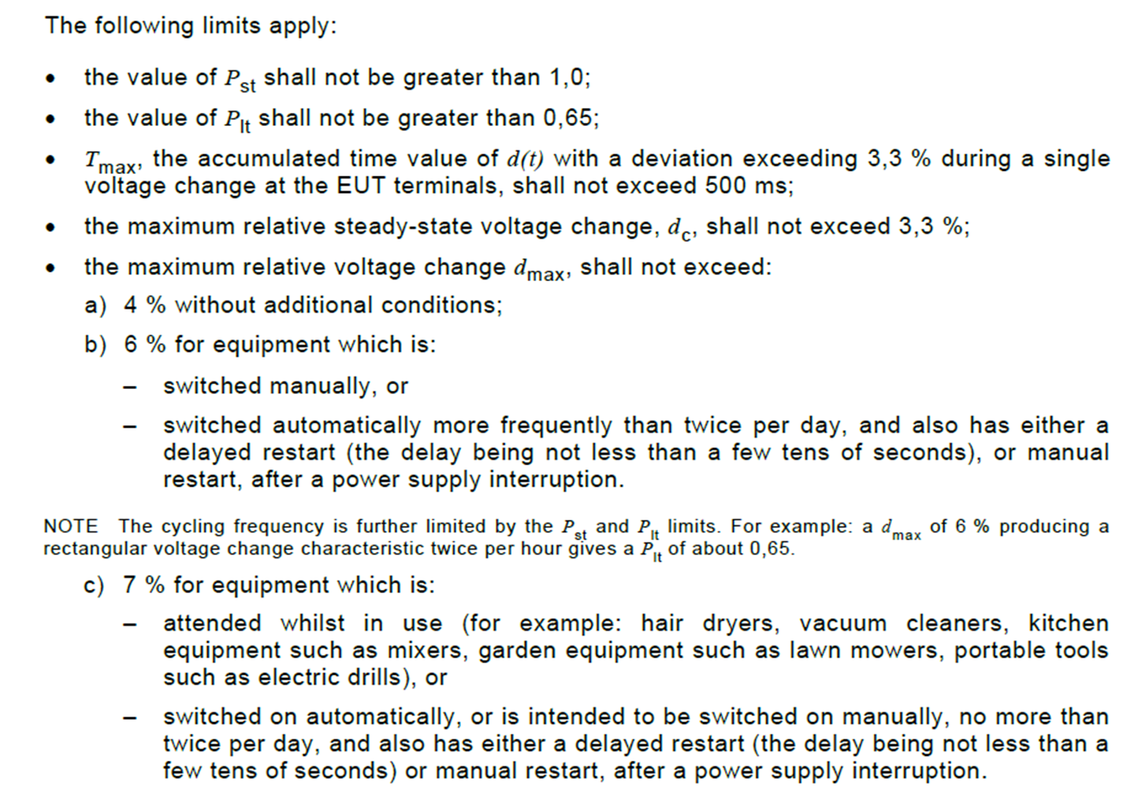
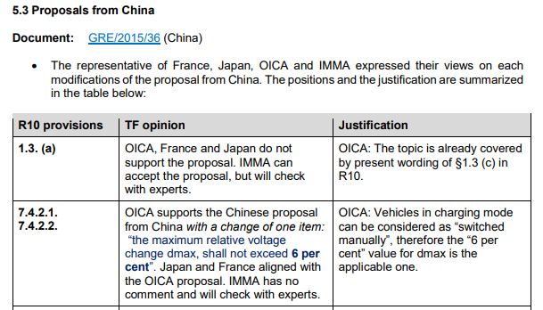
Background
For ESA, the maximum relative voltage change, d_{max} for flicker limits is applied as 4%, 6%, or 7% depending on the condition.
Since In R10.05 Supplement 2, the d_{max} for vehicles was specified as 6%.
However, the d_{max} for ESA has not been specified.
IEC 61000-3-3 Edition 3.2
TF-EMC-01-02
Source: IEC 61000-3-3 Edition 3.2
Source: TF-EMC-01-02e Meeting Minutes.pdf
➔ Vehicles in charging mode can be considered as “switched manually”, therefore the “6 per cent” value for d_{max} is the applicable one.
The d_{max} of flicker varies depending on the conditions.

Slide 3
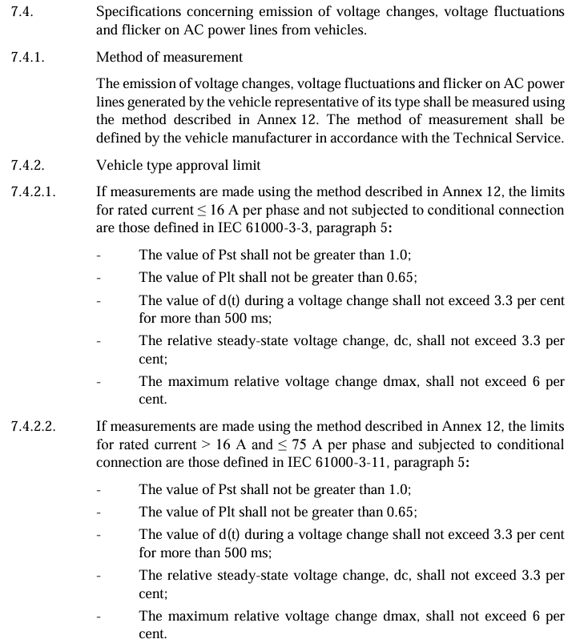
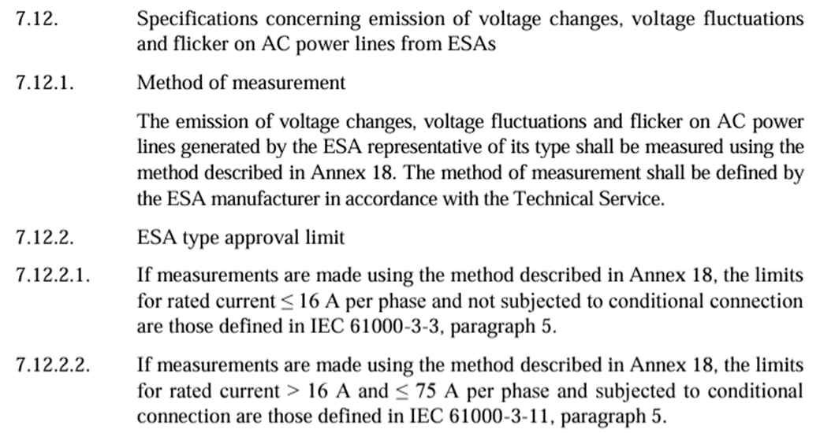
Comparison of Flicker Specifications between Vehicle and ESA
Flicker Specification for Vehicle |  | Flicker Specification for ESA
Source: UN Regulation No. 10 - Rev.6 |  | Source: UN Regulation No. 10 - Rev.6
※ Since there are no changes to the Flicker specification from R10.06 to R10.07, the specifications of the Vehicle and ESA were compared based on R10.06.

Slide 4
Proposal for R10.08
Proposal for the clarification on Flicker limit
Clearly define the d_{max} value for the flicker limit for ESA as 6%
  The d_{max} value for the flicker limit is clearly specified in the vehicle specifications but is not defined for ESAs, which could lead to ambiguity in interpretation.
  Therefore, it is proposed to set the value clearly at 6% to align with the vehicle limits.

Slide 5
Proposal for R10.08 (ctd.)
7.12. Specifications concerning emission of voltage changes, voltage fluctuations and flicker on AC power lines from ESAs7.4.2. Vehicle type approval limit
7.12.2. ESA type approval limit
7.12.2.1. If measurements are made using the method described in Annex 18, the limits for rated current ≤ 16 A per phase and not subjected to conditional connection are those defined in IEC 61000-3-3, paragraph 5.
  - The value of P_{st} shall not be greater than 1.0;
  - The value of P_{lt} shall not be greater than 0.65;
  - T_{max}, the accumulated time value of d(t) with a deviation exceeding 3.3 per cent during a single voltage change at the EUT terminals, shall not exceed 500 ms;
  - The maximum relative steady-state voltage change, d_{c}, shall not exceed 3.3 per cent;
  - The maximum relative voltage change d_{max}, shall not exceed 6 per cent.
7.12.2.2. If measurements are made using the method described in Annex 18, the limits for rated current > 16 A and ≤ 75 A per phase and subjected to conditional connection are those defined in IEC 61000-3-11, paragraph 5.
  - The value of P_{st} shall not be greater than 1.0;
  - The value of P_{lt} shall not be greater than 0.65;
  - T_{max}, the accumulated time of d(t) with a deviation exceeding 3.3 per cent during a voltage change, shall not exceed 500 ms;
  - The maximum relative steady-state voltage change, d_{c}, shall not exceed 3.3 per cent;
  - The maximum relative voltage change d_{max}, shall not exceed 6 per cent.
Source: UN Regulation No. 10 - Rev.6
※ As there are no changes to the Flicker specification from R10.06 to R10.07, the draft revision was prepared based on R10.06

