Slide 1
Informal document GRPE-94-11-Rev.1
94th GRPE, 17-19 March 2026
Agenda item 6 (a)
EUROMOT proposal to amend R96: explanatory notes

Slide 2

EUROMOT proposal to amend R96: explanatory notes
GRPE status:
At GRPE 92. EU Commission submitted amendments to UNECE R49 to allow the type approval of dual fuel hydrogen engines of type 1A with hydrogen as the main fuel. Amendment also included text to allow the measurement of NOx, CO and CO2 with FTIR or QCL-IR analyzers.
R96:
EUROMOT has prepared corresponding text to introduce amendments to R96 05 series, following the same principles that were used to amend R96 to allow the type approval of mono-fuel hydrogen engines:
  Amendment is “lean”
    Minimum viable changes to the Regulation,
    Restricted to engines of type 1A with hydrogen as the main fuel.
  Amendments are self contained
    Impact to existing type-approval procedure is minimized,
    Technical modifications are contained within a new Annex,
    Modification of β is avoided.

Slide 3
EUROMOT proposal to amend R96: explanatory notes
  Documents submitted to GRPE 94:
  Working Document: ECE/TRANS/WP.29/GPRE/2026/24
    Uses R96 as modified by ECE-TRANS-WP29-GRPE-2024-16e and ECE-TRANS-WP29-GRPE-2024-24e as the basis for amendments
    Consolidates amendments included in informal documents GRPE-93-09 and GRPE-93-11
    Includes:
      New dual-fuel text,
      Modifications where required to the mono-fuel text,
      Options to use FTIR/QLC-IR,
      General fixes to issues identified in the base text.
  Informal document GRPE-94-62
    Improves consistency of use of anglicised English in document ECE/TRANS/WP.29/GPRE/2026/24, by replacing all instances of the word “analyzer” with “analyser”
  Changes since submission of the informal documents
  Alignment of options for type-examination between FTIR and QCL-IR

Slide 4
EUROMOT proposal to amend R96: explanatory notes
Thank you for your attention

Slide 5
EUROMOT proposal to amend R96: explanatory notes
  Copyright disclaimer:
  The author and the speaker of this document/presentation confirm that they have authorization to use all content including photos and visual elements.
  The material is either copyright-free or the author/speaker hold the necessary copyright or permission.
  The UNECE will remove any material from its events and supporting websites if there is unlawful use of copyrighted material.
  The author/speaker takes responsibility for any infringement on copyright and holds the UNECE harmless to this effect

Slide 6
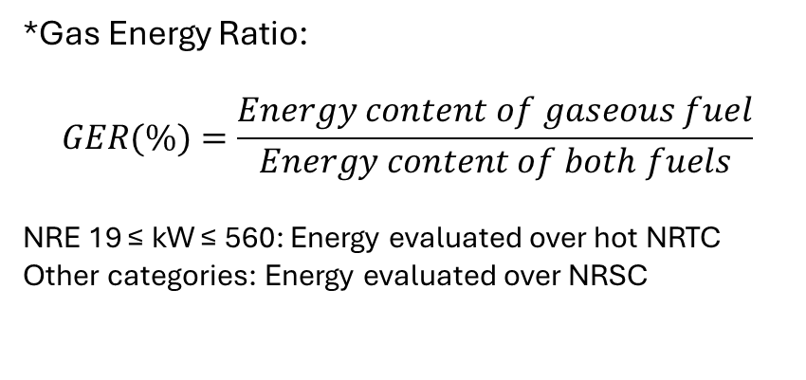
EUROMOT proposal to amend R96: explanatory notes
Reminder: Scope of amendments
 | Gas Energy Ratio* (GER) | Idle on liquid fuel | Warm-up on liquid fuel | Operation on liquid fuel only | Operation in absence of gaseous fuel
Type 1A | GER≥90% | Not allowed | Allowed only in service mode | Allowed only in service mode | Allowed only in Service mode
Type 1B | GER≥90% | Allowed only in liquid fuel mode | Allowed only in liquid fuel mode | Allowed only in liquid fuel mode and service mode | Allowed only in liquid fuel mode
Type 2A | 10%<GER<90% | Allowed | Allowed only in service mode | Allowed only in service mode | Allowed only in service mode
Type 2B | 10%<GER<90% | Allowed | Allowed only in liquid fuel mode | Allowed only in liquid fuel mode and service mode | Allowed only in liquid fuel mode
Type 3A | Not Defined
Type 3B | GER≤10% | Allowed | Allowed only in liquid fuel mode | Allowed only in liquid fuel mode and service mode | Allowed only in liquid fuel mode
*Gas Energy Ratio:
$$GER(\%)=\frac{Energy content of gaseous fuel}{Energy content of both fuels}$$
NRE 19 ≤ kW ≤ 560: Energy evaluated over hot NRTC
Other categories: Energy evaluated over NRSC

