Slide 1
Rear DI/Stop Signal Visibility
SLR-72-18
9th April 2025
<< Images contained in this document are free of copyright >>

Slide 2
Reminder of last GE proposal (SLR-71-04)
2 - UN-R148 § 5.6.3.
3 - UN-R48 § 5.7.1.3.3.
DI apparent surface > 30cm²
STOP
25 mm
1 - UN-R48 § 6.5.4.1.
DI
DI
≥ 75% of the apparent surface
This part of DI shall fulffil the photometric requirements
DI
a
If a >200mm, then a ≤ b
STOP
b
For the check, we consider that if DI is at minimum 25mm from the Stop, requirement is achieved
Outer edge of the vehicle

Slide 3
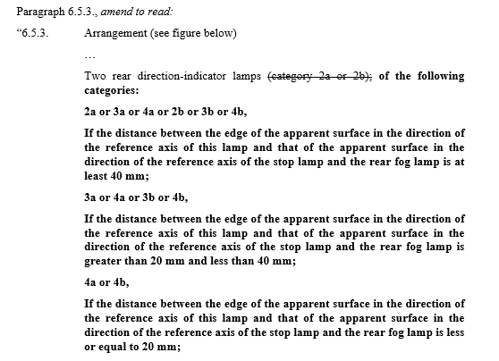
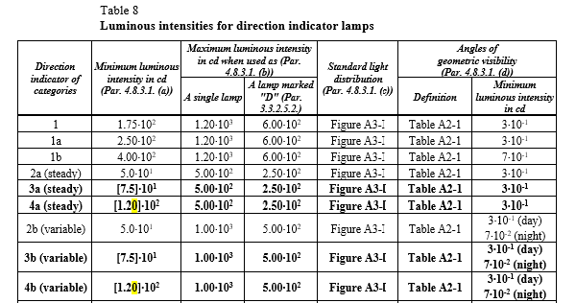
Reminder of previous GE proposal
(SLR-66-08/Rev.1)
UN-R48
UN-R148

Slide 4
Lamps with complaint from Germany

Slide 5
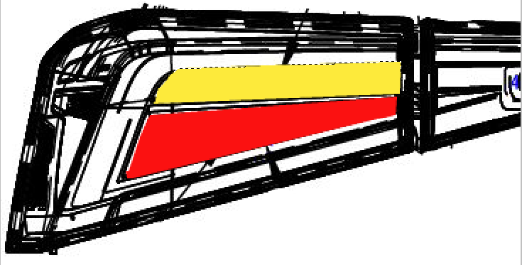
OICA Data
DI photometry provided by areas outside 25mm distance from stop = No
75% of DI area outside 25mm from stop = No
Area of Direction Indicator = <30 cm²

Slide 6
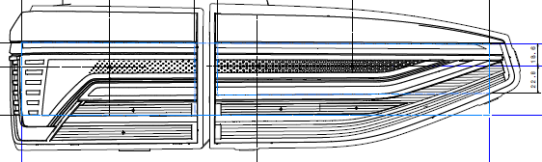
OICA Data
DI photometry provided by areas outside 25mm distance from stop = No
75% of DI area outside 25mm from stop = No
Area of Direction Indicator = <30 cm²

Slide 7
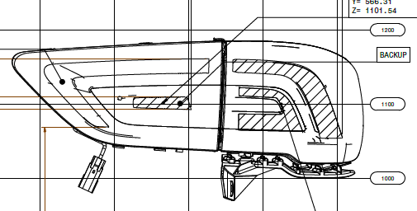
DI photometry provided by areas outside 25mm distance from stop = No
75% of DI area outside 25mm from stop = No
Area of Direction Indicator = <30 cm²

Slide 8
Lamps without complaint from Germany

Slide 9
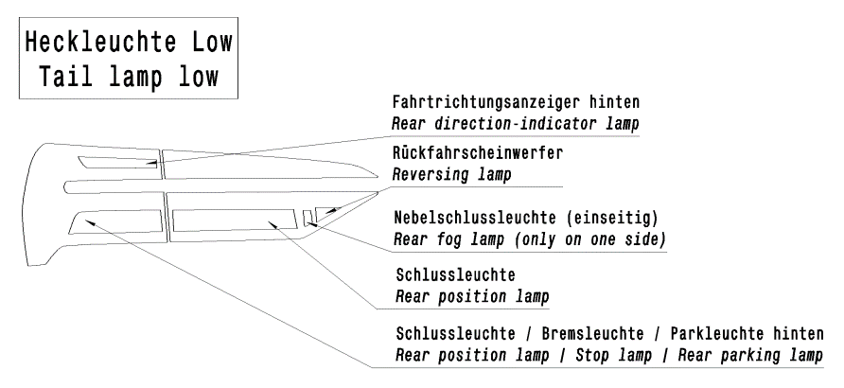
OICA Data
DI photometry provided by areas outside 25mm distance from stop = Yes
75% of DI area outside 25mm from stop = Yes
Area of Direction Indicator = < 30 cm²

Slide 10
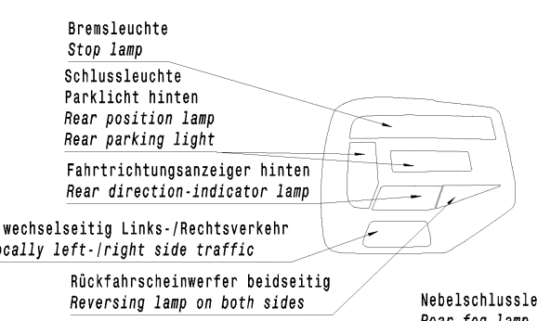
OICA Data
DI photometry provided by areas outside 25mm distance from stop = Yes
75% of DI area outside 25mm from stop = Yes
Area of Direction Indicator = < 30 cm²

Slide 11
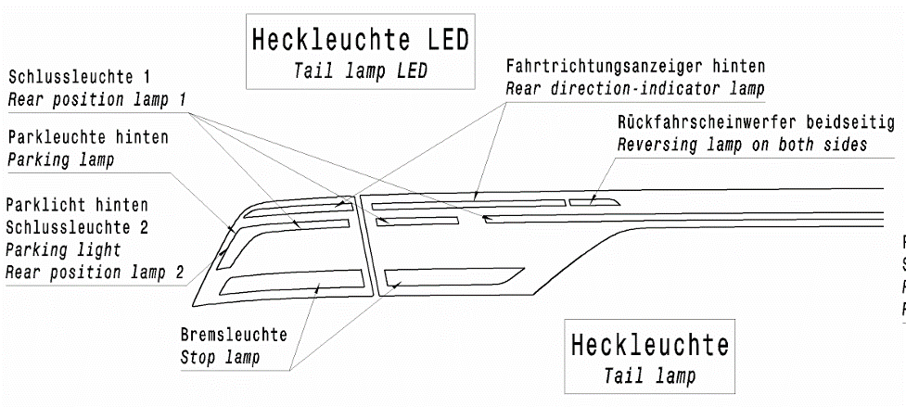
OICA Data
DI photometry provided by areas outside 25mm distance from stop = Yes
75% of DI area outside 25mm from stop = Yes
Area of Direction Indicator = <30 cm² (Part 1 for open Trunk)

Slide 12
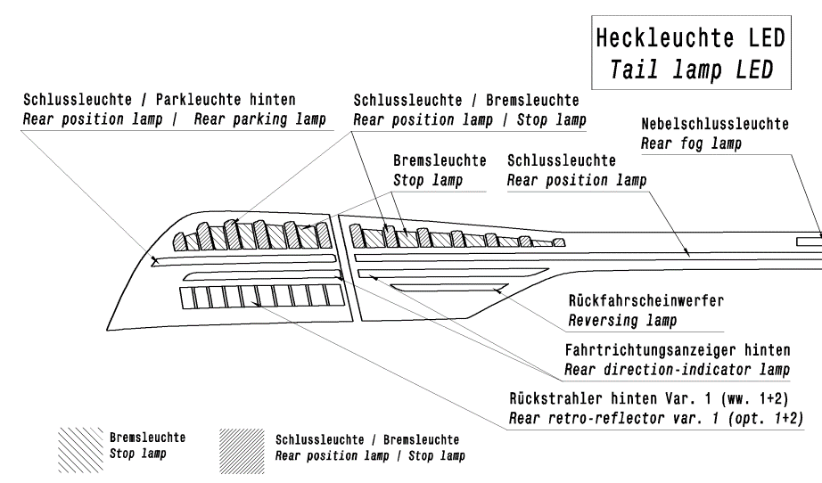
OICA Data
DI photometry provided by areas outside 25mm distance from stop = Yes
75% of DI area outside 25mm from stop = Yes
Area of Direction Indicator = <30 cm²

Slide 13
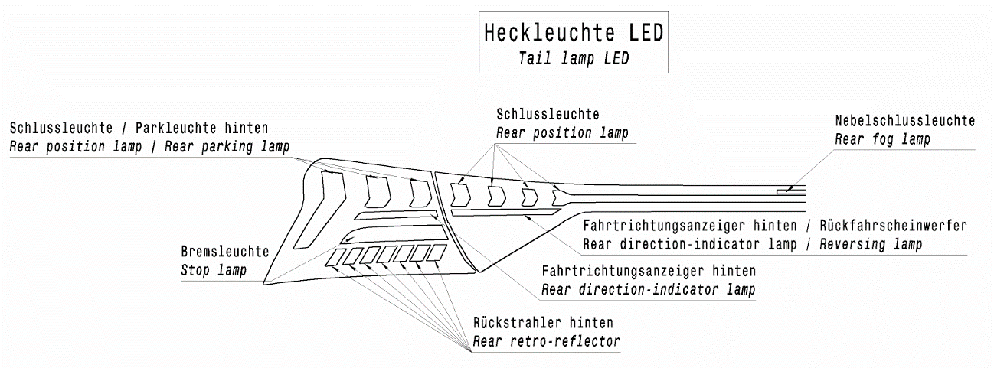
OICA Data
DI photometry provided by areas outside 25mm distance from stop = No
75% of DI area outside 25mm from stop = No
Area of Direction = < 30 cm² (Part 1)

Slide 14
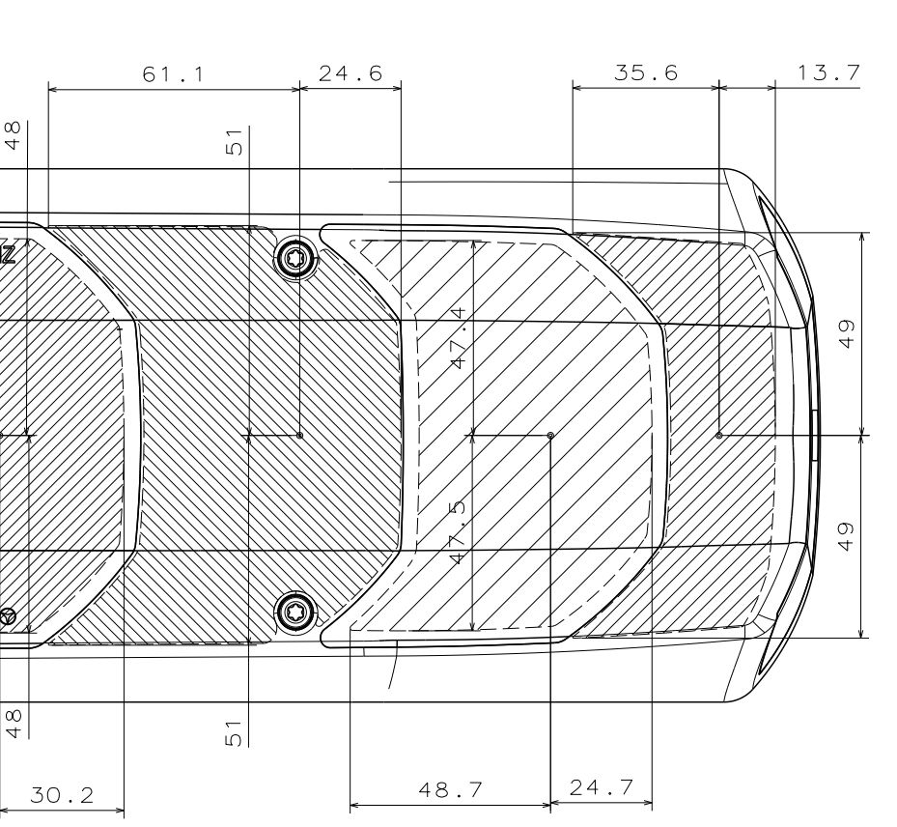
OICA Data
Direction indicator
Stop lamp
25 mm
DI photometry provided by areas outside 25mm distance from stop = No
75% of DI area outside 25mm from stop = No
Area of Direction Indicator = >30 cm²

Slide 15
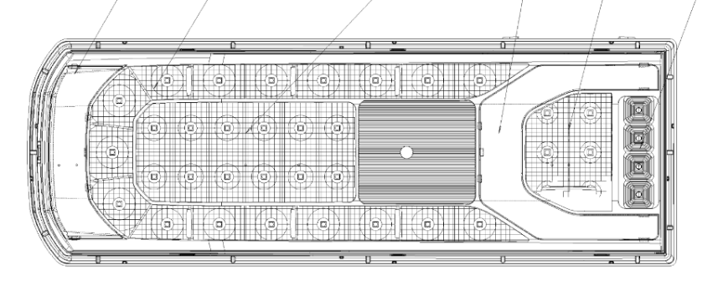
OICA Data
Direction indicator (only sequential activation)
25 mm
25 mm
25 mm
Stop lamp
25 mm
DI photometry provided by areas outside 25mm distance from stop = No
75% of DI area outside 25mm from stop = No
Area of Direction Indicator = >30 cm²

Slide 16
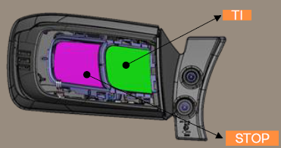
OICA Data
DI photometry provided by areas outside 25mm distance from stop = No
75% of DI area outside 25mm from stop = No
Area of Direction Indicator = <30 cm²

Slide 17
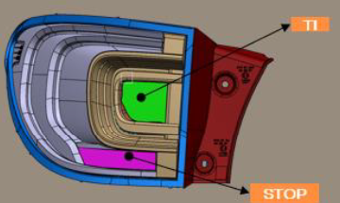
OICA Data
DI photometry provided by areas outside 25mm distance from stop = Yes
75% of DI area outside 25mm from stop = Yes
Area of Direction Indicator = <30 cm²

Slide 18
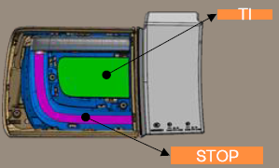
OICA Data
DI photometry provided by areas outside 25mm distance from stop = No
75% of DI area outside 25mm from stop = Yes
Area of Direction Indicator = >30 cm²

Slide 19
OICA Position for discussion only
There cannot be a problem when direction indicators meet one of the following:
The apparent surface is equal to or greater than the apparent surface of the stop lamp.
The intensity at HV is a minimum of 25% greater than the intensity at HV of the stop lamp.
The separation distance in either the vertical or horizontal direction from the stop lamp is equal to or greater than 20 mm.
The apparent surface is equal to or greater than 30 cm².

