Slide 1
Transmitted by the expert of France
Informal document WP.29-197-15
197th WP.29, 11 to 14 Nov 2025
Agenda item 4.14
  Amendment of the Resolution on the Construction of Vehicles (R.E.3)
  Proposal: Introduction of Virtual Testing
Direction générale de l’Energie et du Climat
Sous-direction de la sécurité et des émissions des véhicules
Bureau de la réglementation technique et de l’homologation des véhicules

Slide 2
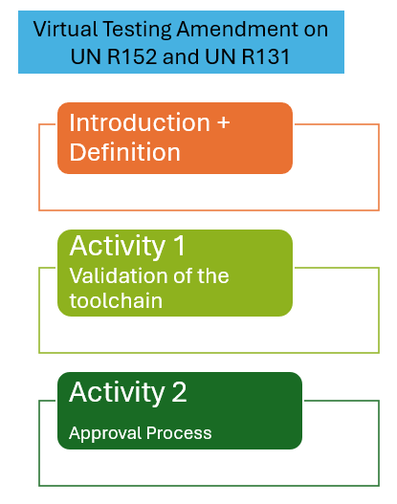
CONTEXT
The AEBS Regulations UN R152 for M1 and N1, and UN R131 for M2, N2, M3 and N3 have been amended by GRVA to introduce an alternative method for performing homologation tests using Virtual Testing.
It is based on specifications developed by GRVA/VMAD SG2 on credibility assessment

Slide 3
OBJECTIVE
➔ Promote a transversal approach in order to facilitate the introduction of Virtual Testing as an optional alternative of some of physical tests in relevant regulations

Slide 4
PROPOSAL
➔ Add a new Annex 8 of the Resolution on the Construction of Vehicles (R.E.3) to introduce Virtual Testing as an alternative to physical tests
Ensure consistency in how Virtual Testing is defined, validated, and applied across relevant regulations
Avoid the repetitive and time-consuming process of amending each regulation separately

Slide 5
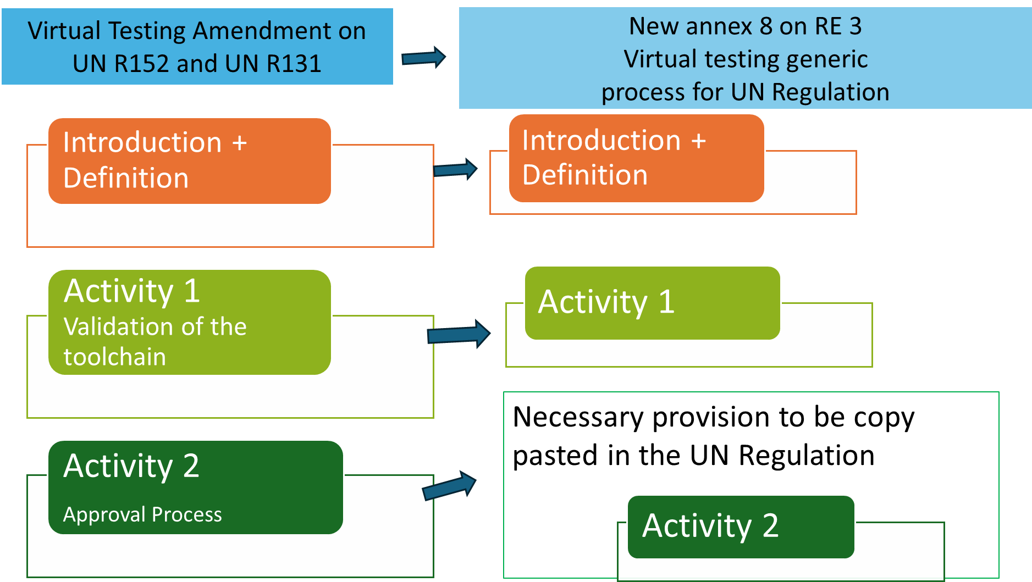

Slide 6
PROPOSAL
Each GR may select the relevant regulations under its responsibility and introduce Virtual Testing as prescribed in the new annex of R.E.3
(as it was done in Reg 152 and Reg 131)
Each GR may consider whether it is relevant or not to amend the regulations already using a Virtual Testing method with this new approach
(as it could be in Reg 21, Reg 66 or Reg 29 as examples)

Slide 7
New R.E.3 annex proposal (see inf WP.29-197-14)
Add a new annex 8 in R.E.3 called : “Virtual Testing Guideline with regards to Tests for Approval”
  Introduction part
    (a) Activity 1: The development, management, verification and validation of the toolchain; and,
    (b) Activity 2: The use of virtual testing results to conduct testing required for approval process.
  Definitions and requirements part
  Necessary provisions for the relevant UN Regulations part
With wording for the core of the concerned regulation and a new annex related to Activity 2:
Activity 2: The use of virtual testing results to conduct testing required for approval process

Slide 8
NEXT STEPS
WP.29 feedback on the proposed approach
Interested parties to reach out France (Pierre Bazzucchi) for questions/comments/suggestions
If agreement, kindly request the GRSG 2026 session to consider WP.29-197-14 (or amended version) as a basis for discussion
If necessary, depending on the received questions/comments/suggestions, workshop to be organized in between with interested parties

Slide 9

Thank you
for your attention
Contact details :
Pierre Bazzucchi (pierre.bazzucchi@developpement-durable.gouv.fr)
Fabrice Herveleu (fabrice.herveleu@utac.com)

