Slide 1
Informal document GRPE-94-10
94th GRPE, 17 – 19 March 2026
Agenda item 12
Proposal for an Amendment 2 to Mutual Resolution (M.R.3) concerning Vehicle Interior Air Quality
Geneva, 17 – 19 March, 2026
Expert from Russian Federation: Andrey KOZLOV

Slide 2
Timeline of the Third Stage
WP.29
198
GRPE
81
82
83
84
85
86
87
88
89
90
91
92
93
94
VIAQ
20
21
22
23
24
25
26
27
28
29
30
31
32
33
34
2020 | 2021 | 2022 | 2023 | 2024 | 2025
2026
PM Draft +Gas Draft Final Draft
Data collection
Analysis of existing test procedures
Tests by VIAQ IWG members
Developing of harmonized test procedure
Stage 3. Phase 1
Stage 3. Phase 2
Notes:
2

Slide 3
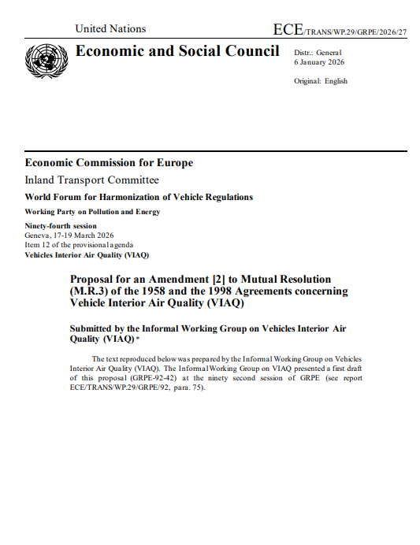
Proposal for an Amendment 2 to M.R.3 on VIAQ
Proposal for an Amendment [2] to Mutual Resolution (M.R.3) of the 1958 and the 1998 Agreements concerning Vehicle Interior Air Quality (VIAQ)
ECE/TRANS/WP.29/GRPE/2026/27
Key changes:
Part I was updated
New Part IV was added
New Annexes VII, VIII and IX were added
Notes:
3

Slide 4
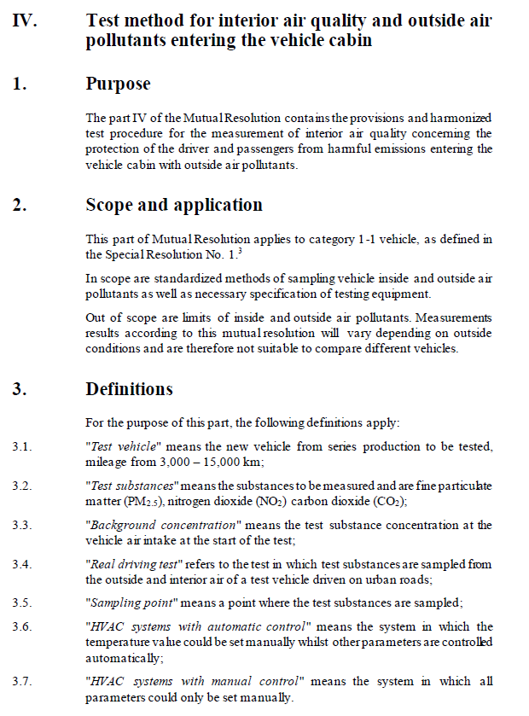
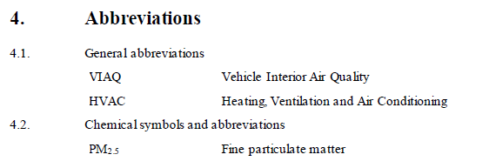
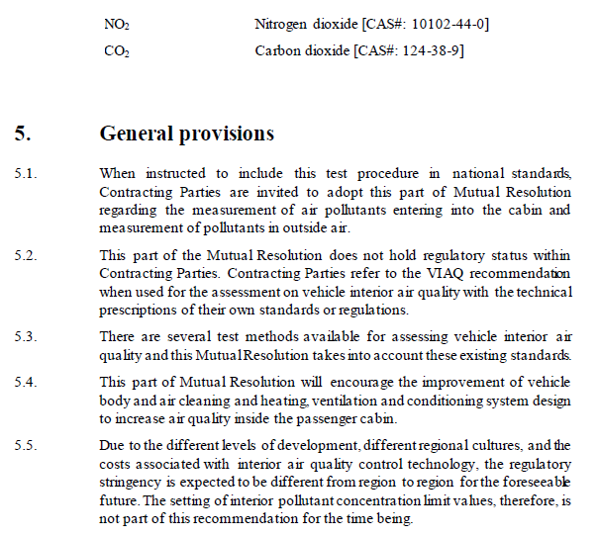
Proposal for an Amendment 2 to M.R.3 on VIAQ
Notes:
4

Slide 5
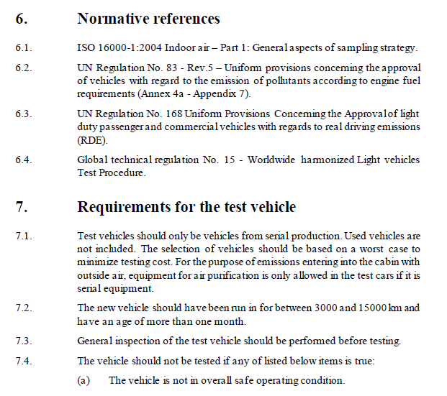
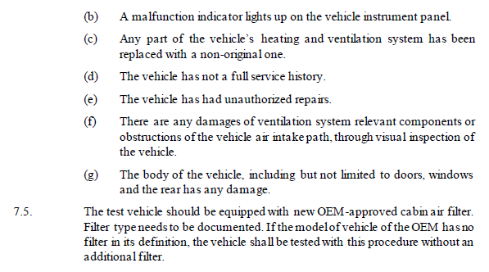
Proposal for an Amendment 2 to M.R.3 on VIAQ
Notes:
5

Slide 6
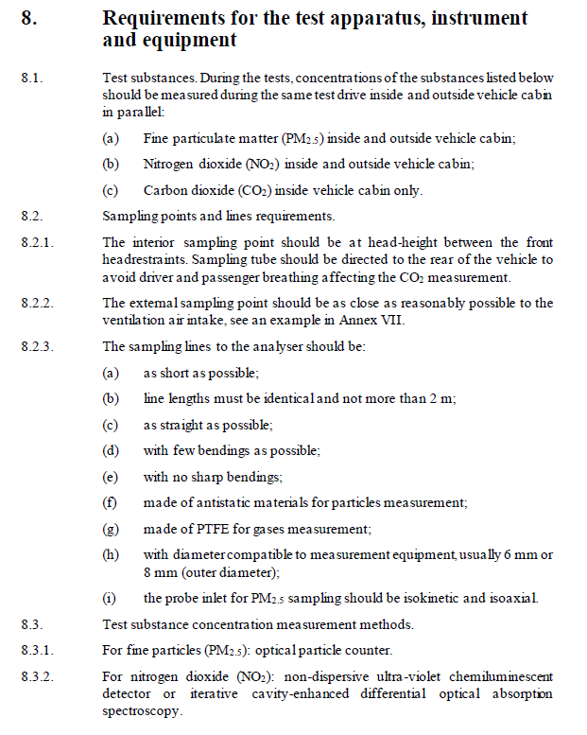
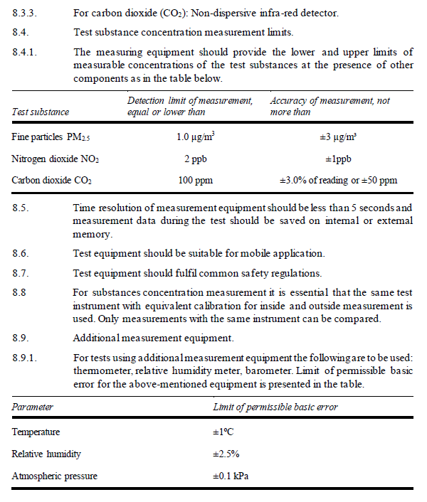
Proposal for an Amendment 2 to M.R.3 on VIAQ
Notes:
6

Slide 7
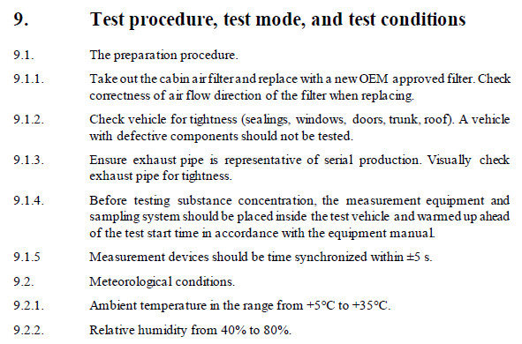
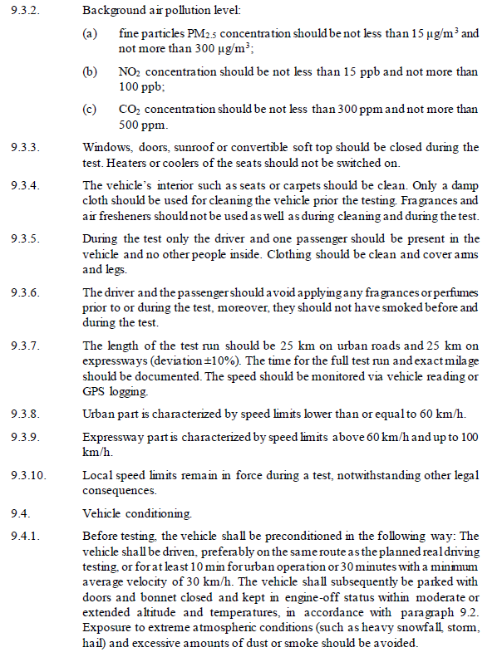
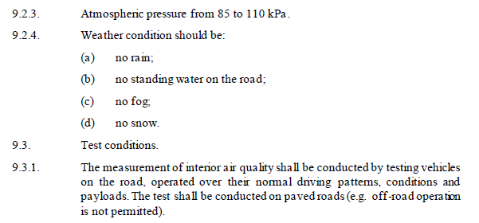
Proposal for an Amendment 2 to M.R.3 on VIAQ
Notes:
7

Slide 8
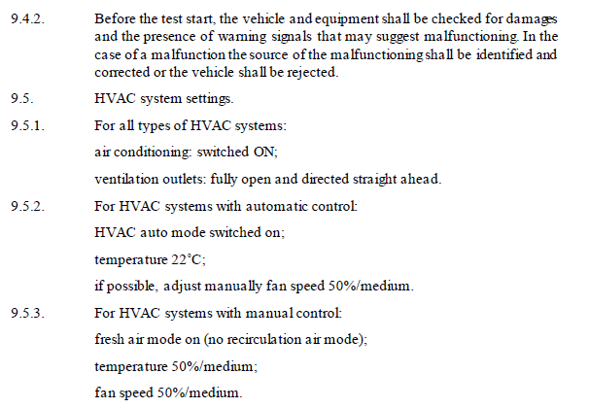
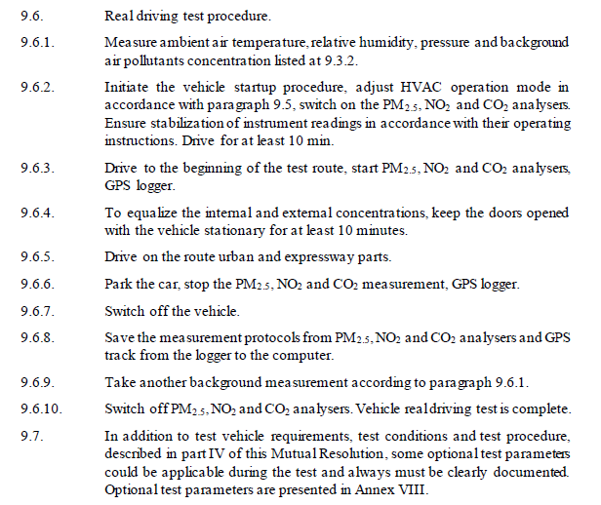
Proposal for an Amendment 2 to M.R.3 on VIAQ
Notes:
8

Slide 9
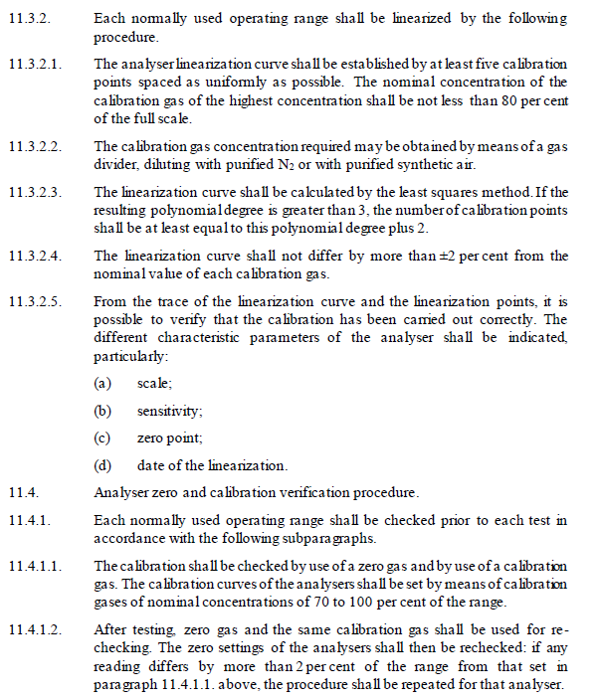
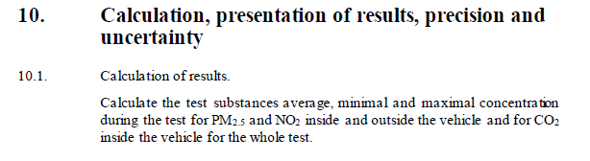
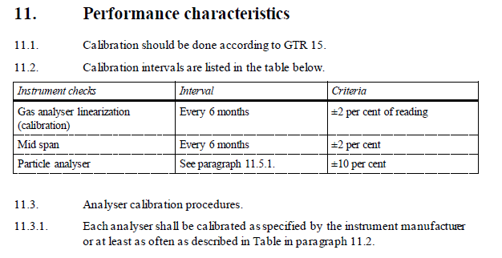
Proposal for an Amendment 2 to M.R.3 on VIAQ
Notes:
9

Slide 10
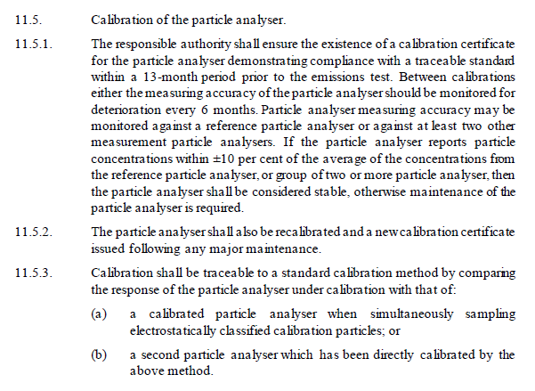
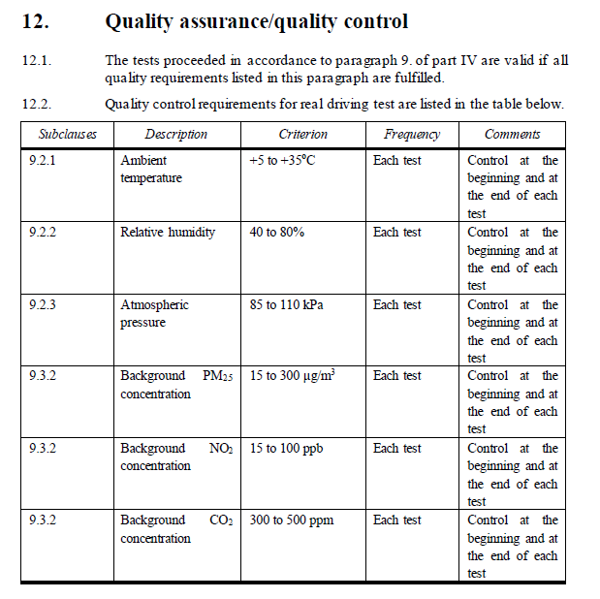
Proposal for an Amendment 2 to M.R.3 on VIAQ
Notes:
10

Slide 11
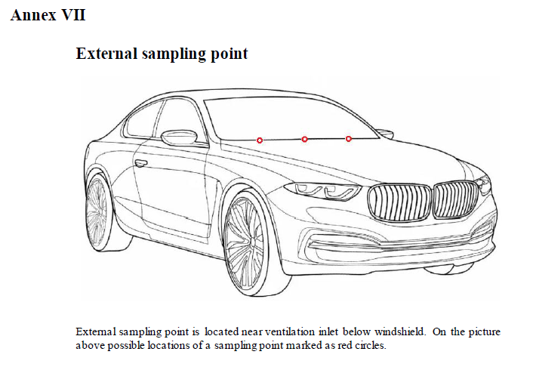
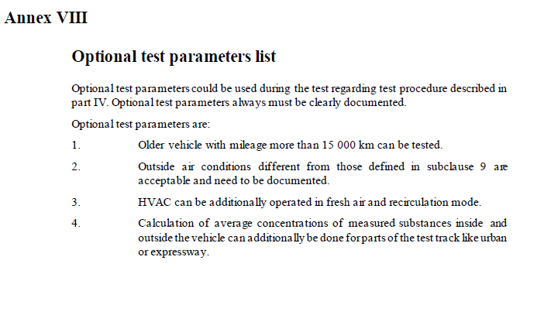
Proposal for an Amendment 2 to M.R.3 on VIAQ
Notes:
11

Slide 12
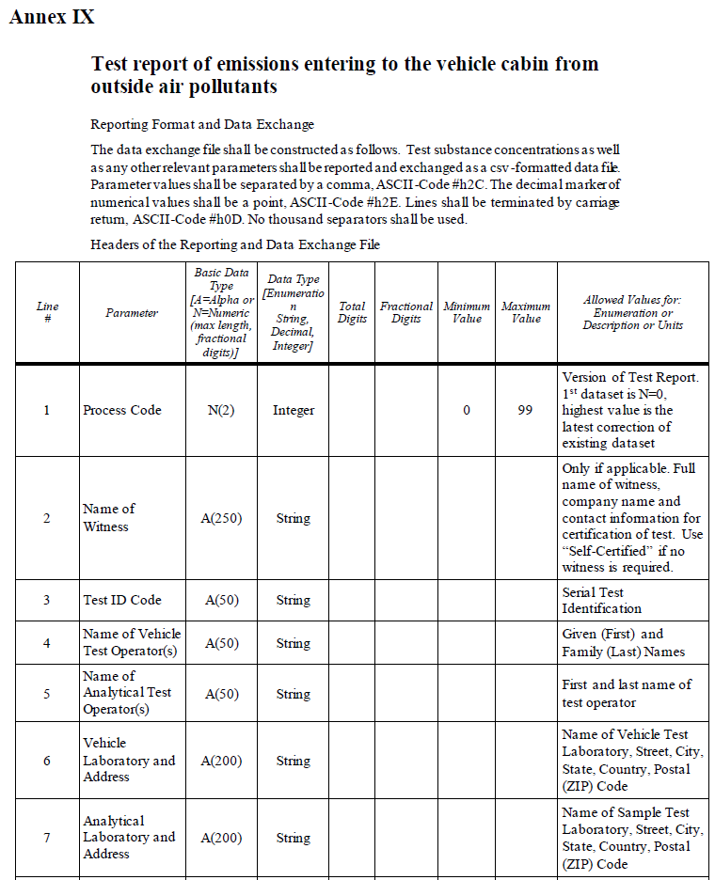
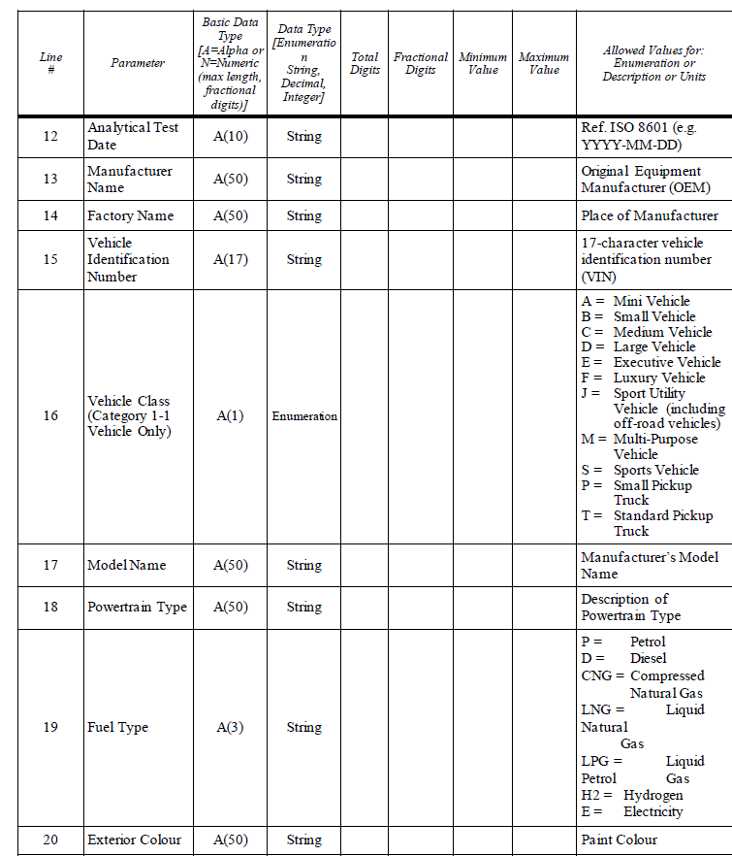
Proposal for an Amendment 2 to M.R.3 on VIAQ
Notes:
12

Slide 13
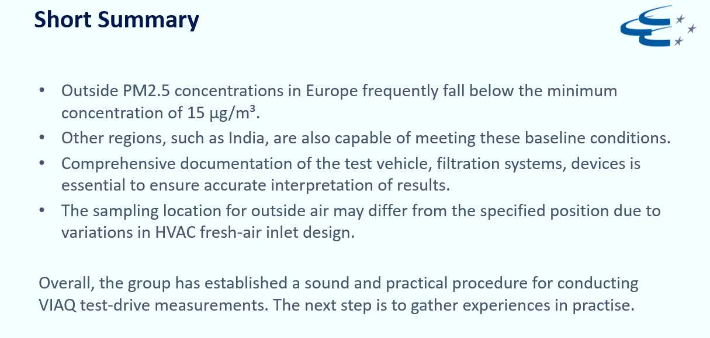
Interlaboratory Tests
Carried out tests, by:
OICA (Germany)
CLEPA (Germany, India)
KAIA (Korea)
NAMI (Russian Federation)
VIAQ-34-02
Notes:
13

Slide 14
VIAQ IWG: Future Steps
Possible future directions of work are:
Collecting new test data in different countries and conditions, improvement of developed test procedure.
Starting work on stage 4 (interior air quality on-board monitoring systems).
Development of equipment and test procedure for vehicle interior air quality assessment in the test chamber in stationary and fully controlled conditions.
Notes:
14

Slide 15
  The author and the speaker of this document/presentation confirm that they have authorization to use all content including photos and visual elements.
  The material is either copyright-free or the author/speaker hold the necessary copyright or permission.
  The UNECE will remove any material from its events and supporting websites if there is unlawful use of copyrighted material.
  The author/speaker takes responsibility for any infringement on copyright and holds the UNECE harmless to this effect

