Slide 1

GIDAS Analysis: Accidents between VRU and bus
Submitted by the experts from Germany | Informal document GRSG-129-43 129th GRSG, 7-11 April 2025 Agenda item 4
Daniel Sander, Federal Highway and Transport Research Institute (BASt)

Slide 2
GIDAS Analysis - Filter Process
GIDAS Database December 2024;
Only complete reconstructed cases
Accident years 2005-2024
33537 accidents
Accidents involving busses (class M2/M3)
824 accidents
Initial conflict between bus and VRU (pedestrian/cyclist)
207 accidents
With collision between bus and VRU
No collision → e.g. passenger have fallen due to braking
125 accidents
82 accidents

Slide 3
GIDAS Analysis – First Insights
Vehicle Class | Accident Opponent | Killed | Seriously Injured | Slightly Injured | Accidents
M2 | Bike | 0 | 0 | 2 | 2
M2 | Pedestrian | 0 | 0 | 0 | 0
M3 | Bike | 1 | 15 | 43 | 55
M3 | Pedestrian | 1 | 32 | 62 | 69
Sum |  | 2 | 47 | 107 | 125
One accident with an injured cyclist and pedestrian

Slide 4
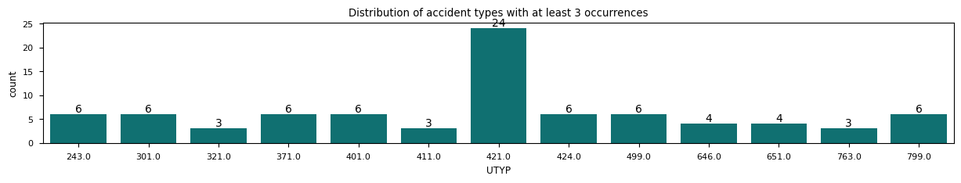
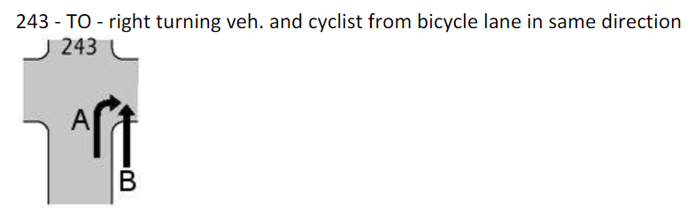
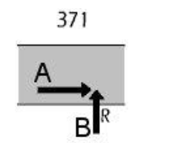
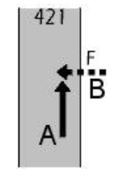
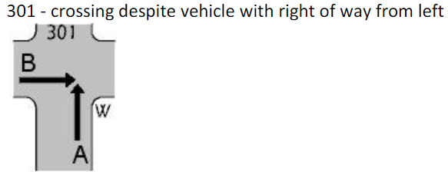
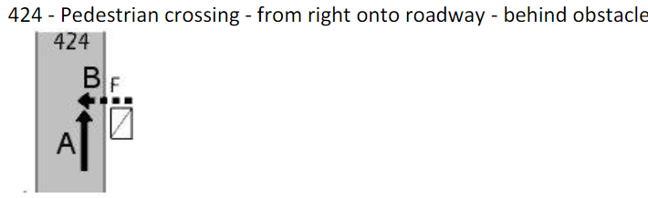
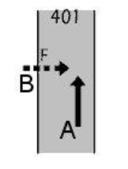
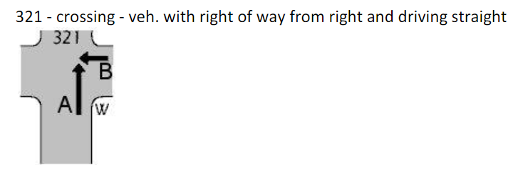
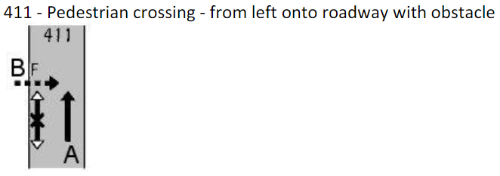
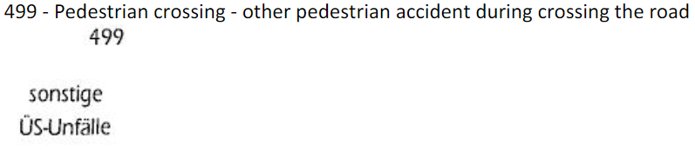
GIDAS Analysis – First Insights
Pictograms source:
Unfallforschung der Versicherer

Slide 5
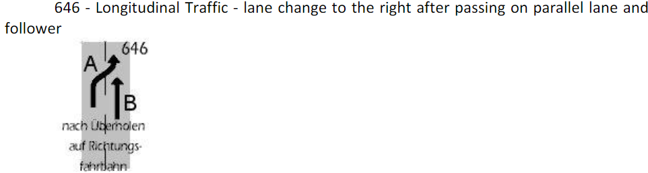
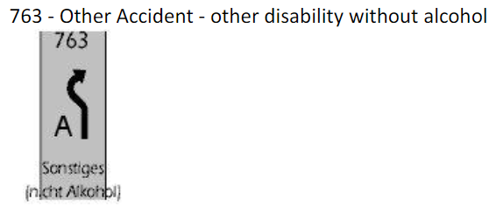
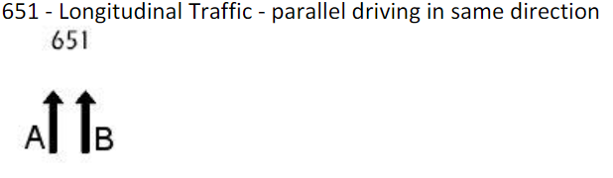

GIDAS Analysis – First Insights
Pictograms source:
Unfallforschung der Versicherer

