Slide 1
Informal document GRE-92-06
(92nd GRE, 22-25 April 2025, agenda item 12 (c))
Energy Saving Opportunities
in Automotive Lighting
GTB Activities Status Report
Dr. phil. nat. Rainer Neumann
GTB WG-SVP Chairman

Slide 2
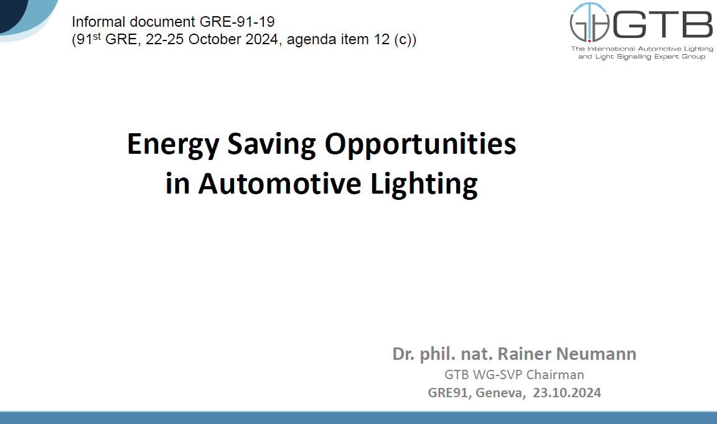
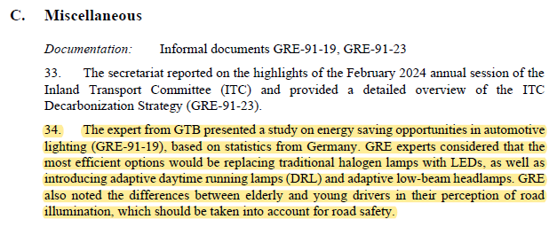
Energy Saving Opportunities in Automotive Lighting
Reminder of GRE 91st session on 23 October 2024
GRE 91st Working Document GRE-91-19
GRE 91st Report ECE-TRANS-WP29-GRE-91e

Slide 3
Energy Saving Opportunities in Automotive Lighting
GTB current working directions
TARGET: ENSURE SAFETY & REDUCE ENERGY CONSUMPTION AND GLARE
DRL → passing-beam switching threshold reduction
> today at 1000lux of ambient illumination
Adaptive DRL
> adapted to the ambient illumination
Adaptive passing-beam
  > new AFS class, focusing in the first 25m
  > activated only in specific situations of sufficient
  environmental illumination, low or zero speed, built-in areas
Specific use case: vehicle in stand still (e.g. stopped in a traffic light)
    > reassessment of lighting and light-signaling functions activation

Slide 4
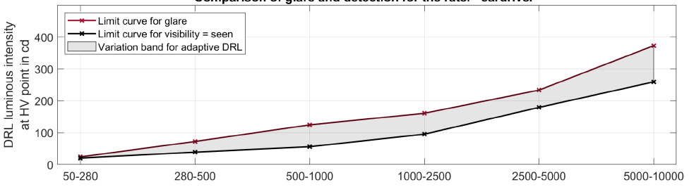
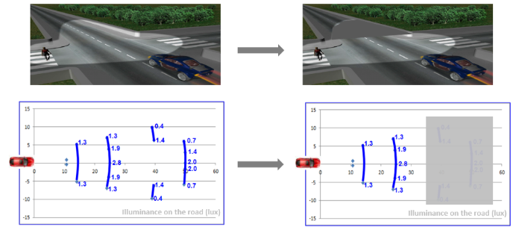
Energy Saving Opportunities in Automotive Lighting
GTB current working status (April 2025)
TARGET: ENSURE SAFETY & REDUCE ENERGY CONSUMPTION AND GLARE
DRL → passing-beam switching threshold reduction
> today at 1000lux of ambient illumination
Adaptive DRL
> adapted to the ambient illumination
Adaptive passing-beam
  > new AFS class, focusing in the first 25m
  > activated only in specific situations of sufficient
  environmental illumination, low or zero speed, built-in areas
Specific use case: vehicle in stand still (e.g. stopped in a traffic light)
    > reassessment of lighting and light-signaling functions activation
Class V
NEW „Class ECO“
First ideas identified and under evaluation by the GTB Experts

Slide 5
Energy Saving Opportunities in Automotive Lighting
Next steps
TARGET: ENSURE SAFETY & REDUCE ENERGY CONSUMPTION AND GLARE
Extended complementary study considering:
- large number of test persons of different ages
- assessment of distances corresponding to city traffic (50m)
and braking distance in country road (75m)
- large range of ambient illuminance (30lx – 10,000lx)
Conclusions: GRE-93 October 2025
DRL → passing-beam switching threshold reduction
> today at 1000lux of ambient illumination
Adaptive DRL
> adapted to the ambient illumination
Adaptive passing-beam
  > new AFS class, focusing in the first 25m
  > activated only in specific situations of sufficient
  environmental illumination, low or zero speed, built-in areas
Specific use case: vehicle in stand still (e.g. stopped in a traffic light)
    > reassessment of lighting and light-signaling functions activation
Initial proposal/input as informal document for GRE-93
Initial proposal/input as informal document for GRE-93

Slide 6

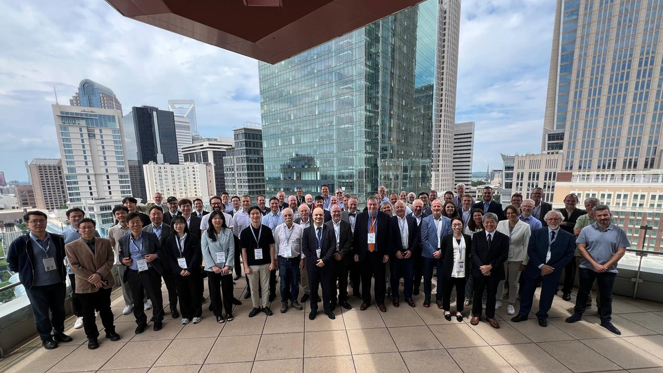



CONTACTS
GTB Secretariat
secretariat@gtb-lighting.org
www.gtb-lighting.org
Via Pasquale Galluppi, 7 10134 Torino (Italy)

