Slide 1
Proposals of Republic of Korea
(on Emergency Door Opening)
EDO 2nd meeting
2025.09
Korea Automobile Testing & Research Institute
Jinseop PARK

Slide 2
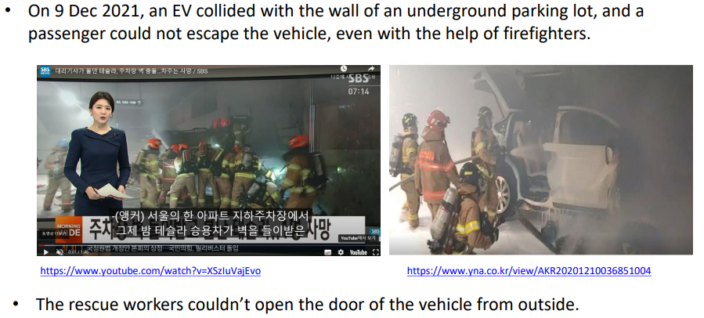
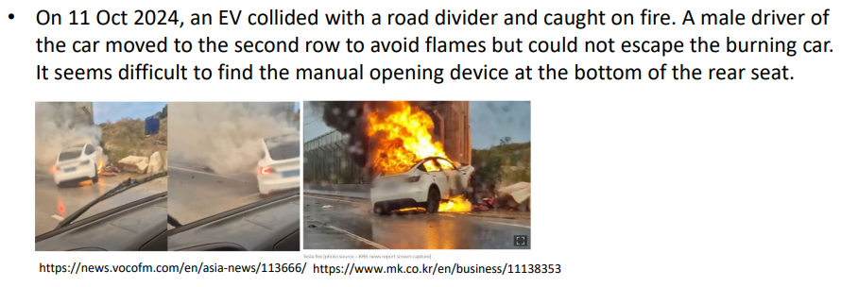
Background
Republic of Korea presented door opening issues with electrically activated doors during 76th GRSP session (GRSP-76-13-rev1)
Several GRSP experts expressed their support for the initiative during 77th GRSP session and the 1st meeting was virtually held on June 16th
Picture Source: GRSP-76-13-Rev1

Slide 3
Discussion items on Emergency Door Opening
Evacuation from the inside
- for electrically activated door system
- for safety belt unbuckling
Rescue from the outside
- door opening safety in case of power issue
- door opening safety after collision
- door opening safety with specific handle/system
Others
- tailgate opening
- submergence
* based on 2025 KNCAP protocol & GRSP comments, 1st meeting of interested GRSP experts

Slide 4
Proposals of Republic of Korea – Priority 1
Door opening requirements with electricity supply cut off
- amendment regulations: GTR No.1, UN R11
- test with a vehicle with its all related electricity supply cut off
- doors shall be opened by main or emergency/secondary opening systems without any tools from inside and outside
- the emergency/secondary opening systems shall be intuitive and those opening methods shall be described in the manual (incl. retractable case)
- the intuitiveness requirements of the controller of those opening systems shall include at least the below
· shall be clearly visible by the seated occupants (for interior)
· shall not be hidden by any parts (e.g. covers, armrest, etc.)
- further specific discussions needed (definitions, test conditions, etc.)

Slide 5
Proposals of Republic of Korea – Priority 2
Door opening requirements after crash tests
- amendment regulations: all crash test regulations
(GTR No.14, UN R34, UN R94, UN R95, UN R135, UN R137, UN R153, & corresponding regulations)
- test with a vehicle after crash tests (all doors except struck side doors in case of side crashes and tailgates)
- doors shall be unlocked after crashes
- door shall be opened when a pulling load is applied as below
· hinged type doors: 750N or less
· sliding type doors: 750N or less, 45 degrees (500mm opening)
- further specific discussions needed (test conditions, etc.)

Slide 6
Proposals of Republic of Korea – Priority 3
Other requirements for extrication
- seat belt unbuckling after crashes
(60N for frontal crashes, 100N for side crashes)
- tailgate opening and vehicle submergence
· agreed in principle
· specific discussions needed from, especially, the testability perspective for self-certification compliance testing

Slide 7
고맙습니다.
Thank you for your attention
jspark@kotsa.or.kr

