Slide 1
Submitted by the expert from CITA
Informal document GRVA-22-34
22nd session, 24 June 2025
For review at the Bangkok meeting, hosted during the Road Safety week,
2-5 June 2025 (ESCAP/UNCC)
Provisional agenda item 8(b)
PTI provisions for
Electromechanical Braking (EMB)
UN REG 13 & 13-H
22nd GRVA
02-05 June 2025 – UNESCAP Bangkok, Thailand
Alejandro Checa
CITA Technical Director

Slide 2
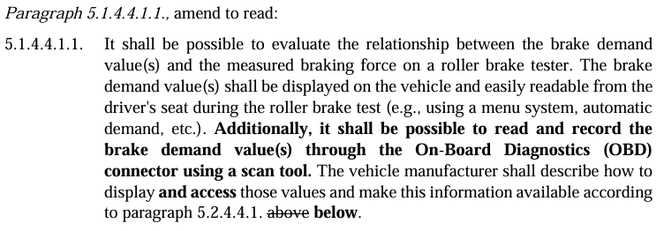
UN REG 13 & 13-H EMB
Last GRVA meeting in January (Geneva) :
CITA presented UN Reg 13 & 13-H amendment through 2 formal documents:
(CITA) Proposal for amendments to UN Regulation No. 13 (Heavy Vehicle Braking) | UNECE
(CITA) Proposal for amendments to UN Regulation No. 13-H (Braking of passenger cars) | UNECE

Slide 3
UN REG 13 & 13-H EMB
CITA proposal
Need for harmonization of braking system tests.
No exclusion of countries using one other method.
Improvement to allow all countries currently using the data available via the OBD to still benefit from this information without any additional investment.
Clarifications
Current proposal not new but consists of an improvement of the existing one.
OBD scan-tool already implemented in PTI with no cybersecurity risks.
Amendment introduction = best time before future technology are on the roads.

Slide 4
UN REG 13 & 13-H EMB
POSITIVE Reactions from Contracting Parties
European Commission, Slovakia, Germany, Spain and the Netherlands provided full support.
FUTURE proposal
Following the last GRVA meeting, CITA has taken into account the various comments from the contracting parties. CITA proposes to postpone its future proposal to September 2025. All contracting parties who have expressed interest in this proposal will be informed individually before publication on the UNECE page.

Slide 5
Thank you for your attention!
Alejandro Checa
CITA Technical Director
a.checa@citainsp.org
www.citainsp.org
Rue du Commerce 123 - 1000 Brussels, Belgium
+32 (0)2 469 06 70
secretariat@citainsp.org

