Slide 1
SLR-73-05/Rev.1
(Rev. of SLR-70-14/Rev.1)
Consistency of similar requirements
among the installation Regulations
Existing text
UN Regulation No. 53 5.17. The fitting of any lighting and light-signalling devices other than those mentioned in paragraphs 5.14. and 5.15. above is prohibited for the purposes of type approval. UN Regulation No. 74 5.17. The fitting of any lighting and light-signalling devices other than those mentioned in paragraphs 5.14. and 5.15. is prohibited with the exception of an appropriate illuminating device for the rear-registration plate if it exists and its lighting is required.

Slide 2
SLR requested guidance and feedback from GRE (see GRE-91-02).
GRE expressed its preference for options A and C in doc. GRE-91-22
5. General specifications
Option A
Notwithstanding those lamps which may be installed at national and regional level or for any special purpose vehicles, the fitting of any lamps other than those mentioned in paragraph 6 is prohibited for the purposes of granting a [UN] type-approval according to this Regulation.
++++++++++++++++++++++++++++++++++++++++++++++++++++++
Option C
The fitting of any lighting and light-signalling devices other than those mentioned in paragraph 6 is prohibited for the purposes of granting a [UN] type-approval according to this Regulation. [National regulations are not considered as part of the type-approval.]

Slide 3
SLR Officers’ suggestion for improved wording
Slide updated during SLR-71
This suggestion:
is based on Options A and C of GRE-91-22, as indicated by the CPs at GRE-91 (see Par. 9 of GRE report)
takes into account the concerns expressed by OICA, particularly with regard to special warning lamps and new technologies
reflects the further informal exchange of views with various parties during the week of GRE-91
5. General specifications
The fitting of any lighting and light-signalling device or function, other than those mentioned in paragraph 6, is prohibited for the purposes of granting a type-approval according to this Regulation, except for:
any special warning lamp approved in conformity with UN Regulation No. 65;
any lighting and light-signalling device or function installed according to the “Procedure for exemption approvals concerning new technologies” (document E/ECE/TRANS/505/Rev.3 - Schedule 7). The applicant shall provide the necessary documentation and proof thereof.
Annex 1
9.xx. Lamps installed according to the “Procedure for exemption approvals concerning new technologies”: yes/no² …………………………………………………………………………
² Strike out which does not apply.
5.22. With the exception of retro-reflectors, a lamp even bearing an approval mark is deemed not to be [present fitted] when it cannot be made to operate [without the knowledge of the vehicle manufacturer by the sole installation of a light source and/or a fuse].
SLR-71: keep 5.22 as it is (no modification)

Slide 4
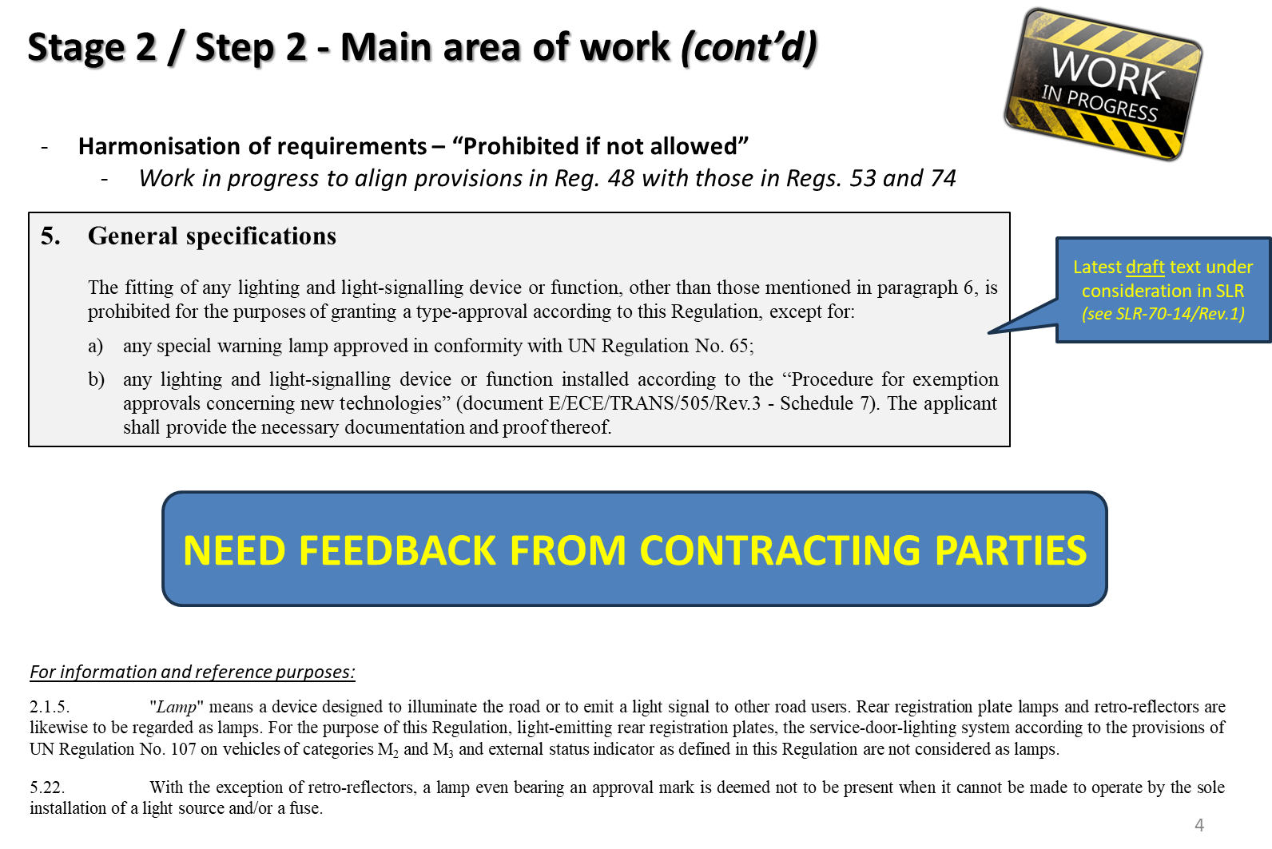
Excerpt of SLR report to GRE-92 (doc. GRE-92-22)

Slide 5
Notes from GRE-92 discussion:
FR: b) Not comfortable with link to exemption procedure. Offered to provide draft text.
DE: Agrees with FR on b) and concerns also on a)
EC: a) Need additional language to avoid conflict with national provisions. National provisions are outside the scope of GRE
  b) no added value but conversely could cause confusion due to different interpretation
  GRE Secretary: Schedule 7 would overrule Regulations anyway so it is not needed to mention b) in Reg.48
  SLR Chair: b) Seems indeed not needed
  OICA recalled that SLR is also discussing Par. 5.22 and requested feedback in case of factory fitted lamps (e.g. taxi)
Takeaways from GRE-92 discussion:
Exemption b) is not needed and therefore can be removed
Should we keep exemption a) ?
Should we amend Par. 5.22 to further clarify / adapt to technical progress ?

Slide 6
Working document reflecting the outcome of SLR-73
5. General specifications
The fitting of any lighting and light-signalling device or function, other than those mentioned in paragraph 6, is prohibited for the purposes of granting a type-approval according to this Regulation
except for:
any special warning lamp approved in conformity with UN Regulation No. 65;
[approved reflecting plates according to Regs. 70 and 150 as well as green lamps used on ADR vehicles] → NEW, proposed by OICA
[light-emitting rear registration plates, the service-door-lighting system according to the provisions of UN Regulation No. 107 on vehicles of categories M₂ and M₃ and external status indicator] → NEW, considered during SLR-73 (text moved from Par. 2.1.5.)
“Core” part to be added
Exceptions for further discussion
2.1.5. "Lamp" means a device designed to illuminate the road or to emit a light signal to other road users. Rear registration plate lamps and retro-reflectors are likewise to be regarded as lamps. [For the purpose of this Regulation, light-emitting rear registration plates, the service-door-lighting system according to the provisions of UN Regulation No. 107 on vehicles of categories M₂ and M₃ and external status indicator as defined in this Regulation are not considered as lamps.]
5.22. With the exception of retro-reflectors, a lamp even bearing an approval mark is deemed not to be present when it cannot be made to operate by the sole installation of a light source and/or a fuse

