Slide 1
EDR
Input on Tasks of EDR Step#2
Comments on EC+DE document of SG-EDR-42-05 and UK document of EDR/DSSAD-IWG-26-09
EDR/DSSAD-IWG-27

Slide 2
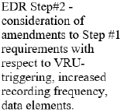
EDR
Input for EDR/DSSAD IWG-27
Focus of EDR Step#2 according to GRSG-128
Proposal for accuracy specification of counters (time since last warning)
CLEPA supports discussion on
  VRU trigger
  changing recording frequency to 10Hz for data elements where it makes sense
  additional data elements as proposed by EC+DE and UK
=> See following slides

Slide 3
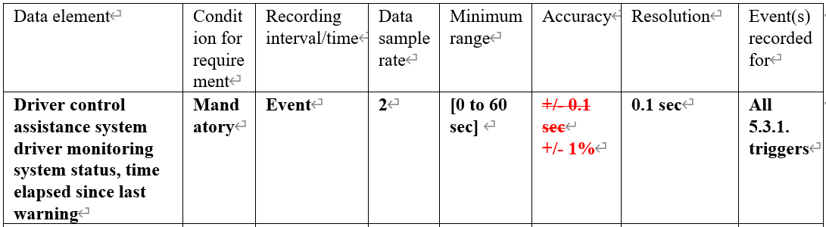
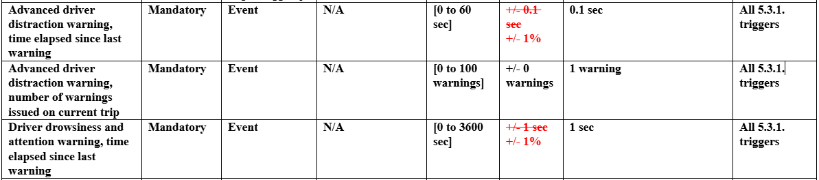
NEW Data Elements proposed by EC+DE/UK
Driver Monitoring System i.e. ADDW ,DDAW and DCAS
[Proposal]
Accuracy requirements for those Driver Monitoring System and DCAS related data elements should be +/-1% like below.
SG-EDR-42-05
EDR/DSSAD-IWG-26-09
[Justification]
1. Accuracy
Airbag ECUs use resonators, which generate fixed periodic signals, to measure elapsed time within ECUs.
Those resonators have manufacturing tolerances and variations which differentiate intervals of generating the signals.
Those variations of resonators which are commonly used on the market are +/- 1%.
Therefore, this accuracy requirements also should be +/- 1%.
2. Unit of accuracy requirement
The amount of error of measured time depends on length of measured time since accumulating errors while measuring time.
Rate(%) is better for unit of accuracy instead of absolute value since it will be changed when changing minimum range.

Slide 4
Principle of Time Measurement
e.g. ADDW, time elapsed since last warning and Accuracy +/-1%
A resonator generates fixed periodic signals to be counted for measuring time(Figure1).
Manufacturing tolerances and variations of resonator cause the difference of time width.
The difference cause the error of measured time since timing of increasing counter is changed(Figure2).
This means that the longer the measurement time, the greater the error(Figure3).
Time width
Figure1
ADDW warning@-10s
ADDW warning@-5s
Collison@0s
-3600
-60
-10
0
Fixed periodic signals
Resonator
-10
error:
+/-0.1s
-4s
-3s
-2s
-1s
Counter
-9s
-8s
-7s
-6s
-5s
-10s
Accuracy:-1%
Measured Time[s]
error:
+/-0.6s
-60
Accuracy
-1%
Accuracy+1%
-3.96s
-2.97s
-1.98s
-0.99s
-8.91s
-7.92s
-6.93s
-5.94s
-4.95s
-9.9s
error:
+/-36s
-3600
Accuracy
+1%
-4.04s
-3.03s
-2.02s
-1.01s
Actual Time[s]
-10.1s
-9.09s
-8.08s
-7.07s
-6.06s
-5.05s
Figure2
Figure3

