Slide 1
ADS IWG
Status Report
Report to GRVA

Slide 2
Progress since GRVA last January
Jan 2025
GRVA-21
Feb 2025
ADS-06 (online)
March 2025
ADS-07 (NL)
April 2025
ADS-08 (JP)
May 2025
ADS-09, 10, 11 (online)
1st draft consolidated common provisions
(ADS-06-04r1)
2nd draft consolidated common provisions
(ADS-08-04r1)
Open issues tracker
(ADS-08-05r1)
3rd draft consolidated common provisions
(ADS-10-05)
Six hybrid and online sessions dedicated to “common provisions” applicable to both a GTR and a UN Regulation.
GRVA ADS Workshops | EDR/DSSAD IWG | FADS/AVRS/AVSR | AVC...
Liaison with other WP.29 IWG and task forces

Slide 3
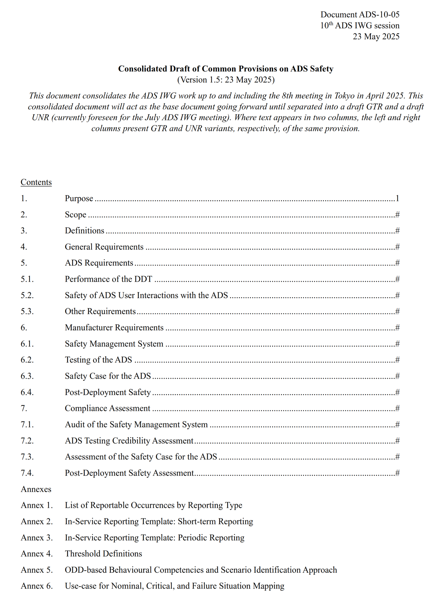
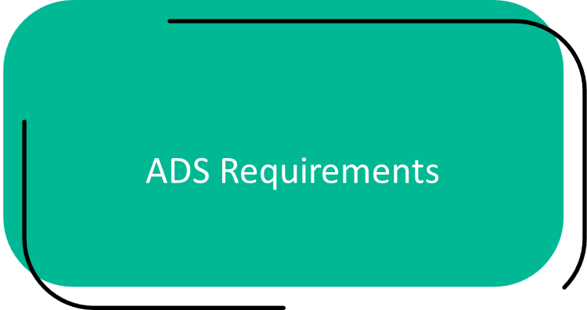
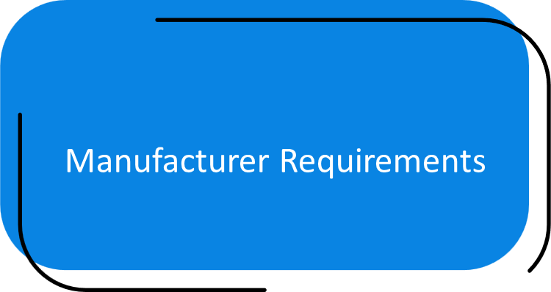
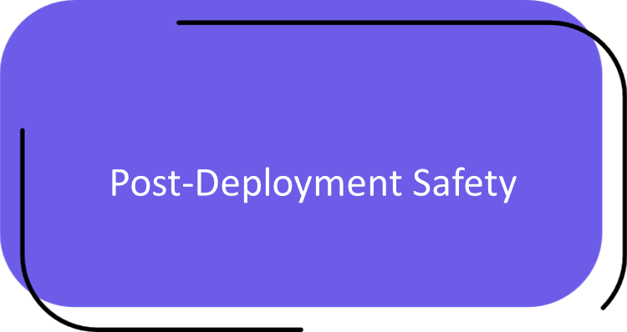
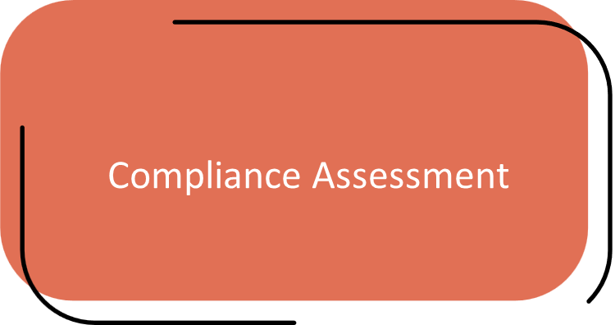
Overview of common provisions (ADS-10-05)
Main Components of the Common Provisions
I
II
IV
III

Slide 4
Overview of common provisions (ADS-10-05)
I
High-level requirements applied depending on ADS use case:
DDT performance across nominal, critical, and failure traffic scenarios (§5.1.)
Safety of Interactions between ADS and ADS vehicle users (§5.2.)
Other safety requirements (in-service, cyber security, software updates, DSSAD) (§5.3.)
II
Requirements for manufacturer validation of an ADS:
Safety Management System (§6.1.)
Testing Environments (§6.2.)
Safety Case (§6.3.)
III
Assessment of manufacturer’s validation against requirements:
Safety Management System Audit (§7.1.)
Testing Credibility Assessment (§7.2.)
Safety Case Assessment (§7.3.)
IV
Assess manufacturer capabilities based on in-service monitoring and reporting requirements:
Safety monitoring
Remedial actions if needed
Short and periodic performance reporting
}
§6.4.
§7.4.

Slide 5






II. Manufacturer requirements
A Safety Management System (SMS) is a systematic approach to managing safety.
  Organisational safety policies, principles and culture
  Processes for risk management and ADS design and development
  Personnel competencies
Minimum requirements for the manufacturer’s safety management system (§6.1)
Minimum requirements for credible testing environments (§6.2)
Ensure that the physical test environments and toolchains (e.g. virtual testing toolchains) are appropriate for their use.
Minimum requirements for providing a valid ADS safety case (§6.3)
Structured presentation of claims supported by SMS and testing outcomes that the ADS meets or exceeds the requirements of the regulation and is free from unreasonable risks to the ADS vehicle user(s) and other road users.
Minimum requirements for in-service monitoring (§6.1) and reporting (§6.4)
Establishes minimum requirements for capabilities to monitor the performance of ADS in use and establishes requirements for reporting on ADS safety performance.

Slide 6




III. Compliance assessments
Verify compliance with SMS requirements.
A single SMS may cover multiple ADS.
Periodic certification anticipated
Audit the Safety Management System (§7.1)
Verify the credibility of the manufacturer’s ADS testing organisation and management, including application of SMS outcomes to ensure effective testing of the ADS.
Assess test environment (§7.2)
Assess the ADS safety concept and the claims, arguments, and evidence for its effectiveness against the ADS safety requirements and mitigation of safety risks identified per the SMS.
Assess safety case (§7.3)
Verify claims for behavioural competencies made in the safety case by selectively reproducing testing used to generate the evidence for those claims.
Perform confirmatory testing (§7.3)

Slide 7
IV. Post-deployment safety
I
Capabilities to monitor ADS performance and comply with reporting requirements verified as part of initial ADS assessment
In-service monitoring and reporting provides feedback to assess effectiveness and support improvements
II
III
IV
“pre-approval”
“post-approval”

Slide 8
Outlook
IDs Sept ’25
WDs Jan ‘26
ADS-10-05
July ADS IWG
“Common provisions” applicable to both GTR and UN Regulation.
GRVA ADS Workshops
Global Technical Regulation
GRVA
DSSAD provisions
UN Regulation
Other input?
ADS IWG finalising common provisions.
Input from GRVA workshops: awaiting further input.
Input from EDR/DSSAD IWG: review of DSSAD guidance document and coordination ongoing. GRVA feedback on expected integration outcome.
Developing documents for GTR and UNR.

Slide 9
Plan going forward
March 2026
WP.29
(informal documents UNR and GTR?)
June 2026
WP.29
(considers UNR and GTR working documents)
September 2025
IWG-ADS #13
(web)
October 2025
IWG-ADS #14
(Canada)
December 2025
IWG-ADS #15
(Japan)
July 2025
IWG-ADS #12
(Helsinki)
September 2025
GRVA
(informal documents for GTR and UNR)
November 2025
Working document submission for GRVA Jan 2026
January 2026
GRVA
(working documents and informal documents for UNR and GTR)
March 2026
Working document submission for WP.29 June 2026
Goals:
Complete ‘common provisions’
Decisions on integration of DSSAD guidance
GTR and UNR integration document (structure and content placement for common provisions, deliverables 1 and 2 from GRVA workshops, and DSSAD guidance.
Note: Anticipate discussions on ADS IWG after formal submissions in early November 2025 (e.g., further work, terms of reference).

Slide 10
Thank you

