Slide 1
Laboratory of Accidentology, Biomechanics and Human behavior
Accidentology – Blind Spot Accidents
N1/all VRU vs. N2/N3/M2/M3/All VRU in FRANCE
30/06/2025
Laura BIGI

Slide 2
Introduction - Foreword
This complementary study stands in the framework of the IWG-VRU « Awareness of Vulnerable Road Users proximity »
Some concerns were raised regarding the scope of current UN ECE Regulations, especially: R151, R158.
LAB supported dedicated analysis to provide accidentology background for France:
  R151: VRU-Proxi-TF_R151_158-02-04, presents a complete overview of injury accident analysis in turning right manoeuvers* with cyclist riding in the same direction, comparing N1 and heavier vehicles (N2, M2, N3, M3).
    Further presentation today supplements the study on all VRUs, with comparison to UK study (DfT)
  R158: VRU-Proxi-TF_R151_158-03-04), presents a complete overview of injury accident analysis of N2, N3 with trailor against VRU (with consideration of motorcyclists).
* turning on the opposite side of the driver

Slide 3
Summary
Context
Methodology
Results
  French analysis
  Comparison with UK DfT
Conclusion

Slide 4
context
Accidentology background
  French analysis
UN ECE R151: project of evolution, UN IWG-VRU proxi Task Force 2025
  Consideration of scope extension to N1 vehicles.
  First French accidentology analysis related to cyclist issue, VRU-Proxi-TF_R151_158-02-04.
  Complementary accidentology analysis extended to all VRU issue: pedestrian, cyclist, motorcyclist, mobility scooter ridder.
    Comparison of French results along with UK outcomes, VRU-Proxi-TF_R151_158-03-05
March 13,
TFscope #2
June 30, TFscope #4
May 8, TFscope #3

Slide 5

Methodology (1/2)
French national injury accident database: BAAC
  Representative yearly database.
Selection for this analysis:
Years 2016-2023
  Period of time consistent with DfT analysis for UK (2013-2023),
  2019 = new reference year for the next decade / road safety strategy.
N1/all VRU* injury accidents, relevant for UN ECE R151 scenario (turning right manœuvre along with VRU in the same direction).
N2/N3/M2/M3 / all VRU* injury accidents (UN ECE R151) for comparison.
Severity: KSI criteria (killed + severely injured VRU).
  Severely injured = injured people hospitalized more than 24 hours and still alive within 30 days following the accident.
  Fatalities = Persons deceased during the accident or within 30 days following the accident.
* Pedestrian, cyclist (conventional bikes and e-bike), motorcyclist, EPMD (Electrical Personal Mobility Device) ~ E-scooter

Slide 6
Methodology (2/2)
French national injury accident database: BAAC
Filtering / Cascading – synthesis 2016-2023 for analysis
EPMD
Cyclist
Motorcyclist
Pedestrian
NB: tables available for each year, and each VRU* category as casualties.
* Pedestrian, cyclist (conventional bikes and e-bike), motorcyclist, EPMD (Electrical Personal Mobility Device) ~ E-scooter

Slide 7
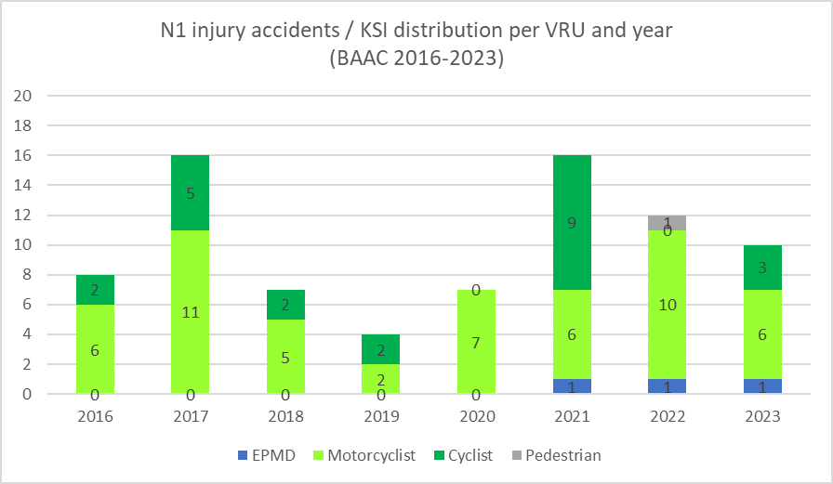
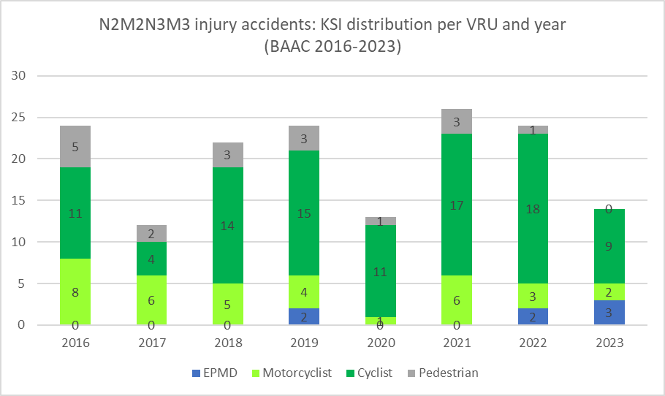
Results
Number of VRUs killed or seriously injured (KSI) in collisions involving at least one N1 vehicle or one heavy vehicle* and one VRU when turning right: yearly distribution over 2016-2023
Total KSIs over the 8-year-period:
*Pedestrian = 1
*Pedal cyclist = 23
*Motorcyclist = 53
*Mobility scooters = 3
Total VRU = 80
Total KSIs over the 8-year-period:
*Pedestrian = 18
*Pedal cyclist = 99
*Motorcyclist = 35
*Mobility scooters = 7
Total VRU = 159
Focus of R151
X 2 total VRU victims (KSI)
*Heavy vehicles: N2, M2, N3, M3

Slide 8

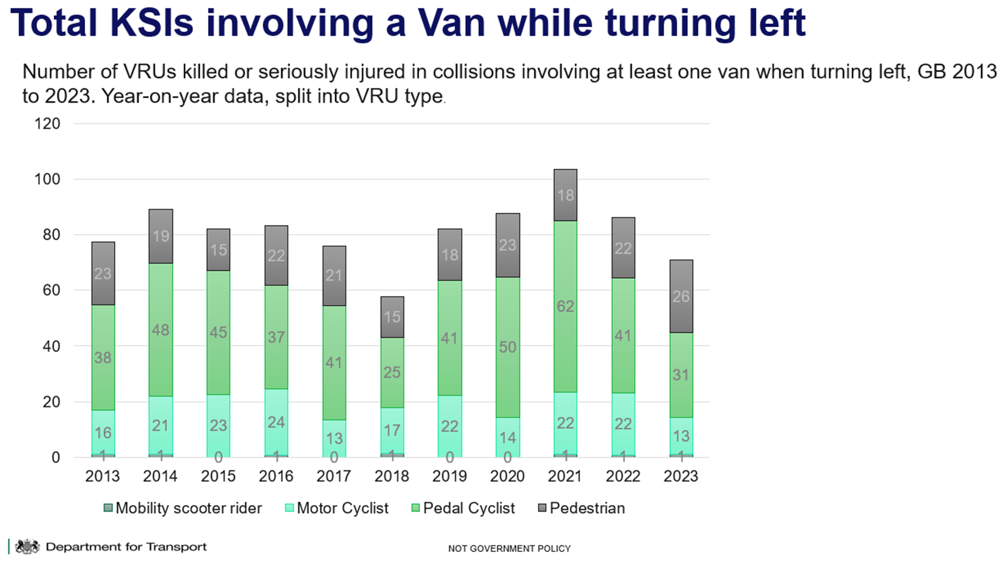
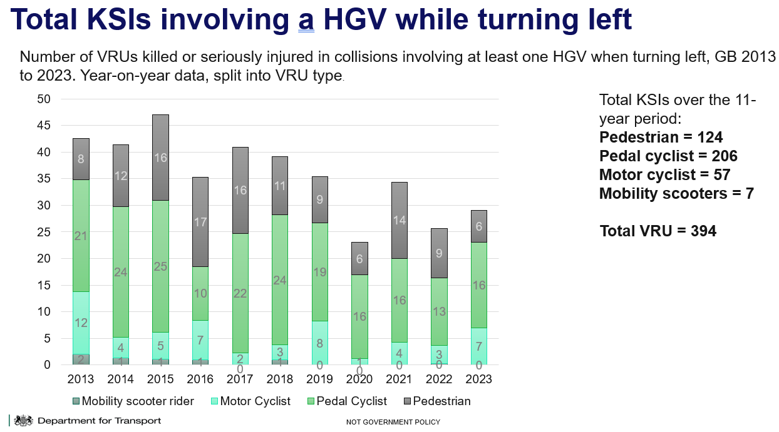
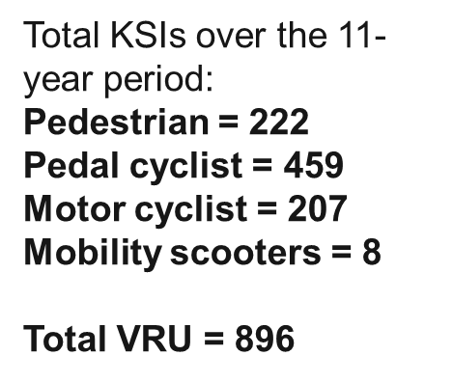

comparison with UK results
Reminder
Caveats related to Vans injury accidents
-Vans are not strictly N1
-All turning left scenarios
and multiple collisions w/o VRU
Reminder
Caveats related to HGV injury accidents
-All turning left scenarios and multiple collisions w/o VRU.

Slide 9
Conclusion (1/2)
This complementary study confirms the conclusion of the previous one, supporting previous German findings (VRU-Proxi-TF_R151_158-01-02): no N1 issue, no urgent need to extend the scope of R151, but interest for monitoring.
France - 8 years of observation: 2016-2023 (BAAC)
  N1 / all VRU
    - 50% of victims (KSI) when it comes to N1 vehicles involved in accident corresponding to R151 scenario, compared to N2M2N3M.
    Cyclists represent 3% of KSI
    Other VRUs / KSI:
      Pedestrians (1%)
      Motorcyclists (66%), speed issue
      EPMD (4%)
  N2M2N3M3 / all VRU:
    Cyclists represent 62% of KSI (consistent with the justification of R151)
    Other VRUs / KSI:
      Pedestrians (11%), mainly with M3
      Motorcyclists (22%)
      EPMD (4%)

Slide 10
Conclusion (2/2)
Comparison with UK results - 11 years of observation: 2013-2023 (STATS19)
Attention: no comparison on a fair basis due to caveats regarding N1 identification (Vans) and driving scenario of interest (all
turning left manoeuvers).
  N1 / Vans:
    France counts 11 times less VRU victims.
      This huge difference could be explained by the above caveats: van definition (larger coverage of vehicles than N1) and driving scenarios (all turning left driving).
    UK and France: 2018 / 2019 show respectively a significant reduction of accidents/vitims (KSI) when 2021 shows a peak (first year after lockdown, behavior issue?).
  N2M2N3M3 / HGV:
    France counts 2,5 times less VRU victims.
    For both France and UK, cyclists represent the majority of victims (KSI): 62% and 52%* respectively.
    Other VRUs: low mobility scooters rates (4% / 0,8%); motorcyclists (22% / 14%); pedestrians (11% / 31%)
    UK and France: 2020 shows a significant reduction of accidents/victims when 2021 shows a peak.
*To be checked out with more dedicated accident cases

Slide 11
Thank you for your attention

Slide 12
Introduction
Annex: extract from DfT presentation
To gather a baseline set of data and an understanding of trends over the last 11 years when considering the expansion of scope for R151 to vans and R158 to trailers, the UK has interrogated its STATS19 database to find out the total number of Killed or Seriously Injured (KSIs) when there is a collision between van and a Vulnerable Road User (VRU) while turning left; and trailers and VRUs while reversing. For these collisions, the VRUs include mobility scooters, pedal cycles, motorcycles and pedestrians.
Caveats to the data
STATS19 does not use vehicles categories e.g. N or O, it uses van and trailer so this data may not have captured all collisions involving N and O category vehicles.
The van and HGV data includes all collisions with at least one VRU, and at least one van or HGV which is turning left – the data included multiple vehicle collisions where the VRU and van may not have collided with each other.
It is not possible to confirm the VRU would have been on the nearside of the vehicle when collision occurred i.e. in the proximity of R.151 devices.
The trailer data includes all collisions with at least one vehicle towing which is reversing – the data includes multiple vehicle collisions where the VRU and towing vehicle may not have collided with each other. It cannot be guaranteed that it was the trailer and not the tractive unit itself that was involved in the collision.
STATS19 data only contains information for collisions on public roads, therefore collisions that have occurred at delivery depots or agricultural premises, for example, are unlikely to be captured in this dataset.

Slide 13
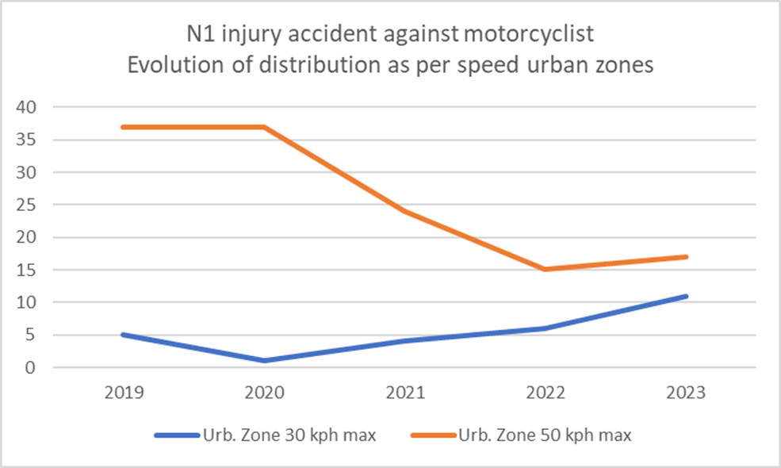
Annex

Slide 14
Annex
14 KSI / 18 hit by bus

