Slide 1
OICA comments on Supplement for UN R49-07 ECE/TRANS/WP.29/GRPE/2025/12
Informal document GRPE-92-45
92nd GRPE, 26-28 March 2025
Agenda item 4.(a)

Slide 2
General
OICA fully supports the introduction of FTIR technology for H2O measurement as it is essential for the introduction of H2 ICE technology.
OICA requests to hold the proposal of introducing FTIR and QCL as optional measurement instruments for NOx, CO, CO2, CH4, in UN R49-07 with the arguments in following slides
OICA express concerns about the inclusion of HD OBFCM requirements, as they are still under discussion at European level. We suggest to evaluate the OBFCM inclusion in a later stage, taking also into account that for UN R49 such a feature is not needed.

Slide 3
BACKUP
Detailed comments

Slide 4
Arguments on FTIR and QCL
There is no urgent need of introducing new measurement technology for the conventional component measurement
Any introduction of a new principle of measurement technology shall be done with great care, since the measurement instrument is one of the most important tools to verify the compliance of the engine emissions
The new measurement technology should be verified via sound statistic data considering performance, repeatability and reproducibility (at least the last two exercises are missing at current stage)
We have special concern for the FTIR technology. We are aware of the wide use of FTIR instruments in R&D lab work, however the UN R49 structure would make the technology a legal tool not only in lab but also in PEMS testing. So far, very limited PEMS FTIR instruments have been evaluated (two only, with one of them showing very poor performance).
We are concerned about the feasibility of FTIR instrument for compliance purpose considering the high noise level impacting low concentration measurements. Especially attention must be paid at NOx < 10 ppm level considering both the accuracy and linearity of FTIR, since that is emission level of current and future engine technology.
Interference check and compensation algorithms of FTIR instrument are critical when it comes to the instrument accuracy and can not be verified by OEMs. Leaving all the procedures to the instrument supplier’s declaration could create the possibility of opening doors for non-serious instrument suppliers.
OICA also suggests interference check shall be done with a mixed gas (which is the working environment of the instrument and essential for the compensation algorithms), not allowing to run interference gases separately for each individual component.
The interferences requirement must be separately specified according to fuel type, since the interferences are directly connected to fuel types,
The linearity check must be also so done with the presences of interferences gases separately with different fuel type
OICA suggests that the analyzer accuracy, noise, drift and repeatability specifications, cross sensitivity specifications shall be certified by an authorized organization rather leaving it to instrument manufacturer declaration.
It is important to point out, a non-proper instrument could lead to misjudgment of the emission performance, could even create “loopholes” in the regulation

Slide 5
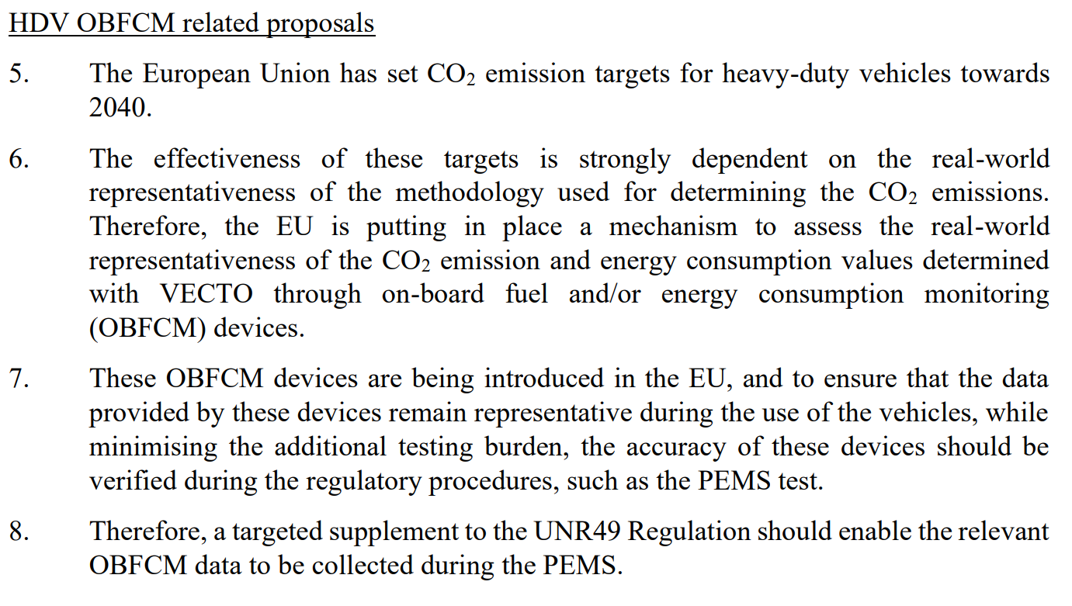
Regarding OBFCM
OICA strongly recommends not including now OBFCM in UN R49
  OBFCM is a pure EU §CO2 regulation, there is no corresponding UN-R
  Many countries/regions base their national regulations on UN R49, hence any requirements on OBFCM is misplaced
  Depending on the final outcome of the OBFCM regulation, it may be suitable to introduce the proposed amendments in (EU) 582/2011 (not in UN R49)
  The EU HDV OBFCM regulation is still under development with many discussions and uncertainties yet to be finalized, hence it should not be added to UN R49 regardless of above points

Slide 6
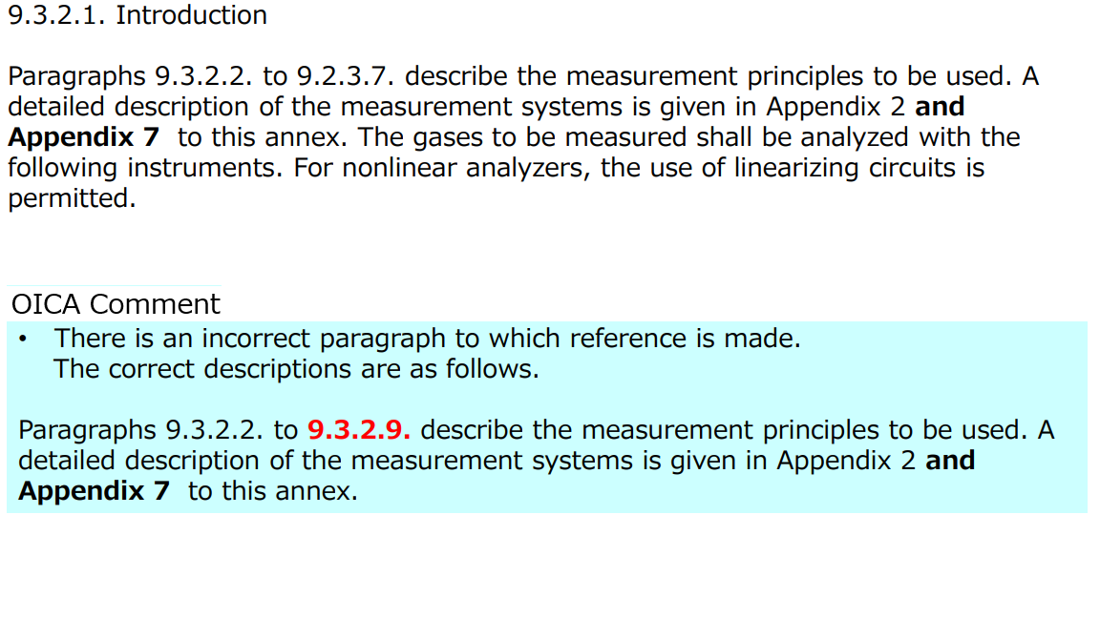
Specific comments - Annex 4

Slide 7
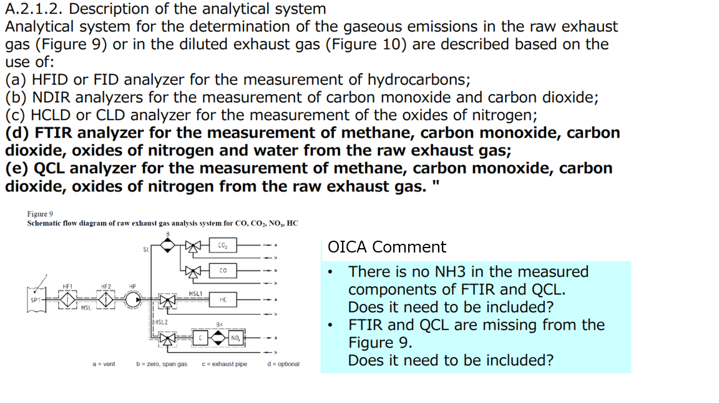
Specific comments - Annex 4, Appendix 2

Slide 8
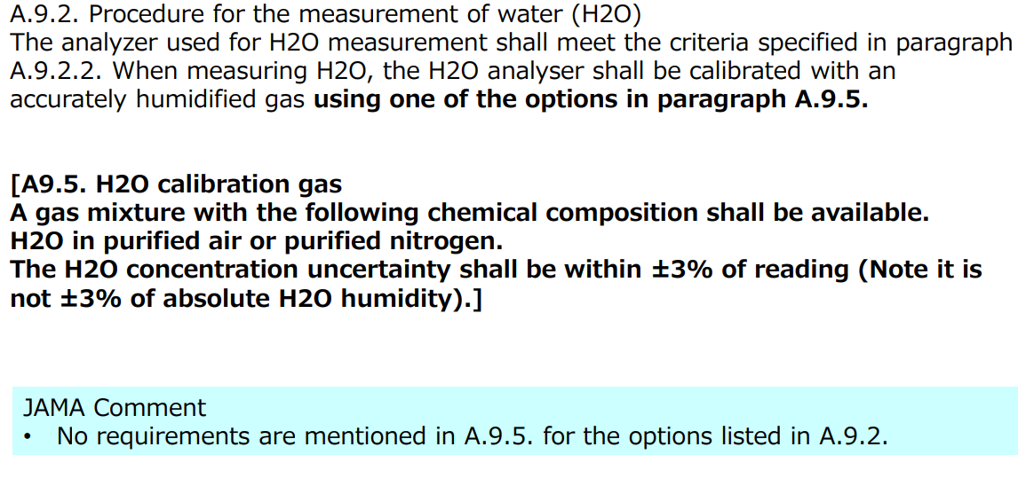

Specific comments - Annex 4, Appendix 9

Slide 9
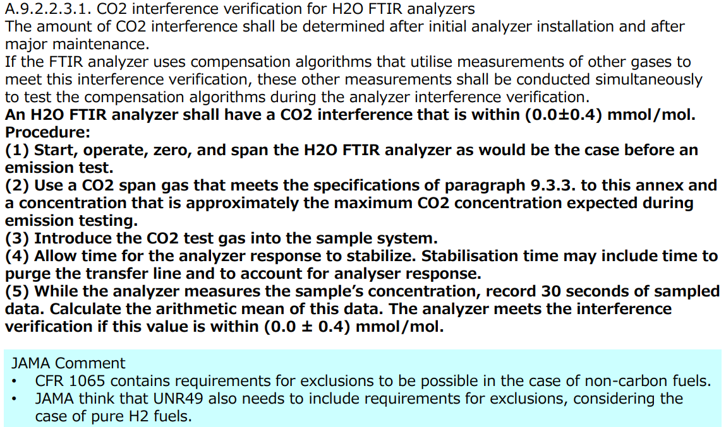

Specific comments - Annex 4, Appendix 9

Slide 10
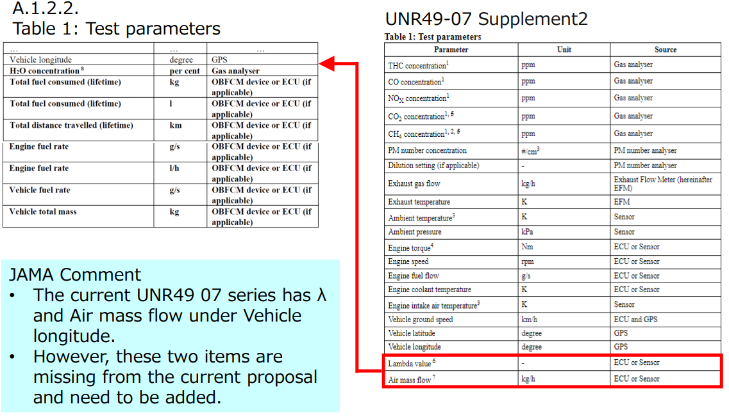
Specific comments - Annex 8, Appendix 1

Slide 11
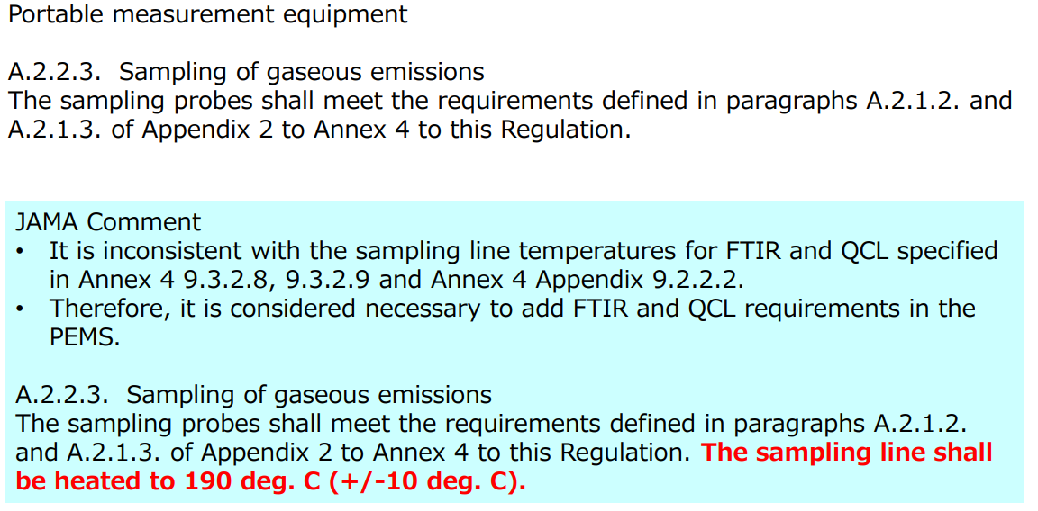

Specific comments - Annex 8, Appendix 2

