Slide 1
Task Force on Tyre Abrasion
Update to GRPE on submission of a new UN Regulation on tyre abrasion performance of C1 tyres
[DRAFT for discussion at TF TA session 35]
26th June 2025

Slide 2
Index
TF TA working document submissions to 82nd GRBP
  Draft UN Regulation on tyre abrasion
    Scope, tyre exclusions
    Testing methods
    Structure and values for proposed abrasion limits for C1 tyres (two-step limit concept, allowances for specific tyre groups)
    Introductory provisions
  Amendments to UNR 117
TF TA activities in preparation of 82nd GRBP
  TFTA sessions (including sub-groups)
  Preparation of informal document(s)
  Amendments to TF TA ToRs

Slide 3
TF TA working document submissions to 82nd GRBP
  Two working documents submitted for the consideration of GRBP in September 2025:
  Draft UN Regulation on tyre abrasion: proposal for a new UN Regulation on the uniform provisions concerning the approval of tyres with regard to abrasion performance, following mandate given to TF TA at 81st GRBP session.
  Amendments to UNR 117: proposal for a new supplement to UNR 117.04. The main aim of this proposal will be to remove the provisions related to tyre abrasion from UNR 117.

Slide 4
TF TA working document submissions to 82nd GRBP
  Two working documents submitted for the consideration of GRBP in September 2025:
  Draft UN Regulation on tyre abrasion: proposal for a new UN Regulation on the uniform provisions concerning the approval of tyres with regard to abrasion performance, following mandate given to TF TA at 81st GRBP session.
  Amendments to UNR 117: proposal for a new supplement to UNR 117.04. The main aim of this proposal will be to remove the provisions related to tyre abrasion from UNR 117.

Slide 5
  Draft UN Regulation on tyre abrasion
  Overview
  The new UN R introduces a dedicated abrasion regulation for C1 tyres (C2 and C3 will be added in the future);
  Defines two test methods: laboratory (drum) and on-road (vehicle) method;
  Establishes marking requirements;
  Includes limits for C1 tyres, and proposes a two-step approach;
  Enables systematic control and verification of tyre abrasion across Contracting Parties.

Slide 6
  Draft UN Regulation on tyre abrasion
  Scope, tyre exclusions
  Applies to new pneumatic tyres of class C1 that conform to UNR 117 with regard to their abrasion performance.
  Exclusions*:
    Tyres designed for competition, [road legal race tyres (new definition)];
    Ice grip tyres, studded tyres;
    Tyres with a speed category < 120 km/h;
    [Tyres for use in severe snow conditions with a speed category less than or equal to 160 km/h (speed category symbol Q)].
*Non-exhaustive. Exclusions in brackets will require further examination

Slide 7
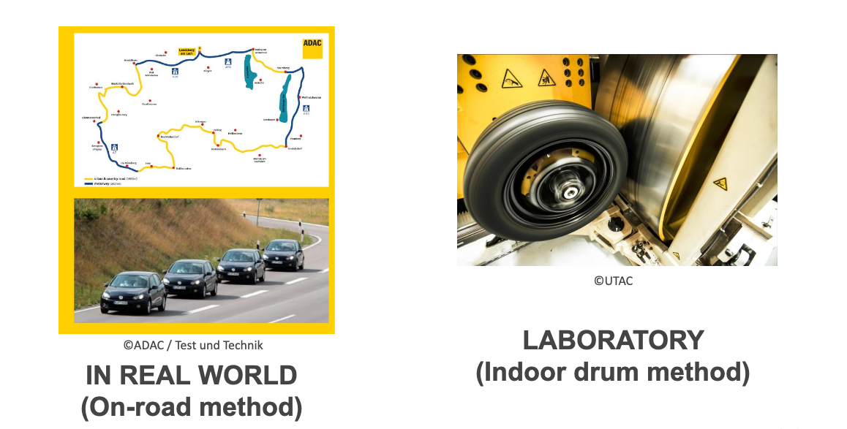
  Draft UN Regulation on tyre abrasion
  Testing methods

Slide 8
  Draft UN Regulation on tyre abrasion
  Testing methods
  ‘Drum’ and ‘Vehicle’ methods included on equal footing in draft UNR
  A low level of correlation between the methods presently observed from the market assessment data, with much better results from the dedicated correlation-validation (COVA) testing campaign
  Abrasion results for a small subset of tyres exhibit high levels of ‘inversion’
  No systematic biases observed for any of the methods (average of pairwise differences ≈ 0.)
  Some TF TA members proposed to delay the limit setting exercise for the ‘drum’ method by six months
  TF TA consensus that technical improvements (tighter specification of key parameters) and dedicated testing to improve correlation will be needed.
*Non-exhaustive

Slide 9
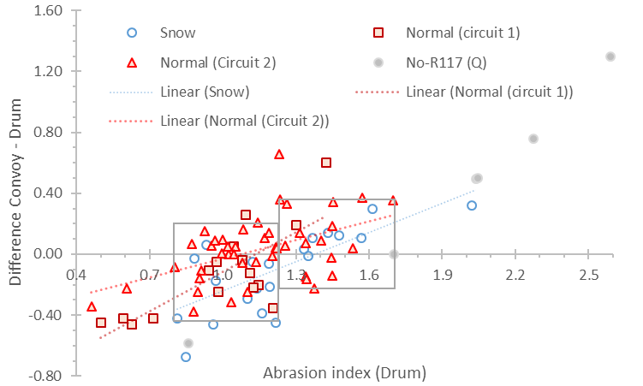
  Draft UN Regulation on tyre abrasion
  Testing methods

Slide 10
  Draft UN Regulation on tyre abrasion
  Structure and values for proposed abrasion limits for C1 tyres
  The proposed structure for limits reflects the technical complexity of tyres and of testing methods
    ‘Core’ limits – Set the overall level of ambition, long-term stability.
    ‘A_{margin}’ – An additional margin that is subtracted from the measured abrasion index result.
    Specific allowances for groups of tyres with special abrasion characteristics (e.g. XL tyres)
    CoP tolerance: fixed value to account for production variability, added in the context of conformity of production testing.
  Limits are proposed with a two-step approach as a way to balance long-term ambition with current state of development of tyres with regard to abrasion
    Step 1: from entry into force – A_{margin} is more generous to reflect the current uncertainty of the methods, several allowances apply.
    Step 2: as of [1st of January 2033] – A_{margin} is tightened to reflect the long-term uncertainty of the methods, certain allowances are dropped.
  See next slide for limits structure (including A_{margin} and allowances) and [proposed values].
*Non-exhaustive

Slide 11
Core limits
Abrasion margin applied at type approval – Open road
Category of Use | AICT
Normal tyre | [1.00]
Snow tyre | [1.00]
Special use | [Not specified]
Category of Use | [Until 2033] | [From 2033]
Normal tyre | [0.20] | [0.15]
Snow tyre | [0.20] | [0.15]
Special use | - | -
Allowances
Abrasion margin applied at type approval - Drum
Category of Use | [Until 2033] | [From 2033]
XL allowance | [+0.10] | [-]
3PMSF allowance | [+0.10] | [+0.10]
UHP allowance (SS >=Y and AR <=40) | [+0.10] | [-]
LI <77 | [+0.10] | [-]
Category of Use | [Until 2033] | [From 2033]
Normal tyre | [0.20] | [0.10]
Snow tyre | [0.20] | [0.10]
Special use | - | -
CoP margin = [0.2]
Maximum acceptable value:
At TA: Core limit + Abrasion Margin + Allowances (where applicable)
At CoP: Core limit + Abrasion Margin + Allowances (where applicable) + CoP margin

Slide 12
  Draft UN Regulation on tyre abrasion
  Structure and values for proposed abrasion limits for C1 tyres
  The estimated impact of the proposed limits was evaluated using the market assessment database (good market representativeness).
  A simplified analysis uses two relevant dimensions
    Market impact (% of tyres that would be excluded from the market at a given abrasion index limit)
    Environmental impact (% of average abrasion reduction resulting from the exclusions)
  Significant effort from industry (ETRTO) to update its position during discussions (see evolution of ETRTO v1 to ETRTO v2 in the next slides).
  Proposed limits and structure of allowances lead to a Stage 1 level of tyre exclusions of ~28-31% (normal tyres) and ~ 36-42% (snow tyres), depending on the method
  Environmental benefits range from ~10% (normal tyres) to ~14-17% lower abrasion (snow tyres), depending on the method.
*Non-exhaustive

Slide 13
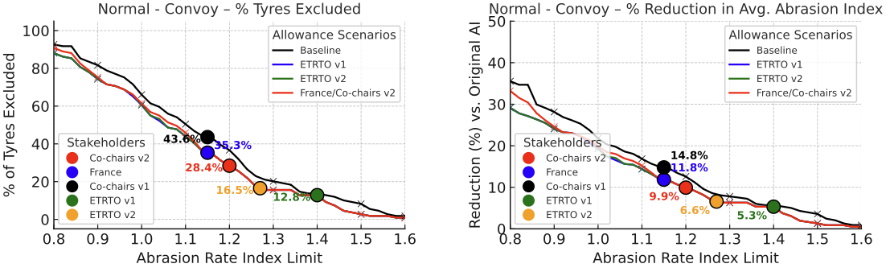
Comparison of positions
Normal tyres, convoy method
TF TA 34th session
3rd June 2025

Slide 14
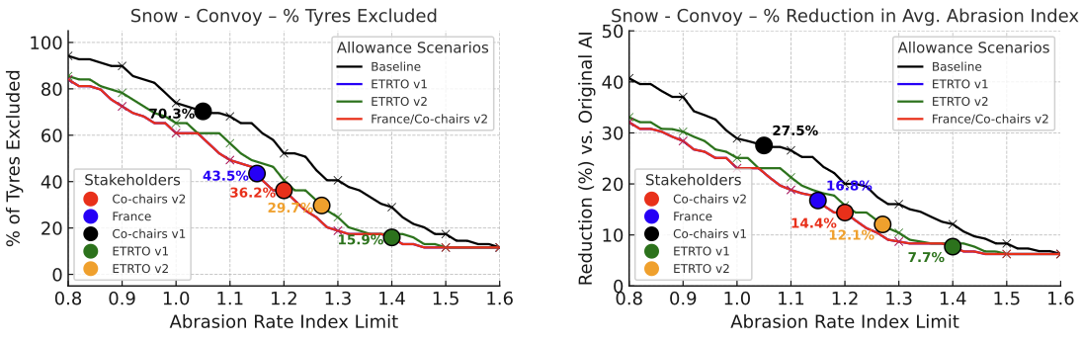
Comparison of positions
Snow tyres, convoy method
TF TA 34th session
3rd June 2025

Slide 15
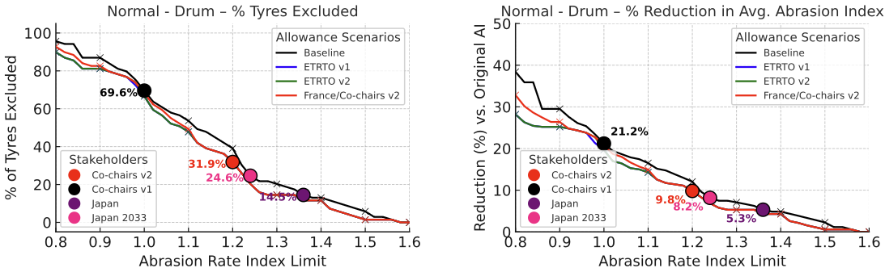
Comparison of positions
Normal tyres, drum method
TF TA 34th session
3rd June 2025

Slide 16
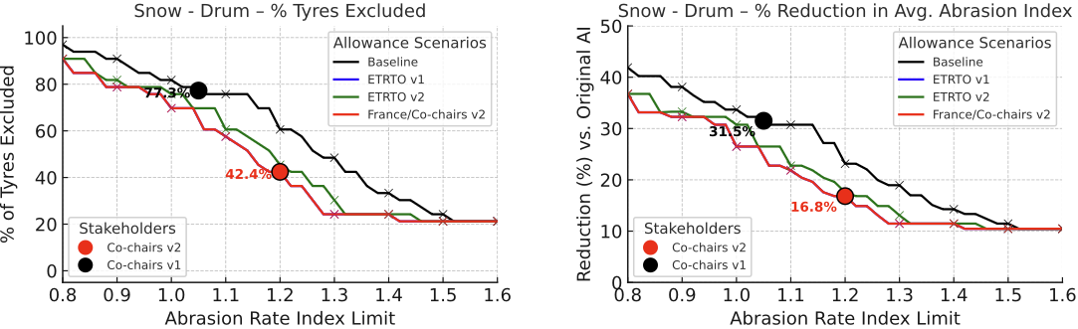
Comparison of positions
Snow tyres, drum method

Slide 17
  Draft UN Regulation on tyre abrasion
  Introductory provisions
  The proposed introductory provisions mirror the Euro 7 calendar for C1 tyres and support the two-stage approach.
Stage 1:
New approvals required no sooner than [30 June 2028].
All approvals required no sooner than [30 June 2030].
Stage 2:
New approvals required no sooner than [31 December 2032].
All approvals required no sooner than [31 December 2034].
Fitting of non-compliant C1 tyres on a vehicle in use:
Until [30 June 2032] for tyres manufactured prior to [30 June 2030].
Extended acceptance (transition from Stage 1 to Stage 2):
Approvals granted before the relevant cutoff can be extended until 31 December 2034.
*Non-exhaustive

Slide 18
TF TA working document submissions to 82nd GRBP
  Two working documents submitted for the consideration of GRBP in September 2025:
  Draft UN Regulation on tyre abrasion: proposal for a new UN Regulation on the uniform provisions concerning the approval of tyres with regard to abrasion performance, following mandate given to TF TA at 81st GRBP session.
  Amendments to UNR 117: proposal for a new supplement to UNR 117.04. The main aim of this proposal will be to remove the provisions related to tyre abrasion from UNR 117.

Slide 19
  Amendments to UNR 117
  Overview
Justification: establishes the separation of abrasion requirements into a new dedicated UN Regulation, making UNR 117 more focused and streamlined.
Scope change: removes tyre abrasion provisions from UNR 117, focusing it exclusively on rolling resistance, rolling noise, and wet grip.
Deletions: all definitions, requirements, and annexes related to abrasion rate, abrasion level, and abrasion index for C1 tyres are deleted from UNR 117.
Updated scope wording: Clarifies that UNR 117 applies to abrasion only until the new dedicated UNR applies.

Slide 20
TF TA activities in preparation of 82nd GRBP
TF TA sessions:
  [8th July]
  [21st August]
Preparation of an informal document to amend the working document
  Seek to remove square brackets where possible through consensus
  Take on-board any additional comments from GRPE
  Take on-board initial method improvements aimed at reducing measurement uncertainty and improving correlation
Revision of the TF TA ToR
  Introduce a clear timeline for further method improvements to reduce measurement uncertainty and improve correlation

Slide 21
TF TA activities in preparation of 82nd GRBP
Comments from GRPE participants requested by [15th August]

