Slide 1

IWG-EMC-48-05
Proposal to include peak detector
for charging mode in
IWG-EMC-48-03e (BNetzA）
China Automotive Technology and Research Center Co., Ltd.
2025.6.16
Notes:
Our proposal is about Vehicles and other places EMC Test under Dynamic Driving Condions.

Slide 2
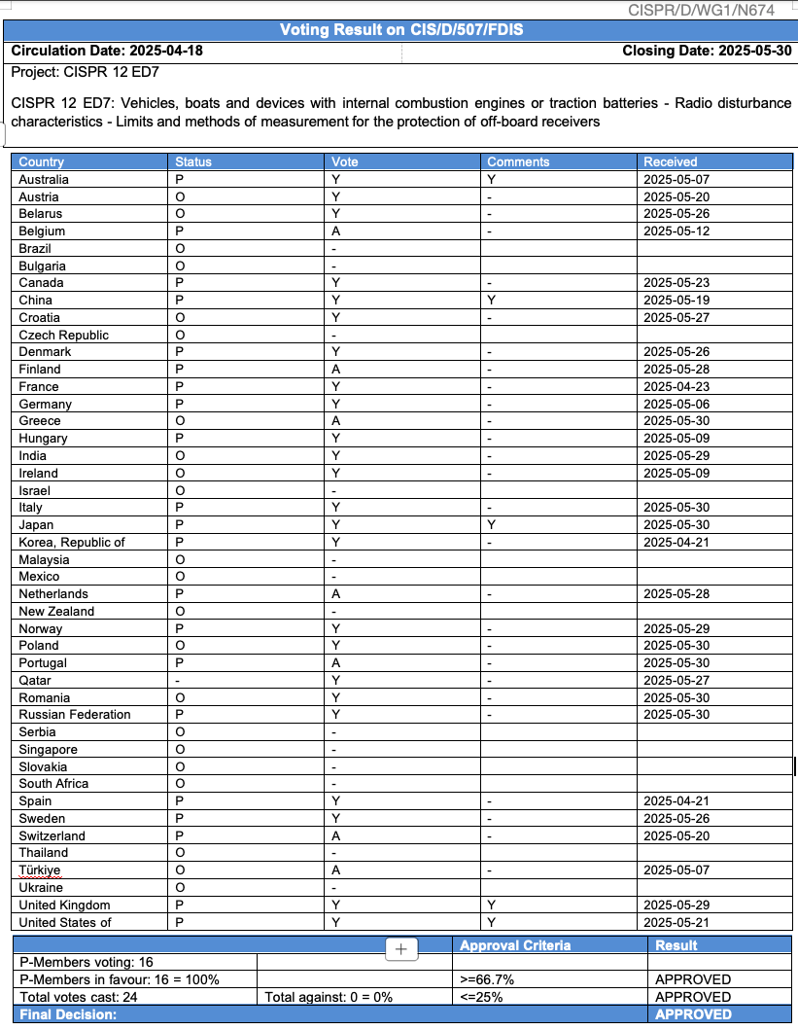
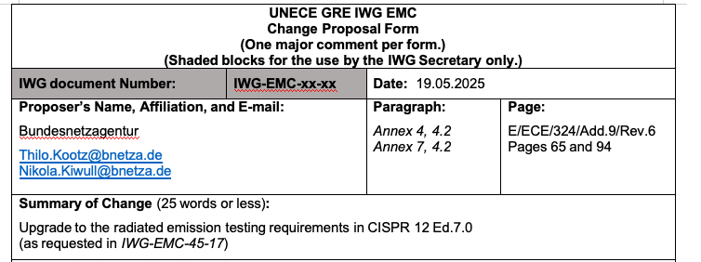
propose to include peak detector for charging mode in IWG-EMC-48-03e (BNetzA）
IWG-EMC-48-05
CISPR12 ED7 FDIS doc finally got approved in this June,
after more than 10 years discussion mainly on the PK limit for charging mode and driving mode.
We strongly support the proposal from BNetzA, except for some details on the possibility of using peak detector in charging mode.

Slide 3
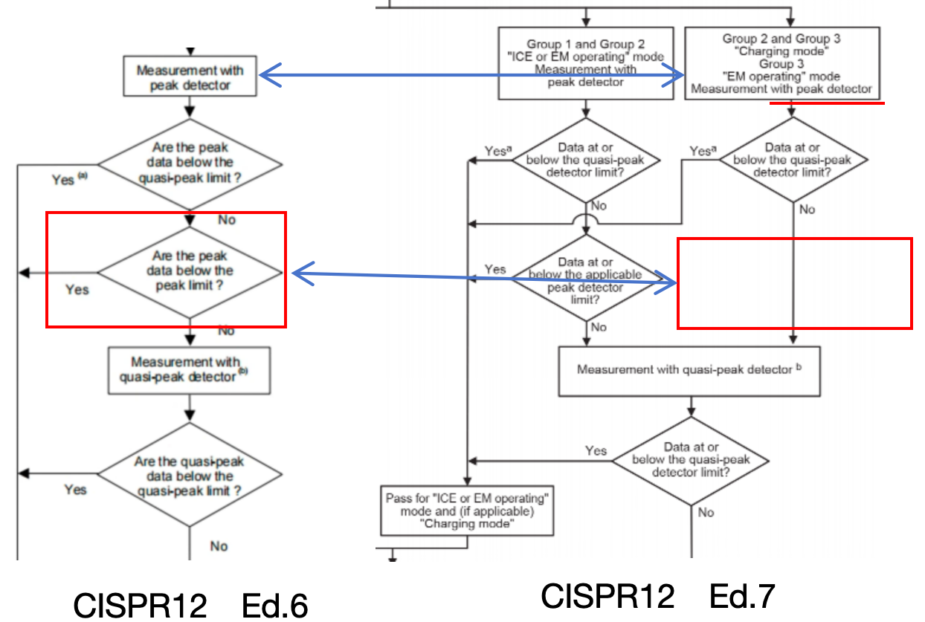
propose to include peak detector for charging mode in IWG-EMC-48-03e (BNetzA）
IWG-EMC-48-05
Peak detector is also allowed in CISPR12 Ed.7 Charging mode
only delete
peak data evaluation
with peak limit

Slide 4
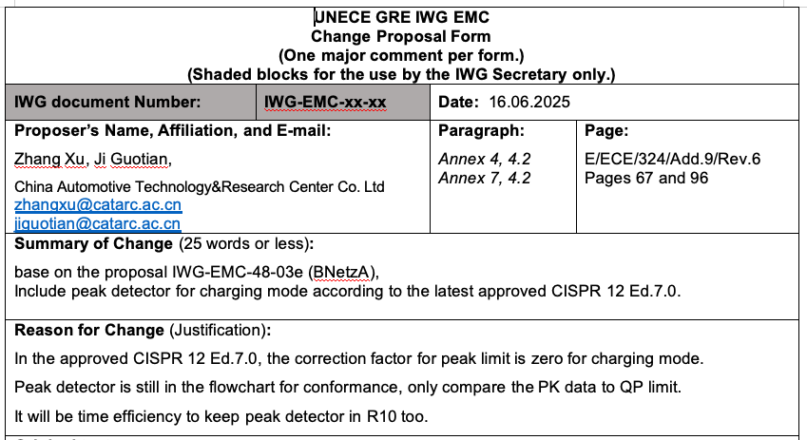
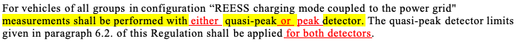

propose to include peak detector for charging mode in IWG-EMC-48-03e (BNetzA）
IWG-EMC-48-05
include peak detector
and clarify the limits

Slide 5


