Slide 1

Informal document WP.29-196-08
WP.29 196th session
24-27 June 2025
Agenda item 8.1.
Transmitted by the Russian Federation
THE RESULTS OF THE STATE SURVEILLANCE OF TRUCKS
ALEXANDER KUZMIN
Deputy Head
Federal Agency on Technical Regulating and Metrology
2025

Slide 2
Background
The ITC at its 87th session held in February 2025 took note of the concerns raised by the Russian Federation on the proper implementation of the provisions of the1958 Geneva Agreement. The ITC requested WP.29 to consider the case presented by the Russian Federation (ECE/TRANS/2025/L.1/Rev.1, para. 95).
At the 195th WP.29 session, the representative of the Russian Federation reported on detected cases of non-compliance of vehicles and components approved in other Contracting Parties pursuant to UN Regulations Nos. 51, 58, 73 and 121 (WP.29-195-11). He said that, upon completion of the necessary tests, notifications of non-compliance would be sent to the type approval authorities that granted the approvals, with a request to undertake actions provided for in Article 4 of the 1958 Agreement. He also pointed out that, in some cases, type approval authorities had not replied to requests to confirm the validity of their type approvals. He looked forward to the proper action of the competent authorities of other contracting parties to restore the conformity of products in cases where non-compliance of approved products was notified (ECE/TRANS/WP.29/1184, para. 88).
WP.29 took note of this information and stressed the need of close cooperation between the competent authorities of contracting parties in cases of non-compliance, to ensure that the non-conformity is rectified (ECE/TRANS/WP.29/1184, para. 89).

Slide 3
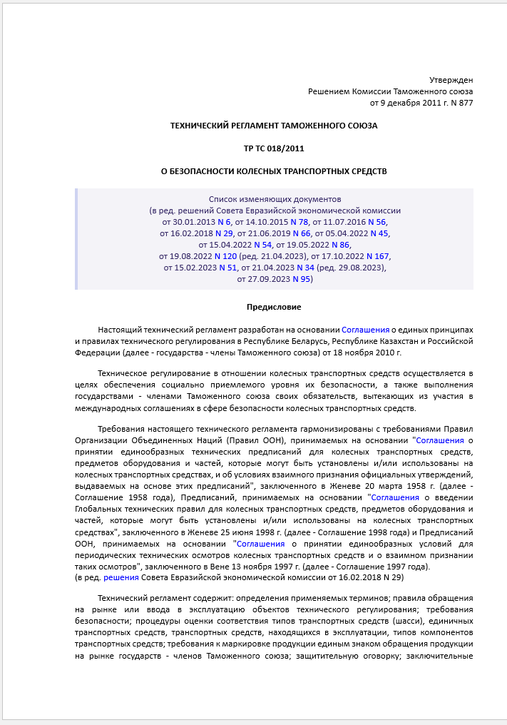
Regulatory framework (1)
The Customs Union Technical Regulation “Concerning Safety of Wheeled Vehicles“ (CU TR 018/2011)
103. The member States of the Customs Union, guided by the protection of their legitimate interests, take measures to prevent access to their market of products that do not comply with the requirements of this technical regulation. For this purpose, the member States of the Customs Union, in accordance with their national legislation, carry out state monitoring (surveillance) over vehicles and vehicle components in circulation on the market that are regulated by these technical regulations.
The above measures may include the restriction or prohibition of the release into circulation, or the forced withdrawal from the market of products that do not comply with the requirements of this technical regulation.
104. State monitoring (surveillance) is carried out prior to the transfer of a vehicle or a vehicle component to the end user by randomly verifying the compliance of the properties and characteristics of a randomly selected sample with the individual requirements provided for in section V of this technical regulation.
105. A vehicle that has been put into circulation and has a vehicle type approval is considered not to comply with the requirements of this technical regulation in the following cases:
1) at least one characteristic of the specified vehicle (at least one of its components), for which the requirements are established, does not meet the level of requirements specified in the vehicle type approval;
2) the design parameters and characteristics of the vehicle differ from those specified in the vehicle type approval.

Slide 4
Regulatory framework (2)
The Customs Union Technical Regulation “Concerning Safety of Wheeled Vehicles“ (CU TR 018/2011)
107. In case of unsatisfactory verification results, the state monitoring (surveillance) body of a member State of the Customs Union shall, within
10 days, notify: the manufacturer of the product; the applicant; the certification body that issued the documents certifying compliance with the requirements of this technical regulation.
Upon receipt of the notification, the manufacturer develops a plan of necessary corrective measures to eliminate the identified nonconformities with specific deadlines for its implementation and submits such a plan to the certification body within 10 days from the date of transmission of the completed verification report to the manufacturer. The certification body conducts an expert examination of the submitted plan within 10 days and, if necessary, sends its comments to the manufacturer, as well as determines the procedure for verifying the implementation of these measures. Upon completion of the deadlines set out in the plan of necessary corrective measures to eliminate nonconformities agreed with the certification body, the manufacturer submits a note of the corrective and preventive actions carried out with an assessment of their effectiveness.
The manufacturer, the applicant and the certification body shall notify the state monitoring (surveillance) body of their actions and measures taken to restore product conformity in accordance with the established procedure.
108. The state monitoring (surveillance) body of a member State of the Customs Union has the right to apply to the court with a claim for the compulsory recall of a specific batch of vehicles (components).

Slide 5
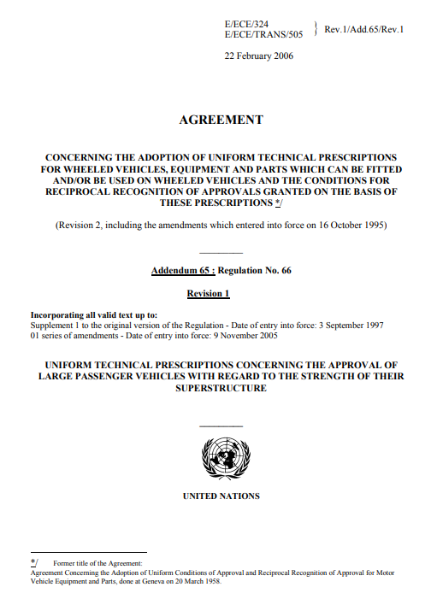
Regulatory framework (3)
1958 Geneva Agreement
Article 4
1. Should a Contracting Party applying a UN Regulation find that certain wheeled vehicles, equipment or parts bearing approval markings issued under the said UN Regulation by one of the Contracting Parties, do not conform to the approved types or the requirements of the said UN Regulation, they shall advise the approval authority of the Contracting Party which issued the approval.
The Contracting Party that issued the approval shall take the necessary steps to ensure that the non-conformity is rectified.
3. Notwithstanding the provisions of paragraph 1 of this Article, if a non-conforming product has not been brought into conformity within a period of three months, the Contracting Party responsible for the approval shall temporarily or permanently withdraw the approval. By exception, this period may be extended by a period not exceeding three months unless one or more Contracting Parties applying the concerned UN Regulation object.
4. When the non-conformity is due to non-compliance with the administrative provisions, approval markings, conditions for conformity of production or the information document specified in a UN Regulation, the Contracting Party that issued the approval shall temporarily or permanently withdraw the approval if the non-conformity has not been rectified within a period of six months.

Slide 6
Identified nonconformities
of the checked trucks
UN Regulation № 51-02
The requirement for an acceptable sound level in dB(A) produced by a moving vehicle and produced by compressed air was not met.
UN Regulation № 58-02
The permissible level of deformation of the rear underrun protection was exceeded, and that protection then collapsed during the tests.
UN Regulation № 73-01
The requirements for the design and arrangement of the side protection device elements were not met.

Slide 7

Measures taken by the State
monitoring (surveillance) body
Based on paragraph 103 of CU TR 018/2011 and Article 4 of the 1958 Geneva Agreement, the State monitoring (surveillance) body banned the sales in the territory of the Russian Federation of the type-approved vehicles for which the nonconformities with the requirements of UN Regulations were identified.

Slide 8
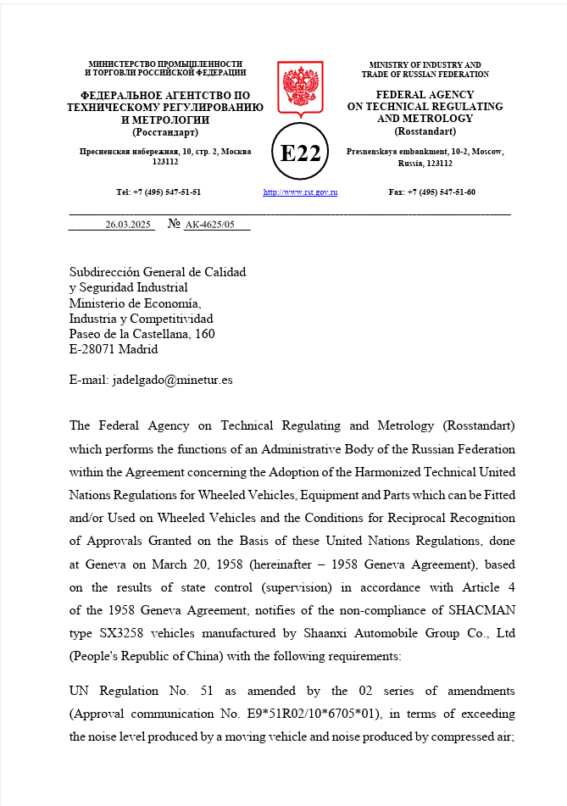
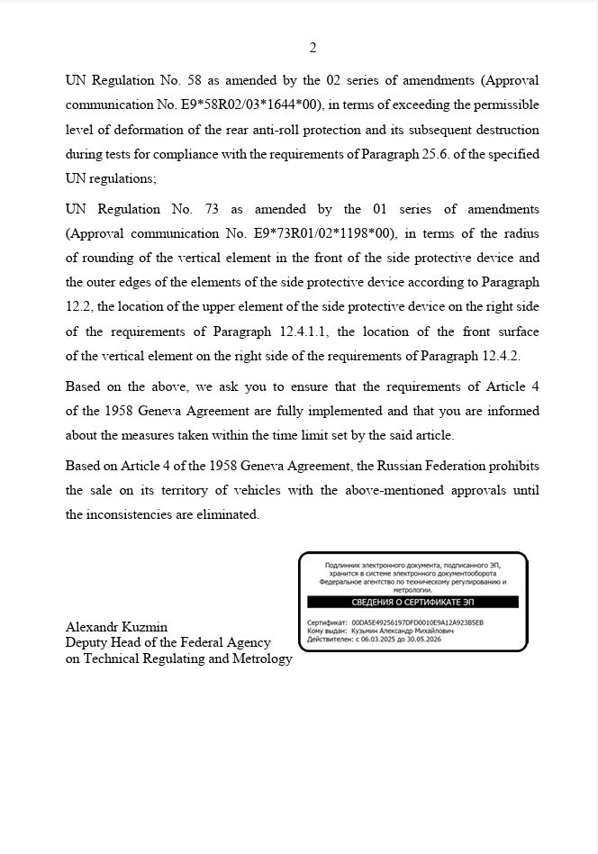
Informing about product non-conformity
On March 26, 2025, the Federal Agency for Technical Regulating and Metrology, which performs the functions of the approval authority of the Russian Federation, sent a notification to the Spanish approval authority about non-conformity with UN Regulations of products for which the specific communications on type approvals were issued.
To date, no response with information on the measures taken to eliminate the identified product non-conformity has been received from the Spanish approval authority.
Type approvals issued for the nonconforming products continue to be valid.

Slide 9
Statement of the Russian Federation
On the site of the World Forum WP.29, which oversees
the 1958 Geneva Agreement, the Russian Federation appeals
to Spain with a proposal to respond to the notification sent
on March 26, 2025 to the Spanish approval authority about non-conformity with UN Regulations of products for which
the specific communications on type approvals were issued,
and to take necessary measures to ensure the restoration
of conformity of these products.
In the absence of a proper response, the Russian Federation
reserves the right not to recognize the communications on type approvals granted by the Spanish approval authority for vehicles, which non-compliance with UN Regulations was identified during the state monitoring (surveillance).
Informing WP.29 about the current situation, the Russian Federation expects WP.29 to confirm the strict implementation of the provisions
of the 1958 Geneva Agreement by the Contracting Parties.

Slide 10

Thank you for your attention!

