Slide 1
Official proposal GRVA/2026/10 from OICA/CLEPA:
Paragraph 5.8.5., reproduced for reference.
"5.8.5. Notwithstanding the provisions of sections 5.1.6. and 5.6., Advanced Driver Assistance Steering Systems shall not be active, or be able to be activated, whilst an ADS feature is active."
Insert a new subparagraph 5.8.5.1., to read:
"5.8.5.1. Steering interventions controlled by an ESC whilst an ADS is active are permitted but are not subject to the CSF requirements of this Regulation. Such functionality shall be subject to the requirements of Annex 6. "
Paragraph 5.8.6.2., reproduced for reference.
"5.8.6.2. ADS Steering Equipment with non-electrical energy transmission shall meet the following additional requirement:
Paragraph 5.8.6.2.1., amendment to read:
"5.8.6.2.1. The level of stored energy in the energy reservoir(s), if fitted, shall be continuously transmitted to the ADS."
Proposal for additional subparagraph by CP’s during FADS-30:
Insert new subparagraph 5.8.6.2.2., to read:
“5.8.6.2.2. Any failure in the energy transmission shall be detected. In the case of a detected failure, a signal shall be transmitted to the ADS.”

Slide 2
Review of the proposal:
“5.8.6.2.2. Any failure in the energy transmission shall be detected. In the case of a detected failure, a signal shall be transmitted to the ADS.”
According to the industry understanding and the explanations given during the discussions in FADS-30, the reason for including this new subparagraph was to ensure that also e.g. failures like leakages in a hydraulic system that will affect steerability and redundancies in the system, will have to be detected and provided to the ADS.
Issues identified:
While the aim of the proposal is fully understood and seen reasonable, the wording
Could create issues that all kind of mechanical failurs will have to be detected by the/a system incl. Those which are not to be considered, since not liable to brakage if properly dimensioned => status quo would be challenged!
Seems to be redundant, because the issue of e.g. the hydraulic leakage is already addressed via paragraph 5.3.1.3.

Slide 3
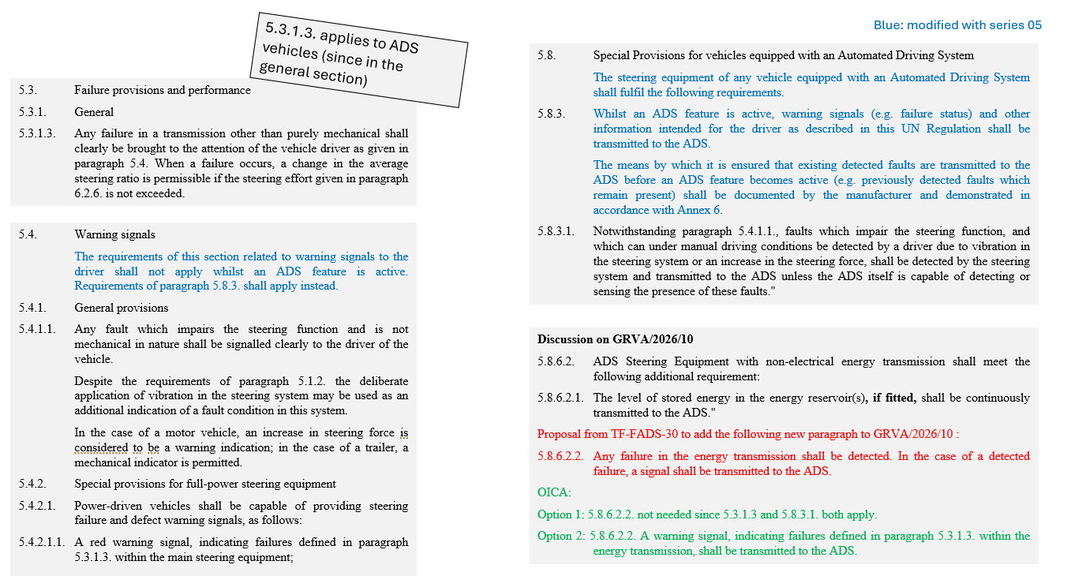
For reference:

