Slide 1
Status and Feedback Request
Task Force
Separate Technical Unit within IWG VRU-Proxi
Lead: B. John / CLEPA for
Agenda item 4
130th GRSG meeting
6th to 9th October 2025
Informal document GRSG-130-XX 130th GRSG, 6-9 October 2025 Agenda item 4

Slide 2
Agenda
Status and Feedback Request from the Task Force (TF) for Separate Technical Unit (STU)
completing R151, R158, R159, R166
within the IWG VRU-Proxi
  Context, Goals and Challenges
  R159 Draft Approval Routes
  R159 Draft Structural Changes
  R158 Outlook
  Questions / Thoughts / Feedback
Request for ToR Changes – Timeline and Scope
IWG VRU-Proxi – Part related to Separate Technical Units (STU)

Slide 3
Context, Goals and Challenges
STU TF within the IWG VRU-Proxi
  Context
  Familiarising with various regulations containing Component or STU approach – all dealing with a specific system, having at the outset a basic specific universal structure, which is picked up in the structure of the regulation.
  STU TF is dealing with regulations which are mostly pure functional and technology independent (especially R151 BSIS and R159 MOIS).
  Consultations suggested such will become a more common matter for regulations with e. g. ADAS functions or self-driving vehicles.
  Focus so far has been mostly on R159 MOIS.
  Goals
  All changes should not make the regulation less or more stringent however adding wider scope – allowing an “Amendment as a Supplement” (and not a new series).
  Current scheme for full vehicle approval will be maintained and ensures possible extension of current approvals.
  Challenges
  Efficiency Avoid or limit the same testing on Component or STU level vs. integration of an approved Component or STU on vehicle level.
  Dependency Taking in account vehicle features which significantly influence the performance of a STU or Component.
  Stringency Ensure fulfilment for all requirement demands after the integration of an approved Component or STU on vehicle level approval.
  Simplicity Guidance for the approval requester providing the information for Component, STU or integration of an approved Component or STU on vehicle level. Ensuring the Technical Service and approval authority can fulfil their responsibilities.

Slide 4
Context – Key Part from UNECE Framework R.E.3
STU TF within the IWG VRU-Proxi
  Definitions
  UNECE has defined Manufacturer, Component and Separate Technical Unit in the latest update of the framework document:
  “Consolidated Resolution on the Construction of Vehicles (R.E.3)”
  See link: ECE_TRANS_WP.29_78_Rev.7e
  Extract of Definitions:
    “...
    1.13 “Manufacturer" means the person or body who is responsible to the Approval Authority for all aspects covered by the UN Regulations requirements for approval process and for ensuring the conformity of production. It is not essential that the person or body is directly involved in all stages of the construction of the vehicle or component which is the subject of the approval process.
    1.14. "Component" means a device intended to be part of a vehicle, which may be approved independently of a vehicle where relevant UN Regulation(s) provide express provisions for so doing.
    1.15. "Separate technical unit" means a device intended to be part of a vehicle, which may be approved separately, but only in relation to one or more specified types of vehicle where relevant UN regulation(s) provide express provisions for so doing.
    ...”
  Note: For “Manufacturer “ frequently the phrase of “approval requester” is used.

Slide 5
R159 Draft Approval Routes – New Types
STU TF within the IWG VRU-Proxi
    Vehicle fitted with a Moving Off Information System (not type approved as a Component or STU)
    (Note: As current text, this “full vehicle” approval will be maintained and related content stays unchanged)
    Component
    STU
    Vehicle fitted with a Moving Off Information System type approved as a Component or STU

Slide 6




R159 Draft Approval Routes – Component
STU TF within the IWG VRU-Proxi
Component:
There are 2 starting points
Already existing full vehicle type ghi approval stays as it is:
E11 159R-001234
Already existing full vehicle type ghi approval *
E11 159R-001234
(assumed to be very unlikely *)
Vehicle ghi with component type approval (either due to system update, special request to unify a range of vehicle types and re-approve the same vehicle type, …)
→ E11 159R-001546 with support of E11 159R-007531
OR
In case no existing vehicle type approval
Component type approval
→ E11 159R-007531
(Independent of vehicle type)
…
* not needed as a precondition for component type approval but possible
Any vehicle type with component type approval
→ E11 159R-007647 / E11 159R-007654 / ...
with support of E11 159R-007531

Slide 7
R159 Draft Approval Routes – STU
STU TF within the IWG VRU-Proxi
STU:
There are 2 starting points
Already existing full vehicle type ghi approval stays as it is:
E11 159R-001234
Already existing full vehicle type ghi approval *
E11 159R-001234
(assumed to be very unlikely *)
Vehicle ghi with STU type approval (either due to system update, special request to unify a range of vehicle types and re-approve the same vehicle type, …)
→ E11 159R-001546 with support of E11 159R-004568
OR
In case no existing vehicle type approval
STU type approval
→ E11 159R-004568
With relevant vehicle type list
abc, def, ghi
(Vehicle type definition is regulation specific)
Vehicle abc with STU type approval
→ E11 159R-009876 with support of E11 159R-004568
* not needed as a precondition for STU type approval but possible
Vehicle def with STU type approval
→ E11 159R-007531 with support of E11 159R-004568

Slide 8
R159 Draft Structural Changes – Overview
STU TF within the IWG VRU-Proxi
Current Chapters |  | Proposed Changes for Chapters *
0. Introduction 1. Scope 2. Definitions 3. Application for approval 4. Approval 5. Specifications 6. Test procedure 7. Modification of vehicle type and ... 8. Conformity of production 9. Penalties for non-conformity of production 10. Production definitively discontinued 11. Names and addresses of the Tech... Appendix 1 Annexes 1 Communication 2 Arrangements of approval marks 3 Test method for determining blind spot boundary |  | 0. Introduction 1. Scope 2. Definitions 3. Application for approval 4. Approval 5. Part 1: Full vehicle type approval with unapproved MOIS 5.1 Specifications 5.2 Test procedure 6. Part 2: Vehicle fitted with already approved Component or STU 6.1 Specifications (tbc.) 6.2 Test procedure 7. Part 3 and 4: Component or STU 7.1 Specifications 7.1.1 Detection 7.1.2 Control 7.1.3 HMI 7.2 Test procedure 8. Modification of vehicle type and ... 9. Conformity of production | 10. Penalties for non-conformity of production 11. Production definitively discontinued 12. Names and addresses of the Tech... Appendix 1 Annexes 1 Communication Part 1 Vehicle fitted with a MOIS Part 2 Component Part 3 STU Part 4 Vehicle fitted with a MOIS type approved as a Component or STU 2 Information Document Part 1 Vehicle fitted with a MOIS Part 2 Component Part 3 STU Part 4 Vehicle fitted with a MOIS type approved as a Component or STU 3 Arrangements of approval marks 4 Test method for determining blind spot boundary
  * Colour scheme for highlighted text: added paragraphs / major updates / new / no or minor updates

Slide 9
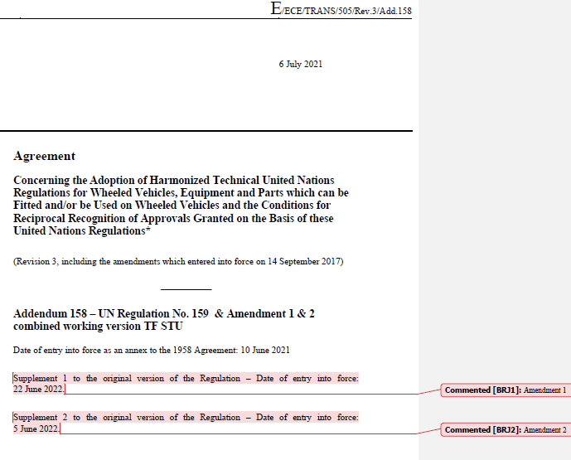
R159 Draft Structural Changes – Informal Document
STU TF within the IWG VRU-Proxi
  Working Version document for R159 drafting
    Consolidates all present amendments merged into one document for simplification of work using comment function referencing changes from which amendment.
    Text changes are logged.
    Submitted current draft in progress as an informal document – for orientation / overview only.
    (Document, not yet ready for word-by-word review:
    GRSG 130-XX (VRU-Proxi) R159 & Amendment 1 & 2 combined Working Version Rev3)
  Goal “Amendment as a Supplement” document
    Document will be created when drafting is complete and after iterative reviews within STU TF and IWG.

Slide 10
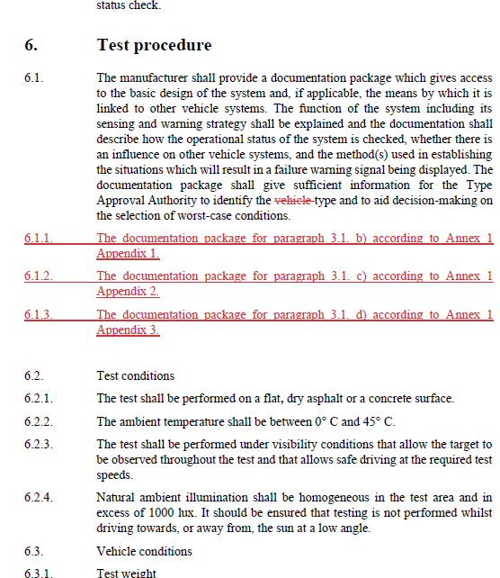
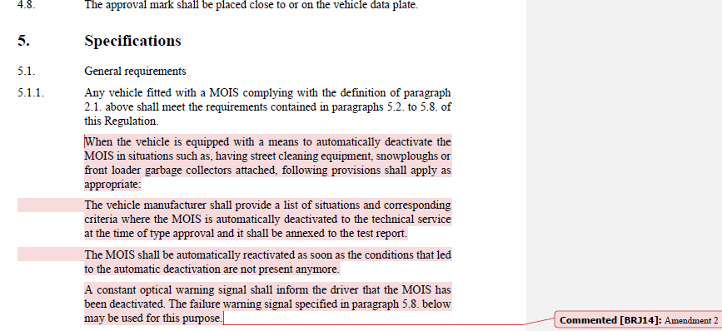
R159 Draft Structural Changes – Details 1
STU TF within the IWG VRU-Proxi
  For requirements adding chapters to cover for the new types. (currently called “5. Specification” and “6. Testing”)
  Introduce universal functional blocks structure for the new types separating the functions for detection, control and HMI with connections to vehicle integration and vehicle inputs elements.

Slide 11
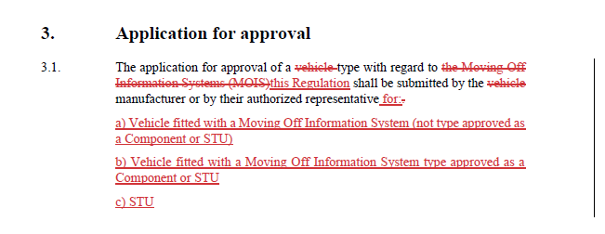
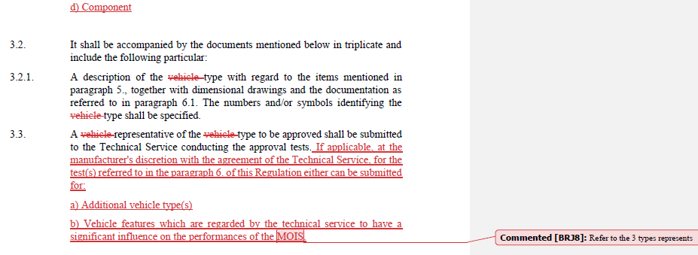
R159 Draft Structural Changes – Details 2
STU TF within the IWG VRU-Proxi
  For Component or STU approval, the minimum functions a system shall fulfil the Detection and Control requirements.
  Approval for HMI function shall be only applied on vehicle approval* or may be include in Component or STU approval.
  Goal is to have a set of simple verification testing for vehicle approval*.
  Testing requirements may be forwarded from Component or STU to vehicle approval*.
  (Note: This allows some flexibility due to possible dependencies on vehicle integration and vehicle inputs subject of a particular system or technology.)
  * Refence to type approval for “Vehicle fitted with a MOIS type approved as a Component or STU“.

Slide 12
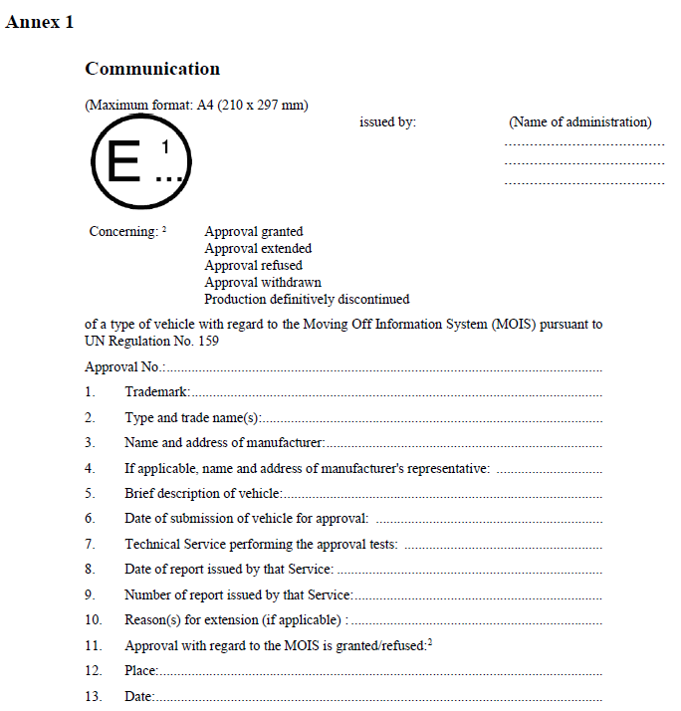
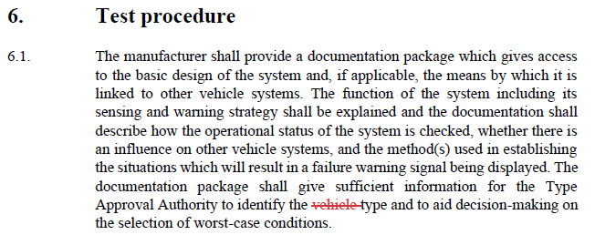
R159 Draft Structural Changes – Details 3
STU TF within the IWG VRU-Proxi
  Add to “Annex 1 Communication” appendixes for each type.
  New annex for “Information Document” with appendixes for each type. (Note: Currently covered under requirements in 6. chapter for Testing)
  Reduce the amount of text to limit multiplying same or common text for each type.
  A range of advised administrative changes to bring text in line with latest UNECE directions for structure and content.

Slide 13
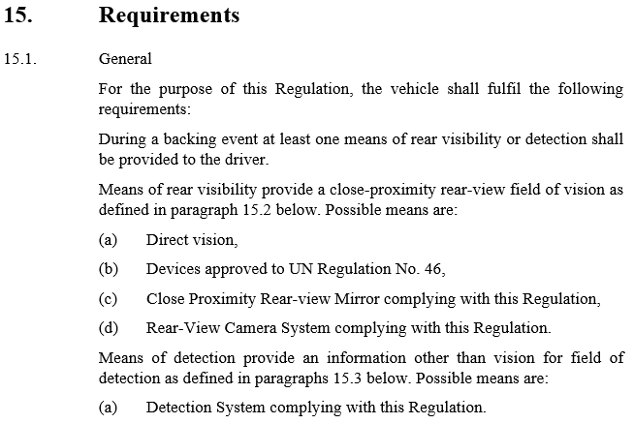
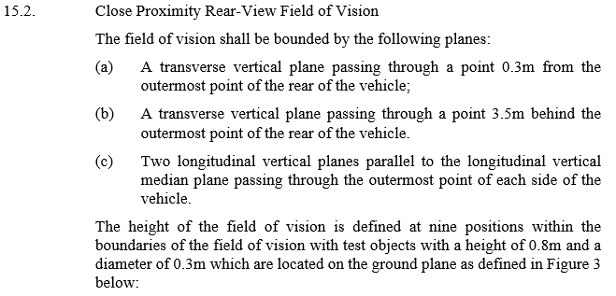
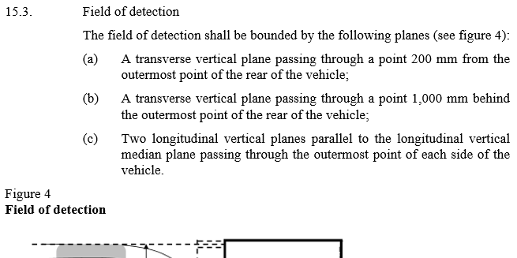
R158 Outlook
STU TF within the IWG VRU-Proxi
  More traditional approach having from the outset a specific universal structure for the each of the define system.
  (called “means” in text)
  Introduce Component or STU types only on provisions for:
    Rear view camera system
    (similar to R46)
    Detection systems

Slide 14
Questions / Thoughts / Feedback
STU TF within the IWG VRU-Proxi
Discussions
Next topic:
Request for ToR Changes – Timeline and Scope
IWG VRU-Proxi – Part related to Separate Technical Units (STU)

Slide 15
Timeline – Request for ToR Change
IWG VRU-Proxi – Part related to Separate Technical Units (STU)
    Propose extension to October 2026 for work item Separate Technical Units (STU)
    Proposal considerations and justifications
    Assessment based on current rate of progress from and R159 work and initial assessment for R158.
    Review demands between IWG and TF. Assuming at one iteration cycle, means two IWG meetings for review covering each of the 4 draft regulations amendments.
    Submission deadline to GRSG for informal and working documents.
    Expect efficiencies for R151 due to applying the concept from R159.
    More traditional approach for R158 due to its content however taking in account the alternative means in the regulation.
    Expect efficiencies for R166 due to applying the approach from R158 and its similarities.
    Guestimate for submission of at least one draft amendment for GRSG session in April 2026.

Slide 16
Scope – Request for ToR Change
IWG VRU-Proxi – Part related to Separate Technical Units (STU)
    Proposed change of the ToR for work item Part Separate Technical Units (STU)
“...
Completing draft regulatory proposals for Component and Separate Technical Units (STU) approvals for the following regulations (if applicable):
o UN Regulation No. 151;
o UN Regulation No. 158;
o UN Regulation No. 159;
o UN Regulation No. 166.
...”
Note: Component and Separate Technical Units as defined in UNECE framework document “Consolidated Resolution on the Construction of Vehicles (R.E.3)”, see ECE_TRANS_WP.29_78_Rev.7e
    Proposal Considerations and Justifications
    The IWG colleagues involved in the definition of the TF scope around 2023 to 2024 likely had limited awareness of the latest updated framework document as stated above.
    This framework defines both, Components and STU in UNECE terms.
    Suggest to cover both in the scope to allow Component and STU approach for flexibility and economic benefits for the industry fulfilling the regulation demands.
    This was the original goal in the initial version of the ToR mentioning “component” at that time.

Slide 17
Thank You – for Supporting the STU TF
Questions ?

Slide 18
Note to the UNECE Secretariat:
The author and the speaker of this presentation confirm that they have authorization to use all content including photos and visual elements.
The material is either copyright-free or the author/speaker hold the necessary copyright or permission.
The UNECE will remove any material from its events and supporting websites if there is unlawful use of copyrighted material.
The author/speaker takes responsibility for any infringement on copyright and holds the UNECE harmless to this effect.

