Slide 1
Comparison of text versions:
R13H
R13
R13H original 02 series
5.1.2.2. Secondary Braking System
The secondary braking system shall make it possible by application of the service brake control to halt the vehicle within a reasonable distance in the event of failure of the service braking system. It shall be possible to graduate this braking action. The driver shall be able to obtain this braking action from his driving seat without removing his hands from the steering control. For the purposes of these provisions it is assumed that not more than one failure of the service braking system can occur at one time.
R13 original 15 series
5.1.2.2. Secondary Braking System
The secondary braking system shall make it possible to halt the vehicle within a reasonable distance in the event of failure of the service braking system. It shall be possible to graduate this braking action. The driver shall be able to obtain this braking action from his driving seat while keeping at least one hand on the steering control. For the purposes of these provisions it is assumed that not more than one failure of the service braking system can occur at one time.
Also March WP-29? ECE/TRANS/WP.29/2026/8
GRVA/2025/40 Adopted at Sept 25 GRVA for Jun 26 WP29
(submitted by TF-FADS, amendments to R13H)
"5.1.2.2. Secondary braking system
The secondary braking system shall make it possible to halt the vehicle within a reasonable distance in the event of failure of the service braking system. It shall be possible to graduate this braking action. The A driver, if any, shall be able to obtain this braking action from his driving seat while keeping at least one hand on the steering control. For the purposes of these provisions, it is assumed that not more than one failure of the service braking system can occur at one time."
GRVA/2025/39 adopted at Sept 25 GRVA for Jun 26 WP29
(submitted by TF-FADS amendments to R13)
"5.1.2.2. Secondary braking system
The secondary braking system shall make it possible to halt the vehicle within a reasonable distance in the event of failure of the service braking system. It shall be possible to graduate this braking action. The A driver, if any, shall be able to obtain this braking action from his driving seat while keeping at least one hand on the steering control. For the purposes of these provisions, it is
assumed that not more than one failure of the service braking system can occur at one time.“
Base text from R13 was used instead of R13H?

Slide 2
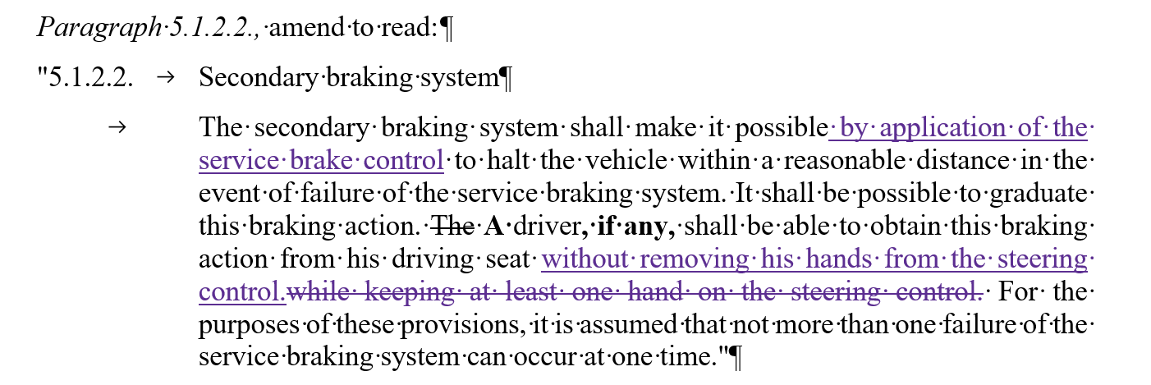
OICA/CLEPA proposed way forward
Possible correction (in purple) of GRVA/2025/40 for R13H
Proposal agreed by FADS-31
5.1.2.2. Secondary braking system
The secondary braking system shall make it possible by application of the service brake control or by demand from the ADS (as applicable) to halt the vehicle within a reasonable distance in the event of failure of the service braking system. It shall be possible to graduate this braking action. The A driver (if any) shall be able to obtain this braking action from his driving seat without removing his hands from the steering control. For the purposes of these provisions it is assumed that not more than one failure of the service braking system can occur at one time.

