Slide 1

ACPE-GTR-02-04-Rev1
Comment and Response to “ACPE-GTR-01-03”
Overview
2026.Feb.24

Slide 2
Item List
 | Item (related UNR text) | Contents | Results
1 | Traffic accidents analysis (0. Introduction, 1. Scope) | Traffic accidents outline Typical scenario extraction | Reflect test scenario
2 | Research of “Pedal error maneuver” (5. Specification, 5.1.2) | Analysis by Driving Simulator experiments (JAMA internal research) | Definition of Pedal error maneuver
3 | ACPE test condition setting (5.Specification, 5.1.1, 5.1.5 ) | Reflect accidents analysis results Reflect “Pedal error maneuver” | Test condition setting
4 | Consider driver’s override (5.Specification, 5.1.11) | Consider necessity (false positive countermeasure) | Allows the driver to interrupt control
5 | Estimation of the system’s effectiveness (0. Introduction) | Effectiveness in the market from statistics | The effect of reducing accidents is apparent
6 | ACPE function (5. Specification, 5.1.1) | Acceleration suppression only or Acceleration suppression and brake | Setting “Acceleration suppression” as a minimum requirement. ( Helps simplify system configuration and facilitate widespread adoption)
 | Tbd ….
These items are mentioned “ACPE-GTR-01-03 (Chair) Table Document_UN R175 towards an ACPE GTR.docx”
( Pick up main topic)

Slide 3
Traffic accidents analysis outline
Taking an overall view of the traffic accident analysis
Extract the characteristics of “pedal error” accidents

Slide 4
Traffic accidents outline
Pedal error accidents rate in JAPAN
Year | 2021 | 2022 | 2023
All traffic accidents number | 305,196 | 300,839 | 307,930
Pedal error accidents number | 3,164 | 3,050 | 3,110
Pedal error accidents rate | 1.04% | 1.01% | 1.00 %
<Traffic statistics>
ref ; 交通統計 - 交通事故総合分析センター (Japanese only)
The ACPE accident rate is extremely low

Slide 5
Pedal error accidents rate by age
in JAPAN
Pedal error accidents rate
55~64
65~74
Age
High accident rate among elderly people
ref : info124_e.pdf

Slide 6
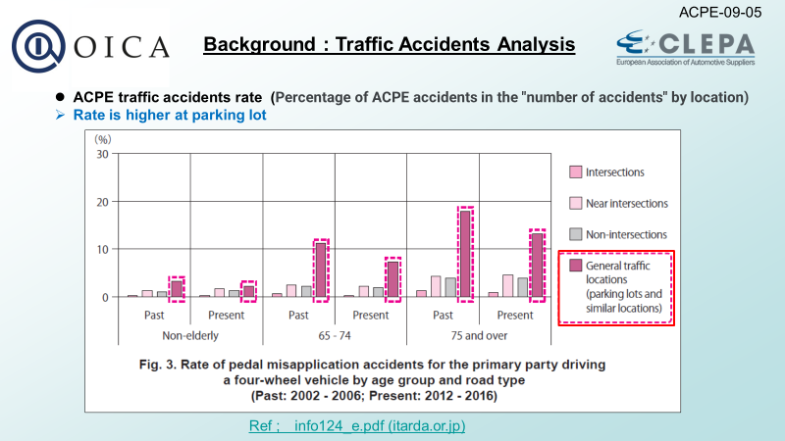
Pedal error accidents :
road type, place in JAPAN
(Repost； ACPE-09-05 document）
ref : info124_e.pdf

Slide 7
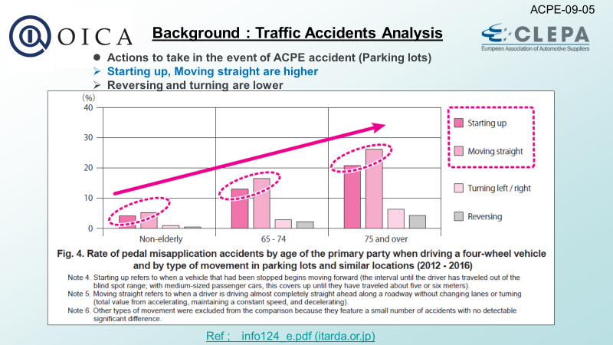
Pedal error accidents :
type of movement at parking lot in JAPAN
(Repost； ACPE-09-05 document）

Slide 8
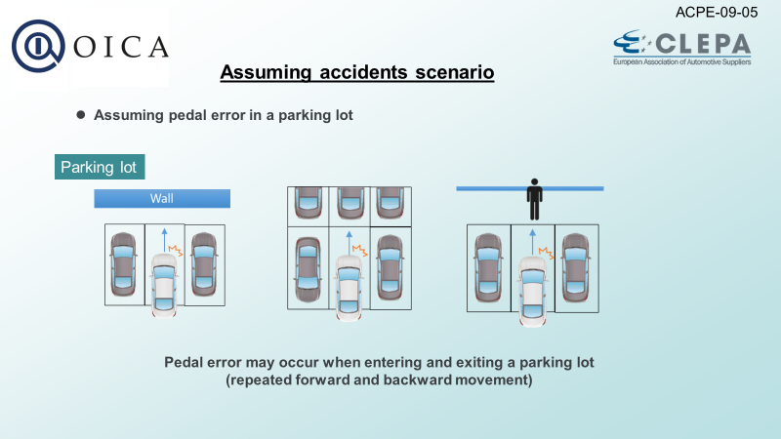
Pedal error accidents assumption
(repost ACPE-09-05)
■ ACPE accidents tendency
●Driver : Elderly driver, ●Place : Parking lot, ●Driving behavior ; Starting up, Low speed running
Various pedal error accidents have occurred, but we have developed a system that can handle the majority of accidents, which are those that occur when the vehicle is stationary or traveling at extremely low speeds.
(considering technical feasibility)

Slide 9
Pedal error accidents scenario and Pedal error maneuver

Slide 10
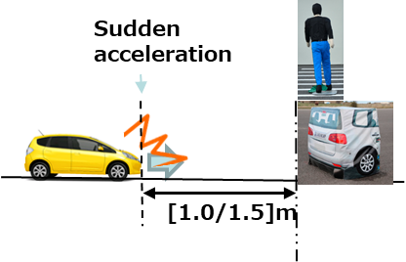
What is Pedal Error ?
■ How to decide “Pedal Error”
An incident in which the driver mistakes the accelerator pedal pressing hard for the brake pedal.
However, it is impossible to accurately judge this, because we cannot know what is going on in the driver's mind.
A "pedal error" is determined in limited circumstances.
Decisions are made based not only on pedal operation but also on the situation.
Assuming situations where accidents are likely to occur, decisions are made in the following situations:
There is an obstacle nearby
(short range)
and
Pedal Error
Accelerator input that is significantly different from normal
In Japan, the system was just beginning to become widespread, and JNCAP began evaluating it.
(ref ; ACPE-01-06, JNCAP Start : FY 2018~ )
10
2026/2/19

Slide 11
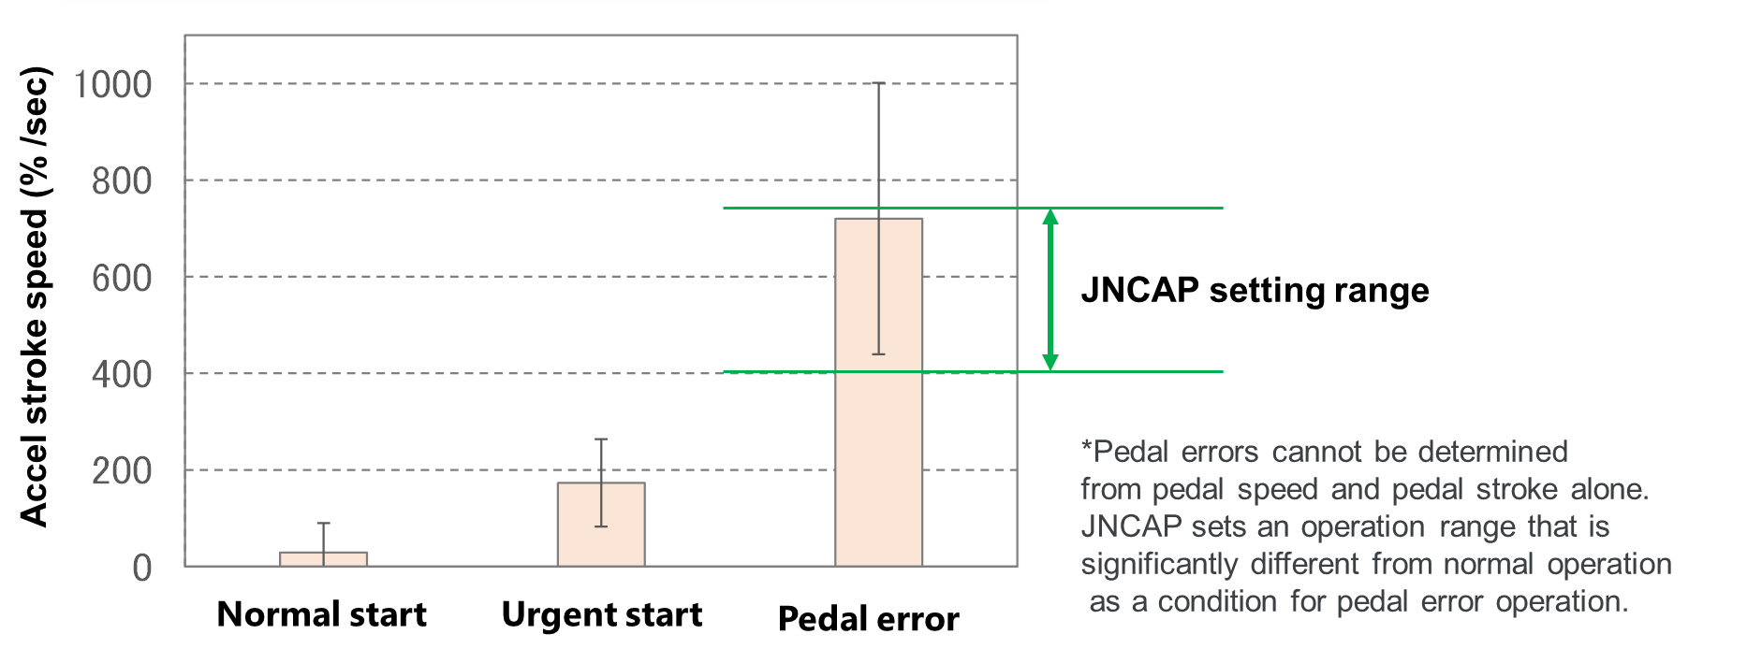
Research of “Pedal Error”
(JAMA internal research)
■ Study driver pedal operation when panicked by Driving Simulator experiments (see another document)
Results: During panic operations, the pedal speed was faster than normal, but some overlapped with normal operation.
↓
Abnormal operation was set to 400%/sec or higher. (speed-range)
* Setting the pedal speed lower increased the overlap with normal operation,
increasing the possibility of false positive operation.
Research summary
*These results were presented to JNCAP,
who adopted them as a testing method.

Slide 12
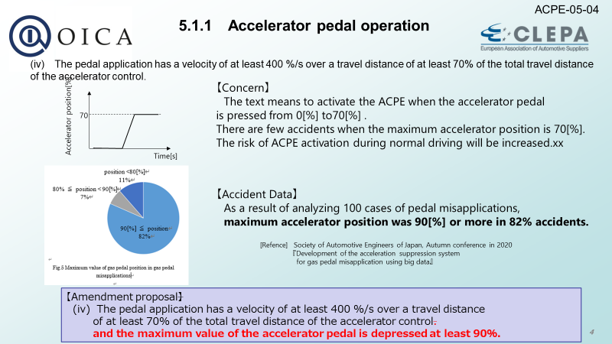
Pedal Stroke at “Pedal Error” (repost: ACPE-05-04)
After these discussions, the test method was established as UNR.

Slide 13
Big data analysis of “Pedal Maneuver”
(JAMA OEM data)
Accelerator pedal speed distribution
frequency
Cumulative
frequency
Next class
[Data Acquisition Conditions]
Extracted under the following conditions
Vehicle number ; approximately 270,000
Driving mileage ; approximately 55 million km
Speed ; 10 km/h or less
Accelerator pedal depression of 90% or more
70% of the accelerator depression speed was measured
Measurement sampling rate ; 100 ms
Even during normal driving,
There is a large variation in pedal depression speed
Difficult to determine “Pedal error” by pedal maneuver alone.

Slide 14
Driver override function

Slide 15

Necessity of driver override
(measures against false positive operation)
■ Possibility of false positive operation
Even if there is an obstacle immediately in front and the condition of excessive pedal operation is set,
false positive operation operation will occur.
Example scenario (False positive scenario)
Approaching right-turn preceding vehicle (JAPAN)
Approaching a vehicle ahead while turning left (JAPAN)
Trapped at a railroad crossing
Approaching a wall in an uphill parking lot
etc.
→ Requires a means for the driver to suppress the control

Slide 16
■ ex. Trapped at railroad crossing
(example VTR (Youtube) )
See below link VTR
↓
See below link VTR
↓
ref : 【まさか】線路内でトラック立ち往生 運転手が助け求めるも… ポーランド #鉄道ニュース
ref : 【ポーランド】踏切内で立ち往生…迫る列車逃げようとするも衝突『世界のミダシ』
Countermeasures against false positive operations are essential.
- Driver-initiated release of control → “Suppression function” is required.

Slide 17
Traffic accidents reduction effectiveness

Slide 18
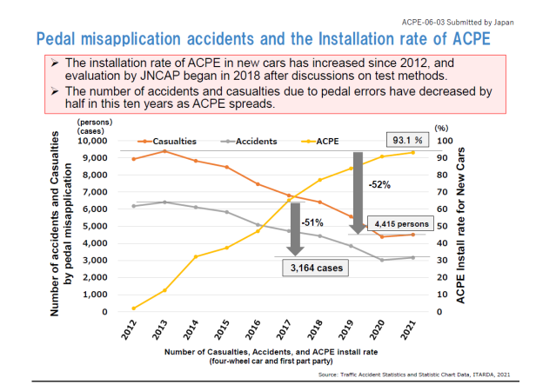
The installation rate of ACPE systems and
their accidents reduction effect
(in JAPAN)
Popular ACPE systems in Japan
Sensor ; ultrasonic sensor (short distance detection capability)
Control ; Suppress acceleration, and/or Suppress acceleration with brake control
As the installation rate of new cars increases,
the number of pedal error accidents is decreasing.
(repost : ACPE-06-03)
Even systems that are compatible with stationary
and low speed driving have been effective
in reducing accidents in the market.

Slide 19
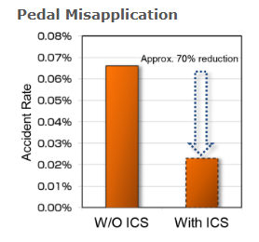
Market effectiveness
Market data indicate that ACPE systems are delivering positive effects.
Target vehicle models: 3 models
Sample size: 63,000 vehicles
Period: 18 months (January 2015 to June 2016)
Sensor system : Ultrasonic-sensor
The difference in accident incidence was examined between vehicles equipped with the system and those without it.
※ICS is a system name
ref ; Toyota Announces the Accident Reduction Effects of Intelligent Clearance Sonar, a Safety Support Technology for Parking | Toyota Motor Corporation Official Global Website
The number of pedal-misapplication (Pedal error) accidents in parking lots decreased by
about 70% after the system was introduced.

Slide 20
END

