Slide 1
UN-R134_03 supplement proposal
Supply Lines for Additional TPRDs
ISO 19887-1:2024 alternative requirements
Informal Industry SG
2026-01-13 Summary

Slide 2
Addressing observations on this approach
This standard specifies requirements for newly manufactured components of compressed hydrogen fuel systems. (Clause 1.1 – Inclusions)
Components and containers used in fuel systems of vehicles manufactured in compliance with GTR-13 or UN-R134 are excluded from the scope. (Clause 1.3 – Exclusions)
Reason for Exclusion: the exclusion applies only to two components [check valve and shut off valve] to avoid redundant re-testing since they are already covered by UN-R134.
ISO 19887-1 is based on industry standards and has been verified by industry experts.
UN-R134, a new definition for supply lines for additional TPRDs will be added.
Proposed definition in UN-R134
2.XX. “Supply lines for additional TPRDs" mean the rigid fuel lines and fittings used to connect an additional TPRD to the container.

Slide 3
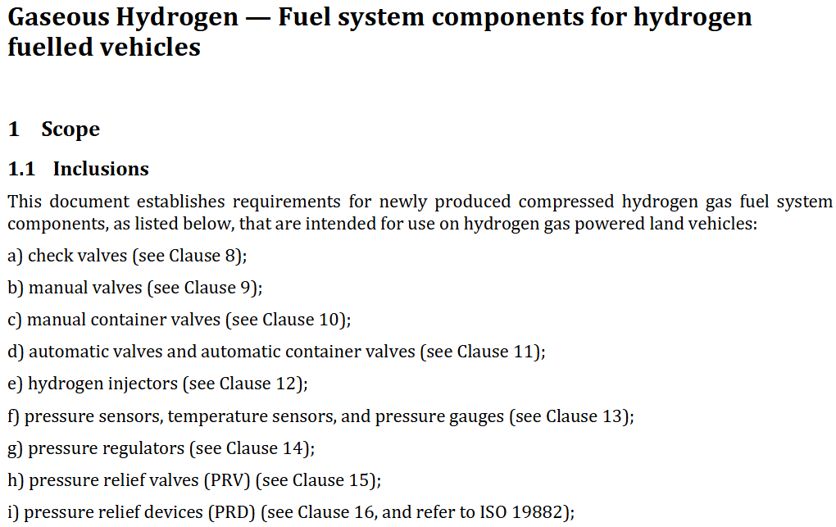
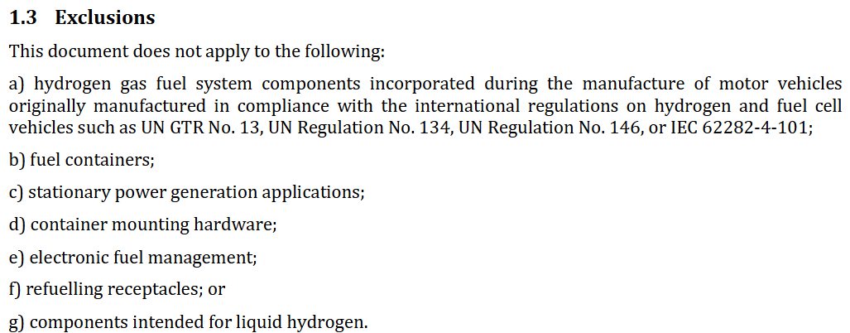
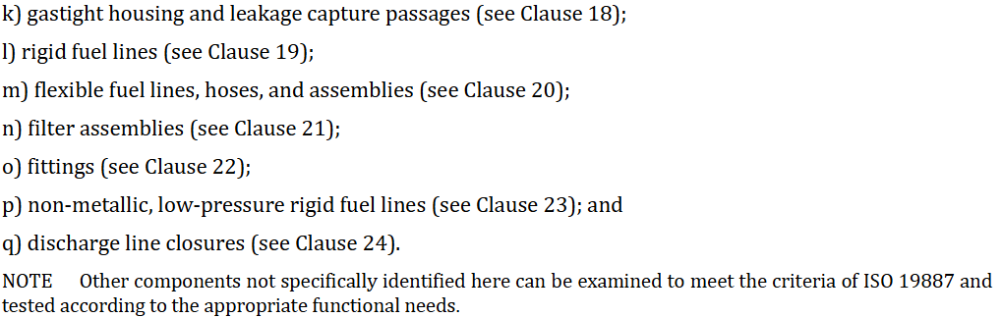
Addressing observations on this approach
GTR-13 Phase 3 could include the supply lines for additional TPRDs by reference to ISO 19887-1 as a qualification standard.
ISO 19887-1 Scope

Slide 4
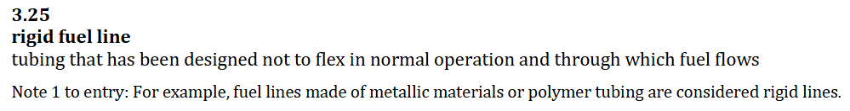
Addressing observations on this approach
“Rigid fuel line” is defined as a non-flexible tube through which fuel flows, typically made of metal or polymer materials. (Definition 3.25)
  Notes aren’t mandatory and are used to provide examples, polymer material is not part of the definition.
  UN-R134 currently includes only metallic supply lines for additional TPRDs.

Slide 5
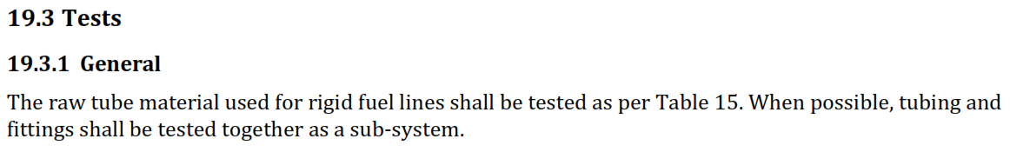
Addressing observations on this approach
All tests applicable to rigid fuel lines require the use of raw tubes and, where possible, testing as a subsystem including fittings. (Clause 19.3.1 – General)
  ISO 19887-1 Fittings (clause 22) will be included in proposed UN-R 134 requirements.
  Tubing in its final shape is tested in the UN-R 134 key functionality tests: pneumatic sequential and localized fire
  Straight tubing samples with fittings are appropriate test pieces per ISO 19887-1 where “bent samples” are less decisive in the determination of the durability of the product.

Slide 6

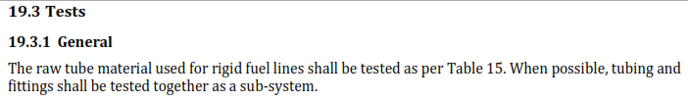
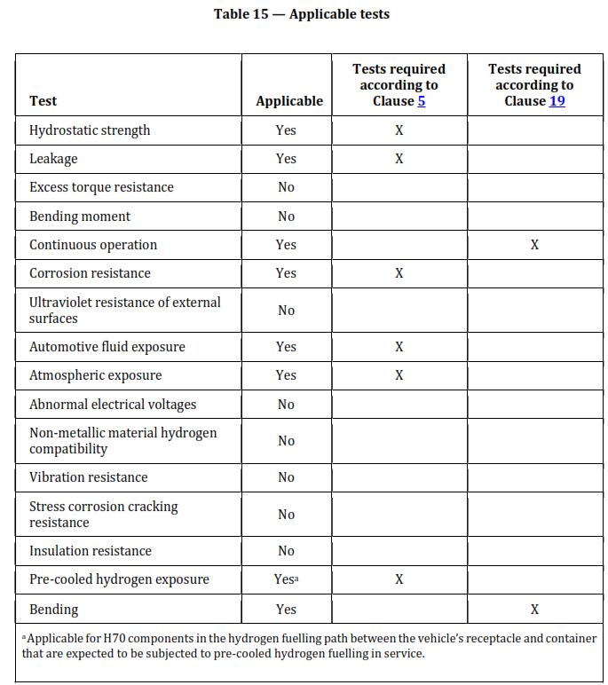
Concerns
Since design verification tests are conducted using raw tubes, differences in the manufacturing method and final geometry may arise, leading to safety concerns. Therefore, this method is inadequate for assessing the safety of components installed in the CHSS.
Tubing + Fittings used in CHSS are not “raw” material but rather they are the finished products.
SG to propose that that fittings and tubes are tested together as recommended in ISO 19887-1 (Clause:19.3.1.)
Supply lines for additional TPRDs are verified as part of the CHSS through the pneumatic (gas) cycle test and bonfire test

Slide 7
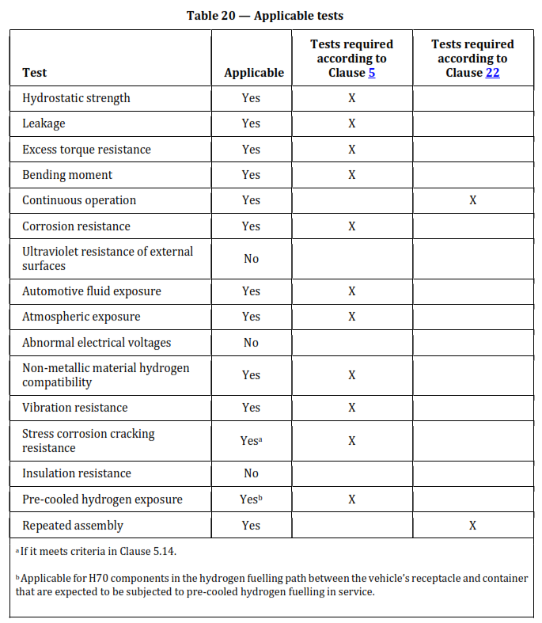
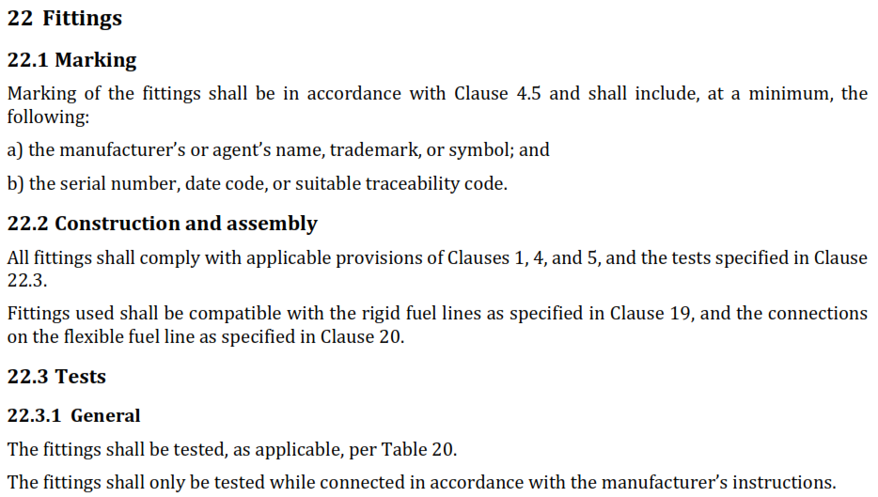
Concerns
The supply lines are assumed to include not only piping but also fittings. Therefore, when referencing ISO 19887-1:2024, it is necessary to consider applying not only Chapter 19 (Rigid Fuel Lines) but also Chapter 22 (Fittings).
ISO 19887-1 Fittings (Clause 22) to be also included.

Slide 8
Concerns
In this standard, material compatibility is considered to be ensured if the hydrogen gas cycle test is conducted and passed. However, since UN-R134 excludes material compatibility from its scope, the treatment of the compatibility between UN-R134 and this standard is inconsistent.
International Standards apply for material compatibility, i.e. (EU 535/2021)
  3. Hydrogen compatibility test: …metallic materials used in CHSS, hydrogen compatibility of the material…shall be demonstrated in accordance with international standards ISO 11114-1:2017 and ISO 11114- 4:2017, with the tests carried out in hydrogen environments as anticipated in service (e.g. in case of 70 MPa systems, the hydrogen compatibility testing is carried out in 70 MPa environment at the temperature of -40C). Alternatively, in agreement with the technical service and the type-approval authority, compliance may be demonstrated in accordance with the standard SAE J2579:2018”
  Section F. Technical specifications for hydrogen components on material compatibility

Slide 9
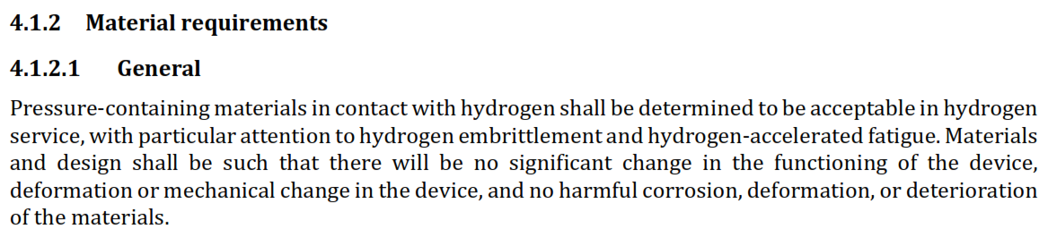
Concerns
UN-R134 does not limit the type of materials used. In this standard, the definition of a rigid fuel line includes lines made of composite materials. However, the test standard does not consider composite materials, making it insufficient for application under UN-R134.
UN-R 134 will continue to be limited to metallic supply lines for additional TPRDs.
The proposed ISO 19887-1 (4.1.2) includes metallurgical or material compatibility requirements.
Testing methods will be per ISO 19887-1, Tubes (Clause 19) and Fittings (Clause 22)

Slide 10
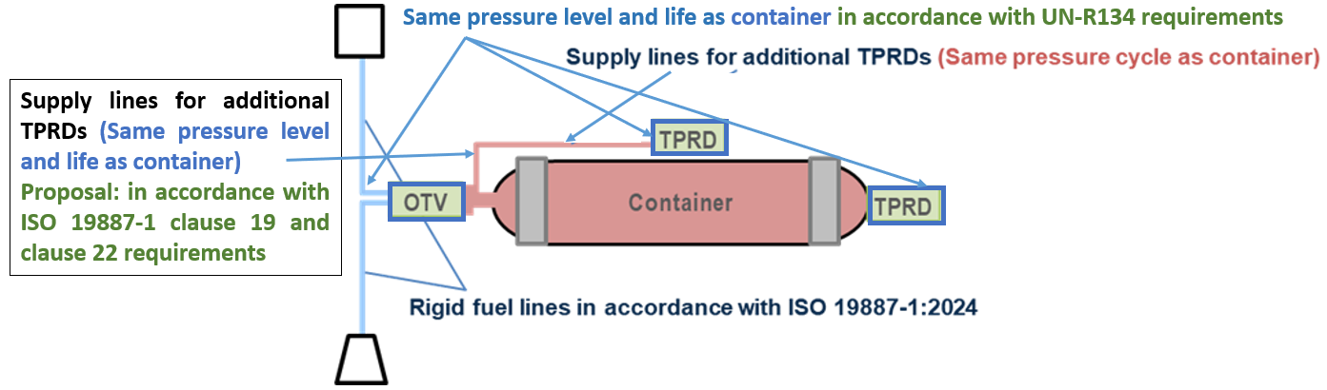
Conclusion
The requirements for rigid fuel lines in ISO 19887-1:2024 apply to the materials and strength of the piping itself, but they are insufficient for verifying the mechanical integrity and durability of fuel lines used as components of a CHSS.
As shown in the figure below, the supply lines of additional TPRDs, including their fittings, are subjected to the same pressure cycles as the container. Therefore, Japan considers it is appropriate to apply baseline tests and hydraulic sequential tests to these lines together with the container, as specified in the test procedures of UN-R134, 03 series.
  OTV and TPRDs are also subjected to the same pressure level and life requirements as the container and are not included in the hydraulic sequential test, not practical to include them
  OTV and TPRDs have their own testing requirements outlined in UN-R134, these components requirements are based on and harmonized with the ISO 19887-1 and 19882 standards.
  Proposal: Use ISO 19887-1 clause 19 and 22 as alternative testing procedures for the supply lines for additional TPRD testing requirements, instead of adding the supply lines for additional TPRD testing requirements in UN-R134. In such a case, the supply lines will not be tested in the hydraulic sequential test but will be included as part of CHSS in pneumatic sequential test and bonfire test.

Slide 11
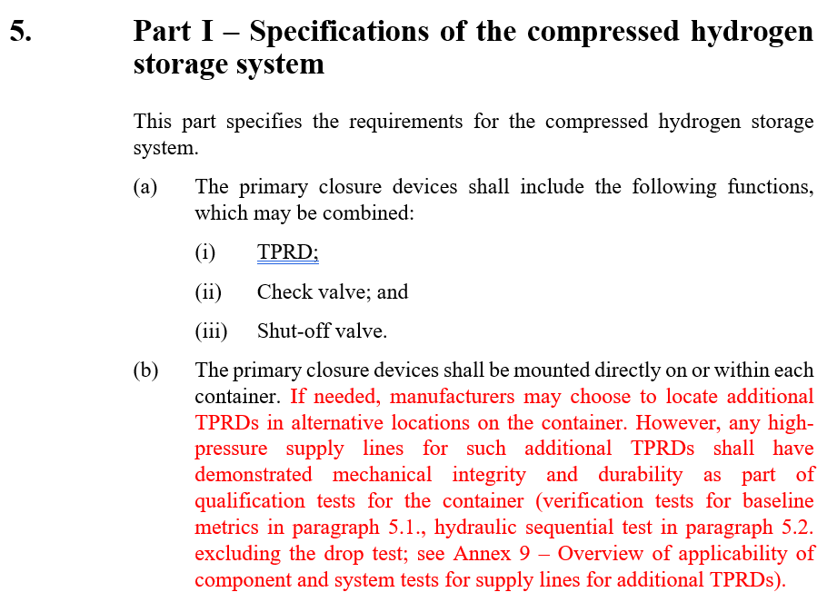
Summary
UN-R 134 new definition proposed
UN-R 134 alternative testing requirements for supply lines for additional TPRDs proposed to read:
Alternatively, the tube and fittings used for supply lines for additional TPRDs may be tested together as a sub-system per the ISO 19887-1 requirements clause 19 (Tubes) and clause 22 (Fittings).
Proposed definition in UN-R134
2.XX. “Supply lines for additional TPRDs" mean the rigid fuel lines and fittings used to connect an additional TPRD to the container.

