Slide 1
Status report to 82nd GRBP
(September 2025)
Transmitted by the co-chairs
of TF for Tyre Abrasion
Informal document GRBP-82-33
agenda item 5(b)
Task Force on Tyre Abrasion
On behalf of GRBP and GRPE

Slide 2
Task Force on Tyre Abrasion
Targets | Develop a robust procedure for measuring the abrasion of tyres: Test conditions and methods; Define the acceptable uncertainty for the tyre abrasion test method(s) and assess the uncertainty of the tyre abrasion test method; Based on the abrasion test method, define a characterisation of relative mileage potential index; Evaluate the abrasion performance and tread depth reduction of a wide range of tyres available in the market; Define abrasion limits for tyres in order to limit the emission of microplastics to the environment; Develop a proposal of amendment to UN Regulation No 117 for the type approval of tyres in respect to their abrasion.
Roles | Co-chairs: United Kingdom (David.Miles@dft.gov.uk) and European Commission (Vicente.Franco@ec.europa.eu) Secretariat: ETRTO (European Tyre and Rim Technical Organisation)
Reporting | To both working parties: GRPE and GRBP Adoption: GRBP
Web page | Task Force on Tyre Abrasion (TF TA) - Transport - Vehicle Regulations - UNECE Wiki ToRs: TF TA Terms of Reference – proposed amendment in GRBP-82-34

Slide 3


Task Force on Tyre Abrasion: facts and figures
Meetings
Attendees ~80
  30th online meeting: 25th February 2025 - TF TA session 30
  31st hybrid meeting (Geneva): 25th March 2025 - TF TA session 31
  32nd online meeting: 23rd April 2025 - TF TA session 32
  33rd online meeting: 20th and 21st May 2025 - TF TA session 33
  34th online meeting: 3rd and 5th June 2025 - TFTA session 34
  35th online meeting: 24th June 2025 - TF TA session 35
  36th online meeting: 7th July 2025 - TF TA session 36
  37th online meeting: 21st 26th August and 2nd September 2025 - TF TA session 37
  CPs:
  European Commission, France, China, Germany, India, Japan, Norway, Netherlands, South Korea, Spain, Switzerland, UK, USA, Canada
  Other organisations:
  ADAC, AVL, ETRMA, ETRTO, HORIBA, IDIADA, ITMA, JAMA, JATMA, LINK, OICA, SMMT, TRAC, TÜV Nord, UBA, UniBW., USTMA, UTAC, VTI, TWMS

Slide 4
Task Force on Tyre Abrasion: work completed
Adoption of methodologies | Test conditions and methods for C1 tyres: adopted ☑ GRBP/2024/10 as amended by GRBP-79-12rev2 new supplement to UNR117.04 ☑ Adopted at WP.29 during its 193rd session in June 2024 ECE/TRANS/WP.29/2024/65 ☑
C1 Testing | For C1: conduct an extensive market assessment test campaign to inform abrasion limit development – completed March 2025 ☑ For C1: conduct a correlation/validation study of the two test methods – completed March 2025 ☑
C1 limits | Develop proposal for C1 tyre abrasion limits – Working document at GRBP in Sept 2025 ☑ Develop an informal document addressing remaining issues in working document and targeting adoption at GRBP in Sept 2025 ◻

Slide 5
Documents for consideration by GRBP
  Two working documents submitted for the consideration of GRBP in September 2025:
  Draft UN Regulation on tyre abrasion (GRBP/2025/27): proposal for a new UN Regulation on the uniform provisions concerning the approval of tyres with regard to abrasion performance, following mandate given to TF TA at 81st GRBP session.
  Amendments to UNR 117 (GRBP/2025/28): proposal for a new supplement to UNR 117.04. The main aim of this proposal will be to remove the provisions related to tyre abrasion from UNR 117.
  Two informal documents submitted for the consideration of GRBP in September 2025:
  (GRBP-82-29) Amendments to working document GRBP/2025/27 to address areas in square brackets and introduce initial test method improvements aimed at reducing measurement uncertainty.
  (GRBP-82-34) Amendments to the TF TA terms of reference.

Slide 6
  New UN Regulation on tyre abrasion (GRBP/2025/27)
Overview
The new UN Regulation introduces a dedicated abrasion regulation for C1 tyres (C2 and C3 will be added in the future);
Defines two test methods: laboratory (drum) and on-road (vehicle) method;
Establishes marking requirements;
Includes limits for C1 tyres, and proposes a two-stage approach;
Enables systematic control and verification of tyre abrasion across Contracting Parties.
Summary of working document
GRBP/2025/27 shown in black
Changes within informal document
GRBP-82-29 shown in blue

Slide 7
  Draft UN Regulation on tyre abrasion
Scope, tyre exclusions
Applies to new pneumatic tyres of class C1 that conform to UNR 117 with regard to their abrasion performance.
Exclusions*:
  Tyres designed for competition, [road legal race tyres (new definition)];
  Ice grip tyres, studded tyres, professional off-road tyres;
  [Tyres for use in severe snow conditions with a speed category less than or equal to 160 km/h (speed category symbol Q)].
Informal document removes square brackets
Informal document removes this exemption
Update
*Non-exhaustive

Slide 8
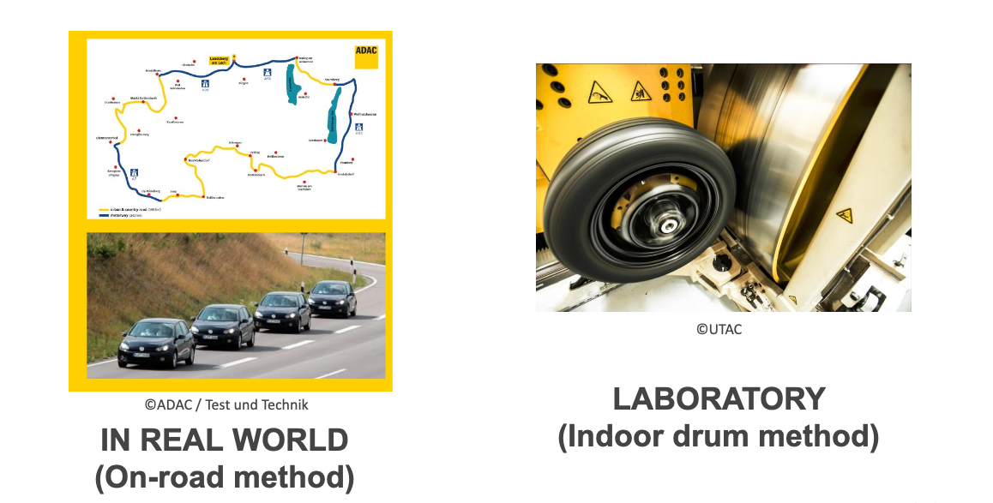
  Draft UN Regulation on tyre abrasion
Testing methods

Slide 9
  Draft UN Regulation on tyre abrasion
Testing methods
‘Indoor drum’ and ‘On-road vehicle’ methods included on equal footing in draft UNR
A low level of correlation between the methods presently observed from the market assessment data, with much better results from the dedicated correlation-validation (COVA) testing campaign
Abrasion results for a significant number of tyres exhibit high levels of ‘inversion’ (see next slide)
No systematic biases observed for any of the methods (average of pairwise differences ≈ 0.)
Some TF TA members proposed to delay the limit setting exercise for the ‘drum’ method by nine months (two WP.29 sessions) – square brackets therefore remain in the document
TF TA consensus that technical improvements (tighter specification of key parameters) and dedicated testing to improve correlation will be needed.
Several initial proposals for improving the test accuracy of the drum test method have been made and have already been incorporated into the working document and informal document.

Slide 10
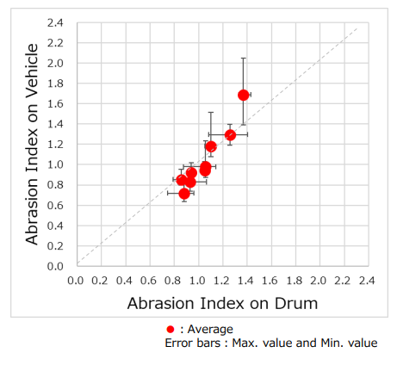
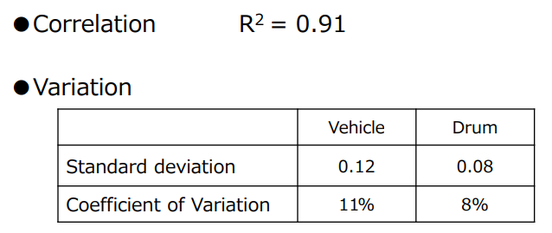
Draft UN Regulation on tyre abrasion
Testing methods – correlation study
Source: TA-37-6 (JASIC)

Slide 11
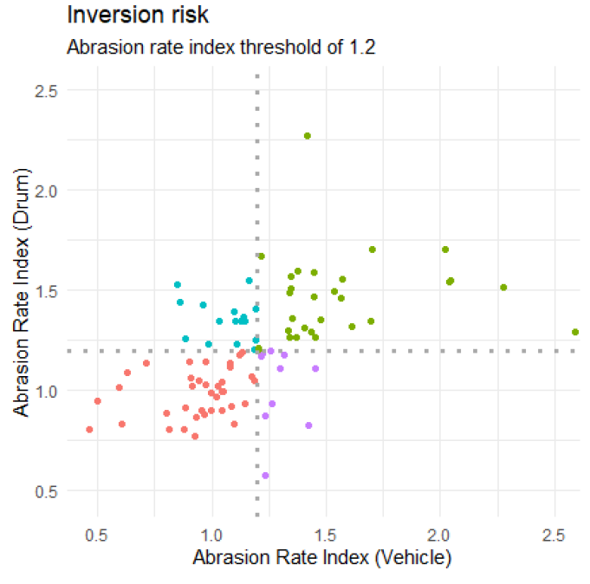
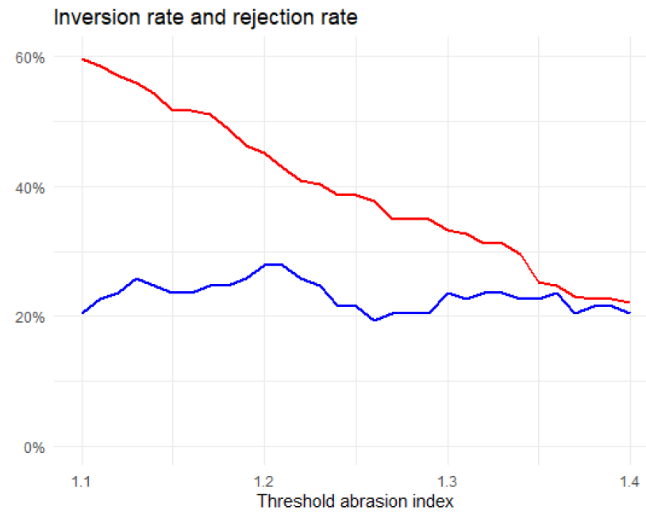
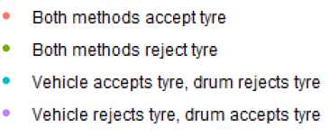

  Draft UN Regulation on tyre abrasion
Testing methods – market assessment data
Source: TA-32-10rev1 (RDW)

Slide 12
  Draft UN Regulation on tyre abrasion
Structure and values for proposed abrasion limits for C1 tyres
The structure for limits within the working document reflects the technical complexity of tyres and of testing methods. It includes:
  ‘Core’ limits – Set the overall level of ambition, long-term stability.
  ‘A_{margin}’ – An additional margin that is subtracted from the measured abrasion index result.
  Specific allowances for groups of tyres with special abrasion characteristics (e.g. XL tyres)
  CoP tolerance: fixed value to account for production variability, added in the context of conformity of production testing.
Within the informal document, we have amended the structure of the limits to try and simplify it for the reader and bring relevant allowances alongside the core limits within the text. (More information on the next slides)
Limits are proposed with a two-stage approach as a way to balance long-term ambition on environmental improvement with the current state of development of tyres with regard to abrasion:
  Stage 1: from entry into force – aims to balance environmental objectives with recognition of the current performance of the tyre market - provides several allowances for specific tyre groups.
  Stage 2: as of [1st of January 2033] – a tightening of stringency to achieve longer term environmental objectives, certain allowances are dropped.

Slide 13
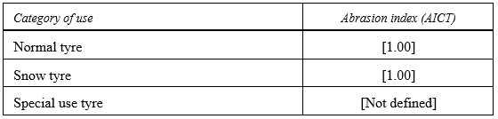
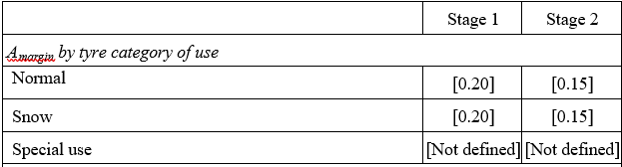
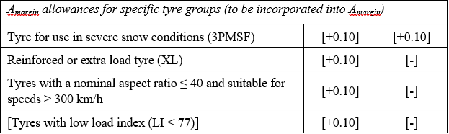
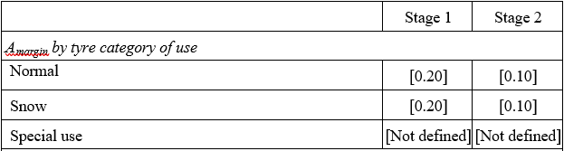
Structure and values for proposed abrasion limits for C1 tyres – as proposed in the working document
Core limits (paragraph 6.1.1.)
Abrasion margin applied at type approval – Open road (Annex 3, 1.11.13.5.)
Allowances (Annex 3, 1.11.13.5. & 2.8.)
Abrasion margin applied at type approval – Drum (Annex 3, 2.8.)
CoP margin (paragraph 8.4.) = [0.20]
Maximum acceptable value:
At TA: Core limit + Abrasion Margin + Allowances (where applicable)
At CoP: Core limit + Abrasion Margin + Allowances (where applicable) + CoP margin

Slide 14
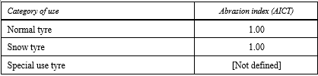
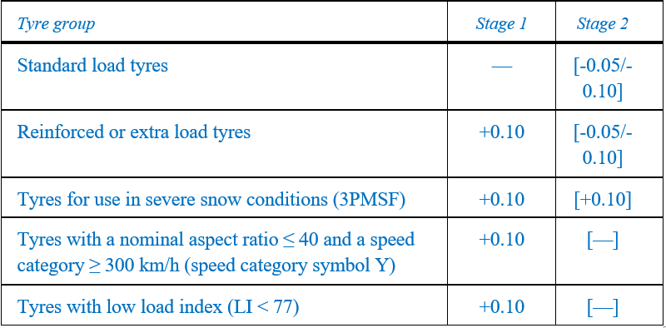
Structure and values for proposed abrasion limits for C1 tyres – as proposed in the informal document
Core limits (paragraph 6.1.1.)
Limit adjustments for specific tyre groups (both methods) (paragraph 6.1.1.)
Abrasion margin (Annex 3, paragraphs 1.11.13.5. & 2.8) = [0.20]
CoP margin (paragraph 8.4.) = [0.20]
Maximum acceptable value:
At TA: Core limit + Limit Adjustment (where applicable) + Abrasion Margin
At CoP: Core limit + Limit Adjustment (where applicable) + Abrasion Margin + CoP margin

Slide 15
Structure and values for proposed abrasion limits for C1 tyres – as proposed in the informal document
Square brackets removed
Core limits (paragraph 6.1.1.)
Limit adjustments for specific tyre groups (both methods) (paragraph 6.1.1.)
Abrasion margin simplified with single margin across both methods
Abrasion margin (Annex 3, paragraphs 1.11.13.5. & 2.8) = [0.20]
“Allowances” changed to “limit adjustments” and moved next to core limits in the text for clarity
Same overall stringency as working document
Square brackets removed for stage 1
CoP margin (paragraph 8.4.) = [0.20]
Maximum acceptable value:
At TA: Core limit + Limit Adjustment (where applicable) + Abrasion Margin
At CoP: Core limit + Limit Adjustment (where applicable) + Abrasion Margin + CoP margin

Slide 16
  Draft UN Regulation on tyre abrasion
Introductory provisions
The proposed introductory provisions mirror the Euro 7 calendar for C1 tyres and support a two-stage approach.
Stage 1:
New approvals required no sooner than [30 June 2028].
All approvals required no sooner than [30 June 2030].
Stage 2:
New approvals required no sooner than [31 December 2032].
All approvals required no sooner than [31 December 2034].
Fitting of non-compliant C1 tyres on a vehicle in use:
Until [30 June 2032] for tyres manufactured prior to [30 June 2030].
Extended acceptance (transition from Stage 1 to Stage 2):
Approvals granted before the relevant cutoff can be extended until [31 December 2034].
Square brackets removed by informal document
Provision re-drafted in line with UNR 117 text and new paragraph 12.7. added to cover stage 2. Square brackets added around both paragraphs.

Slide 17
Further changes introduced by GRBP-82-29
Introduction of new definition of Road Legal Race tyres
Removal of square brackets to:
  confirm 3PMSF and non-3PMSF tyres cannot fall within the same tyre type
  confirm the abrasion margin applied at CoP should be the same as at the original type approval
Introduce small improvements to the drum and on-road methods to reduce areas of measurement uncertainty
Introduce provisions for the testing of mixed fitment tyres (i.e. where the candidate tyre cannot be fitted on all 4 positions)
Drafting improvements to address errors and bring clarity, based on feedback

Slide 18
New UNR - what is still to be agreed?
  Inclusion (or not) of special use tyres from the scope
Special use tyres are currently included within the scope in the draft regulation, but with limits marked as “not defined” in square brackets:
There are two main points of view on how to handle special use tyres within the regulation:
  Exclude them from the scope of the regulation entirely
  Include them within the scope, but without a limit defined, to allow monitoring of their abrasion performance and potential inclusion of limits in future

Slide 19
New UNR - what is still to be agreed?
  Limit adjustments and margins
It was not possible to come to a consensus within TF TA on limit adjustments for stage 2, abrasion margins and CoP margins.
As some of these numbers relate not just to technical feasibility, but also to the desired environmental outcome of CPs, we have brought this to GRBP for discussion and agreement.
Figures within square brackets represent the co-chairs’ attempt to try to come to a proposal based on the various positions expressed within the task force. However, there remain a range of positions with regards to stringency of the limits.
Based on analysis presented by the co-chairs within TF TA, the proposed limits and margins would be expected to give rise to reductions in the mean abrasion rate of normal tyres of ~10% in the first stage and would result in ~30% rejection of tyre types based on those tested in the market assessment. Different figures have been presented by other participants of the task force, depending on the analysis method taken.

Slide 20
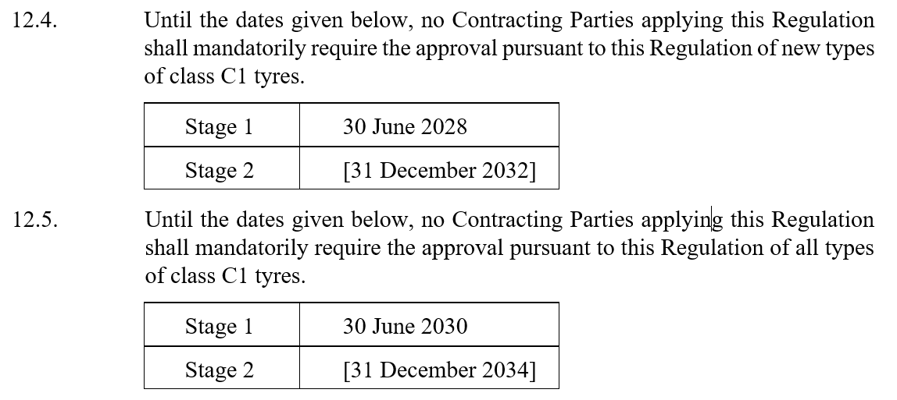
New UNR - what is still to be agreed?
  Stage 2 dates
  Whilst dates for stage 1 have been agreed within TF TA, there remain different views on the date of application of a stage 2
  As discussion of an appropriate date relates also to the accompanying stringency of the limits for stage 2, we have brought this to TF TA for discussion and agreement

Slide 21
New UNR - what is still to be agreed?
  Limit setting on both the drum and on-road methods
Issues with regards to correlation and measurement uncertainty of the test methods have been identified through the market assessment
The need for improvement on this is widely recognised in the task force and we will be committing to further method improvement work to address this (see ToR update slide)
The majority of TF TA participants support proceeding for adoption of limits based upon both test methods at GRBP 82
ETRTO currently do not support this position – we are therefore seeking views from GRBP on this issue

Slide 22
  Amendments to UNR 117 (GRBP/2025/28)
  Overview
Justification: establishes the separation of abrasion requirements into a new dedicated UN Regulation, making UNR 117 more focused and streamlined.
Scope change: removes tyre abrasion provisions from UNR 117, focusing it exclusively on rolling resistance, rolling noise, and wet grip.
Deletions: all definitions, requirements, and annexes related to abrasion rate, abrasion level, and abrasion index for C1 tyres are deleted from UNR 117.
Updated scope wording: clarifies that UNR 117 applies to abrasion only until the new dedicated UNR applies.

Slide 23
Task Force on Tyre Abrasion: next steps
C1 tyres | Develop proposal for C1 tyre abrasion limits – Working document at GRBP in Sept 2025 ☑ Develop an informal document addressing remaining issues in working document and targeting adoption at GRBP in Sept 2025 ◻ Assess the feasibility of rating and definition of the mileage of tyres -“relative mileage potential calculated performance”- ongoing - September February 2026 ◻ NEW – conduct further work on C1 method improvement – working document at GRBP in Sept 2026 ◻ Full updated timeline of C1 activities can be found here: TA-29-4
C2 tyres | Assessment of C1 method suitability for C2 tyres – ongoing ◻ Propose abrasion method(s) – working document at GRBP in Feb 2026 Develop proposal for C2 tyre abrasion limits – working document at GRBP in Sept 2027
C3 tyres | Propose abrasion method(s) – working document at GRBP in Feb 2027 Develop proposal for C3 tyre abrasion limits – working document at GRBP in Sept 2029

Slide 24
Terms of reference update (GRBP-82-34)
Corrections to reference a new UNR on tyre abrasion rather than amendments to UNR 117
C1 – introduction of timeline for further work on method improvements to address concerns on correlation and measurement uncertainty – targeting September 2026 for a working document
C1 – update to timeline on mileage potential metric – targeting working document in February 2026
C2 – removal of the timeline item for an informal document on C2 methodology in September 2025

Slide 25
Thank you

