Slide 1
TF TA 32nd session
23rd April 2025
Co-chairs’ note:
Delivering a C1 limits proposal for the 82nd GRBP

Slide 2
TF TA 32nd session
23rd April 2025
A reminder on deadlines:
Working document deadline for 82nd GRBP: 10th June 2025
Online GRPE session to present working document: 26th June 2025 (provisional)
82nd GRBP: 3-5th September 2025
Less than 7 weeks away!

Slide 3
TF TA 32nd session
23rd April 2025
Key decisions for C1 limits proposal
Can we proceed on limit setting for both test methods based on current correlation?
What tyres should be in/out of scope for limit setting?
What tyre groupings should be used for limits? (e.g. one limit for all, different limits for normal and 3PMSF, further groupings?)
What limit values should be used?
How should measurement uncertainty be accounted for within the limit setting?

Slide 4
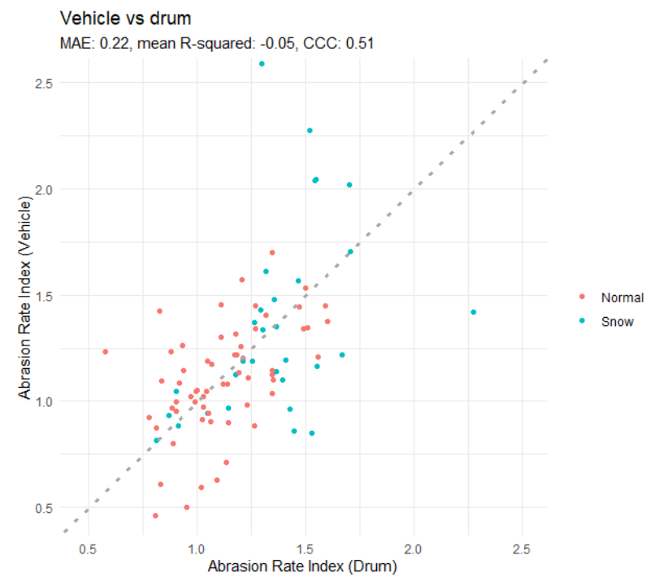
TF TA 32nd session
23rd April 2025
Key decisions for C1 limits proposal
Can we proceed on limit setting for both test methods based on current correlation?
Correlation of the two methods is currently far from ideal
This presents high risk of a vehicle passing a limit on one method, but not the other, reducing the potential impact of regulation
Questions:
Do we think that both methods can be used for the limit setting proposal? (within the next 7 weeks)
If yes, should the same limits apply to both methods?
If no, do we need to consider limit setting on one method only whilst working to improve correlation over the longer term?
From RDW presentation: comparing methods & temperature correlations, given at TAPP

Slide 5
TF TA 32nd session
23rd April 2025
Key decisions for C1 limits proposal
Can we proceed on limit setting for both test methods based on current correlation?
What tyres should be in/out of scope for limit setting?
What tyre groupings should be used for limits? (e.g. one limit for all, different limits for normal and 3PMSF, further groupings?)
What limit values should be used?
How should measurement uncertainty be accounted for within the limit setting?
TAPP review so far has shown some of the non-R117 tyres to be outliers in their abrasion behaviour
Should we limit to R117 approved tyres only?

Slide 6
TF TA 32nd session
23rd April 2025
Key decisions for C1 limits proposal
Can we proceed on limit setting for both test methods based on current correlation?
What tyres should be in/out of scope for limit setting?
What tyre groupings should be used for limits? (e.g. one limit for all, different limits for normal and 3PMSF, further groupings?)
What limit values should be used?
How should measurement uncertainty be accounted for within the limit setting?

Slide 7
TF TA 32nd session
23rd April 2025
Key decisions for C1 limits proposal
Can we proceed on limit setting for both test methods based on current correlation?
What tyres should be in/out of scope for limit setting?
What tyre groupings should be used for limits? (e.g. one limit for all, different limits for normal and 3PMSF, further groupings?)
What limit values should be used?
How should measurement uncertainty be accounted for within the limit setting?
Should the limits be determined based on:
the desired environmental outcome? (e.g. X% reduced emission factor)
the performance of the current market? (e.g. median performing tyre or exclusion of Y% of current market)

Slide 8
TF TA 32nd session
23rd April 2025
Key decisions for C1 limits proposal
Can we proceed on limit setting for both test methods based on current correlation?
What tyres should be in/out of scope for limit setting?
What tyre groupings should be used for limits? (e.g. one limit for all, different limits for normal and 3PMSF, further groupings?)
What limit values should be used?
How should measurement uncertainty be accounted for within the limit setting?
Should the limits be inclusive of any determined measurement uncertainty margin, or should this be stated separately?
Should we consider different measurement uncertainty margins for approval and COP?

Slide 9
TF TA 32nd session
23rd April 2025
Key decisions for C1 limits proposal
Can we proceed on limit setting for both test methods based on current correlation?
What tyres should be in/out of scope for limit setting?
What tyre groupings should be used for limits? (e.g. one limit for all, different limits for normal and 3PMSF, further groupings?)
What limit values should be used?
How should measurement uncertainty be accounted for within the limit setting?

Slide 10
TF TA 32nd session
23rd April 2025
A possible framework for C1 limits proposal
Factual elements 1/2 – Data to support limit setting
Market assessment was a successful exercise, with an appropriate selection of tyres and extensive testing for both methods. This dataset is an appropriate basis for [initial] limit setting.
There is a trade-off between the stringency of the limit and the impact upon tyre references currently on the market. As a rule of thumb, a relationship of 3 to 1 (30% of tyres affected for a 10% reduction in AI) has been observed by independent analyses.
The uncertainties of both methods are reasonably understood. Some improvement can be expected.
Considering that the tyre selection is representative of the market, and excluding uncertainty considerations, there is a band for feasible limits around an abrasion index of 1.0.

Slide 11
TF TA 32nd session
23rd April 2025
A possible framework for C1 limits proposal
Factual elements 2/2 - Method correlation
The two testing methods aim to measure the same thing. They have their own strengths and weaknesses, which complement each other.
The correlation of the two methods is currently poor (low R²). An ‘alignment’ formula looks difficult to derive.
Some improvement can be expected by focusing on specific situations and by incorporating new data from further tests.
A single limit for both methods may dilute the stringency of the regulation if compliance is only required for one method (‘inversion risk’).
A stringent nominal limit could improve the agreement between the methods by removing certain outliers (tyres with high differences between the methods).

Slide 12
TF TA 32nd session
23rd April 2025
A possible framework for C1 limits proposal
Proposed building blocks for a TF TA limits proposal for C1 tyres
A nominal limit for normal tyres that is relatively stringent (close to 1.0, with possible special consideration of market impact on snow tyres). (supports long-term ambition and improvement in agreement between the methods).
A mechanism (in drafting) to separate the ‘core’ limit from the measurement uncertainty as the methods continue to evolve / improve. (mitigates the short-term impact upon existing tyre references).
A mechanism to address ‘inversion risk’ (via CoP or market surveillance provisions?) (addresses the shortcomings of the coexistence of two methods).
A review mechanism (in drafting) in case the alignment of methods is achieved in the future (allows single limit now without prejudging future development of both methods).

Slide 13
Organisation of TF TA for delivering C1 limits proposal
TF TA 32nd session
23rd April 2025
TF TA
Co-chairs: Vicente Franco(EC), David Miles (UK)
Secretary: ETRTO
TAPP
(post processing)
Responsible for: analysing, summarising and disseminating results from the market assessment to TF TA
Sub-group leader: Josep Guinjoan (ETRTO)
TADG
(drafting group)
Responsible for: drafting of informal and working documents based on the position of TF TA
Sub-group leader: Maёlle Dodu

