Slide 1
Supporting Information to
GRBP/2025/29 replaced by GRBP-82-08
Informal document GRBP-82-09
(82nd GRBP, 3-5 September 2025,
agenda item 3)
82nd GRBP
3-5 September 2025, Geneva
UN Regulation No. 51
(Noise of M and N Categories of Vehicles)

Slide 2
Placing GRBP/2025/29 in Context
Close a Regulatory Gap within a Short Period of Time.
A concern regarding an existing and non-regulated gap for electric vehicles led OICA submit the proposal GRBP/2024/22 last year, that was capable to close that gap from October 2025 on. GRBP didn’t adopt the proposal and installed a subgroup to IWG RD-ASEP for further improvements. OICA supports the work of the subgroup and is still seeking for a consensus.
Nevertheless, OICA has submitted a refined proposal for adoption, to enable the delegates of 82nd GRBP to close this regulatory gap within a short period of time (possible October 2026). While OICA is still open for improvements or could withdraw these documents, when an acceptable alternative approach is available in time.
GAP in Regulation
In Paragraph 6.2.3 EVs are exempted from ASEP in
UN-R 51/03 Annex 7:
“The Additional Sound Emission Provisions (ASEP) apply only to vehicles of categories M₁ and N₁ equipped with an internal combustion engine.”
OICA sees this proposal as a fast interim step that addresses this issue until RD-ASEP will be introduced by a forthcoming new series of amendment and presented in 84th GRBP.
OICA wants to concentrate on the refinement of the RD-ASEP concept, in a forthcoming new series of amendments to UN R-51 (expected in 84th GRBP in September 2026)

Slide 3
Placing GRBP/2025/29 in Context
GRBP/2024/22 is replaced by GRBP/2025/20 and GRBP/2025/29
OICA presents now a refined document GRBP/2025/29 to 82nd GRBP as a replacement to its proposal GRBP/2024/22 originally issued for the 80th GRBP in September 2024:
reiterating our concern regarding an existing and non-regulated gap for electric vehicles.
using the way of a simple supplement without transitional provisions for fast implementation (possible EiF October 2026).
reflecting the findings from our technical validation work of the last year.
considering what we sensed as feedback from CPs in the subgroup by informal document GRBP-82-08 replacing GRBP/2025/29.
separating the editorial corrections and clarifications of GRBP/2024/22 in an additional Working Document GRBP/2025/20.
starting to work out an amendment for EVs in document for reference GRB-68-03.
addressing new requirements to a forthcoming new 04 series of amendments to
UN-R 51 (expected EiF 2027), and if needed to a new series of amendments to UN-R 138.

Slide 4

Placing GRBP/2025/29 in Context
Estimated Timing of GRBP-Work on UN Regulation No. 51
2024
2025
2026
2027
2028
2029
UN-R 51: Supplement [11] to 03 series of amendments
10.2025
less than 3 years < product cycle (4 years)!
GRBP/2024/22
80th
195th
EIF
10.2026
GRBP/2025/20
GRBP/2025/29
82nd
198th
NT
  New Types
Amendment to GRB-68-03
83rd
84th
DfR
  Amended Document for Reference
2024
2025
2026
2027
2028
2029
07.2029
84th
201th
EIF
NT
UN-R 51: New 04 series of amendments (estimated)
Transitional Provisions
  New Types
Working
Document
99th
GRBP
meeting
999th
WP.29
meeting
EIF
Entry into Force (EiF) with
Transitional Provisions
NT
AV
EiF New Types
EiF All Vehicles

Slide 5


GRBP/2025/29: Concept “ASEP¹ for xEVs”
Small changes are needed for getting Annex 7 ready for xEVs.
ASEP for vehicles with Internal Combustion Engines (ICEs) |  | ASEP for vehicles with Electric Motors (xEVs)
Engine Speed used as reference for ASEP evaluation in any gear below type approval gears (Annex 3). |  | Vehicle Speed is introduced as a new reference for ASEP evaluation, since EVs don‘t have a meaningful engine speed for the purpose of noise.
Slope of ASEP limit curve is based on gear individual sound behavior in any gear below gears used for Type Approval (Annex 3). |  | Slope of ASEP limit curve is fixed since it is based on speed. It realizes a handshake to the maximum sound pressure limits of UN-R 138.
ASEP is only applicable in full load condition, acceleration is adjusted to the control range by gear selection with gear dependent limits. |  | ASEP is applicable as well under partial load and not only under full acceleration, since there is usually only one gear available. The limit curve is adjusted to higher performances than performed during UN-R 51/03 Annex 3 Type Approval test.

Slide 6
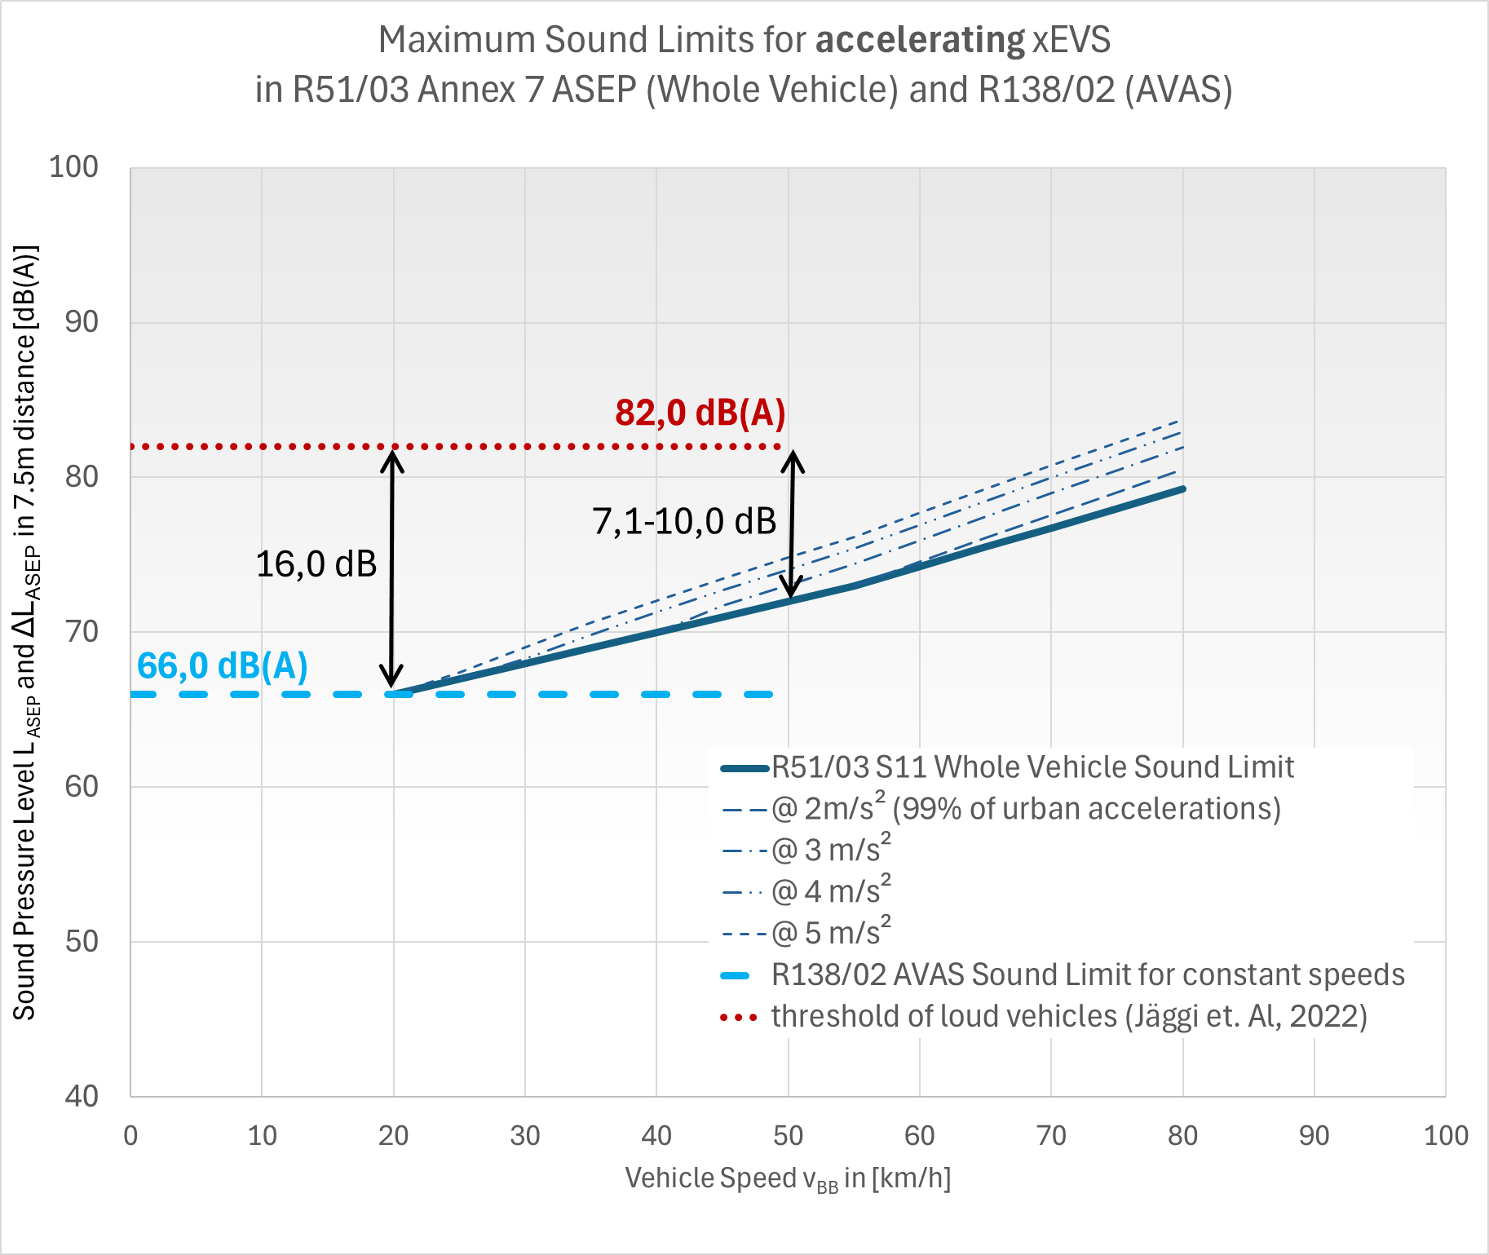
GRBP/2025/29: Concept “ASEP¹ for xEVs”
ASEP is working with AVAS² Requirements while Preserving EV’s Advantages
ASEP-Limits are
closing an unregulated gap,
preserving the advantages of low EV‘s sound emission especially in urban traffic,
making sure that EVs without any additional sound (only with AVAS) are passing these limits (performance-based approach),
incorporating vehicle performances higher than urban performances (safety benefit),
handshaking with UN Regulation No. 138 limits,
compatible with 01 and 02 series of amendments of UN Regulation No. 138, and will be
supported by a future revision of GRB-68-03 (amendment adopted latest in 84th GRBP)

Slide 7
GRBP/2025/29: Concept “ASEP for xEVs”
Open Topics and Recommendations
Topic of Proposals
Proposed changes and OICA position
Recommendation
New
Specifications
for Enhanced Exterior Sound (EES)
A system generating EES must have a button for direct driver control. The EES shall fulfill additional requirements for detectability and not masking.
Accepted sounds are described in an additional side document.
OICA:
This is not subject to a (fast) Supplement.
Mandate the subgroup to revise GRB-68-03 regarding EES of electric vehicles.
If needed, add new requirements to the suitable UN Regulation.
Changing
ASEP principles
New base for anchor point will create new limit principles. Other treatment of ASEP results for EVs.
OICA:
Move discussion to new RD-ASEP method.
Continue discussion in
IWG RD-ASEP targeting the new 04 series of amendments to
UN Regulation No. 51.

Slide 8

Summary of Recommended Actions
Close Topics to Concentrate on Important GRBP Work
01 | GRBP/2025/20 replaced by GRBP-82-07 Adoption of the OICA proposal during the 82nd GRBP session to implement necessary corrections and clarifications in the short term.
02 | GRBP/2025/29 replaced by GRBP-82-08 Adoption of the OICA proposal during the 82nd GRBP session to close a regulatory gap in the short term until the new 04 series of amendments enters into force.
03 | Amendment to GRB-68-03 Mandate the Subgroup on R51 & R138 to prepare an amendment to document for reference GRB-68-03, which could be adopted during the 84th GRBP session at the latest.
04 | IWG RD-ASEP Focus the GRBP resources on the refinement of the RD-ASEP concept in a new 04 series of amendments to UN Regulation No. 51 in the dedicated IWG on RD-ASEP.
Text
TT.MM.JJJJ

Slide 9
Backup

Slide 10

Placing GRBP/2025/29 in Context
Estimated Timing of GRBP Regulations on Sound Emission
2024
2025
2026
2027
2028
2029
UN-R 51: Supplement [11] to 03 series of amendments
10.2025
less than 3 years < product cycle (4 years)!
GRBP/2024/22
80th
195th
EIF
10.2026
GRBP/2025/20
GRBP/2025/29
82nd
198th
NT
  New Types
Amendment to GRB-68-03
83rd
84th
DfR
  Amended Document for Reference
2024
2025
2026
2027
2028
2029
07.2029
84th
201th
EIF
NT
UN-R 51: New 04 series of amendments (estimated)
Transitional Provisions
  New Types
UN-R 138: 02 series of amendments (already adopted)
09.2026
09.2028
79th
193rd
EIF
NT
AV
Transitional Provisions
  New Types
  All Vehicles
Working
Document
99th
GRBP
meeting
999th
WP.29
meeting
EIF
Entry into Force (EiF) with
Transitional Provisions
NT
AV
EiF New Types
EiF All Vehicles

