Slide 1
Supporting material to ETRTO working documents
Transmitted by the experts of ETRTO Informal document GRBP-81-13-Rev.1
(81st GRBP, 18-21 February 2025,
agenda item 6)
81st GRBP session (February 2025)

Slide 2
Contents
Elements triggering ETRTO amendment proposals
POR requirements (clarification request from the Netherlands)
Principal groove revised definition (clarification request from France)

Slide 3
1. Elements triggering ETRTO amendment proposals
R30 | R54 | R75 | R117.02 | R117.04 | R142 | R108.01 | R109.01 | R172
GRBP-81-05e-Rev.1 | GRBP-81-06e-Rev.1 | GRBP-81-07e-Rev.1 | GRBP-81-08e-Rev.1 GRBP-81-09e-Rev.1 |  | GRBP-81-10e-Rev.1 | GRBP-81-11e-Rev.1 | GRBP-81-12e-Rev.1 | GRBP-81-XX
ZRF marking |  | M/C suffix | ISO/ASTM references |  |  |  |  | new c3 SRTT siped
 | Free Rolling Tyre front axle, FRT |  |  |  | Free Rolling Tyre, front axle, FRT |  | Free Rolling Tyre, front axle, FRT
 |  |  |  |  |  | traction tyres | traction tyres
 |  |  | tyre for use in severe snow conditions |  | Normal tyre snow tyre snow tyre for use in severe snow conditions | Normal tyre snow tyre snow tyre for use in severe snow conditions
principal grooves | principal grooves | principal grooves | principal grooves |  |  | principal grooves | principal grooves
tread groove |  |  | tread groove |  |  | tread groove | tread groove
tread depth |  |  |  |  |  | tread depth
secondary grooves | secondary grooves |  |  |  |  | secondary grooves
ISO/ASTM references
POR | POR |  | POR |  |  |  | POR | POR
section width | section width | section width |  |  |  | section width
overall width |  | overall width
Dmax snow | Dmax snow
nominal rim diameter | nominal rim diameter | nominal rim diameter |  |  |  | nominal rim diameter | nominal rim diameter
 |  | Tyre section width specifications
 |  | Tyre outer diameter specifications
 |  | centrifugal radius
 |  | category of use
 |  |  | transitional provisions |  |  |  |  | transitional provisions
 |  |  |  |  | contents and paragraph titles
 |  |  |  | scope
 |  |  |  |  | table load-capacity variation with speed

Slide 4
2. On POR requirements (R117.02)
2.15. "Professional off-road tyre" is a special use tyre primarily used for service in severe off-road conditions.
6.6. In order to be classified as a "special use tyre" a tyre shall have a block tread pattern in which the blocks are larger and more widely spaced than for normal tyres and have the following characteristics:
For class C1 tyres: a tread depth ≥ 11 mm and void to fill ratio ≥ 35 per cent
For class C2 tyres: a tread depth ≥ 11 mm and void to fill ratio ≥ 35 per cent
For class C3 tyres: a tread depth ≥ 16 mm and void to fill ratio ≥ 35 per cent
duplication
duplication
Current
Proposal
6.7. In order to be classified as a "professional off-road tyre", a tyre shall have all of the following characteristics:
(a) For classes C1 and C2 tyres:
(i) A tread depth ≥ 11 mm;
(ii) A void-to-fill ratio ≥ 35 per cent;
(iii) A maximum speed category symbol of ≤ Q.
(b) For class C3 tyres:
(i) A tread depth ≥ 16 mm;
(ii) A void-to-fill ratio ≥ 35 per cent;
(iii) A maximum speed category symbol of ≤ K.
6.7. In order to be classified as a 'professional off-road tyre', a special use tyre shall fulfil the following characteristics additional requirement:
For classes C1 and C2 tyres:, the maximum speed category shall be less than or equal to 160 km/h (speed category symbol Q).
For class C3 tyres:, the maximum speed category shall be less than or equal to 110 km/h (speed category symbol K).
Only difference between C1/C2 special use and C1/C2 POR
Only difference between C3 special use and C3 POR

Slide 5
2. On POR requirements (R117.04)
2.15. "Professional off-road tyre" is a special use tyre primarily used for service in severe off-road conditions.
6.7. In order to be classified as a "special use tyre" a tyre shall have a block tread pattern in which the blocks are larger and more widely spaced than for normal tyres and have the following characteristics:
For class C1 tyres: a tread depth ≥ 9 mm and void to fill ratio ≥ 30 per cent
For class C2 tyres: a tread depth ≥ 11 mm and void to fill ratio ≥ 35 per cent
For class C3 tyres: a tread depth ≥ 16 mm and void to fill ratio ≥ 35 per cent
duplication
duplication
Current
Proposal
6.8. In order to be classified as a "professional off-road tyre", a tyre shall have all of the following characteristics:
(a) For classes C1 and C2 tyres:
(i) A tread depth ≥ 11 mm;
(ii) A void-to-fill ratio ≥ 35 per cent;
  A maximum speed category symbol of ≤ Q.
(b) For class C3 tyres:
(i) A tread depth ≥ 16 mm;
(ii) A void-to-fill ratio ≥ 35 per cent;
(iii) A maximum speed category symbol of ≤ K.
6.8. In order to be classified as a "professional off-road tyre", a special use tyre shall have the following characteristics:
(a) For class C1 tyres:
(i) A tread depth ≥ 11 mm;
(ii) A void-to-fill ratio ≥ 35 per cent;
(iii) A maximum speed category less than or equal to 160 km/h (speed category symbol).
(b) For class C2 tyres, a maximum speed category less than or equal to 160 km/h (speed category symbol Q).
(c) For class C3 tyres:, a maximum speed category less than or equal to 110 km/h (speed category symbol K).
Only difference between C2 special use and C2 POR
Only difference between C3 special use and C3 POR

Slide 6
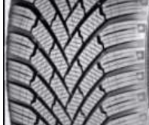
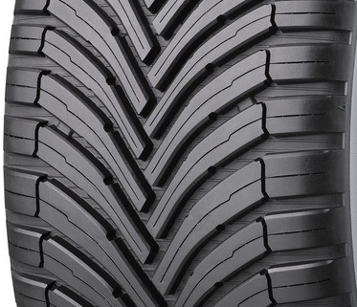
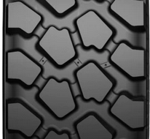

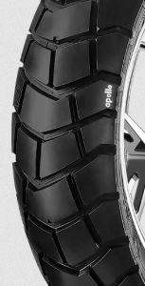
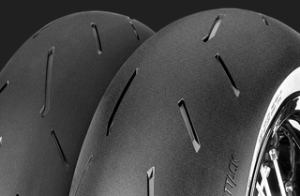
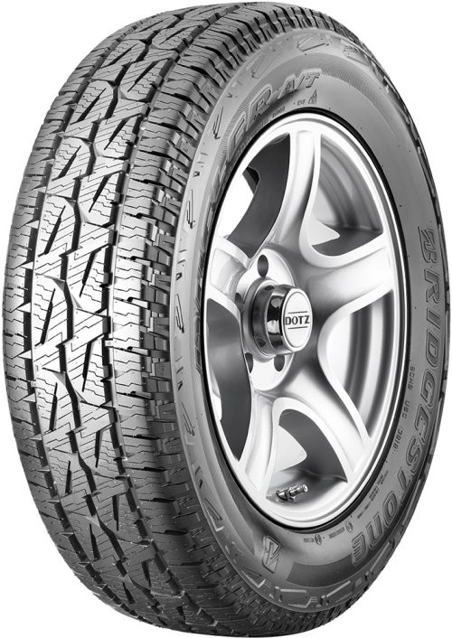
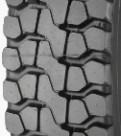
3. On principal groove revised definitions
Tyre tread patterns depend on the application and on the type of vehicle
Principal groove definition cannot be the same in all tyre related regulations
No circumferential grooves
Few grooves in the central zone
UN R30
UN R54
UN R75
UN R75

Slide 7
3. On principal groove revised definitions
Current definition |  | Proposed definition
"Principal groove" means the wide grooves situated in the central zone of the tread. | UNR75 | "Principal grooves" means the wide tread grooves of the tyre.
- | UNR54 | "Principal grooves" means the wide tread grooves positioned in the central zone of the tyre tread. The central zone is the area on the tread which comprises of 75 per cent of the width of the tread measured symmetrically from the centre line.
"Principal grooves" means the wide circumferential grooves positioned in the central zone of the tyre tread, which have the tread-wear indicators located in the base. | UNR30
 | UNR108
"Principal grooves" means the wide circumferential grooves positioned in the central zone of the tyre tread, which, in the case of passenger and light truck (commercial) tyres, have the treadwear indicators located in the base. | UNR109
 | UNR117.02
 | UNR117.04 | "Principal grooves" means the wide tread grooves positioned in the central zone of the tyre tread, as defined in Annex 9 to this Regulation.

Slide 8
Thank you

