Slide 1
World Forum for Harmonization of Vehicle Regulations
Submitted by the experts from OICA | Informal document WP.29-196-26 196th WP.29, 24-27 June 2025 Agenda item 2.
Streamlining the regulatory activity at WP.29
Alberto MUSSO -- Chair of OICA Technical Committee

Slide 2
Why does the WP.29 exist?
In March 2000, WP.29 became the
"World Forum for Harmonization of Vehicle Regulations"
The objective of the WP.29 is to initiate and pursue actions
aimed at the worldwide harmonization or development of technical regulations for vehicles
https://unece.org/transport/vehicle-regulations/faq
What is WP.29?

Slide 3
What are WP.29’s most important goals?
…there is the need to harmonize the different national technical requirements for vehicles and to elaborate a unique international regulation
…these regulations have to be continuously adapted to the technical progress and to the new requirements regarding safety and environmental protection
https://unece.org/transport/vehicle-regulations/faq
What is “Harmonization of Vehicle Regulations”?

Slide 4
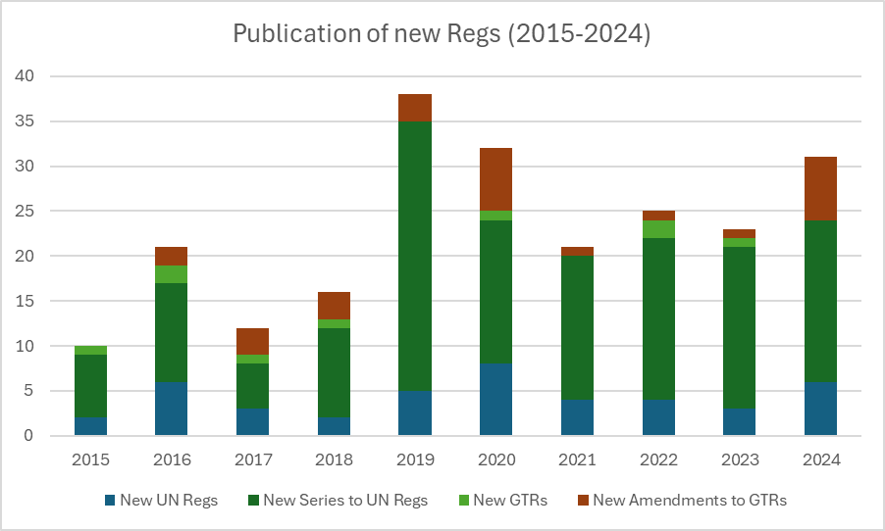
Facts: what does the WP.29 do?
At WP.29/177, on March 2019, a very high number (20) of new series of amendments to UN Regs have been published.
Those new series were needed just to introduce TPs to Regs which were to be replaced by UN R148, R149 and R150 for the simplification of lighting regulations.
*
Slope of linear regressions:
1,68
1,80

Slide 5
Facts: what does the WP.29 do?
Number of active Working Groups (IWG; TF; SIG; ad hoc Groups)
1st Level:
39
2nd Level:
20
Total:
59
Number of meetings (physical; virtual; hybrid) from foundation
Total:
1342
Oldest Working Group: GRPE/PMP (06/2004)
Most meetings: GRPE/EVE (85)

Slide 6
Common perception: actual overload at WP.29
With the increase in the number and size of regulations that require maintenance, the workload at WP.29 has grown substantially
Decisions to establish new working groups, task forces or special interest groups sometimes have not been based on rational criteria
At times, this has led to experts focusing on low-benefit regulatory measures, diverting their efforts from more critical aspects
In some cases, this misallocation of resources hampers the ability to address truly important regulatory issues effectively

Slide 7
CP’s suggestions
Perform a Cost/Benefit Analysis before proposing a new item of work;
Perform a Gap Analysis before proposing a new item of work;
Set a minimum number of Contracting Parties being needed as sponsors before starting a new activity;
Improve the PoW document with real weighting of the different priorities;
Adopt metrics to assess priority;
Share good practices between the 58A and the 98A;
Focus WP.29 efforts on Management Systems at OEM level in a view to let the 58A and the 98A converge and be future-proof;
Combine different Regulations (and new Series of Amendments) with the same EiF dates in a single package every e.g. [3]-years.

Slide 8
OICA’s suggestions
To enhance the efficiency of WP.29, OICA would suggest to work together with the aim of identifying a few general criteria that would serve as a basis for a streamlined regulatory activity in the coming years.
Focusing on improvements in safety, emissions, security
Prioritizing regulations that significantly and demonstrably enhance vehicle safety, reduce emissions, or increase security
Keeping harmonization as the main goal of our activity
Ensuring consistency and compatibility of regulations across different regions to streamline compliance activity
Ensuring regulatory stability
Maintaining stable and predictable regulatory environments to support
long-term planning and investment

Slide 9
Next steps
OICA is willing to undertake further actions in this regard, in collaboration with the Contracting Parties and the other NGOs to help all stakeholders allocate the existing resources to the most impactful areas, balancing the need for progress with practical constraints

Slide 10
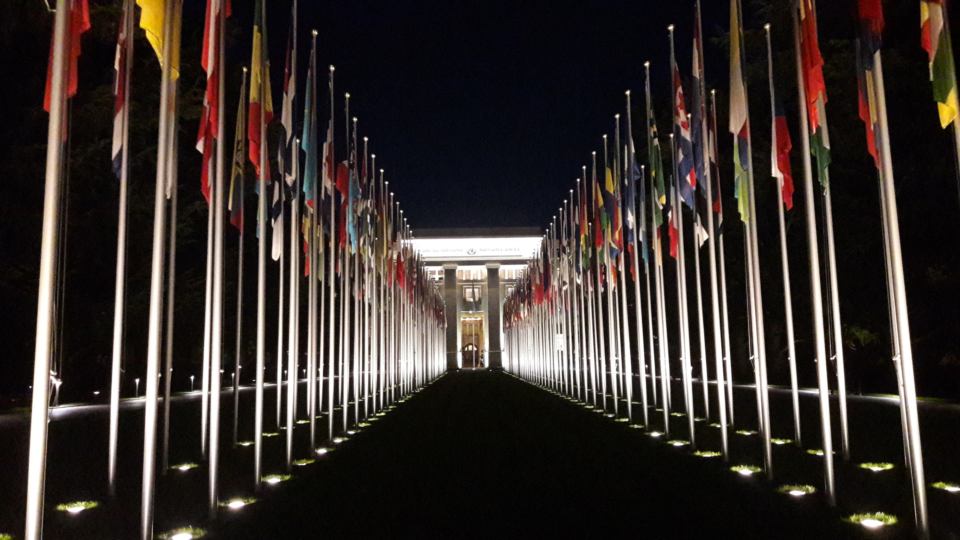
Thank you !
Questions are welcome

