Slide 1

Electrical Transmission Braking System (ETBS)
UN REG 13 & 13-H
PTI 41-03

Slide 2

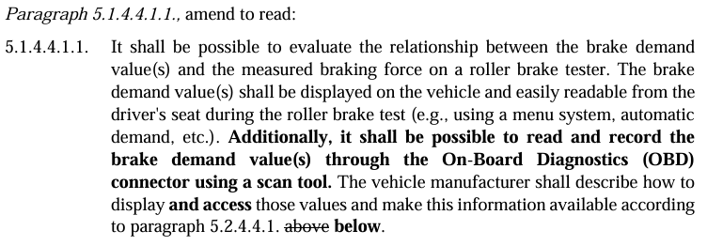
UN REG 13 & 13-H Electrical Transmission Braking
GRVA meeting in January (Geneva) :
CITA presented UN Reg 13 & 13-H amendment through 2 formal documents:
(CITA) Proposal for amendments to UN Regulation No. 13 (Heavy Vehicle Braking) | UNECE
(CITA) Proposal for amendments to UN Regulation No. 13-H (Braking of passenger cars) | UNECE

Slide 3
UN REG 13 & 13-H Electrical Transmission Braking
CITA proposal
Need for harmonization of braking system tests.
No exclusion of countries using one other method.
Improvement to allow all countries currently using the data available via the OBD to still benefit from this information without any additional investment.
Clarifications
Current proposal not new but consists of an improvement of the existing one.
OBD scantool already implemented in PTI with no cybersecurity risks.
Amendment introduction = best time before future technology on the roads.
POSITIVE reactions from EC, Slovakia, Germany, Spain and the Netherlands

Slide 4
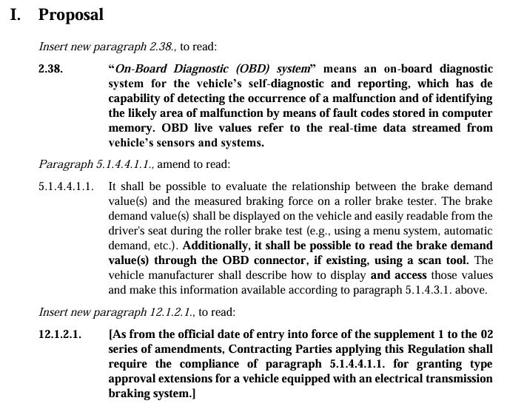
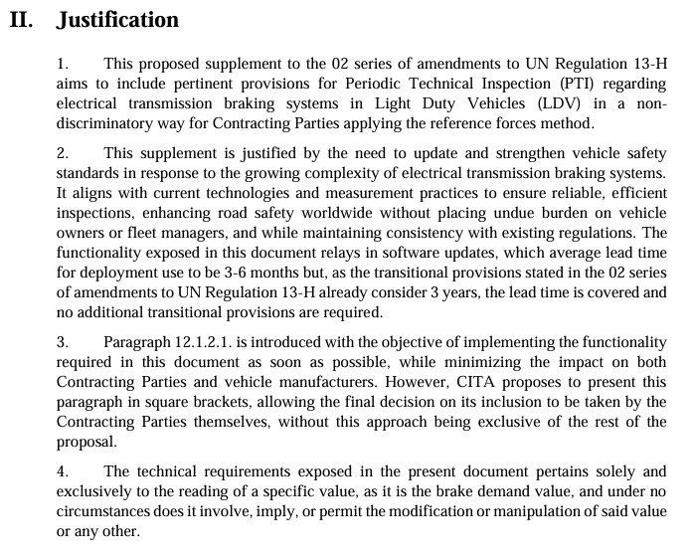
UN REG 13 & 13-H Electrical Transmission Braking
GRVA meeting in June (Bangkok) :
Enable live reading of brake demand values via OBD and display during PTI
Improve road safety by ensuring accurate brake performance assessment
Scope: UN R13 – Doc 2025/43e & UN R13-H – Doc 2025/44e

Slide 5
UN REG 13 & 13-H Electrical Transmission Braking
Key Provisions:
New OBD definition including real-time live values
Brake demand values:
  Visible from driver’s seat during roller brake test
  Accessible via OBD connector with a scan tool
Implementation:
  For type approval extensions; transitional ~3 years
  No manipulation of values – read-only
  Optional immediate application (12.1.2.1 in square brackets)
Impact:
Harmonizes PTI for LDV & HDV brake-by-wire systems
Enhances inspection efficiency & road safety without extra burden

Slide 6
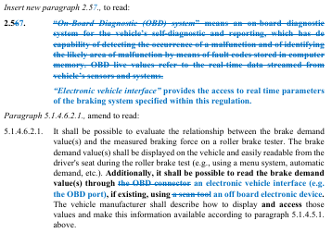
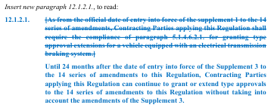
UN REG 13 & 13-H Electrical Transmission Braking
GRVA meeting in September (Geneva) :
Proposal submitted by CITA, OICA and CLEPA to amend UN R13 & R13-H regarding Electrical Transmission Braking Systems (ETBS)
Scope: Amendments to UN R13 – Doc 2025/43 & UN R13H – Doc 2025/44

Slide 7
UN REG 13 & 13-H Electrical Transmission Braking
Key Provisions:
Introduction of a neutral term “electronic vehicle interface”, replacing references to the OBD connector, to allow access to real-time brake demand values via any interface.
Brake demand values must be:
  Displayed on the vehicle dashboard (visible to driver) during test.
  Accessible via an off-board device (e.g. OBD port when available).
Alignment with terminology in UN R156 (software updates) and UN R157 (ALKS) ensures regulatory consistency.
Includes a 24-month transitional period for manufacturers to adapt, without requiring a new amendment series.

Slide 8
UN REG 13 & 13-H Electrical Transmission Braking
Impact – Next steps:
A revised proposal, developed after discussions between UK, Denmark, OICA and CITA, gained support from Sweden, UK, Denmark, Germany and Spain.
The document was approved by GRVA and will be forwarded to WP.29 in March 2026.

Slide 9
THANK YOU
www.citainsp.org
Rue du Commerce 123 - 1000 Brussels, Belgium
+32 (0)2 469 06 70
secretariat@citainsp.org

