Slide 1
Status report to the 82nd session of GRBP
(September 2025)
Transmitted by the chair of the TF-SL (Sound Limits)/VS (Vehicles’ Sound)
Informal Document GRBP-82-20
82nd GRBP, 3-5 September 2025
Agenda item 7
Task Force Vehicles’ Sound
(TF-VS)
NB: the previous name of this TF was TF-SL for Sound Limits
Notes:
Thank you, Mr. President. Good morning, everyone.
I am pleased to present the status report on the activities conducted within the framework of the Task Force on Vehicle Sound since the last GRBP meeting in September.

Slide 2
Task Force on Vehicles’ Sound
Targets | Provide a forum for discussions on Road Traffic Noise control Make a holistic review of studies available Review information on new initiatives on Road Traffic Noise control Provide a technical report to contribute to any work on future sound emissions
Roles | Chair: France (serge.ficheux@utac.com) Secretariat: OICA (yannick.denoual@renault.com)
Reporting | To GRBP
Documents | UNECE Wiki page: Task Force on Vehicle Sound (formerly TF on Sound Limits TF-SL) TF-VS Guidelines: GRBP-74-03e-Rev.1 TF-VS Synthesis Report: 2023_06_20 TF-VS Report on 11 Sessions

Slide 3


Task Force on Vehicles’ Sound: facts and figures
Meetings
Attendees ~35
  18th online meeting: 9th July 2025 – TFVS-18
  CPs:
  China, European Commission, France, Germany, India, Italy, Japan, Spain, Switzerland, The Netherlands, United Kingdom
  NGOs:
  CLEPA, ETRTO, EUWA, IMMA, ISO, OICA
  Guests:
  ICCT, RWTH Aachen University, …

Slide 4
Task Force on Vehicles’ Sound: achievements
TF-VS synthesis report on the first 11 sessions
  11 Sessions, 54 presentations
  Five key “domains” of activity were identified
    General findings and recommendations were identified for each domain
Immission (sound at receiver point)
Sound mapping, traffic flow, abatement measures
Enforcement
Regulation & type Approval, PTI, Road-side inspection
Tyres / Road
Tyre sound level & labelling, road surface monitoring
Vehicle
Vehicle sound emission, evolution over lifetime
Driver
Driving behaviour, manipulation, maintenance,..
  Link to the report: 2023_06_20 TF-VS Report on 11 Sessions

Slide 5
TF-VS #18 Session – Brussels, 9th July 2025
Presentations
Domains
1. ICCT | “Considerations for transport policies mitigating the negative impact of vehicle noise” stresses out the adverse effect on health of single events and Lmax It proposes to take regulatory action to put a “not to exceed” sound limit at any operation condition, and put a limit on stationary sound Discussion: The group reminded that forthcoming RD-ASEP will cover a wider range of operation conditions in R51 and R41
2. RWTH Aachen University | “Integrating Type Approval into CNOSSOS-EU” CNOSSOS-EU sound mapping tool uses 2007 data, missing recent vehicle noise improvements It is proposed to use Type Approval data to refresh tyre and powertrain noise models. Discussion: CNOSSOS is acknowledged as outdated by some CPs, but there is no plan to update CNOSSOS at EU. This would require a preliminary EU research project
Enforcement
Vehicle
Immission
Vehicle

Slide 6
TF-VS #18 Session – Brussels, 9th July 2025 (continued)
Presentations
Domains
3. ETRTO | “ETRTO comments on the latest outcomes on the LEON-T study” In TF-VS #17, JRC presented the conclusions on LEON-T project, recommending to lower the tyre sound level limit values by 2dB. ETRTO stresses the fact that this reduction would have an impact on other tyre performances Discussion: feedback to LEON-T should be discussed in specific meeting with JRC and ETRTO/OICA
4. EMPA (Switzerland) | “Comparing Measured Pass-by Levels of Accelerating Battery Electric Cars and Combustion Engine Cars” EMPA measured the noise emissions of ICE vs. EVs vehicles under similar conditions. EVs and ICE appear to emit similar sound levels at constant speed ICEs are 1–3 dB louder during acceleration. This data is processed to calibrate a CNOSSOS-like model using real traffic profiles. The model shows EV noise benefit is limited to high acceleration and speeds below 40 km/h Discussion: these findings are in line with other works on the benefits of electrification
Enforcement
Tyre / road
Immission
Vehicle

Slide 7
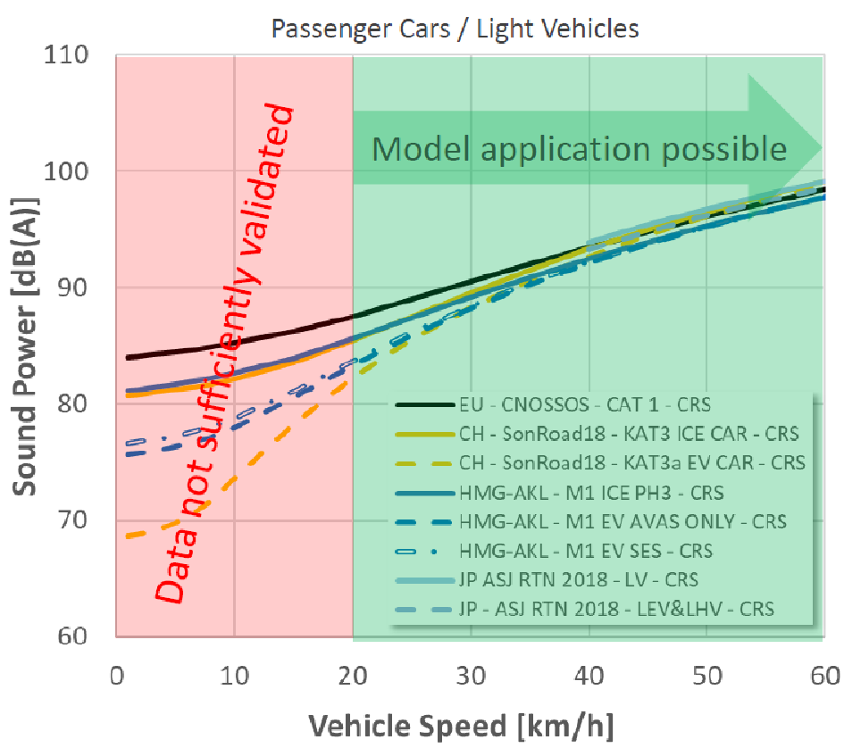
Task Force Vehicle Sound – other activities
The Cross Matrix
Purpose : provide reference sound exposure models for the evaluation of sound abatement measures
Mean : sound exposure models are based on commonly agreed hypothesis on:
Vehicle fleet composition
Vehicle sound emission models (powertrain, tyre/road)
Traffic scenarios (single event ?, average L_{eq} ?)
A Cross Matrix Subgroup was created to gather data
Last meeting held in April 2022
Recent outcome
TFVS-17-07 – “Considerations on the use of existing road traffic noise models for GRBP work” – HMG Akustiklabor
Compares vehicle sound emission models from EU (CNOSSOS), Japan, Switzerland and HMG Akustiklabor

Slide 8
Task Force Vehicle Sound – Next Step
TF-VS #19 meeting
  Joining the Working Groups meeting week in Munich, 20th October 2025
 | Mon. 20 Oct | Tue. 21 Oct. | Wed. 22 Oct. | Thu. 23 Oct | Fri. 24 Oct.
Morning |  | IWG RD-ASEP | IWG RD-ASEP | SG R51/R138 | TF-AVRS
Afternoon | TF-VS | IWG RD-ASEP | SG R51/R138 | SG R51/R138

Slide 9
Thank you!

