Slide 1
ADS IWG
Status Report
Report to GRVA

Slide 2
Content
Progress since 22nd GRVA (slide 3)
Overview of the common provisions (slides 4-8)
Forward planning (slides 9-11)
  Timeline
  Priorities for IWG #14 (Canada) and beyond
Key points for GRVA (slide 12)

Slide 3
Progress since 22nd GRVA (June 2025)
June 2025
GRVA-22
July 2025
ADS-12 (Helsinki)
September 2025
ADS-13 (online)
4th draft consolidated common provisions
(ADS-12-03r3)
5th draft consolidated common provisions
(ADS-13-03)
Introduction of 1st drafts UN Reg and UN GTR
Two hybrid and online sessions dedicated to “common provisions” applicable to both a GTR and a UN Regulation.
GRVA ADS Workshops | EDR/DSSAD IWG | FADS/AVRS/AVSR | AVC...
Liaison with other WP.29 IWG and task forces

Slide 4
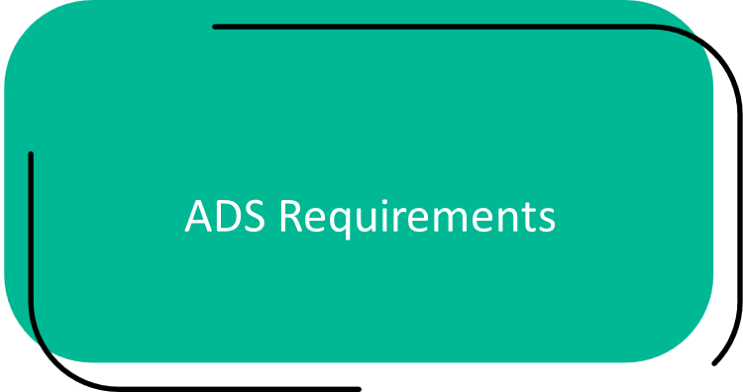
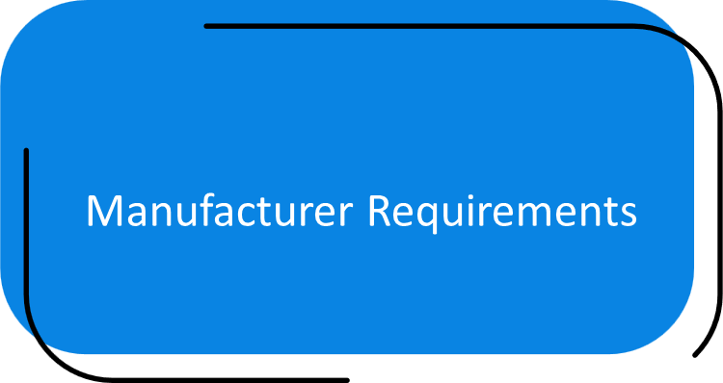
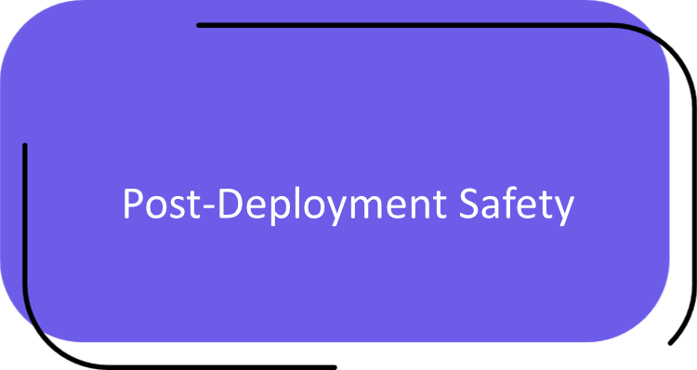
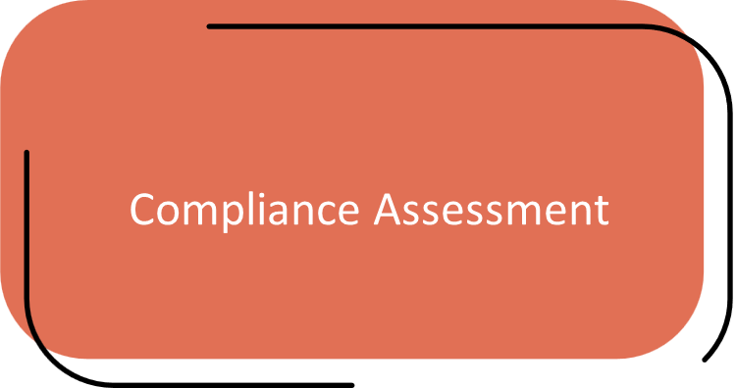
Overview of common provisions
Main Components of the Common Provisions
I
II
IV
III

Slide 5
Overview of common provisions (ADS-13-03)
High-level requirements applied depending on ADS use case:
Free from unreasonable risk (functional safety and ‘safety of the intended functionality’)
DDT performance across nominal, critical, and failure traffic situations
Safety of Interactions between ADS and ADS users
Other safety requirements (cyber security, software updates, DSSAD, facilitating periodic technical inspection, managing signals from other systems)
I
II
Requirements on the manufacturer:
Safety Management System
Testing Environments
Safety Case
Assessment of manufacturer’s validation against requirements:
Safety Management System Audit
Testing Credibility Assessment
Safety Case Assessment (including confirmatory testing)
III
Assess manufacturer capabilities based on in-service monitoring and reporting requirements:
Safety monitoring
Remedial actions if needed
Short-term and periodic performance reporting
IV

Slide 6






II. Manufacturer requirements
A Safety Management System (SMS) is a systematic approach to managing safety.
  Organisational safety policies, principles and culture
  Processes for risk management and ADS design and development
  Personnel competencies
Minimum requirements for the manufacturer’s safety management system
Minimum requirements for credible testing environments
Ensure that the physical test environments and toolchains (e.g. virtual testing toolchains) are appropriate for their use.
Minimum requirements for providing a valid ADS safety case
Structured presentation of claims supported by SMS and testing outcomes that the ADS meets or exceeds the requirements of the regulation and is free from unreasonable risks to the ADS vehicle user(s) and other road users.
Minimum requirements for in-service monitoring and reporting
Establishes minimum requirements for capabilities to monitor the performance of ADS in use and establishes requirements for reporting on ADS safety performance.

Slide 7




III. Compliance assessments
Verify compliance with SMS requirements.
A single SMS may cover multiple ADS.
Periodic certification anticipated
Audit the Safety Management System
Verify the credibility of the manufacturer’s ADS testing organisation and management, including application of SMS outcomes to ensure effective testing of the ADS.
Assess test environment
Assess the safety case for completeness and robustness, and that each requirement of the regulation is addressed within the safety case. Assess that the ADS is free from unreasonable risk.
Assess safety case
Confirm that the evidence provided by the manufacturer accurately represents the ADS performance.
Perform confirmatory testing

Slide 8
IV. Post-deployment safety
I
Capabilities to monitor ADS performance and comply with reporting requirements verified as part of initial ADS assessment
In-service monitoring and reporting provides feedback to assess effectiveness and support improvements
II
III
IV
“pre-approval”
“post-approval”

Slide 9
Plan going forward
March 2026
WP.29
Submission of
UN Reg and UN GTR
as informal documents
May 2026
GRVA 25th Session
Possible submission of
informal documents related to
UN Reg and UN GTR
13 – 17 October 2025
IWG-ADS #14
(Canada)
28 October 2025
IWG-ADS #15
(Online)
8 – 12 December 2025
IWG-ADS #17
(Japan)
September 2025
GRVA (23)
27 October 2025
formal documents
(UN Reg and UN GTR ) submission for GRVA Jan 2026
25 November 2025
IWG-ADS #16
(Online)
January 2026
GRVA 24th Session
seek endorsement
formal and informal documents
UN Reg and UN GTR
March 2026
Submission of
UN Reg and UN GTR
as formal documents
for WP.29 June 2026
June 2026
WP.29
Consider endorsement of
UN Reg and UN GTR
Aim: Finalise UN Reg and UN GTR for submission as formal documents to 24th session of GRVA January 2026.
* ADS IWG activities in 2026 not shown

Slide 10



Priorities for IWG #14 (Canada)
Aim of the meeting
Finalise working documents (GTR and UNR) for 24th session of GRVA January 2026 (submission deadline for working documents 27th October 2025).
Priority will be given to:
Close off remaining open items
Review and remove square brackets []
Integration of latest workshop text and DSSAD text
Address any ‘major issues’
Priority items
Cybersecurity and software updating
Confirmatory testing
DSSAD
Concept of ‘useful life’/’lifetime’ of an ADS
Known remaining open items

Slide 11

Looking beyond Canada
Addressing any major issues not fixed during IWG-ADS #14 in Canada (informal documents prepared in the IWG-ADS meeting #15 in Tokyo 8-12 December submitted to GRVA #24 in January 2026)
Supporting workshop task 3 on developing the guidance document
Consideration of items for further amendments to the GTR and UNR (‘parking lot’ items)
Post-Canada priorities
P
Parking lot items identified for further consideration by the IWG:
Allowing more expansive ADS to ADAS transitions
Defining remote assistance for an ADS
Parking lot items

Slide 12



23rd session GRVA: key points
Please note:
The progress of the IWG to date
The timelines, priorities and remaining open items of the IWG
Please note
Document ADS-12-03/Rev.3 reflects the output of discussions up to and including our last hybrid meeting (meeting #12 Helsinki)
Documents from our online meeting in September (meeting #13) can be found on our wiki page (including draft UN GTR, UN Reg and side-by-side text) and will be further reviewed by the IWG in Canada.
Key documents
Current mandate runs until June 2026.
Early discussions in IWG suggest further work beyond June 2026.
The IWG foresee a discussion on the mandate of the IWG in GRVA-24 (Jan 2026).
Mandate

Slide 13
Thank you

